Slide 1
Remote Patient Monitoring Feature Analysis
Product Metrics, User Journey, and Problem Breakdown
Tushar Goswami
October 2024

Slide 2
Agenda
1. Key Metrics
2. User Journey Overview
3. Problem Breakdown
4. Hypotheses and Validation
5. Recommendations

Slide 3
RPM Feature Key Metrics
• Setup Completion Rate
• Average Data Sync Frequency
• Average Retention Period
• Health Alerts Triggered
• User Engagement (e.g., Active Users, App Usage Time)

Slide 4
RPM User Journey
Awareness
Device Setup
Data Syncing
Provider Feedback
Usage monitoring

Slide 5
Key Engagement Points in the User Journey
• During Setup
• After Data Syncs
• Following Health Alerts

Slide 6
RPM Feature Problem Breakdown
• Problem 1: Difficulty in Setting Up Device
- Hypothesis: Simplifying the setup will improve completion rate.
• Problem 2: Inconsistent Data Syncing
- Hypothesis: Offering clearer instructions will increase syncing frequency.

Slide 7
Hypotheses Validation
• Hypothesis 1: Simplifying the setup process will increase setup completion by 20%.
- Validation Method: Run a setup process survey.
• Hypothesis 2: Clearer syncing instructions will reduce data sync drop-offs by 15%.
- Validation Method: Track data syncs after implementation.

Slide 8
Recommendations for Improving RPM Feature
• Recommendation 1: Simplify the setup flow (based on user feedback).
• Recommendation 2: Improve syncing reliability and instructions.

Slide 9
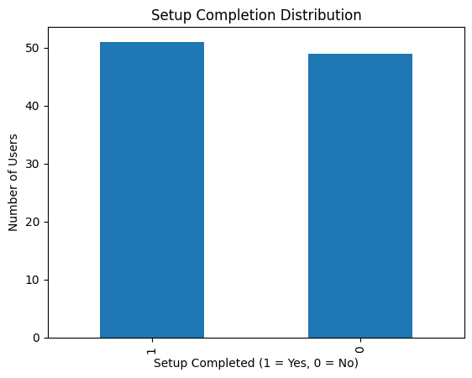
Conclusion
Key Findings:
The Setup Completion Rate is only 51%, indicating significant room for improvement in the onboarding process.

Slide 10
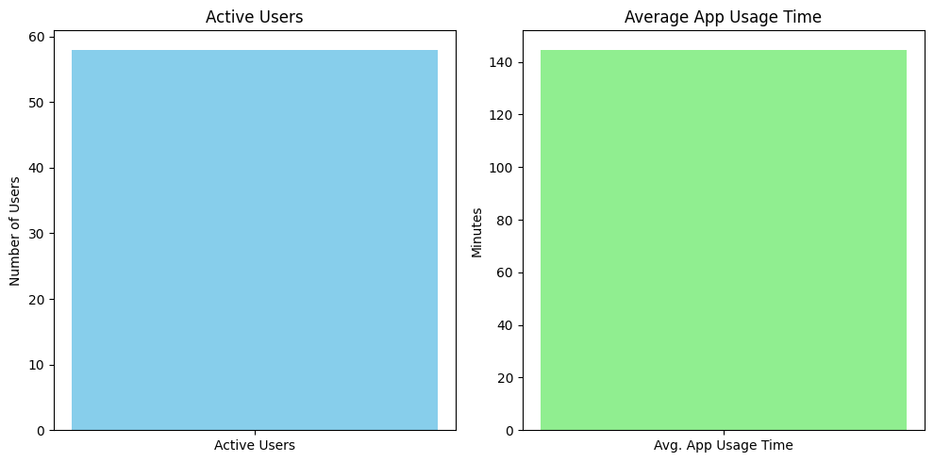
The Average Data Sync Frequency is moderate, at 9.44 syncs per user, but inconsistent syncing still presents a challenge.

Slide 11
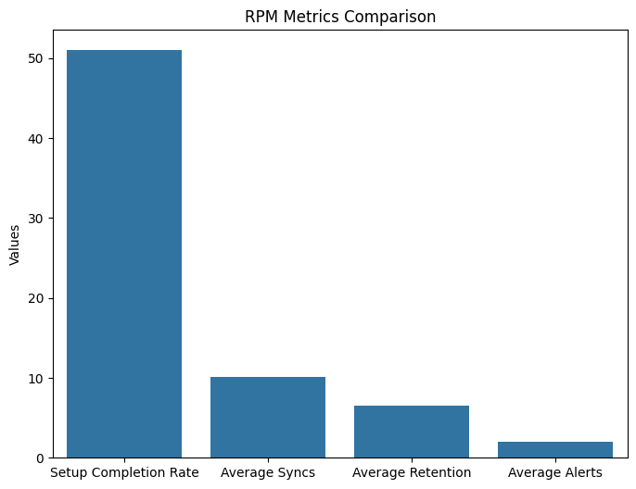
Users retain the RPM feature for an average of 6.84 months, suggesting decent long-term engagement.
Health Alerts triggered are relatively low, averaging 1.95 alerts per user.

Slide 12
Why This Matters:
Improving the setup process and sync consistency can lead to better user engagement and health outcomes, as patients and healthcare providers will have more reliable access to health data.
Next Steps:
Implement the recommended improvements in the setup process.
Conduct A/B testing to validate the effectiveness of the proposed changes.
Monitor changes in user behavior and key metrics after implementation.

