Slide 1
A NOVEL HYBRID MULTIKEY CRYPTOGRAPHY TECHNIQUE FOR VIDEO COMMUNICATION WITH CLIENT-SERVER MODEL
Under the guidance of
KUMAR ANURUPAM SIR

Slide 2
ABSRACT
Online video streaming is becoming more widespread in people’s everyday entertainment routines. Protecting copyright and piracy has become a key concern in real-time video streaming systems. This research provides a revolutionary multi-key and hybrid cryptography approach to offer security. This work describes the software implementation of video encryption and decryption employing continuous systems based on the Elliptic Curve Cryptography approach as pseudo random encryption key generators. This approach creates several keys to encrypt and decode small chunks of video files that are produced dynamically based on the video data. The suggested approach was implemented on the client server, where applications for sender and recipients had been created to enable streaming. The security and performance of the proposed system have been examined by implementing it on devices and streaming videos. The outcomes demonstrate superiority in terms of performance and security.
KEYWORDS :
Hybrid Cryptography, Multikey Cryptography, Video Communication, Real-time Streaming, Elliptic Curve Cryptography (ECC), AES Encryption, Client-Server Model, Socket Programming, Flask, SQLAlchemy, RSA, Key Generation.

Slide 3

INTRODUCTION
This project proposes a multi-key and hybrid cryptography approach to provide robust security for video communication systems. The approach uses multiple cryptographic keys and the advanced Elliptic Curve Cryptography (ECC) technique to encrypt and decrypt video data in real-time. The implementation follows a client-server model, where the client requests video content from the server and the server dynamically generates multiple encryption keys based on the video data, encrypts the content, and sends it back to the client. The client then decrypts the received encrypted chunks using the corresponding keys for seamless playback.

Slide 4
MOTIVATION
As online video streaming becomes more popular, copyright infringement and piracy are becoming major problems. Researchers are working on new ways to protect copyright and prevent piracy using multi-key and hybrid cryptography techniques.
Similarly, for security purposes, a hybrid multikey cryptography techniques can be applied for video communication to provide better security than traditional single-key cryptography approaches.

Slide 5
REAL-WORLD APPLICATIONS
Financial Applications
Military & Government Applications
Online Streaming Applications
need to transmit financial data securely and protect it from unauthorized access.
protect sensitive data during transmission.
protect content from piracy streaming.

Slide 6
User Interface
Server
01
04
02
Client
Client Server Model
05
Key Generation
03
06
Video Playback
PHASES
User registration on Flask App
Contains videos and encryption scheme
Client Program to connect with server
A Client Server implementation
Generating encryption keys
Video Decryption and Playback

Slide 7
RELATED WORKS
The paper discusses traditional cryptographic approaches for securing video communication, including symmetric key encryption (e.g., AES) and asymmetric key encryption (e.g., RSA). It highlights the challenges of key management and distribution in symmetric encryption and the computational expense of asymmetric encryption. The authors propose a hybrid model using both RSA and ECC, leveraging the strengths of each method. They suggest that ECC is suitable for real-time video streaming due to its small key size and fast processing, while RSA enhances security. The hybrid approach aims to enhance the robustness of secured data.

Slide 8
RESEARCH GAPS IDENTIFIED
The X coordinate value was proposed as a constant value in the proposed algorithm. To bring more novelty and security we used a dynamic value which will be changing for every newly generated key from the ECC equation.
Proposed algorithm included receiver's public key in the ECC equation of the key generation. This additional inclusion will not increase the security of the crypto system and it will take additional computational power of the hardware.

Slide 9
RESEARCH GAPS IDENTIFIED(continues)
The Proposed algorithm encrypts the initial video chunk with the RSA key as a whole block. We even divided the initial 1 Mb chunk into more chunks of size 200 bytes each, which eventually increases the security of the system.
Proposed method suggested to use FFMpeg module to divide the video into chunks, we used a pythonic method to divide the video rather than using a third-party service.

Slide 10

PROPOSED METHOD USED HYBRID MULTI-KEY CRYPTOGRAPHY TECHNIQUE FOR VIDEO COMMUNICATION

Slide 11
FLOWCHART
Start
Video input file
Split the video file into multiple chuncks
Generate Video Id using 1st video chunk (i=0)
Video ID
Generate Key using ECC equation for i=1
Receiver’s MAC Address
i = 1
Generate Key using ECC equation for i
i = 2
i++
i<=n
Figure : Key Generation
no
Stop
yes

Slide 12
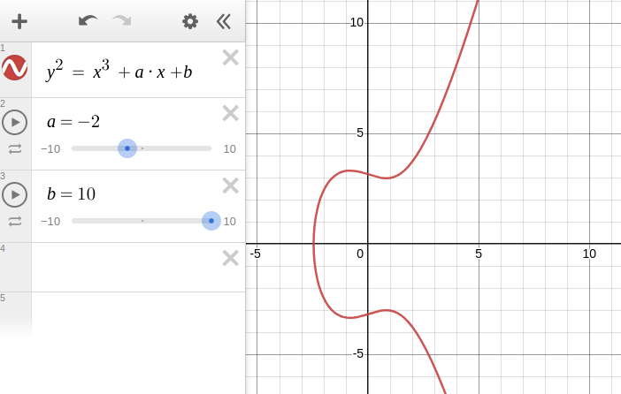
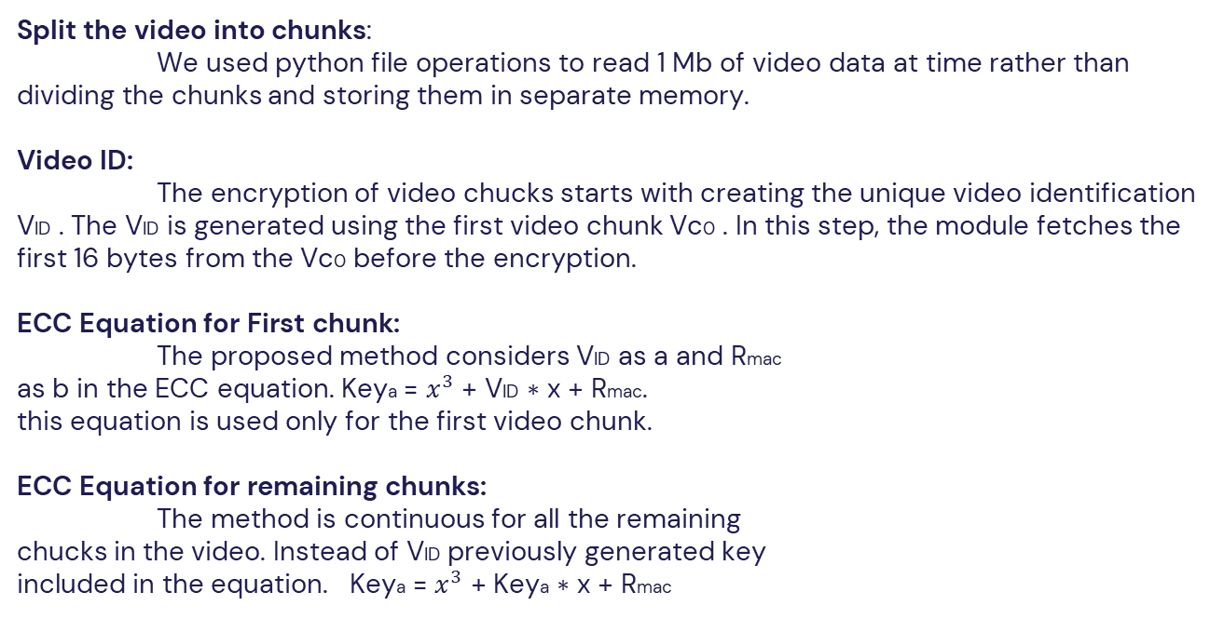
EXPLANATION OF EACH COMPONENT
Split the video into chunks:
We used python file operations to read 1 Mb of video data at time rather than dividing the chunks and storing them in separate memory.
Video ID:
The encryption of video chucks starts with creating the unique video identification VID . The VID is generated using the first video chunk Vc0 . In this step, the module fetches the first 16 bytes from the Vc0 before the encryption.
ECC Equation for First chunk:
The proposed method considers VID as a and Rmac
as b in the ECC equation. Keya = $x^{3}$ + VID ∗ x + Rmac.
this equation is used only for the first video chunk.
ECC Equation for remaining chunks:
The method is continuous for all the remaining
chucks in the video. Instead of VID previously generated key
included in the equation. Keya = $x^{3}$ + Keya ∗ x + Rmac

Slide 13
EXPLANATION OF EACH COMPONENT(continues)
Receiver MAC Address and Public Key:
The Public key and MAC address of the user will be collected from the user registration phase.
RSA :
The initial chunk of the video will be encrypted with the RSA. It is an asymmetric encryption algorithm, which means it uses a pair of keys: a public key for encryption and a private key for decryption. The public key can be freely shared, while the private key must be kept secret.
AES :
We encrypted the video chunks except the initial chunk with the AES-256 in CBC mode. AES (Advanced Encryption Standard) is a symmetric encryption algorithm widely used for securing sensitive data. It is a symmetric-key algorithm, meaning the same key is used for both encryption and decryption processes.

Slide 14
EXPLANATION OF EACH COMPONENT ( continues )
ECC :
Elliptic Curve Cryptography (ECC) is a type of public-key cryptography that utilizes the mathematics of elliptic curves to provide secure communication, key exchange, and digital signatures. ECC offers strong security with relatively small key sizes compared to other asymmetric encryption algorithms like RSA. The AES keys are generated using ECC in the implementation.
SHA-256:
SHA-256 (Secure Hash Algorithm 256-bit) is a cryptographic
hash function that belongs to the SHA-2 (Secure Hash Algorithm 2) family.
It is widely used for data integrity checks, digital signatures, password
hashing, and other security applications. We used SHA-256 to choose
the X coordinate in the ECC equation.

Slide 15
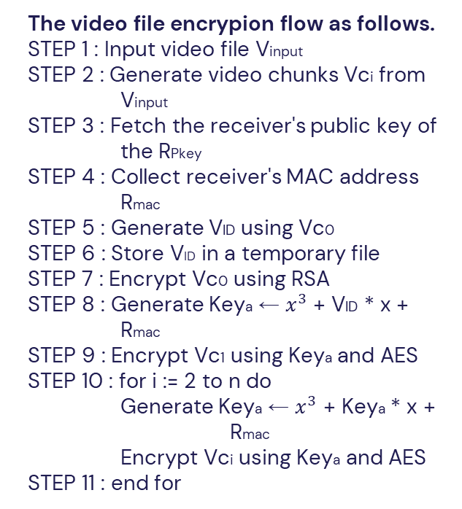
ALGORITHM
The video file encrypion flow as follows.
STEP 1 : Input video file Vinput
STEP 2 : Generate video chunks Vci from Vinput
STEP 3 : Fetch the receiver's public key of the RPkey
STEP 4 : Collect receiver's MAC address Rmac
STEP 5 : Generate VID using Vc0
STEP 6 : Store VID in a temporary file
STEP 7 : Encrypt Vc0 using RSA
STEP 8 : Generate Keya ← $x^{3}$ + VID * x + Rmac
STEP 9 : Encrypt Vc1 using Keya and AES
STEP 10 : for i := 2 to n do
Generate Keya ← $x^{3}$ + Keya * x + Rmac
Encrypt Vci using Keya and AES
STEP 11 : end for

Slide 16
TECHNOLOGIES / LIBRARIES USED
Cryptography
Programming Language : Python 3.10
Front-end : HTML,CSS,JS and Bootstrap
Multi Threaded Programming : Python threads
Flask : Front-end to register the user
SqlAlchemy : Python module to manage database
Sqlite : Database to store user details
Socket Programming : Client Server model
pycryptodome : Cryptography pip library
hashlib : Python library
moviepy : Python library
RSA : Initial chunk encryption
AES : Video encryption except initial chunk
ECC : Key generation
SHA : Choosing X in ECC

Slide 17
SYSTEM RESOURCES
Processor : Reasonably powerful x86 hardware. Any recent Intel or AMD processor should do.
Memory : 10 to 20 Mb required for the project.
RAM : 2GB recommended
Operating System : Windows, Linux/Unix (Preferred Linux/Unix)

Slide 18
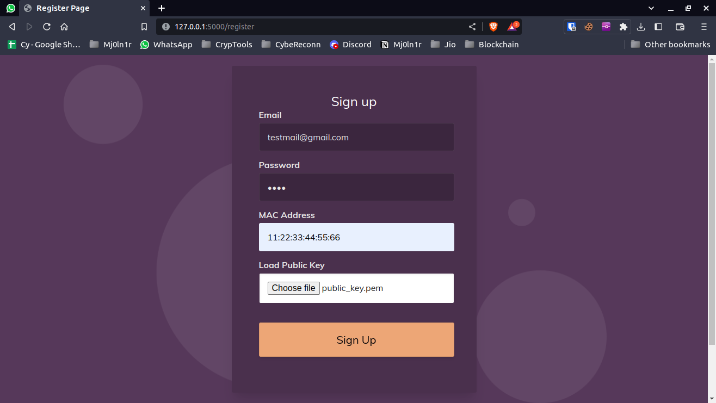
RESULTS
User registration on web page developed by Flask as shown below :

Slide 19
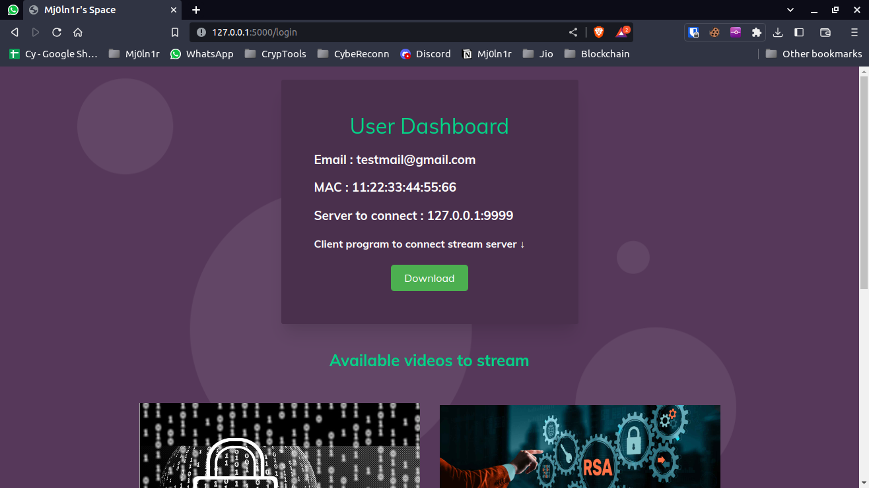
RESULTS(continue)
User's Dashboard after login :

Slide 20
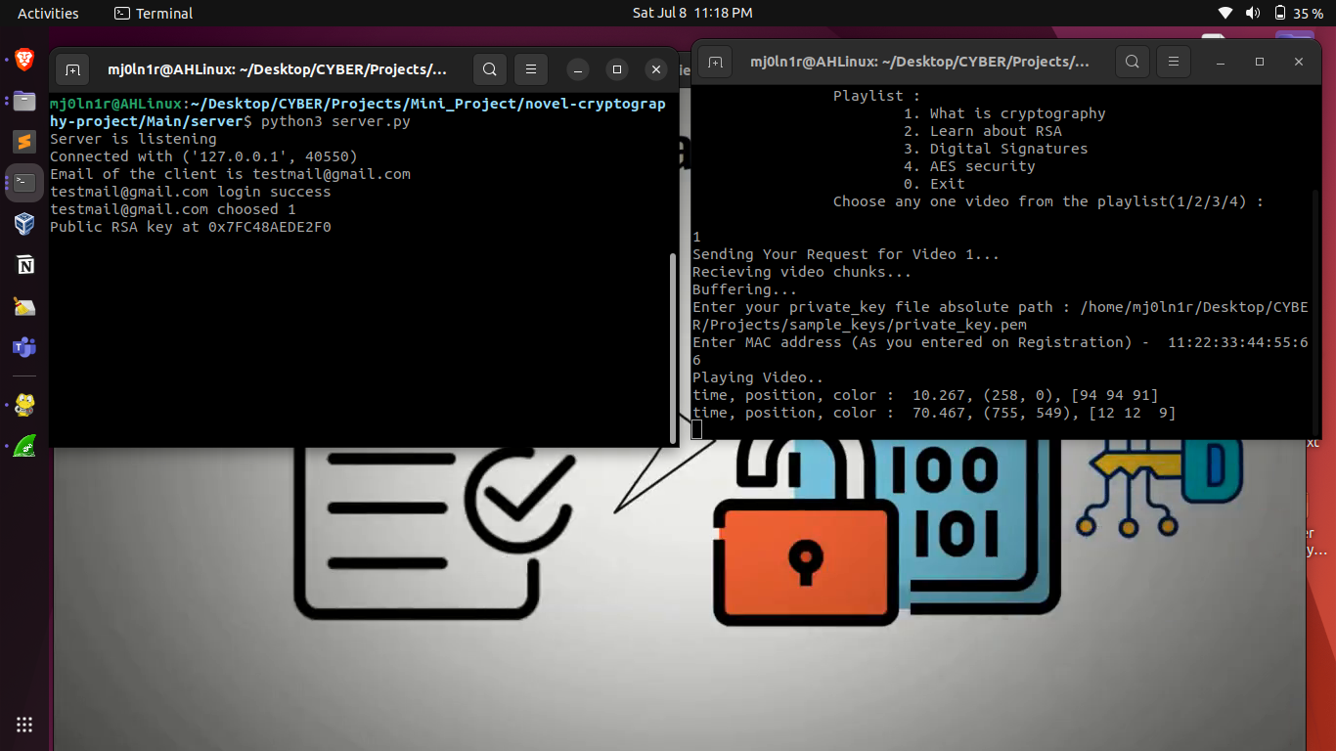
RESULTS(continue)
Status of Server and Client Program Execution :

Slide 21
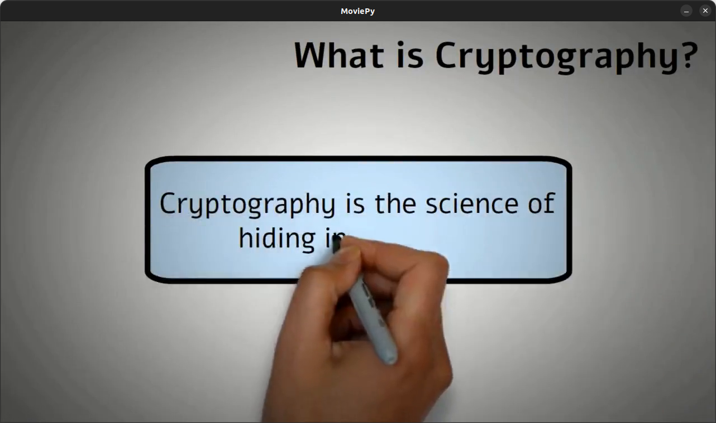
RESULTS (continue)
Video playback on client screen :

Slide 22
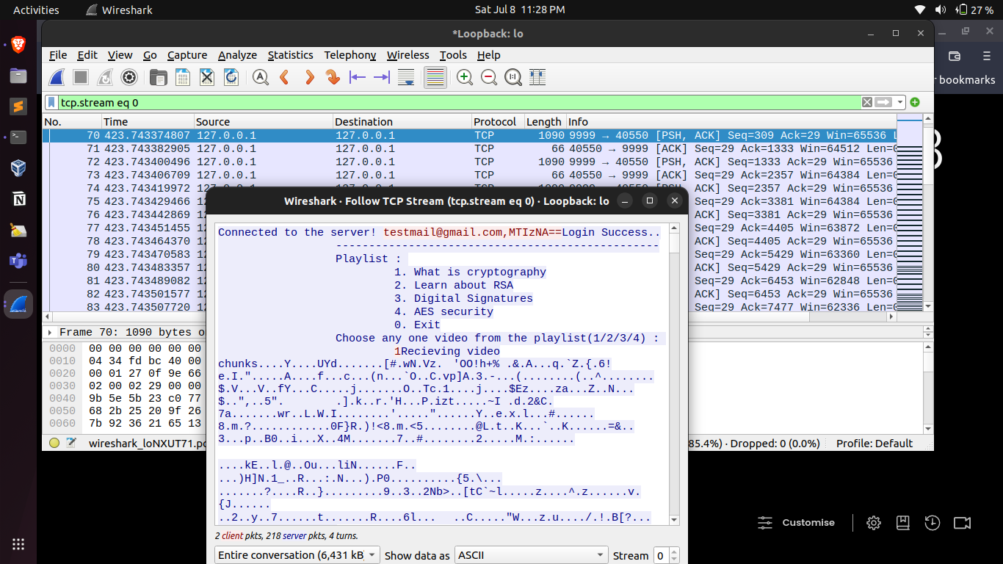
RESULTS ANALYSIS
Encrypted Video data sharing over an insecure channel. When analyzed the traffic between server and client using Wireshark, we are unable to view the actual video data instead we are able to see only the encrypted data.

Slide 23
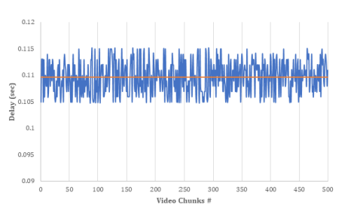
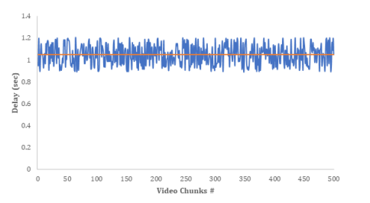
GRAPHS
Delay in generating multi keys
Time taken to encrypt the video chunks
The method and equation for key derivation are the same for encryption and decryption. Keys are generated using receiver's public key, partial video data, MAC address, and previously computed key. Time between key generation is consistent.
Video files are split into 1 MB chunks. The graph shows Encryption delay. Chunks vary between 1-1.2 MB and encryption time varies from 0.9 to 1.2 seconds. AES module used for encryption.

Slide 24
CONCLUSION
The proposed hybrid multikey cryptography technique for video communication utilizes RSA, ECC, and AES to ensure robust security.
It combines asymmetric and symmetric encryption methods, offers efficient key management, and aids in copyright protection, promising secure video communication with improved performance.

Slide 25
FUTURE SCOPE
Future goals include expanding this work to multi-level security systems and creating a cutting-edge, deeply implemented security system for online video streaming.
Expanding the strict streaming to normal streaming across multiple devices at a time.
Including more user specific attributes in the key generation like mnemonics or passphrases.
Generating X coordinate from a true entropy source to make it unpredictable.

Slide 26
REFERENCES
Socket Programming in Python (Guide) – Real Python
A Novel Hybrid Multikey Cryptography Technique for Video Communication | IEEE Journals & Magazine | IEEE Xplore
Login and Registration with Python, Flask & MySQL | WD (webdamn.com)

Slide 27
THANK YOU ALL

