Slide 1
NIMBUS
AI Productivity Assistant
Save time. Summarize notes. Draft emails. Capture meeting insights.
AI-Assistant Project • React + TypeScript • TanStack Start

Slide 2
The Problem & Our Solution
The Problem
Nimbus Helps
Students and professionals juggle scattered tasks, long meeting notes, and constant emails. • Time lost switching between apps • Notes pile up without summaries • Email drafting eats focus time • Tasks slip without clear priorities
One calm dashboard powered by AI tools. • Smart Task Manager with priorities • Meeting Summariser for fast recaps • Email Generator with tone control • Research & Chat Assistants on demand

Slide 3
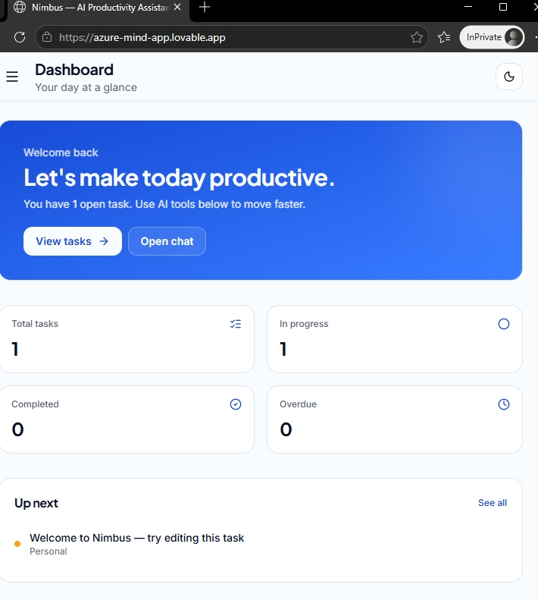
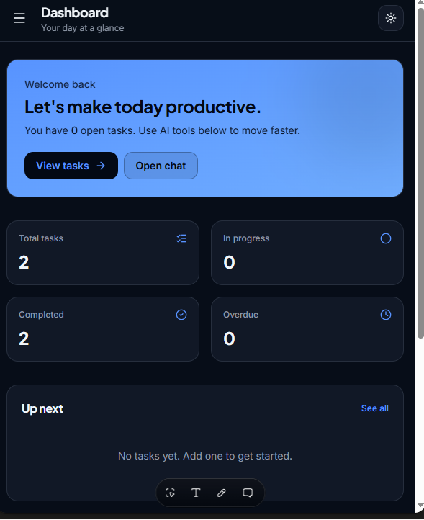
Clean Dashboard
Your day at a glance — open tasks, progress, and AI tools in one place.
Light mode
Dark mode

Slide 4
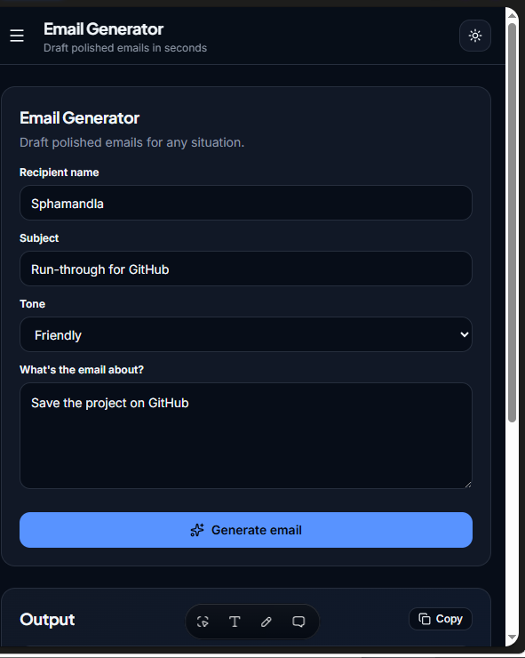
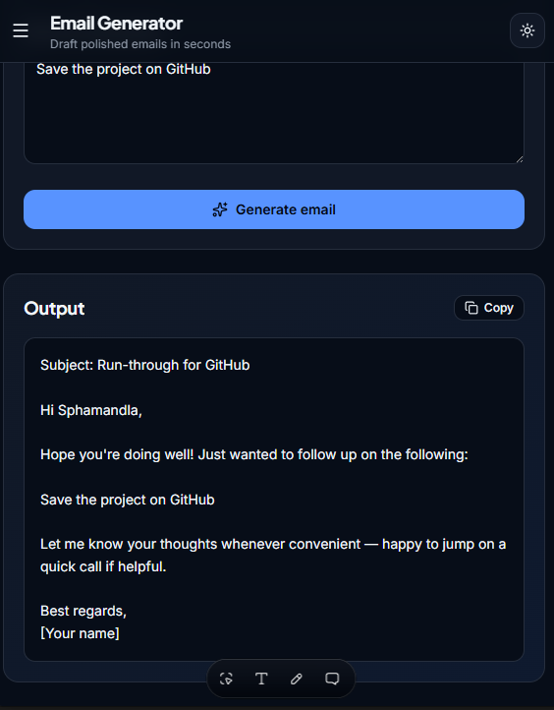
AI Email Generator
Pick a tone, describe the message, get a polished draft in seconds.

Slide 5
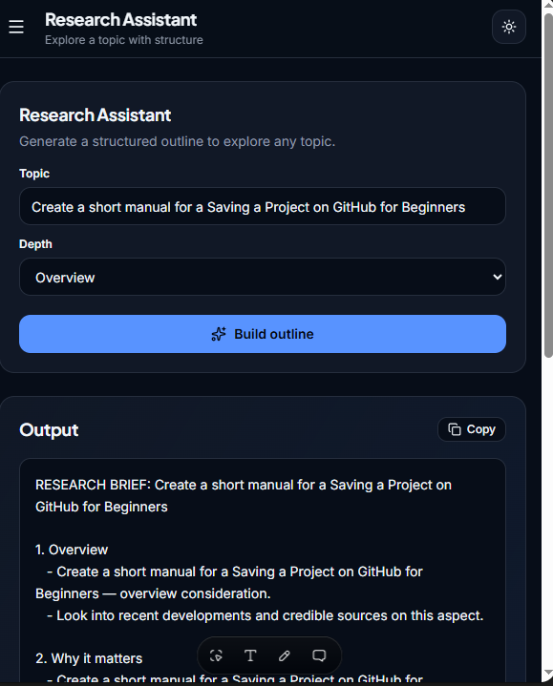
Research Assistant & AI Tools
Email Generator
Polished drafts with tone selection.
Meeting Summariser
Key points and action items from raw notes.
Research Assistant
Structured outlines for any topic.
Chat Assistant
Persistent conversational helper.

Slide 6
Built With
React 19 + TypeScript
TanStack Start
Tailwind CSS v4
LocalStorage
Component-based UI
File-based routing & SSR
Royal blue design system
Simple, no backend needed
Thank You
Nimbus — a clean, calm, AI-powered way to get things done.
azure-mind-app.lovable.app

