Slide 1
Mining from massive datasets: Automatic post tagging
Theodoros Diamantidis, 112
Sofia Kostoglou, 117

Slide 2
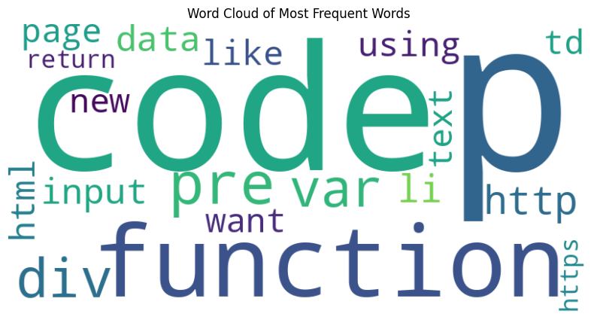
task
Given a large dataset of posts from stackoverflow.com, train ML models to predict their tags.
Tags can be one of, or a combination of: ‘javascript’, ‘css’, ‘jquery’, ‘html’.
Each post contains 4 fields:
id
Title
Full text of question
Labels

Slide 3
preprocessing
Question text contains html tags as a residue of the scraping process.
Many questions contained code within the <code>, </code> tags.
We:
Removed any code by removing anything between the <code>, </code> tags.
Removed all other html tags via BeautifulSoup.
Then we applied standard NLP preprocessing:
Removed any non-alphanumeric characters and extra whitespaces.
Applied tokenization.
Removed stop words.
Applied lemmatization.
Applied Tf-Idf.

Slide 4
approach
Initially we wanted to develop our solution using PySpark, so we can take advantage of its efficiency for big data.
We did, but had technical difficulties, so we also developed our solutions in ‘pure’ python (sklearn).
Methods applied:
Method 1: Problem transformation methods:
Binary relevance (python)
Label Powersets (pyspark + python)
Classifier Chains (python)
Method 2: Approximate Nearest Neighbour Search.
Method 3: K-Means Frequency Classification.

Slide 5
Method 1: Problem transformation methods
Binary Relevance
Treats each label independently, multilabels are separated as single-class classification.
Label correlation may be lost.
Label Powerset
Each unique combination of labels is treated as a separate label.
Need large train set because some label combination may only appear in test set.
Classifier Chains
Train multiple classifiers through a chain.
First classifier is trained on input data and predicts first label.
Second Classifier is trained on input data + first label, predicts second label, etc.

Slide 6
Method 2: approximate knn search
Parameters: k, frequency_threshold
Apply Locality Sensitive Hashing:
Hash datapoints into buckets so that points that are close to each other, are in the same buckets with high probability.
For each instance of the test set find its k nearest neighbours.
A tag that appears with frequency more than some frequency threshold is assigned to the new example.

Slide 7
Method 3: k-means frequency classification
Parameters: k, frequency_threshold
Cluster data into k clusters.
For each cluster, find the tags that appear with frequency more than a frequency threshold. Assign these tags to the cluster.
For each new instance, find the centroid closest to it and assign it the tags that correspond to the cluster of that centroid.

Slide 8
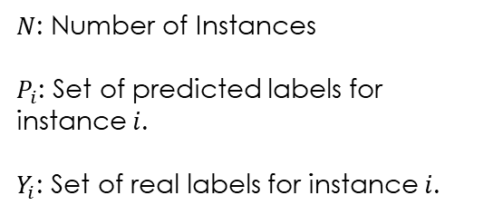
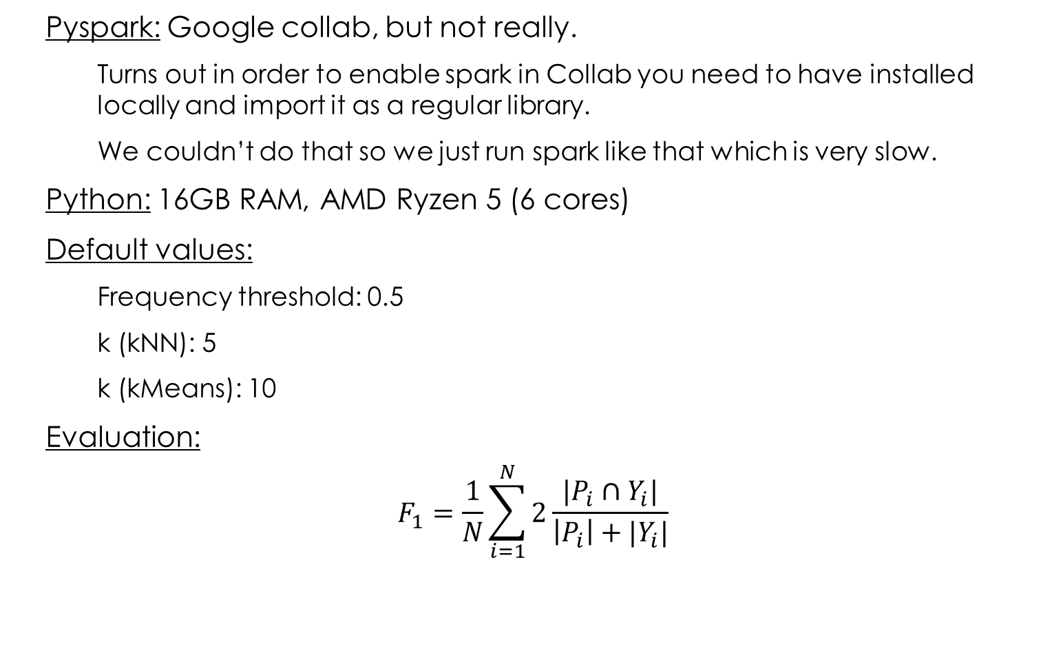
setup
Pyspark: Google collab, but not really.
Turns out in order to enable spark in Collab you need to have installed locally and import it as a regular library.
We couldn’t do that so we just run spark like that which is very slow.
Python: 16GB RAM, AMD Ryzen 5 (6 cores)
Default values:
Frequency threshold: 0.5
k (kNN): 5
k (kMeans): 10
Evaluation:
$$F_{1}=\frac{1}{N}\sum_{i=1}^{N}{2\frac{|P_{i}∩Y_{i}|}{\left|P_{i}\right|+|Y_{i}|}}$$
$N$: Number of Instances
$P_{i}$: Set of predicted labels for instance $i$.
$Y_{i}$: Set of real labels for instance $i$.

Slide 9
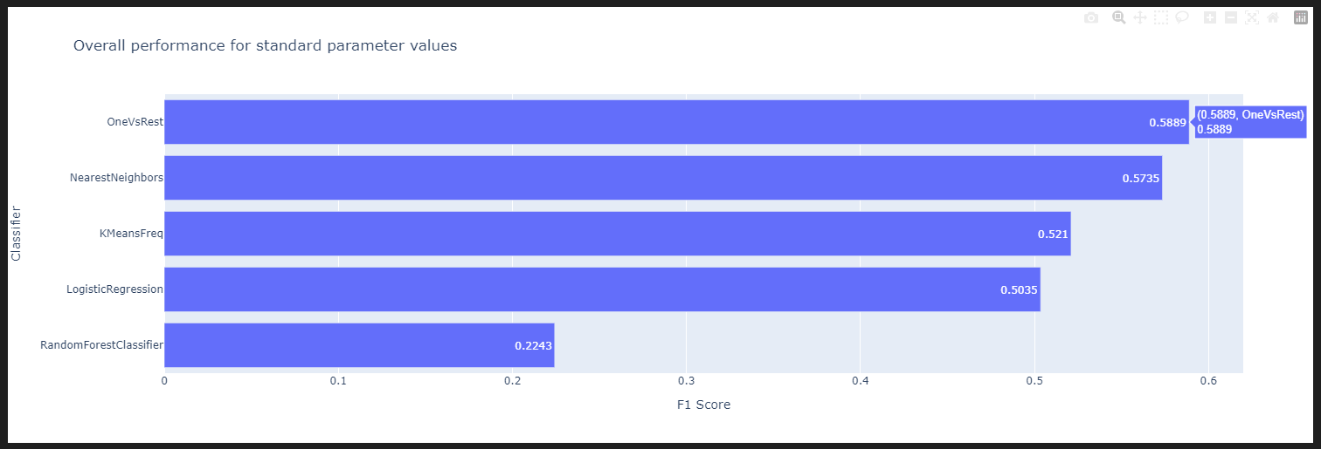
Pyspark – results: overall performance

Slide 10
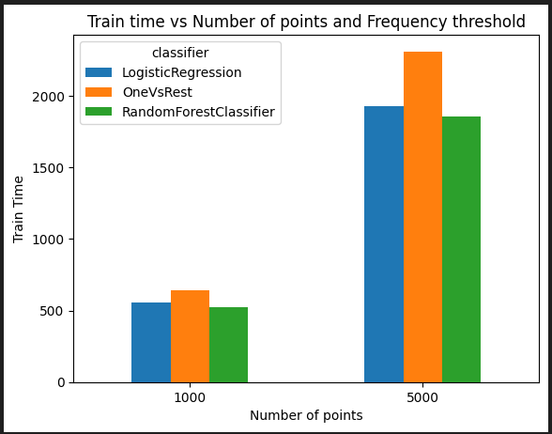
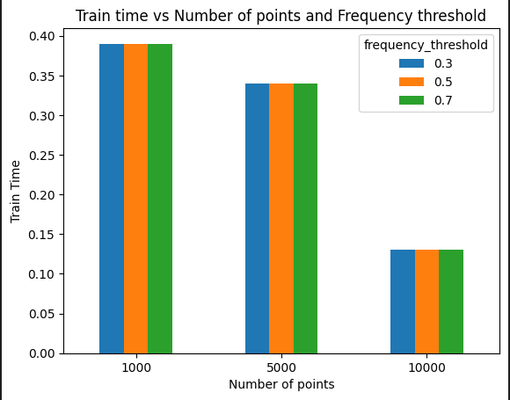
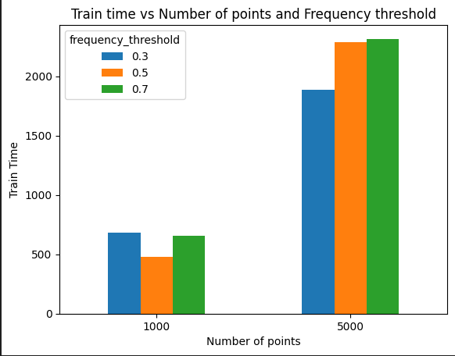
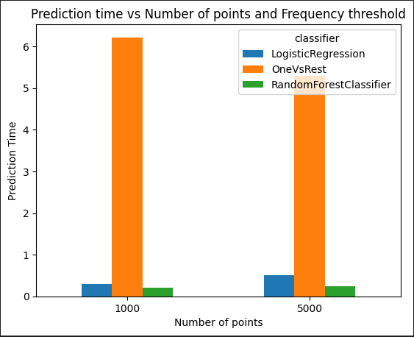
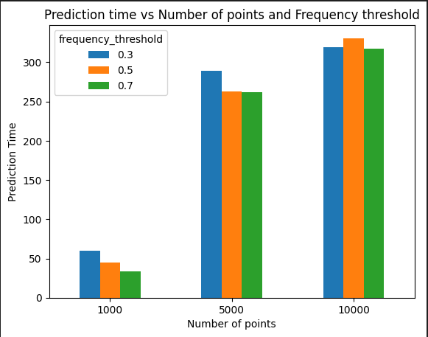
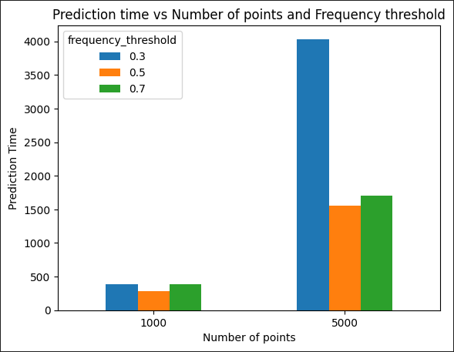
Pyspark – results: Train/prediction time vs number of points
Method 1: Label Powersets
Method 2: kNN
Method 3: kMeans

Slide 11
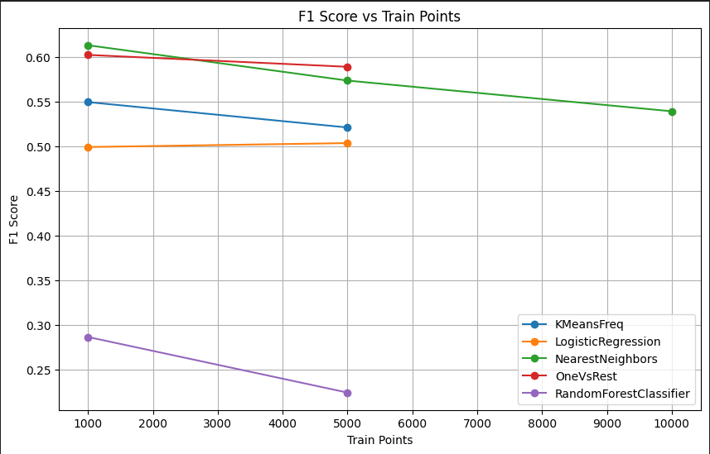
Pyspark – results: f1 vs number of points

Slide 12
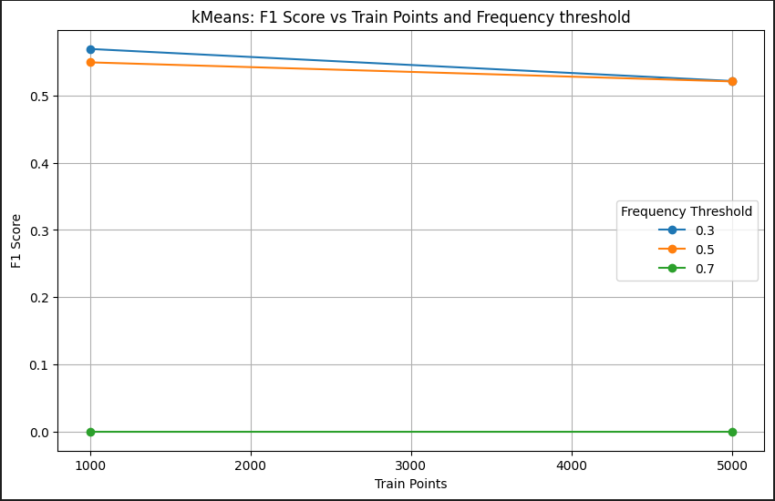
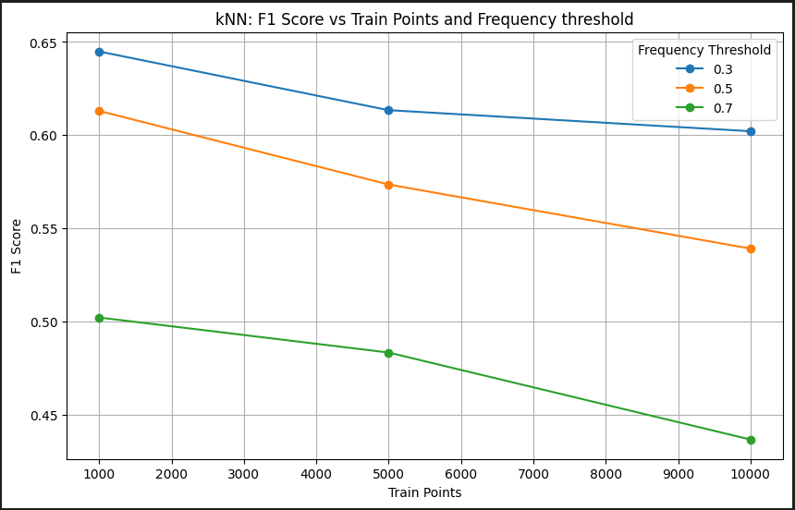
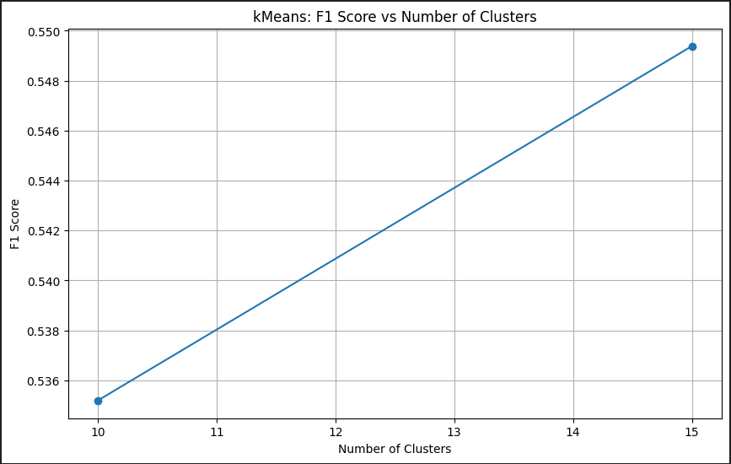
Pyspark – results: f1 vs parameters
Method 2: kNN
Method 3: kMeans

Slide 13
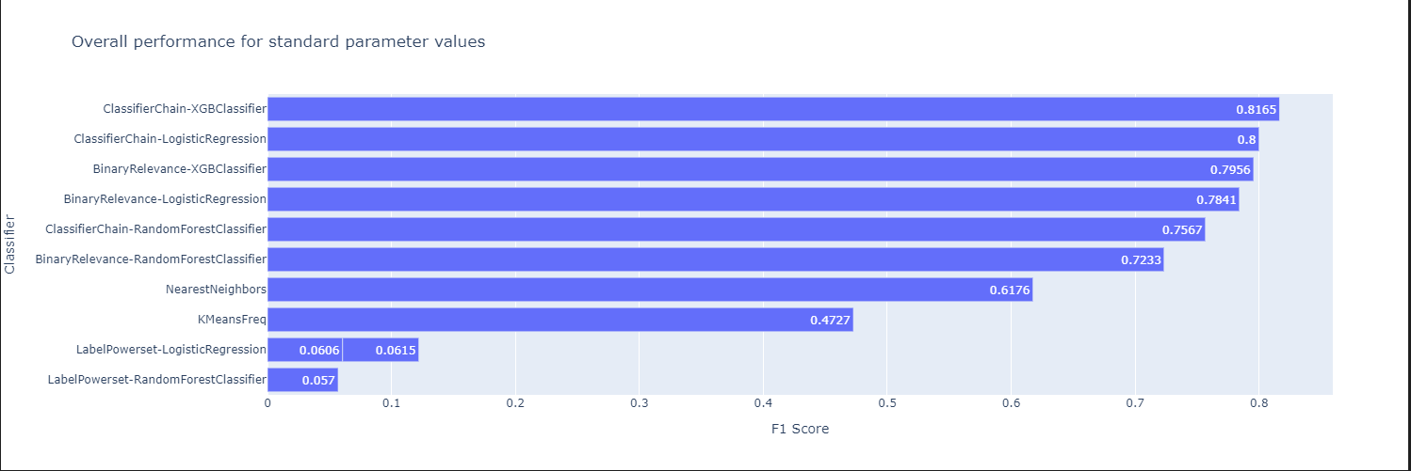
Python – results: overall performance

Slide 14
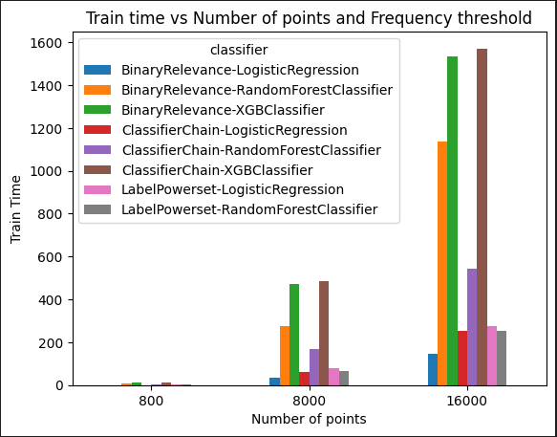
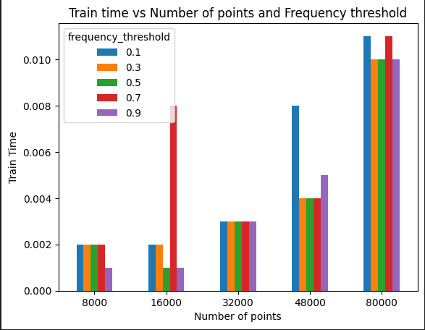
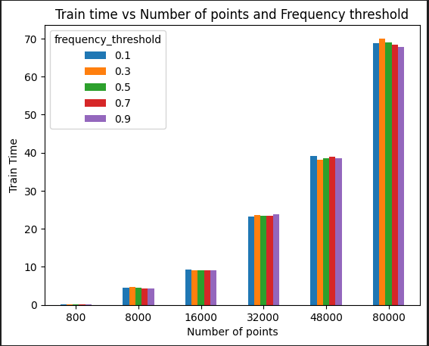
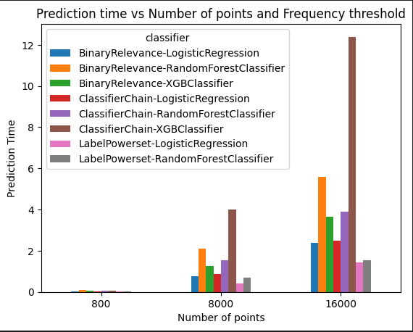
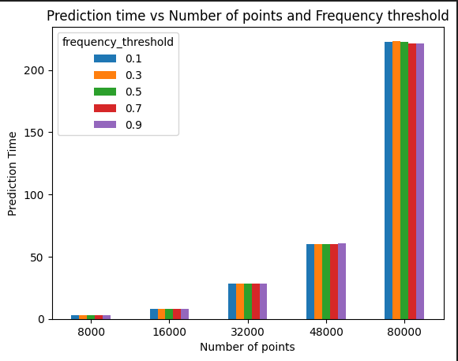
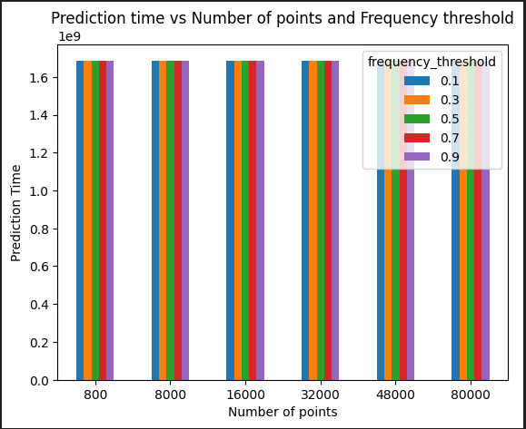
python – results: Train/prediction time vs number of points
Method 1: Problem Transformation Methods
Method 2: kNN
Method 3: kMeans

Slide 15
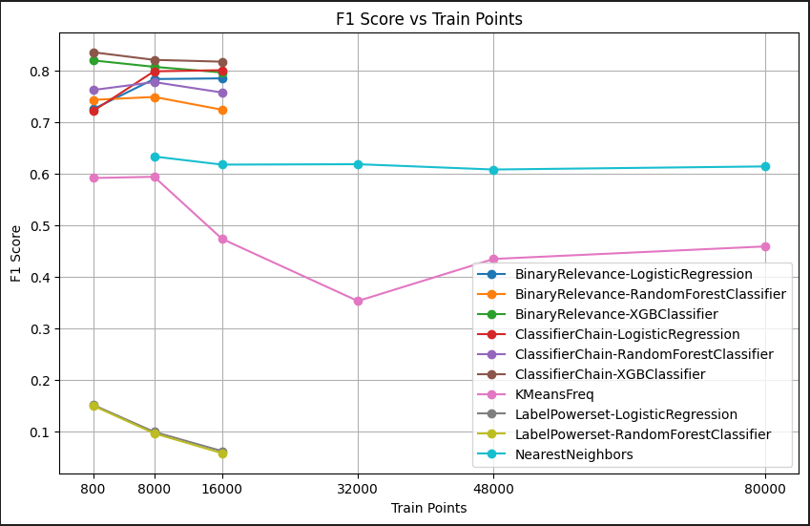
python – results: f1 vs number of points

Slide 16
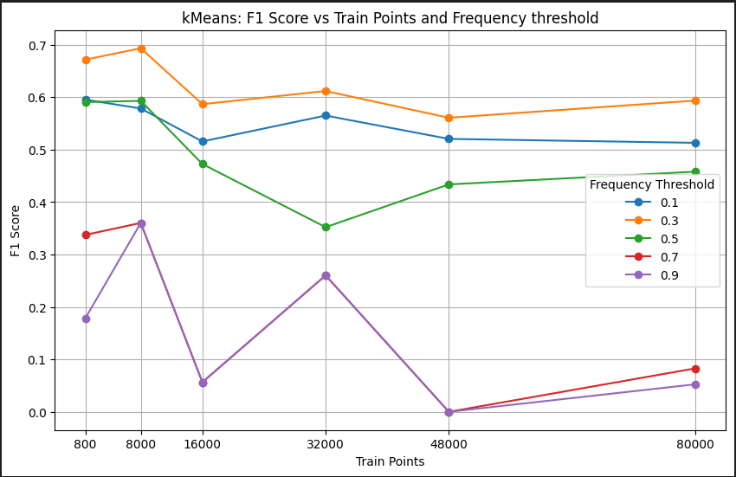
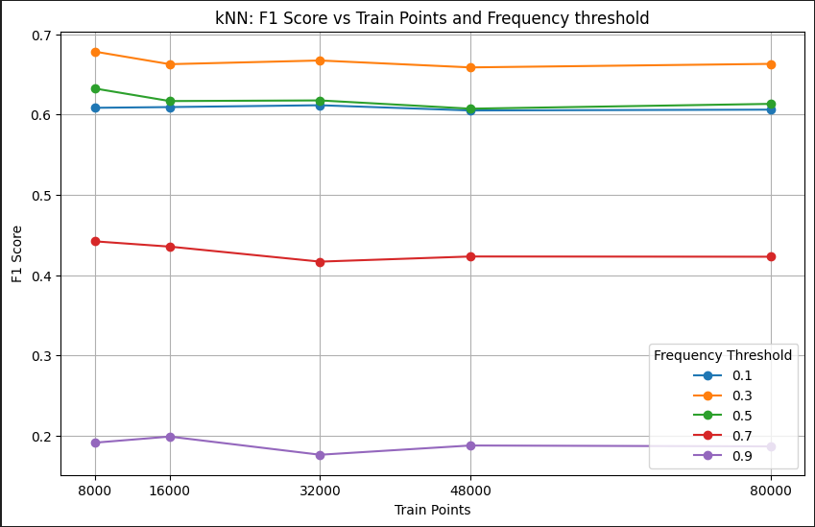
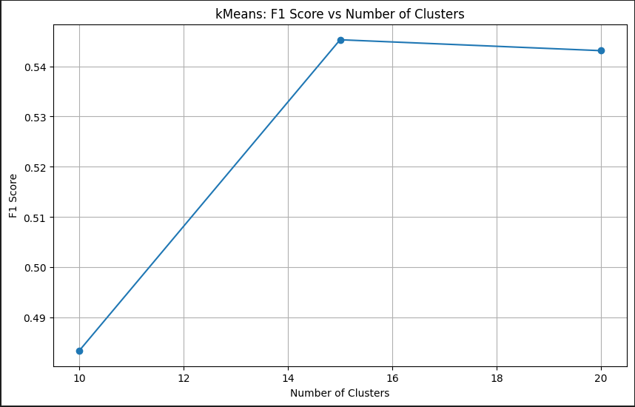
python – results: f1 vs parameters
Method 2: kNN
Method 3: kMeans

Slide 17

Main takeaways
Pyspark: OneVsRest achieves the best performance.
Python: XGBoost with Classifier Chains achieves the best performance.
More data points $⇒$ more training and prediction time
In most cases, the smallest frequency threshold (0.3) in $kNN$ and $k−Means$algos achieves best performance .
$k−Means:$ more clusters $⇒$ higher f1-scores.

Slide 18
Thank you!

