Slide 1

Analyzing sleep and activity data from the Fitbit API
Pantelis Ypsilantis
Theodoros Diamantidis
Grigoris Barmpas
Costas Tsikkinis

Slide 2

Why this project?
Insightful Patterns
Health Importance
Fitbit API Integration
Understand the impact of sleep quality and activity levels on health and provide personalized recommendations.
Gain valuable insights into sleep and activity patterns for improved well-being and productivity.
Utilize real-time sleep and activity data from Fitbit devices for comprehensive analysis.

Slide 3
Solutions
Challenges
We extensively researched Fitbit documentation, Developer forums, and the unofficial Fitbit Python module on GitHub, including related issues. Ultimately, we requested a different endpoint and settled on the Activity endpoint.
API endpoints
SpO2 and Breathing Rate endpoints are faulty from the Fitbit side
Mismatching
versions
FitBit’s codebase contained hard-coded endpoints from previous versions.
We utilized the requests module to retrieve sleep-related data. Specifically, we manually made a request using version 1.2 instead of version 1 to obtain the desired format of the sleep data.
To enable the streaming aspect of this assignment, we recognized the requirement for a live data server connected to Fitbit.
Streaming
A continuous while loop was implemented to send requests at 15-minute intervals.
We initially attempted using AutoRegression, a simple model, for forecasting, but it did not yield satisfactory results. We then explored a more complex model, but the limited amount of available data posed a challenge.
A one-month duration of time series data proved insufficient for our needs.
ML limitations

Slide 4
Approach
1
Obtained permissions and consents to access Fitbit data.
2
Developed data collection scripts and integrated with Fitbit API.
Applied statistical and machine learning techniques for analysis and pattern identification.
3
Transformed data for entry in Mongo, handled possible duplicate entries.
4
Notes:
Notes:
Python module was used to get activity data because it was working correctly for this endpoint.
Requests module for sleep data because of mentioned issues.
Created index on type and data.dateTime keys to avoid data duplication (+ mongo.errors.DuplicateKeyError handling).
Analysis of each variable on its own as well as correlations through plots in streamlit with the use of widgets so that the user can select desired dates and/or variables.
ML to predict sleepEfficiency and steps.
Streaming: endless while loop (giga chad mode).

Slide 5
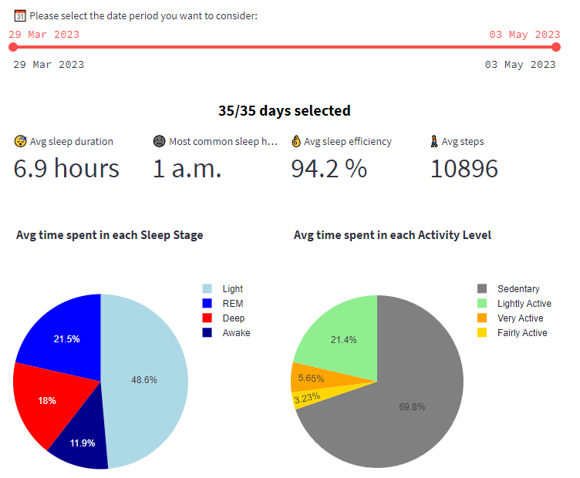

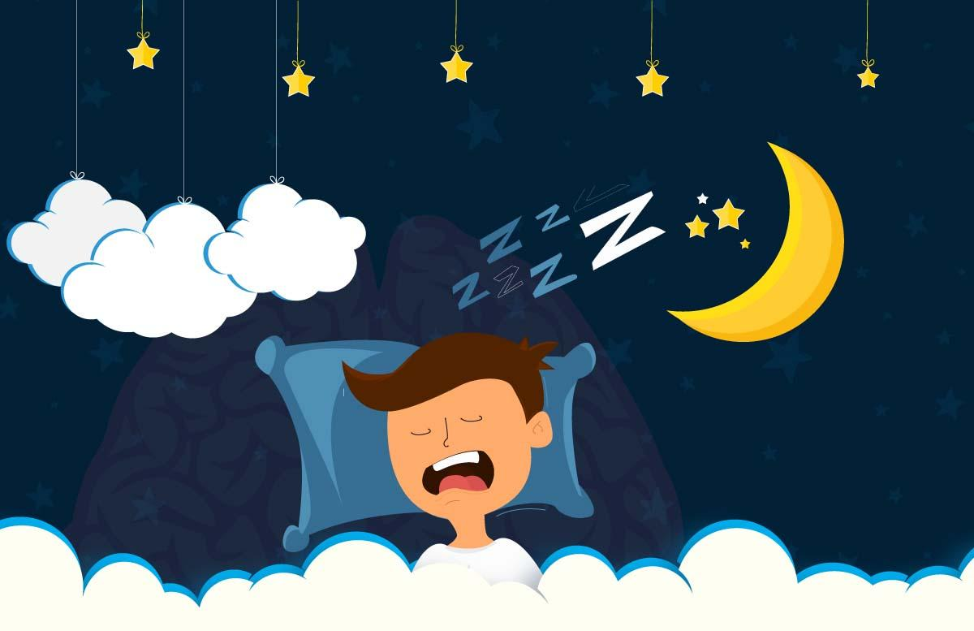
Outcomes
Activity Profile Analysis of an Active Individual
Active individual consistently achieves 10k steps, with preferred exercise times before 12:00 or around 18:00.
Peak activity observed on Fridays and Saturdays, while Mondays show lower activity levels.
Activity profile exhibits alternating days of higher and less active periods.
Sleep Analysis of a Night Owl
Adequate sleep observed despite late bedtime habits.
Approximately 50% of sleep spent in Light sleep stage, with fluctuation between Deep and Light sleep on most days.
No specific day of the week stands out as the best sleep day.
It seems that the longest the Light sleep the higher the sleep efficiency.
Activity and Sleep Relationship Insights
High step counts primarily attributed to intense activity days.
Exercise shows a positive impact on Light Sleep duration.
Deep Sleep and Light Activity patterns exhibit a correlation.
Notes:
Interesting to see patterns on wearer’s lifestyle regarding exercise (e.g., they seem to exercise in bursts of exercise followed by rest periods, as opposed to a steady exercise schedule.

Slide 6

More Data Points
Include additional variables like heart rate, breathing rate, and more to enhance the analysis.
ML Enchantment
Further, delve into machine learning with a detailed approach involving feature engineering and other techniques.
Streaming
Future Work
Configure the server to utilize the built-in streaming capability.

Slide 7
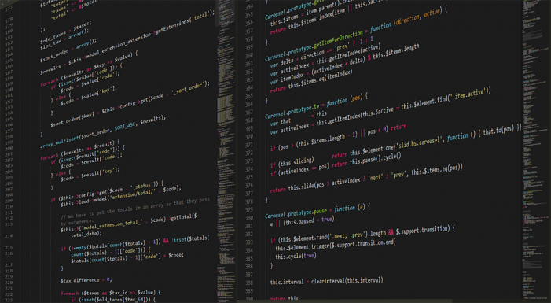
Thank you!
In conclusion, we've journeyed through sleep and activity data, conquered challenges, and danced with endless loops. Let's embrace data, wield Python's magic, and march towards a healthier future! Thank you, and here's to bug-free dreams!

