Slide 1
Sparse Recovery and Compressed Sensing
A Model-Based Deep Learning Approach
Core question: How far can model-based structure take us — and when do we need data-driven flexibility?
Etay Baron · Etai Wigman
Model-Based Deep Learning (361.2.2320) · Ben-Gurion University · Spring 2025–2026
Based on: Chen, Liu, Wang, Yin — "Hyperparameter Tuning is All You Need for LISTA" · NeurIPS 2021
Notes:
Hello everyone. We are Etay Baron and Etai Wigman, and this is our final project for the Model-Based Deep Learning course. Our topic is sparse recovery and compressed sensing, based on the NeurIPS 2021 paper 'Hyperparameter Tuning is All You Need for LISTA'. The core question that guides this talk is simple: how far can model-based structure take us — and when do we need data-driven flexibility?

Slide 2
Seminar Roadmap
1
2
3
4
5
Background
Unrolling
Our Study
Results
Images
Motivation, LASSO, ISTA / FISTA
LISTA, ALISTA, HyperLISTA
Scalar variants + training methods
Sparse recovery & design space
MNIST & FashionMNIST CS stress tests
Goal: systematically compare how much learning is needed when moving from ideal sparse signals to real compressed-sensing images.
Synthetic signals
m=250, n=500, s=50
Gaussian A, noiseless
Trained models
LISTA, ALISTA, HyperLISTA
+ 3 scalar designs (ours)
Image CS
MNIST & FashionMNIST pixel domain
ratios ∈ {0.25, 0.5}
2 / 16
Notes:
Here is the plan for the next fifteen minutes. We start with the background: the sparse recovery problem, the LASSO formulation, and the classical ISTA and FISTA algorithms. We then move to deep unrolling — LISTA, ALISTA, and HyperLISTA. The central part is our own study: we ask which components of ISTA are actually worth learning, and we compare the training methods for unfolded optimizers that were discussed in class. Finally, we stress-test everything on real images — MNIST and Fashion-MNIST — under compressed sensing. Our synthetic setup uses 250 measurements, signal dimension 500, and sparsity 50.

Slide 3

Motivation & Problem Formulation
Sparse recovery appears everywhere:
Measurement model
Application | Measurements | Goal
MRI acceleration | k-space (m ≪ n) | Image pixels
Radar | Compressed snapshots | Reflectivity
Hyperspectral | Spectral bands | Spatial cube
Compressed sensing | Random projections | Original signal
A ∈ ℝ^{m×n}, m ≪ n
x*: s-sparse signal
ε: additive Gaussian noise
Why tractable? Natural signals have only s ≪ n non-zero components.
LASSO — the optimization backbone:
Metrics: NMSE (dB) for synthetic signals;
NMSE + PSNR + SSIM for image CS.
LASSO = Least Absolute Shrinkage and Selection Operator (Tibshirani, 1996)
3 / 16
Notes:
Let us define the problem. We want to recover a sparse vector x-star of dimension n, but we only observe m linear measurements, with m smaller than n, possibly with noise. This inverse problem is underdetermined — infinitely many signals explain the same measurements. The sparsity assumption is what makes it solvable, and this situation appears everywhere: MRI acceleration, radar, hyperspectral imaging. The standard formulation is the LASSO — Least Absolute Shrinkage and Selection Operator — a trade-off between fidelity to the measurements and an L1 norm that promotes sparsity. Our metrics are NMSE in decibels for synthetic signals, plus PSNR and SSIM for images.

Slide 4
Classical Baselines: ISTA and FISTA
ISTA — proximal gradient descent on the LASSO objective:
FISTA — ISTA with Nesterov momentum, O(1/k²) convergence vs O(1/k):
Method | NMSE @ K=16 | Error energy [%] | Params
ISTA | −5.3 dB | 29.5% | 0
FISTA | −11.0 dB | 7.9% | 0
At K=16 iterations both methods are far from converged.
ISTA needs 200+ iterations for −20 dB.
Can we make 16 steps count?
ISTA = Iterative Shrinkage-Thresholding Algorithm; FISTA = Fast ISTA (Beck & Teboulle, 2009)
4 / 16
Notes:
ISTA — the Iterative Shrinkage-Thresholding Algorithm — is proximal gradient descent on the LASSO objective. Each iteration takes a gradient step on the data-fidelity term, and then applies soft-thresholding, which shrinks small entries to zero. FISTA — the fast variant of ISTA — adds Nesterov momentum and improves the convergence rate from order one-over-k to one-over-k-squared. The t-k in the formula is just an auxiliary scalar sequence: it starts at one and grows with k, so the momentum coefficient starts at zero and approaches one — this specific schedule is exactly what gives the faster rate. But here is the key point: after only sixteen iterations, ISTA reaches just minus 5.3 dB — meaning about 30 percent of the signal energy is still error — and FISTA minus 11, about 8 percent. Reaching minus 20 dB takes hundreds of iterations. So the question is: how do we make sixteen steps really count?

Slide 5
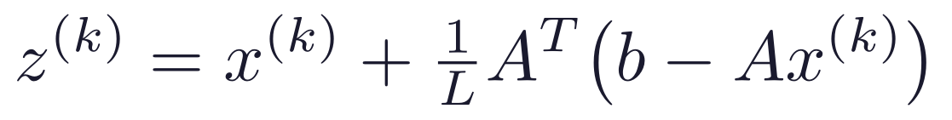
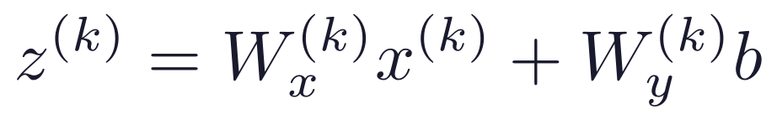
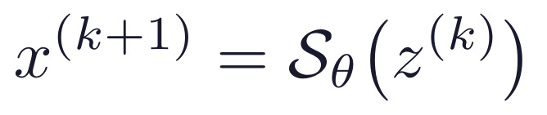
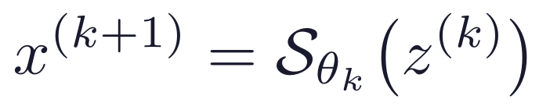
Deep Unrolling: From Iterations to Layers
Key idea (Gregor & LeCun, 2010): unfold K ISTA iterations into a K-layer network and learn the update parameters from data.
Classical ISTA — parameters fixed
Unrolled LISTA — parameters learned
Fixed — no learning
~6 M parameters — learned end-to-end
MBDL principle: preserve the known algorithmic structure (gradient step + soft-threshold);
learn only what improves finite-depth reconstruction. Training minimizes ‖x(K) − x*‖² via BPTT.
BPTT = Backpropagation Through Time — end-to-end backpropagation through all K unrolled layers, as when training a recurrent network
5 / 16
Notes:
The idea, due to Gregor and LeCun in 2010, is to unfold the K iterations of ISTA into a network with K layers, and to turn the algorithmic constants into learnable parameters. On the left you see classical ISTA, with a fixed step size and a fixed threshold. On the right is LISTA: two weight matrices and a separate threshold per layer, all trained end-to-end with backpropagation. This is the model-based deep learning principle: keep the structure — a gradient step followed by soft-thresholding — and learn only what improves reconstruction at a finite depth. In our setting this amounts to about six million parameters.

Slide 6
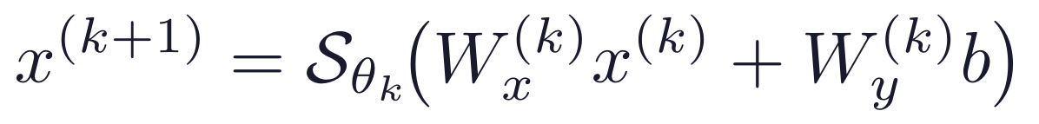
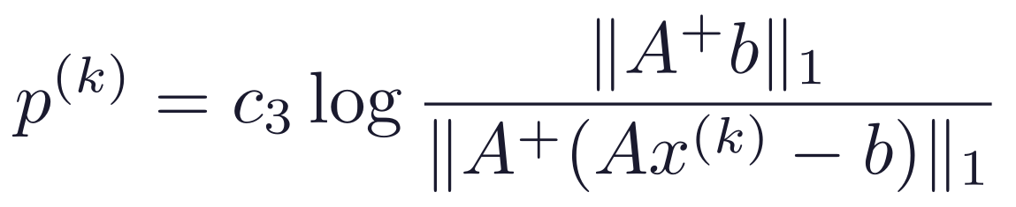
The MBDL Ladder: LISTA → ALISTA → HyperLISTA
LISTA — learn all matrices per layer, ~6 M params:
Model | Params | NMSE | Error [%]
ISTA | 0 | −5.3 dB | 29.5%
FISTA | 0 | −11.0 dB | 7.9%
LISTA | 6 M | −20.3 dB | 0.93%
ALISTA | 32 | −29.8 dB | 0.10%
HyperLISTA | 3 | −61.4 dB | 0.00007%
ALISTA — W analytic, learn step sizes and thresholds, 32 params:
NMSE on synthetic sparse recovery (m=250, n=500, s=50, noiseless, K=16 layers)
HyperLISTA — adaptive θ/β/p from residuals, 3 params (grid search, zero backprop):
More structure → fewer params → better performance
This is the MBDL principle in action.
6 / 16
Notes:
Now the MBDL ladder — more structure, fewer parameters. LISTA learns everything: six million parameters, minus 20 dB. ALISTA shows that the weight matrix does not need to be learned at all: it can be computed analytically from A, leaving only per-layer step sizes and thresholds — 32 parameters, and minus 30 dB. HyperLISTA takes this to the extreme: only three scalars. The threshold, the momentum, and the support selection are computed adaptively from the residual at every layer, using the formulas on the slide. And notice — there is no backpropagation at all: the three scalars are found by a simple grid search. The result: minus 61 dB — less than one ten-thousandth of a percent of residual error — the best of all. More structure, fewer parameters, better performance — this is the MBDL principle in action.

Slide 7
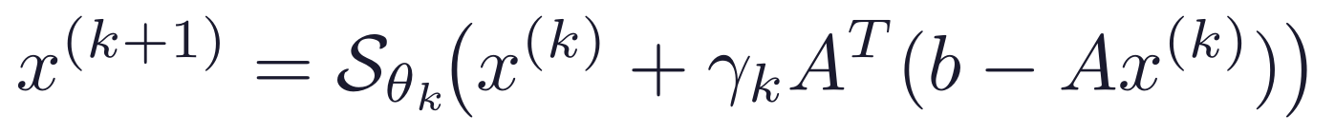


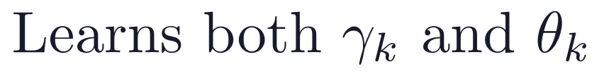



Our Design Space Study: What Should We Learn?
Research question: LISTA learns 6 M parameters; HyperLISTA uses 3 scalars. What is the minimal useful set of learnable components?
The ISTA gradient-correction update has two free scalar sequences:
We designed three models, each learning a different subset:
ThresholdISTA
StepISTA
StepThresholdISTA
16 params
16 params
32 params
independently per layer
Init: ISTA values
All parameters softplus-reparameterized (positivity). All initialized to reproduce ISTA exactly before training.
7 / 16
Notes:
This leads to our research question: between six million parameters and three, what is the minimal set that is actually worth learning? The generalized ISTA update exposes two free scalar sequences: the step size gamma and the threshold theta. We designed three models. ThresholdISTA learns only the thresholds. StepISTA learns only the step sizes, with the threshold tied to them. And StepThresholdISTA learns both, independently — 32 scalars in total. All of them are initialized to the exact ISTA values, so before training, every model is identical to ISTA.

Slide 8
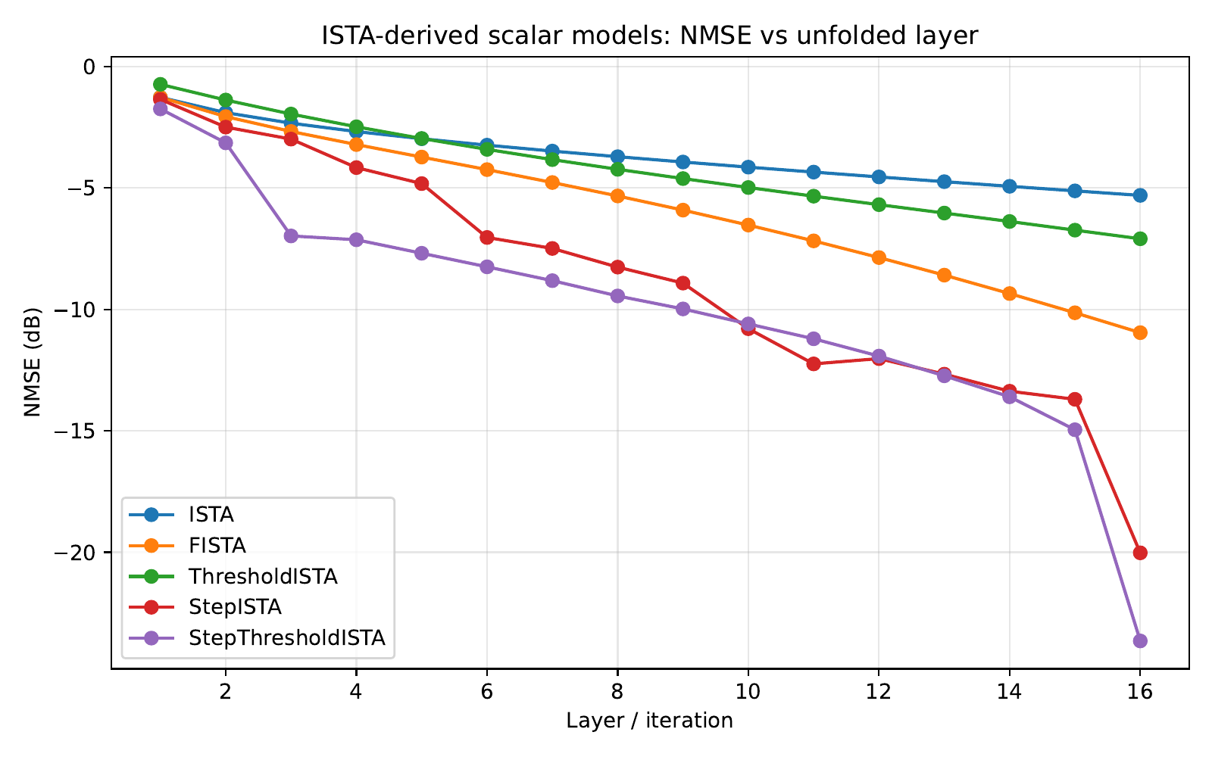
Our Results: Scalar Models
Model | NMSE | Params
ISTA | −5.3 dB | 0
FISTA | −11.0 dB | 0
ThresholdISTA | −7.1 dB | 16
StepISTA | −20.0 dB | 16
StepThresholdISTA | −23.6 dB | 32
LISTA-L1 (ref.) | −20.3 dB | 6 M
Key finding
Learning γₖ alone (16 scalars) already
matches full LISTA (6 M parameters).
Decoupling θₖ adds 3 dB at zero extra cost.
StepThresholdISTA beats LISTA-L1
with 187,000× fewer parameters.
8 / 16
Notes:
The results are quite striking. Learning thresholds alone barely helps: minus 7 dB. But learning the step-size schedule alone — just sixteen scalars — jumps to minus 20 dB and matches the full LISTA with six million parameters. Decoupling the threshold from the step adds another 3.6 dB, essentially for free. The conclusion: the step-size schedule is the critical component to learn at finite depth, and learning full matrices is largely redundant when the sensing matrix is fixed.

Slide 9
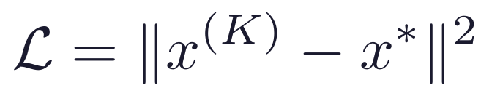
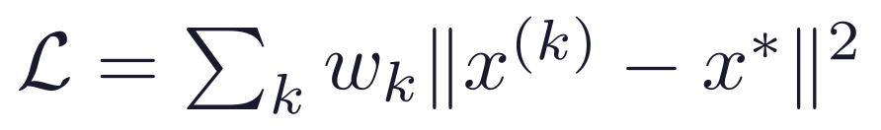
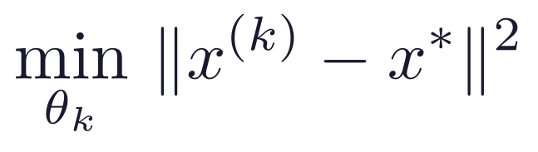
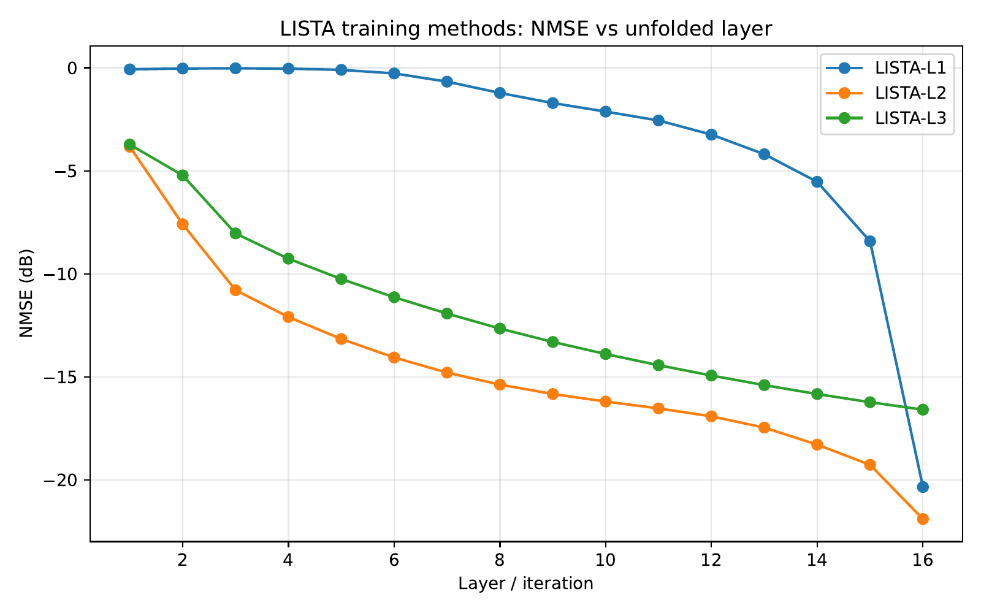
Training Methods for Unfolded Optimizers
Architecture fixed (LISTA). Only the training strategy changes.
L1 — End-to-end
L2 — Deep Supervision
L3 — Greedy Layerwise
Supervise final output only. Standard BPTT.
Supervise every intermediate layer.
Train layer k while layers 1…k−1 frozen.
Training | NMSE @ K=16 | Params
LISTA-L1 | −20.3 dB | 6 M
LISTA-L2 | −21.9 dB | 6 M
LISTA-L3 | −16.6 dB | 6 M
LISTA-Tied-L1 | −19.1 dB | 375 K
Tied = one shared (Wx, Wy, θ), RNN-style.
Implicit regularization: −19.1 dB
with 16× fewer parameters.
9 / 16
Notes:
Following the training strategies discussed in class, we compared them on the exact same architecture. L1 is standard end-to-end training, with a loss on the final layer only. L2 is deep supervision: a weighted loss on every intermediate layer. L3 is greedy layer-wise training, where each layer is trained while the previous ones are frozen. We also tested weight tying — the same layer repeated K times, like a recurrent network. The curve at the bottom shows all three on the exact same architecture: deep supervision improves every layer and finishes best at minus 21.9 dB; end-to-end L1 improves mostly in the final layers; and greedy L3 flattens around layer eight at minus 16.6, because later layers have no incentive to improve on what earlier layers already solved. And note tied LISTA: with sixteen times fewer parameters it comes very close to the untied version — weight tying acts as a built-in regularizer.

Slide 10
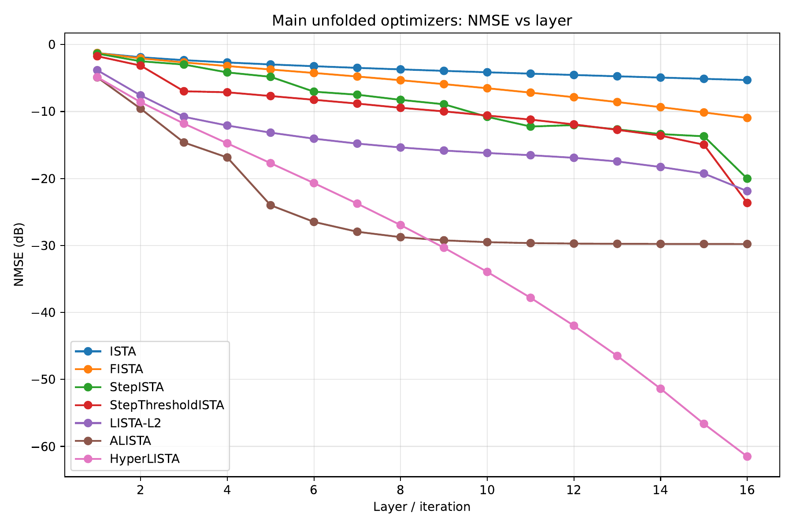
Synthetic Sparse Recovery Results
Method | NMSE | Params
ISTA | −5.3 dB | 0
FISTA | −11.0 dB | 0
StepISTA (ours) | −20.0 dB | 16
StepThresholdISTA (ours) | −23.6 dB | 32
LISTA-L2 (best LISTA) | −21.9 dB | 6 M
ALISTA | −29.8 dB | 32
HyperLISTA | −61.4 dB | 3
Each family is shown with its best variant
(LISTA → L2; full L1/L2/L3 comparison on
the previous slide).
ALISTA (32 params) beats every LISTA variant;
HyperLISTA (3) beats everything.
10 / 16
Notes:
Here is the full picture on the synthetic problem: NMSE as a function of depth, with each family shown at its best — for LISTA that is the L2 variant from the previous slide. The hierarchy is clear: our scalar models match or beat full LISTA, ALISTA beats every LISTA variant with 32 parameters, and HyperLISTA beats everyone with three. When the model assumptions hold, structure beats capacity.

Slide 11
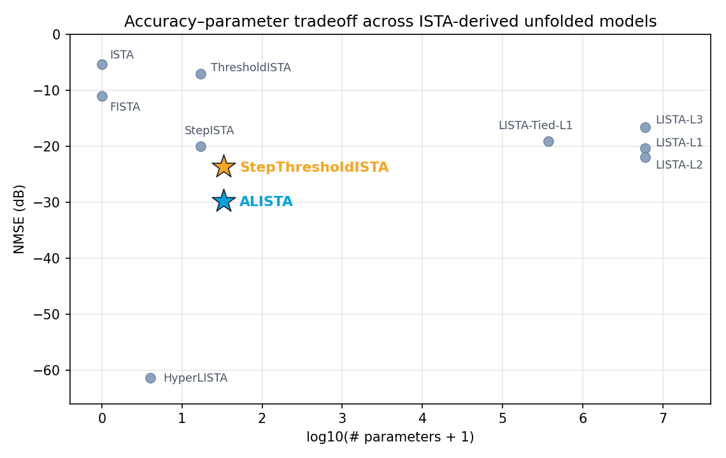
Design-Space Map
Model | Params | NMSE | What drives it
ThresholdISTA | 16 | −7.1 dB | learned θₖ
StepISTA | 16 | −20.0 dB | learned γₖ
StepThresholdISTA | 32 | −23.6 dB | γₖ + θₖ
LISTA-L2 | 6 M | −21.9 dB | full matrices + L2
ALISTA | 32 | −29.8 dB | analytic W
HyperLISTA | 3 | −61.4 dB | adaptive residuals
StepThresholdISTA (32 scalars)
beats even the best LISTA (L2, 6 M params).
The step-size schedule γₖ is the bottleneck.
11 / 16
Notes:
This map summarizes the synthetic part. The x-axis is the number of parameters on a logarithmic scale; the y-axis is the reconstruction error; the bottom-left corner is the ideal. The two starred models are the interesting ones: our StepThresholdISTA, with 32 scalars, beats even the best LISTA variant with 187,000 times fewer parameters, and ALISTA reaches minus 30 dB with the same 32 parameters thanks to its analytic weight matrix. HyperLISTA breaks the scale entirely. The message: in problems with known structure, choosing what to learn matters more than raw capacity.

Slide 12
Real Image CS: FashionMNIST Pixel Domain
Setup: flatten 28×28 image to x ∈ [0,1]^784, measure b = Ax, ratio m/784 ∈ {0.25, 0.5}. FashionMNIST: ~51.5% of pixels exactly zero.
Method | NMSE | PSNR | SSIM | Params
ISTA | −1.2 dB | 8.9 | 0.13 | 0
FISTA | −1.2 dB | 8.9 | 0.14 | 0
StepThresholdISTA | −1.2 dB | 8.9 | 0.13 | 32
ALISTA | −0.9 dB | 8.4 | 0.12 | 32
HyperLISTA | −0.3 dB | 7.7 | 0.09 | 3
LISTA-L2 | −13.7 dB | 22.3 | 0.82 | 12 M
Signal model mismatch
All structured methods assume i.i.d.
Gaussian sparse signals.
FashionMNIST pixels are bounded [0,1],
spatially correlated, and only soft-sparse.
Why LISTA wins
LISTA-L2 is assumption-free —
it learns the actual image distribution
from 51 K training images.
Wrong prior is worse than no prior.
ratio = 0.25
12 / 16
Notes:
Now the real test — actual images. We moved to pixel-domain compressed sensing on Fashion-MNIST: the image is flattened into a 784-dimensional vector, and we measure only a quarter of that dimension. No transform is needed, because these images have a black background and are naturally sparse in pixels. And here the ranking flips completely. All the structured methods collapse — ALISTA and HyperLISTA do even worse than plain ISTA — while LISTA with deep supervision reaches an SSIM of 0.82. The reason: the assumption of i.i.d. Gaussian sparsity is simply wrong for bounded, spatially-correlated pixels. A wrong prior is worse than no prior.

Slide 13
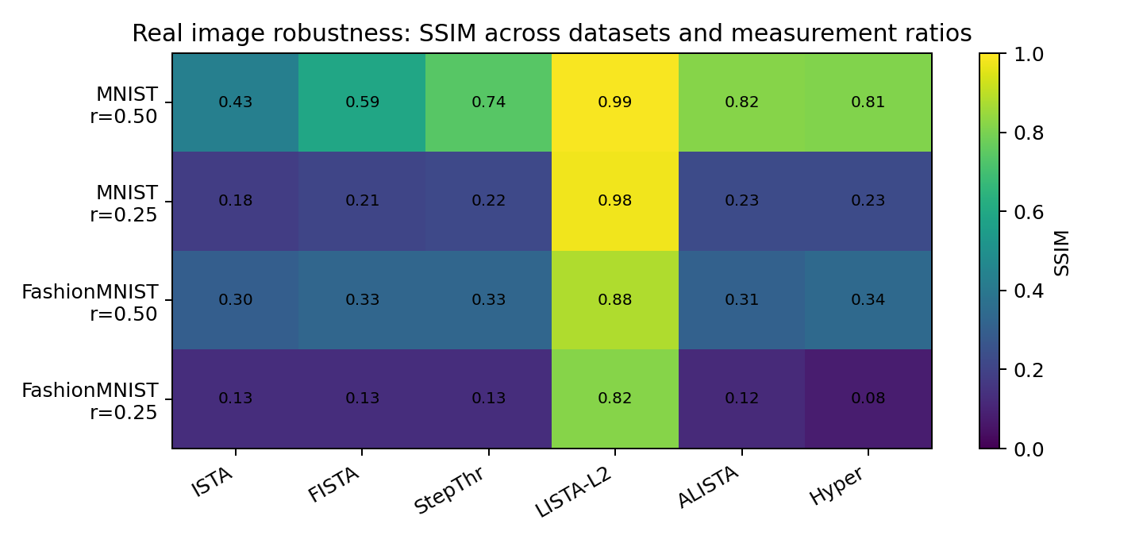
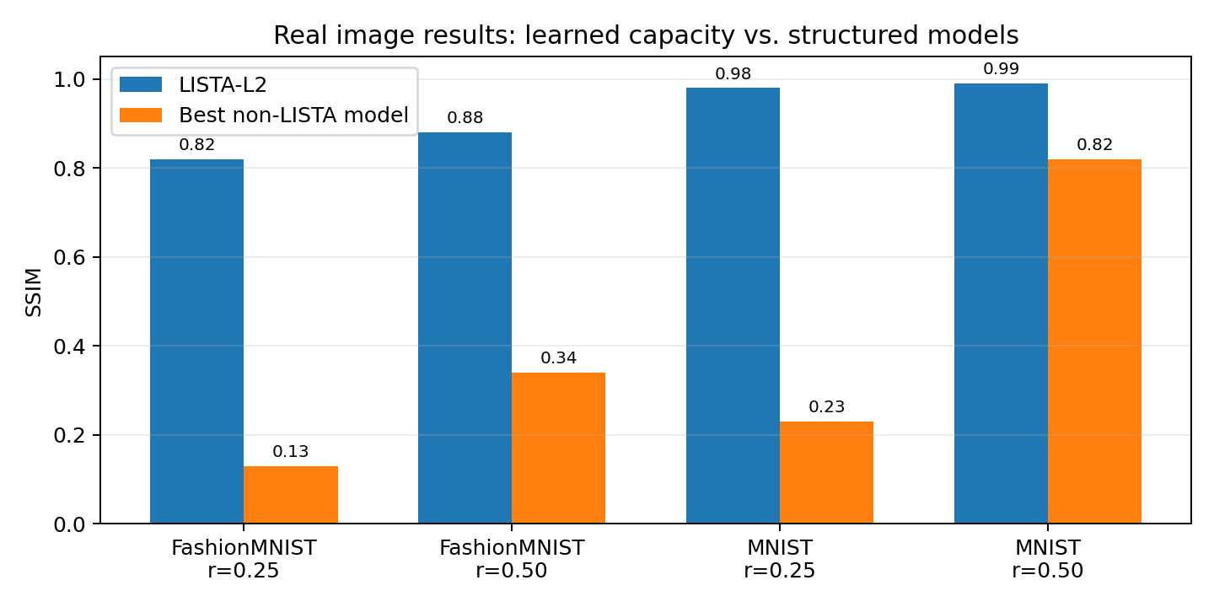
Robustness Across Datasets and Measurement Ratios
SSIM across {MNIST, FashionMNIST} × ratio {0.25, 0.5}: harder data and fewer measurements widen the gap.
Trend
MNIST @ 0.5 is easy for everyone; FashionMNIST @ 0.25 breaks every structured model. LISTA-L2 stays ≥ 0.82 SSIM everywhere.
Interpretation
The sparse-Gaussian prior degrades gracefully on MNIST (~78% zeros) but fails on FashionMNIST (~51% zeros, textured).
13 / 16
Notes:
We tested this systematically over two datasets and two measurement ratios; the heatmap shows SSIM. On MNIST with half the measurements, every method does fine, because MNIST is genuinely sparse — about 78 percent of its pixels are zero. As the task gets harder — fewer measurements, or more textured data — the structured methods degrade sharply, while LISTA-L2 stays above 0.82 in every scenario. The sparse prior breaks down gradually as the data moves away from the assumptions.

Slide 14
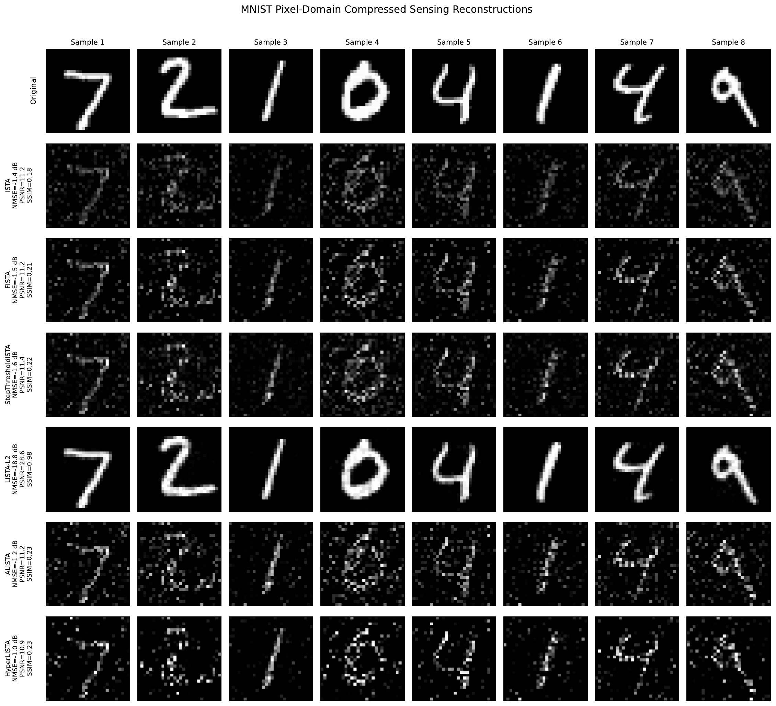
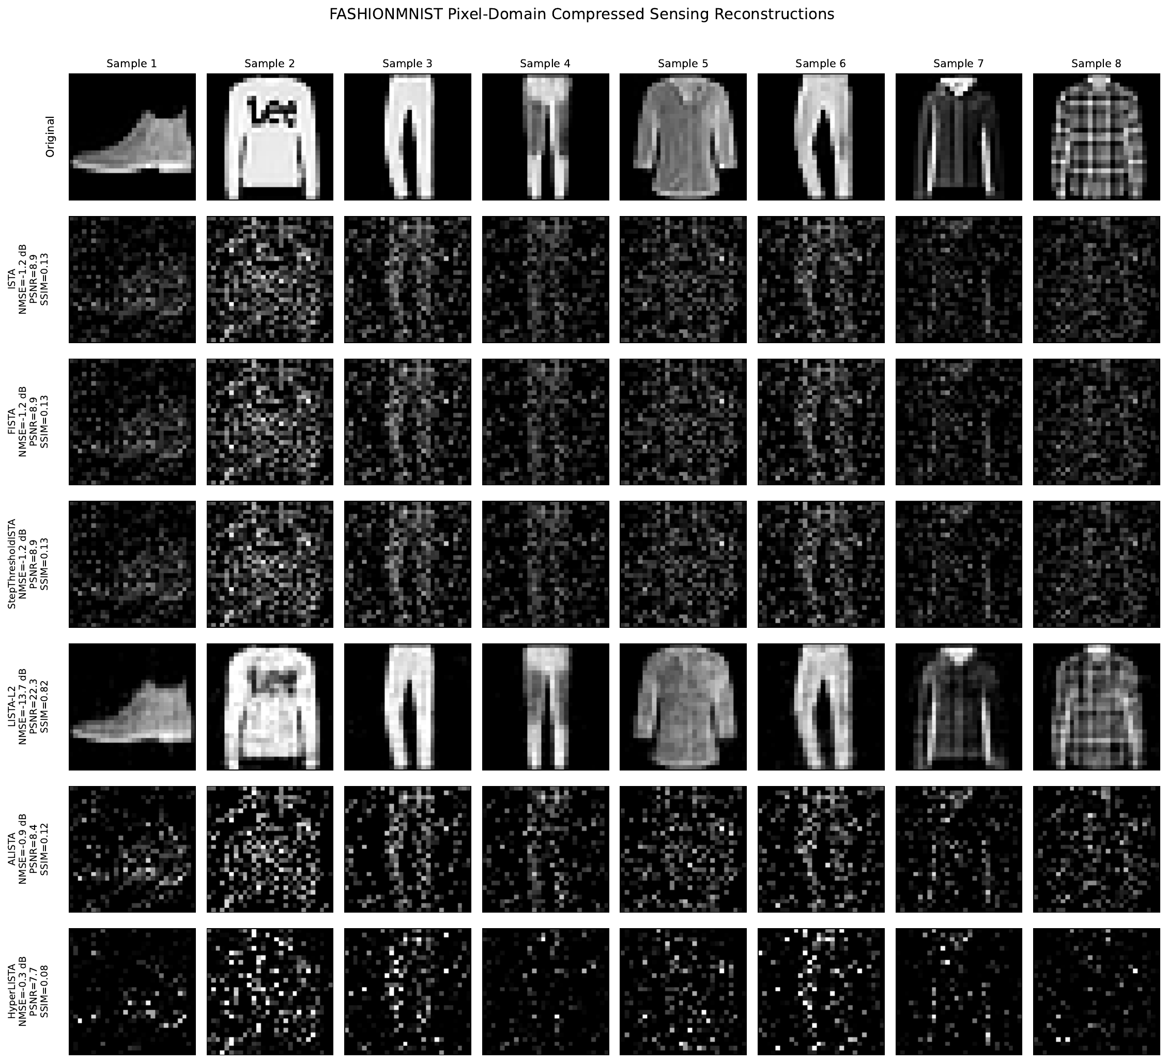
Visual Stress Tests (ratio = 0.25)
LISTA-L2 recovers clean structure on both datasets. ALISTA / HyperLISTA zero out valid signal on FashionMNIST —
the Gaussian-sparse threshold is miscalibrated for textured images. Wrong prior is worse than no prior.
14 / 16
Notes:
The visual comparison makes the numbers concrete. MNIST is on the left, Fashion-MNIST on the right, both with a quarter of the measurements. The LISTA-L2 row is almost identical to the originals in both cases. ALISTA and HyperLISTA literally erase real signal — a threshold calibrated for sparse Gaussian residuals deletes the image itself. This is what a wrong prior looks like.

Slide 15
Conclusions
1
Structure wins when assumptions match.
2
Step sizes matter most.
HyperLISTA's 3 scalars beat 6 M learned parameters by 41 dB on synthetic sparse data.
StepISTA (16 scalars) matches LISTA. Decoupling θₖ adds 3 dB. Matrix learning is largely redundant.
3
Weight tying is implicit regularization.
4
Wrong prior actively hurts.
LISTA-Tied matches LISTA-Untied (−19.1 vs −20.3 dB) with 16× fewer parameters.
ALISTA / HyperLISTA score below ISTA on real images. LISTA wins by making no structural assumptions.
MBDL hierarchy on synthetic data:
ISTA → LISTA → ALISTA → HyperLISTA
0 → 6M → 32 → 3 params
−5 → −20 → −30 → −61 dB
Future work
Apply models in DCT / wavelet domain — images are
sparser there, closer to the Gaussian-sparse model.
Design image-aware thresholds for bounded,
non-negative pixel structure.
15 / 16
Notes:
To summarize, four lessons. One: when the assumptions hold, structure wins — three scalars beat six million parameters by 41 dB. Two: the step-size schedule is the most valuable thing to learn. Three: weight tying is implicit regularization. Four: a wrong prior actively hurts — on real images, the flexible LISTA wins. As future work, we would like to test these models in the DCT or wavelet domain, where images are much closer to the Gaussian-sparse assumption.

Slide 16
Code & References
Code — public GitHub repository (notebooks 01–04 + src modules):
github.com/ThEpiCake/hyperlista-mbdl
References:
[1] A. Beck and M. Teboulle, "A Fast Iterative Shrinkage-Thresholding Algorithm for Linear Inverse Problems," SIAM J. Imaging Sciences, 2009.
[2] K. Gregor and Y. LeCun, "Learning Fast Approximations of Sparse Coding," ICML 2010.
[3] X. Chen, J. Liu, Z. Wang, W. Yin, "Theoretical Linear Convergence of Unfolded ISTA and Its Practical Weights and Thresholds," NeurIPS 2018.
[4] J. Liu, X. Chen, Z. Wang, W. Yin, "ALISTA: Analytic Weights Are As Good As Learned Weights in LISTA," ICLR 2019.
[5] X. Chen, J. Liu, Z. Wang, W. Yin, "Hyperparameter Tuning is All You Need for LISTA," NeurIPS 2021.
[6] N. Shlezinger and Y. C. Eldar, "Model-Based Deep Learning," Foundations and Trends in Signal Processing, vol. 17, no. 4, 2023.
[7] Course lecture notes 1–8, Model-Based Deep Learning (361.2.2320), Ben-Gurion University, 2026.
Thank you very much for listening!
16 / 16
Notes:
All of our code — the four notebooks and the source modules — is available in a public GitHub repository, and these are the main references we built on. Thank you very much for listening.

