Slide 1

TUTORIAL
EMBEDDED SYSTEMS
UML CODE GENERATION
Department of ElectricalEngineering and Information Technology
Welcome to the UML code generation tutorial!
In the next few hours you will learn how to generate C++ Code out of UML diagrams. This Tutorial is based on the “UML Getting Started” tutorial of the Willert company.
So, let’s start!
supported by

Slide 2



Software
IBM® Rational® Rhapsody® for C++
With Rhapsody, we create UMLDiagrams and generate C++-code from them. The “Blinky” example will be modeled completely with the help of this environment.
KEIL MDK ARM
We need the Keil µVision IDE to flash our executable model to the target or to let it run in the built-in simulator. On top of that the IDE offers additional debugging possibilities for our model.
Realtime eXecution Framework
The Willert Embedded UML RXF™ combines Rhapsody with the Keil µVision IDE. It opzimizes the code generation for a resource friendly use in an embedded real-time enviroment.

Slide 3
MDA Principle
Textual Description CIM
Architectural Model
UML
MCB1700/Cortex M3
Board – LEDs should
blink, no of blinking
LED showed on display
Manual
Integration
Platform Independent
Modell PIM
Transformation
Model
Plattform Description
Model
Tool: Rhapsody
Tools: Willert/Rhapsody
Tools: Keil/Willert
Automatic
Integration
UML Model for
blinking LEDs
Plattformspecific Model
PSM
Executable
Model
On target
executable C Code

Slide 4
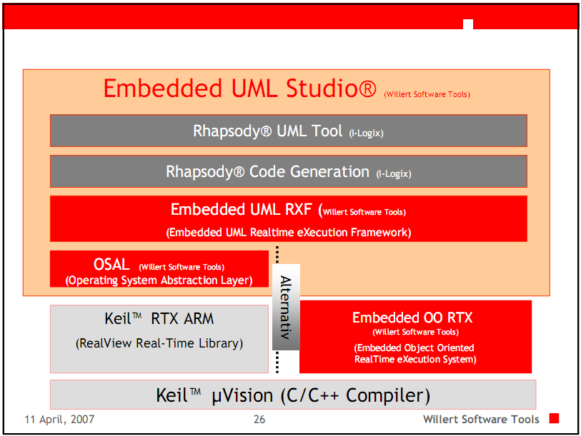

Slide 5

Codegeneration with Rhapsody in C++
UML classes generate a struct-Typ in C.
To adress components of a class (encapsulation) an automatically generated me-pointer can be used.
Example for using an attibute
bitNr : Type int Attribute in a class
Usage inside a class method:
me->bitNr=16;

Slide 6
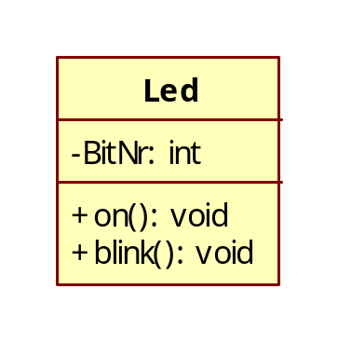
Codegeneration with Rhapsody in C++
The name of every public operation is implicitely prefixed by the
class name
To realize the ownership principle the first parameter in a class
method a pointer to the owner of the method.
Example:
Generated C code for class Led with operation on():void
void Led_on(struct Led * const me);
usage in implementation of blink()
...
me->BitNr++;
Led_on(me); ...
The extensions are not visible in prototype / UML model

Slide 7
Automatically generated functions
Available predefined types:
char char* double
float int unsigned long
long long double short unsigned
void void* unsigned short RiCString RiCBoolean OMString
Rhapsody generates operations and objects to create, to initialize, to cleanup, and to destroy objects.
Object constructors contain creators and initializers; Objekt destructors contain cleanup and destroy operations.
  Naming:
<classname>_Create().
e.g.
B *mynewB;
mynewB = B_Create();
Object destructors
delete object instances
Naming: <object>_Destroy().

Slide 8
Object initializer
The function named init can be used to initialize attributes and links of an instance.
It is necessary to allocate the memory before (e.g. with create)
Format: <object>_init()
Example:
Prototype of the generated initializer for object myA of type A:
void A_init(struct A* const me);
(is called automatically when using create())
Primitive Operations
Primitive operations are operations defined by the modeler. They are defined by name, list of parameters and return type.
All object operations are represented in code as C-functions.
Remember, first parameter is always a pointer to the owner object followed by the parameter list.
example: Method print() of object B results in:
void B_print(B* const me);

Slide 9
Reactive Objects
Reactive Objects are objects which can receive and deal with events. Usually they are state dependent:
  They are described by a state machine or
  They have an event reception
Rhapsody automatically generates state based functions
  for entry of a state
  for consuming events
  for state request
  for leaving a state

Slide 10
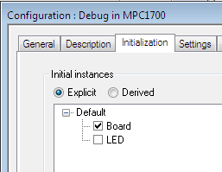
Objects
Functionality of classes is only usable by instances / objects
Creation of objects is done directly im Object Model Diagram or Model
Automatically generated Objects at program start are possible:
Attention: Always decide for reasonable objects, e.g. for a LED bar with 50 LEDs you should not create 50 single objects

Slide 11
Events
Events:
enable asynchronous communication between objects and via statecharts
created inside the class which receives the event or alternatively defined as global operation
defined by using the Makro CGEN which is available in Rhapsody:
CGEN( &Receiver, eventToBeSent());
e.g. CGEN( &myLED, evLEDChange());
The receiver of an event may be a global object, a local
object or a subobject.
Events can transport information by using parameters.
The receiver of an event can get the parameter values via
params->parametername
Note:
Creation of an event with parameters in Rhapsody: Create an operation, insert parameters, change operation type to type reception.

Slide 12
Other useful functions
Using the IS_IN function you can decide whether an object is in a special state.
Notation:
IS_IN( &object, &object_specificState)
e.g.
if(IS_IN(me, me_LEDon)) …
return value is 0 or 1 (boolean value)
Further Informations
Roundtrip means to generate a UML model out of existing code. You don‘t want to use this feature in the lab project.
Always choose „No to all“
If you are asked for roundtrip multiple times you propably have „old“ or „wrong“ elements in your model.
The path to the keil-Project is a configuration in Rhapsody. It can be changed but it is more convenient to keep it as defined.

Slide 13
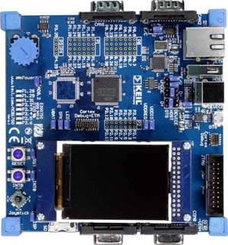

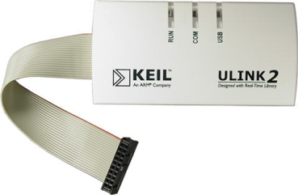
MCB1700 Board
We use a Keil MCB1700 evaluation board with a LP1768 Cortex M3 processor
To debug our Software we use the Keil Ulink2 Debugger, which allows us to debug our embedded programs on our target.
Connect the JTAG plug of the ULINK2 to the connection jack of the MCB1700
Now connect the two USB cables to ULINK2 and the 1700
Make sure that the POWER LED (red) is on
MCB1700
USB
PC
USB
Debugger

Slide 14
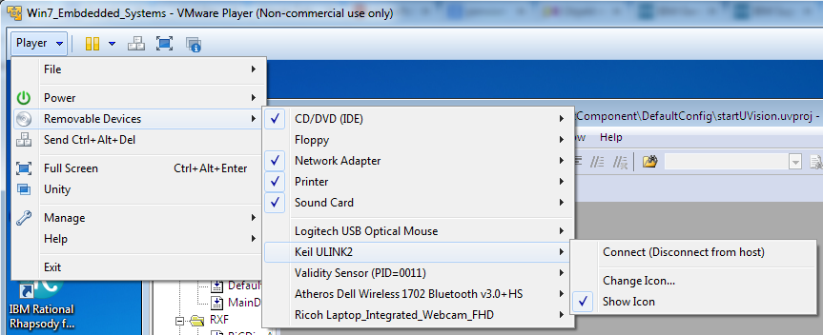
MCB1700 Board
Use the Virtual Machine VM_SS2016_EMSYS
User: Embedded Systems
In case that Keil has problems to find the debugger after you connected it
to the PC: Connect Keil with the VM (as seen in the picture below)
Usually the USB Devices are detected and connected automatically.

Slide 15
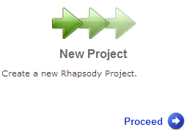

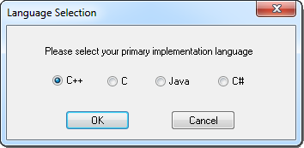
Blinky project GettingStarted
Let’s start IBM Rational Rhapsody Developer for C++ in the startup menu.
Off-course we could save a few pages, by omitting classes and objects in this simple Blinky. However since we will later mostly work with classes, we'd rather just put a solid foundation.
On the Rhapsody welcome screen of we click on the Next symbol, or choose File/New from the menu.
If you started IBM Rational Rhapsody
Architect for Software choose C++ as your
primary implementation language.

Slide 16
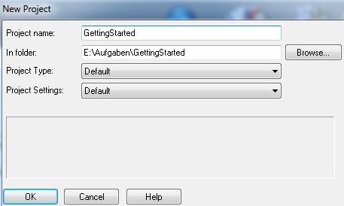
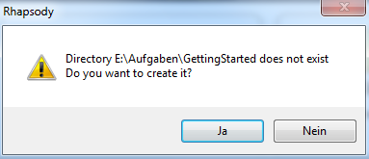
Getting Started project
We determine an appropriate name for our project, e.g. GettingStarted in a folder in our working directory.
Yes you want to…

Slide 17
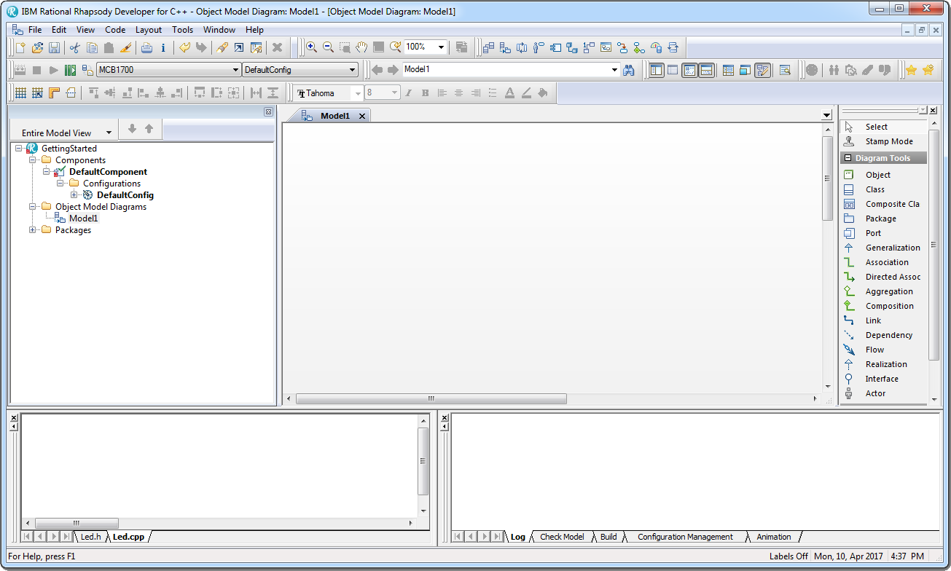
Getting Started project
This is the user interface of Rhapsody. Please make yourself familiar with it, because this is the program we work with most of the time.
Elementpool
for Diagrams
Model Browser
Diagram Area
Active Code View
Debug/Output

Slide 18
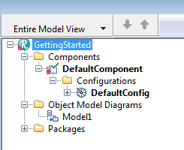
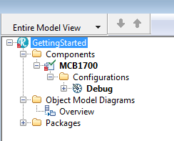
Getting Started project
We take a look at the model browser. Similar to the Windows Explorer, you can navigate using the (+/-) symbols through the model.
All elements of our UML model are accessible through the browser. We first start with renaming a couple of items in the model browser. The easiest way to do that is a slow double-click on the element to be renamed.
Rename

Slide 19
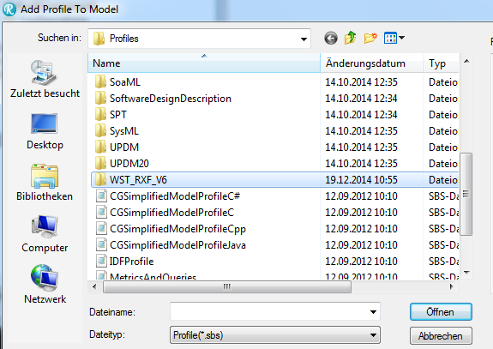
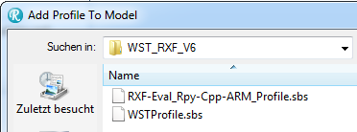
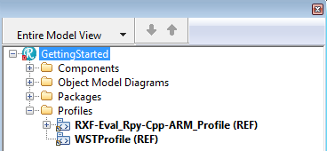
Select Profiles
Chose the WST-Profile for the Willert RT-OS select File → Add Profile to Model and select the folder WST_RXF_V6.
Add both profiles.
The Profiles folder of your Project should look like this.

Slide 20
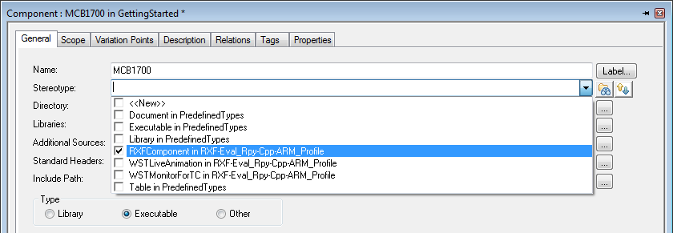
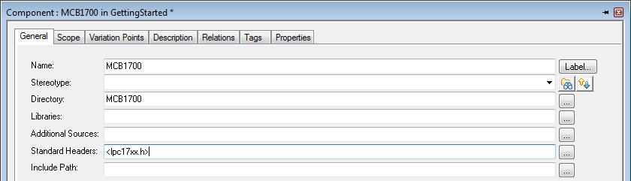
GettingStarted project
Double-click on the MCB1700 component and select the following stereotype in the pop-up window: RXFComponent…
For the hardware specific components add the file lpc17xx.h:

Slide 21
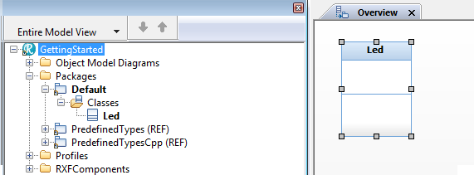
GettingStarted project
We open the freshly renamed OMD (Object Model Diagram) Overview by a double-click. This will open the Overview OMD in our diagram area. We draw a class in our diagram with selecting the class symbol from our element pool and name the class Led.
This class can also be found in the model browser under:
Packages / Default / Classes / Led

Slide 22
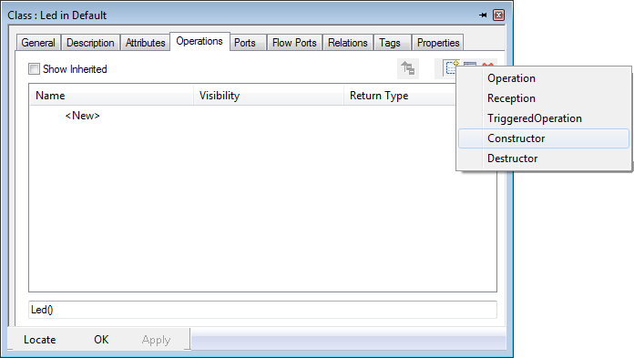
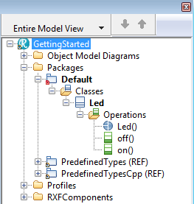
Blinky project – Methods
Switch to the Operations-Tab and click on the New symbol and a Constructor.
Rhapsody will ask you which arguments the constructor should get. We will do that later.
Just click OK.
Add the Operations on() and off() in the same way.
Your class Led should have three operations now and look like this:

Slide 23
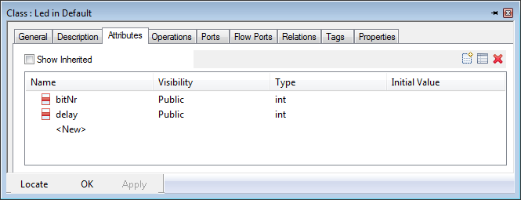
Blinky project – Methods and Attributes
Next, we add two attributes to our class. The first one is bitNr, where the information which port is connected to which Led is located. The second one is delay. It’s the delay time between on and off.
Open the features of our class Led (double-click or right-click → Features) and create the two attributes at the Attributes-Tab.

Slide 24
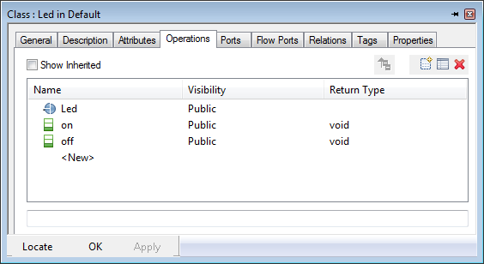
Blinky project – Methods and Attributes
So open the Features of the constructor Led() again and embark in the Argument tab. We create the arguments aBitNr and aDelay there, using the New symbol .

Slide 25
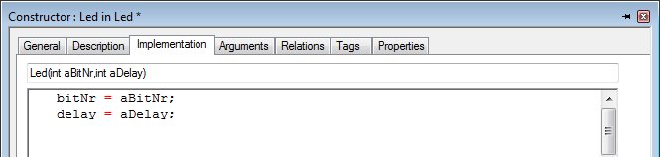
Blinky project – Attributes
We have three empty methods in our class (Led() / off() / on()) and two attributes (bitNr / delay)
In order to get both variables initialized at create time we will add the following C++-code to the Implementation-Tab of the constructor Led().
What happened here?
If we later create an object of the class Led , the constructor Led() assigns a number and a delay time passed to the constructor Led() as parameters to this object.

Slide 26
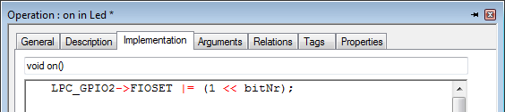

Blinky project – Attributes
In order to define one of the eight LEDs on the MCB1700 as output, we need to set the appropriate bit in the FIODIR register of the CortexM3. We do this with two code lines in the Implementation-Tab of the constructor Led(int aBitNr,int aDelay).
bitNr = aBitNr;
delay = aDelay;
LPC_GPIO1 -> FIODIR |= 0xB0000000;
// B=1011 e.g. Pin 28 and 29 with LEDs are set to output pin
// – we will not use these
LPC_GPIO2 -> FIODIR |= 0x0000007C;
// LED 1,2,…5 are addressed by GPIO2,
// here all LED Pins are set to output
Add content to the on() and off() operations. Just fill in the lines below:
Notes:
Sauberer ist es, beim Setzen der LEDs das FIOPIN Register zu belassen. Hierfür besser verwenden:
LPC_GPIO2->FIOSET |= 1<<me->bitNr;
LPC_GPIO2->FIOCLR |= 1<<me->bitNr;

Slide 27
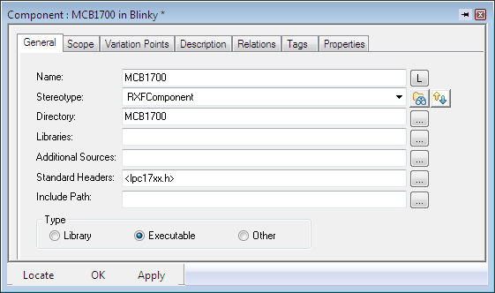

Header and so on…
It’s time to add a header file to our “MCB1700” component. We want Rhapsody to know which specific hardware we use.
Double click on the component or open the “Features” window.
In the General tab fill in “Standard-Headers” with <lpc17xx.h>
LED.h should contain
the following include:

Slide 28
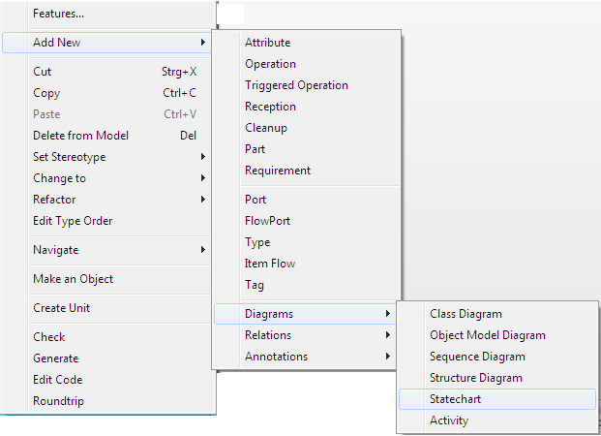
Blinky – Statecharts
Our constructor will be automatically called at the initialization of the LED. But who will now call both our on()- and off()- operations?
For that we use one of the most commonly used UML diagrams - the Statechart (State Diagram).
In the model browser, we right click on the class Led and wind our way through the menus.

Slide 29
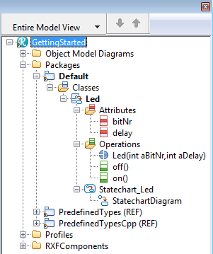
Blinky – Statecharts
Your project should look like this now:
Above our diagram area we see a tab bar in which we now see, next to our Object Model Diagram and the Welcome Screen, our newly created state chart.

Slide 30

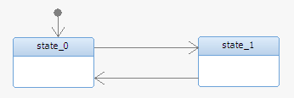
Blinky – State chart
We need three different elements to build our state chart from the element pool. Add two States and connect the two of them with one arrow (Transition) in each direction. Our chart should look like this now:
The only missing thing is an entry point now. Add it by using the Default Transition element.

Slide 31
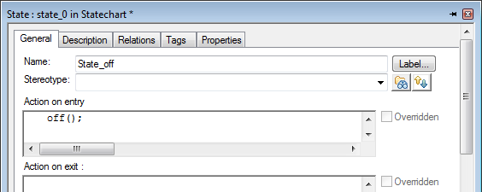
Blinky – State chart
If we want to draw the diagrams more precisely then this toolbar will support us in that:
If you select multiple objects in a diagram while keeping the Shift-Key pressed, the symbols in this toolbar will become active. Now you can align the selected objects to the edge of the diagram or to each other. The last selected object is used as pivot point!
Open the state_0 features and rename it to State_off and enter the call of the off() operation at Action on entry.

Slide 32
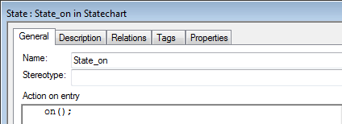
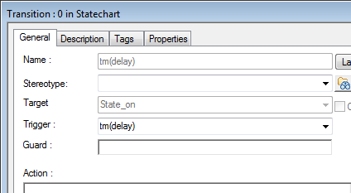
Blinky – State chart
Enter the similar name and operation into the general tab of State_on.
In the current situation our state chart would toggle between both states.
The Transitions between the states would be executed immediately.
To change that we open the features of one of the transitions with a double-click. Enter tm(delay)in both transitions as Trigger.

Slide 33
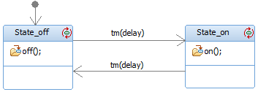
Blinky – State chart
The tm(me->delay) uses the system clock of the CortexM3, to delay the transition for the time we specified. (We will initialize the attribute with a value later in this tutorial).
Our finished state chart should look like this:
A click on the symbol makes the Action on entry/exit visible in the state icon.

Slide 34
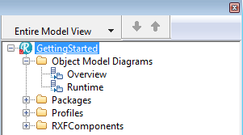
Blinky – Instances of a class
The class Led is now complete.
To create an object of our class Led at run-time we have to initialize the class. In Rhapsody there are multiple alternatives to achieve this. The simplest possibility looks as follows:
We create a new Object Model Diagram to differentiate between classes and instances – to use the existing diagram would also be possible
Right click on Object Model Diagrams … and call it Runtime.

Slide 35
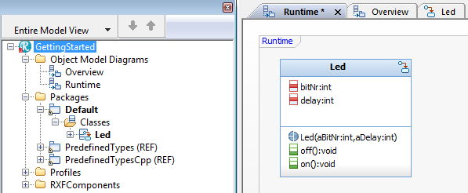
Blinky – Instances of a class
Now drag the class Led from the model browser and drop it in the Runtime OMD:

Slide 36
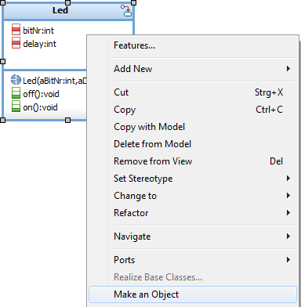
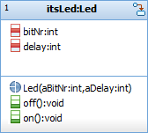
Blinky – Instances of a class
Right-click on the class Led in the Runtime and select: Make an Object
At runtime an object will be created at run-time out of our class Led. It is called itsLed.

Slide 37
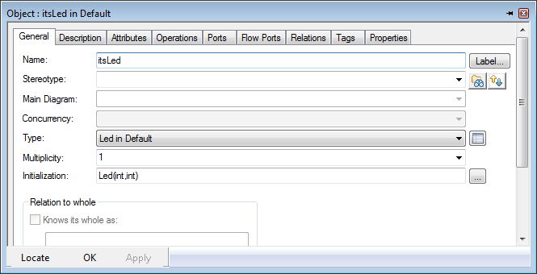
Blinky – Instances of a class
The only thing this object is missing is a suitable bitNr and a value for the delay in our statechart. For this we open the features of the object itsLED and click the General-Tab under Initialization on the extend button.

Slide 38
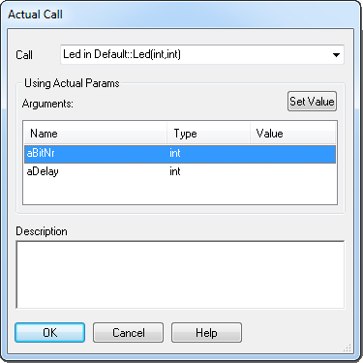
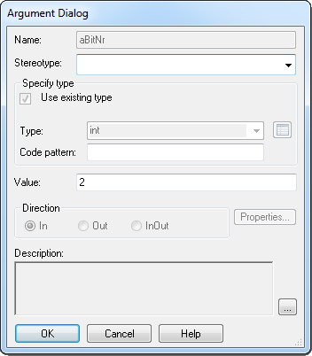
Blinky – Instances of a class
In the next window, we select the variable aBitNr and we click on SetValue.
To address the LED P2.2 on the Keil MCB1700 we enter the value 2, in the Argument Dialog under Value.

Slide 39
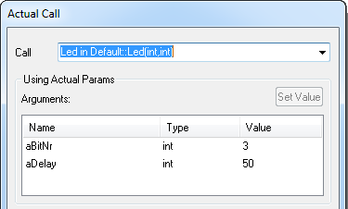
Blinky – Instances of a class
We repeat the same game now with the argument aDelay. As a value we take 100 (milliseconds). To fully exploit the advantages of object orientation, we will immediately add a second instance of our class. So we will again drag the class Led from the browser to the Runtime diagram, next to the other instance, we right click the class Led again and from the context menu select
Make an Object.
We then click the General-Tab under Initialization on the Extend button and enter now for the aBitNr a 3 and for the
aDelay a 50.

Slide 40
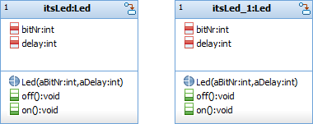
Blinky – Instances of a class
That’s it!
We have just, in a very simple way, created two objects from the same class.
Both objects can be simply distinguished using the name and the attributes.
Alternative: Choose the Object template from the Elementpool, double-click on the new object and assign Type Led in Default.

Slide 41
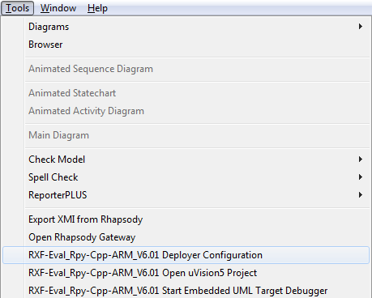
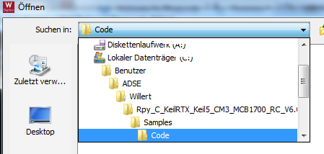
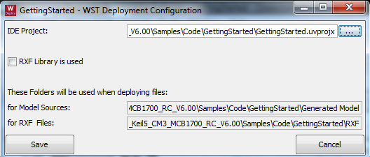
Generate / Make / Run
We now want to generate Code and compile this code with Keil µVision
For the Keil µVision Project Willert provides a deployment. Choose Tools → Rpy-Eval_Cpp... Deployer Configuration.
There you have to insert the Path to the Keil Project. Choose the folder Code under:
C:\Benutzer\ADSE\Willert\Rpy_C_KeilRTX_Keil5_CM3_MCB1700_RC_V6.00\Samples\Code\GettingStarted\GettingStarted.uprojx

Slide 42
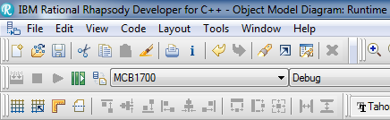
Generate / Make / Run
If we have made no mistakes, the model should now be able to run. To test this, we click in Rhapsody on the GMR-Button (Generate / Make / Run). It will automatically go through two steps in succession.
In the first step Rhapsody generates C++-Code from our diagrams and the other model components. The result of the Generate, after you confirm the next question, can be found in:
<yourProjectDirectory>\MCB1700\Debug

Slide 43
Generate / Make / Run
Now start the project in the Keil µVision IDE.
C:\Users\ADSE\Willert\Rpy_C_KeilRTX_Keil5_CM3_MCB1700_RC_V6.00\Samples\Code\GettingStarted\GettingStarted.uprojx
Compile it and load your executable to your virtual device with Load. Start the debug mode with the debug-button to start the simulator or to debug your program.
compile download debug
Alternative in Rhapsody: select Tools → Rpy-Eval_Cpp... Open uVision5 Project.

Slide 44

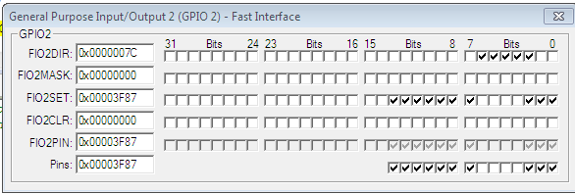
Keil µVision Development Enviroment
Of course, now we want to see if our LEDs will flash in rhythm.
We can download the program and see the blinking LED.
In case of an error or missing target, we can use the Keil Simulator:
We have to activate the debug mode
of the Keil IDE.
When we are in debug mode, an IO-window automatically opens or we choose the General Purpose IO Fast Interface and Select GPIO2. There we can monitor the state of the ports.
If we now click on the RUN button, we can see how bit 2 of FIO2SET toggles in the 100ms rhythm and bit 3 in 50ms intervals.
We can switch from Simulator to Hardware with Project/OptionsforTarget

Slide 45
LABORATORY GUIDE –
EMBEDDED SYSTEMS
PROF. M. VON SCHWERIN
PROF. N. NORMANN
On the next few pages several tasks and exercises are described which have to be solved during the laboratory.
Department of Electrical Engineering and Information Technology
Notes:
Anmerkungen:
Komposition mir Multiplizität 1 funktioniert nur, wenn Init() der Komponente keine Parameter hat (Standardkonstruktor wird automatisch verwendet)
Kaskadierung funktioniert nur zur direkt benachbarten Klasse hin:
itsBoard->itsLED.on() wird muss in C-Code so geschrieben werden:
LED_on(me->itsLED)

Slide 46
Annotations
Start the exercise part with a new project. Do not use parameters for the initialization of a class because in the following we will also use other types of instantiation of an object as shown in the example.
Create a new project for every exercise.
Therefore you can select a suitable already existing project
You should copy selected former project by using File → Save As... and create a new top directory folder.
Note that the last project is not always the best fit for the next exercise.

Slide 47
Exercise 1
Modify the project from the tutorial, that:
  a) all LED’s (P2.2 to P2.6) flash in turn and go out in reverse order.
  b) all LED’s flash in a row to build a ‘moving light’.
Modify the time, which the “moving light” takes for one iteration. Therefore implement a code that changes the “Delay” variable dynamically during the runtime.
Exercise 2

Slide 48
Exercise 3
Now the iteration time should be modified by using the Poti, which is right beside the LEDs. Its potential is connected via jumper AD0.2 to the A/D Converter channel 2 of the LPC1768. The potentiometer changes should be processed using polling mode.
AD Initialization:
// Initialize Poti (page 574)
LPC_PINCON->PINSEL1 &= ~(3<<18); // P0.25 is GPIO - Reset (page 108)
LPC_PINCON->PINSEL1 |= (1<<18); // P0.25 is AD0.2 - Function 01 (page 108)
For the configuration of the A/D Converter the following code can be used. The page references in the comments belong to the LPC17xx User manual.

Slide 49
Exercise 3 (continued)
Sampling:
LPC_SC->PCONP |= (1<<12); // Enable power ADC block (page 63)
LPC_ADC->ADCR = (1<<2) | // Select AD0.2 pin (page 577)
(4<<8) | // ADC clock is 25MHz/5 (page 577)
(1<<21); // Enable ADC (page 577)
LPC_ADC->ADCR |= 0x01200000; // Start A/D conversion now (page 577)
do{
potiVal = LPC_ADC->ADDR2; // Read A/D Data Register...
// into potiVal (page 579)
}while((LPC_ADC->ADGDR & 0x80000000) == 0); // Wait unitl A/D conversion...
// completes (page 578)
LPC_ADC->ADCR &= ~0x01000000; // Stop A/D Conversion (page 577)
delay = (potiVal >> 4) & 0x0FFF; // Extract result (page 579)
Exercises 1 – 3 have to be checked through a lab advisor. Please mail your projects and submit printouts of your implementations, methods and state charts to the advisors.

Slide 50
Exercise 4
The LEDs should now be controlled by a new class Board. This class sends suitable events to the LED instances to change from on to off state. Try to use reasonable UML relations in your class diagram.
The delay does not have to be controlled by the Poti in this exercise.
Events can be used for asynchronous communication between objects beyond the borders of their state charts. An event is created as an operation of the class that receives the event or as an global operation. The predefined macro CGEN defines an event
      CGEN( &Receiver, sendEvent());
Parameters can be passed to events similar to functions and so it is possible to transport information. The receiver can access the parameters via:
      params->parametername
Attention: Create an event with parameters as Operation and add its parameter. After that, change the Stereotype of the operation to Reception.

Slide 51
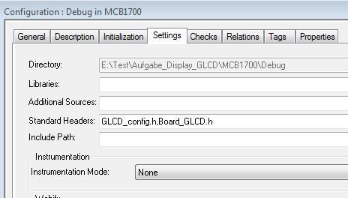
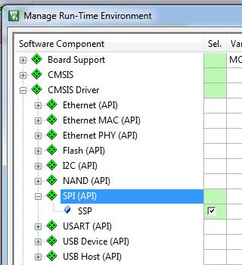
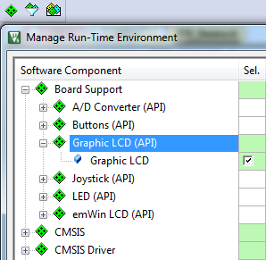

Exercise 5
Print now the number of the currently flashing LEDs onto the LCD Display.
Hint:
The display requires additional drivers
which are provided by the Keil IDE.
In the Rhapsody project you should add
two additional headers:
GLCD_config.h, Board_GLCD.h
In Keil choose theManage Run Time Envronment
and add
  Board Support – Graphic LCD
  CMSIS Driver – SPI – SSP
  Device – Seclect all

Slide 52


Exercise 5 (continued)
  You now see the Board Support and CMSIS in your project
  Choos Device – RTE_Device.h and select SSP1
  Save the settings and close the project
  Now you can use the GLCD commands in your Rhapsody Project

Slide 53
Exercise 5 (continued)
  You can use the following commands for controlling the display:
  extern GLCD_FONT GLCD_Font_16x24; //in case you don’t want to
  // use the default string
  GLCD_Initialize();
  GLCD_SetBackgroundColor(GLCD_COLOR_WHITE);
  GLCD_SetForegroundColor(GLCD_COLOR_BLUE);
  GLCD_SetFont(&GLCD_Font_16x24);
  GLCD_ClearScreen();
  GLCD_DrawString(2,3,”Hello”); //line,column, text as char-Array GLCD_Bargraph(unsigned int x, unsigned int y, unsigned int w,
  unsigned int h, unsigned int val);
    /*Print a Value val as bargraph to line x and column y with the pixel width w and high h*
    Annotation: in C sprintf(str, "i is %i", i) changes integer i
    to a C string str (char array) with the same content
    ( header stdio.h necessary)

Slide 54
Exercise 6
Model a periodic A/D conversion of the potentiometer voltage. The interval between two AD samples should be 10ms. Convert the AD values to a number between 0 to 100. Print the current value to the LCD as number and bargraph.
Design a complete LED supervision through the board class. The delay of the “moving-light“ should be controlled through the potentiometer in the area 0 to 100.
Hint: Consider again how to use the UML relations reasonably.
Exercise 7
Exercises 4 – 7 have to be checked through a lab advisor. Please mail your projects and submit printouts of your implementations, methods and state charts to the advisors.

Slide 55
Exercise 8
Use the “joystick“ on the MCB1700 board to control the „moving light“ through user inputs. Model a LED supervision that allows the user to enable/disable, stop and restart the LED line by using the joystick. The joystick should be prompted by polling.
Joystick initialization:
LPC_GPIO1->FIODIR&= ~((1UL<<20)|(1UL<<23)|
(1UL<<24)| (1UL<<25)| (1UL<<26));
/* Port P1.20 and 1.23 to 1.26 is input (Joystick)*/
Identification:
position = (LPC_GPIO1->FIOPIN >> 20) & Joystick_Mask ; // last 7 Bits now are related //to Joystick
Bit 4 to 7 includes the information about the Joystick position:
position = position >> 3;

Slide 56


Exercise 8 (continued)
  Joystick_Mask is a constant. A constant can be created as a Type through a right-click on the Default package and selecting Add New → Type. Call the new type MASK and write to Declaration:
  #define Joystick_Mask 0x79
We need another constant DIRECTION from
kind Enumeration which looks like:
The variable position can now be
compared with the DIRECTION items.

Slide 57
Exercise 9
Now use the EINT0 Interrupt (triggered through button INT0) to start and stop the LED line.
EINT0 Interrupt initialization :
// P2.10 is function EINT0 for 01 (page 110)
LPC_PINCON->PINSEL4 |= (1<<20);
// Disbale IRQ interrupt for INT0 in NVIC to configure
// EXTMODE (page 25) and EXTPOLAR (page 26)
NVIC_DisableIRQ(EINT0_IRQn);
// To ensure that EINT0 interrupt is cleared (page 24)
LPC_SC->EXTINT |= (1<<0);
// EINT0 is edge-sensitive (page 25)
LPC_SC->EXTMODE |= (1<<0);
// EINT0 is falling edge sensitive (page 26)
LPC_SC->EXTPOLAR &= ~(1<<0);
// Enable IRQ interrupt for INT0 in NVIC
NVIC_EnableIRQ(EINT0_IRQn);

Slide 58

Exercise 9 (continued)
An operation EINT0_IRQHandler() is necessary. The core interrupt handler jumps to this function. There the EINT0 Interrupt Service Routine (ISR) code takes place. In the ISR first clear the pending EINT0 interrupt flag:
The operation EINT0_IRQHandler() has to be an unqualified function.
Cleaning Interrupt flag:
// Clear EINT0 interrupt (page 24)
LPC_SC->EXTINT |= (1<<0);

Slide 59
Exercise 10 (optional) Ethernet
We now want to use the Ethernet communications which ist provided by our board. We need an additional platform model file and an idea how to model a class Ethernet. Therefore there is a starting project in E:Ethernet_Aufgabe.
Use this as start and deploy the Keil Project to
E:Ethernet_Aufgabe\GettingStarted_Ethernet\
GettingStarted
Now develop a model which uses two boards. Connect them with an Ethernet cable. Then model the following scenario:
If you push the joystick up on one board, the other board shows an LED light. If you push the joystick down, the light switches off again. For the communication between the boards Ethernet is used.

Slide 60

Blinky Test
1. Open Rational Rhapsody
2. Choose Blinky Example Project in Rhapsody
C:\users\Embedded Systems\IBM\Rhapsody\7.6.1\Share\WST_RXF_V5\
LisztV5.5r9\Smples\Model\Blinky.rpy
3. Generate Code
4. Open Keil µVision
5. Choose Target
Release
( Compile Project not necessary)
7. Download on target LED is blinking

