Slide 1
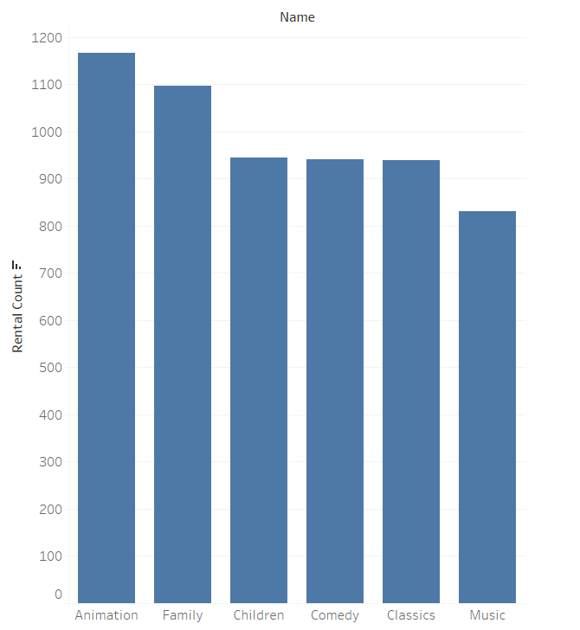
Set1 , Q1: we can see here that the Animation category is the must watched one followed by Family

Slide 2
Set1, Q2: we can see that the minimum rental duration is 3 days, and the maximum is 7 days , and the same duration can be in two deferent quartile

Slide 3
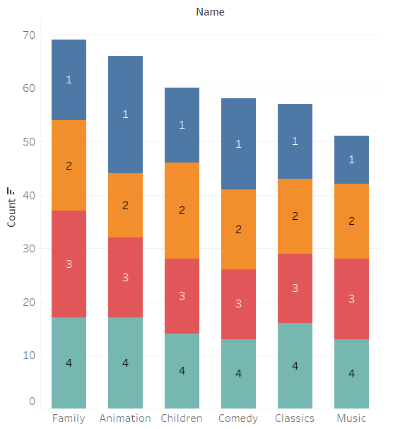
Set1, Q3: The chart shows that Famliy category has the highest number in the 3rd quartile and the Animition has thas highest in 1st quartile

Slide 4
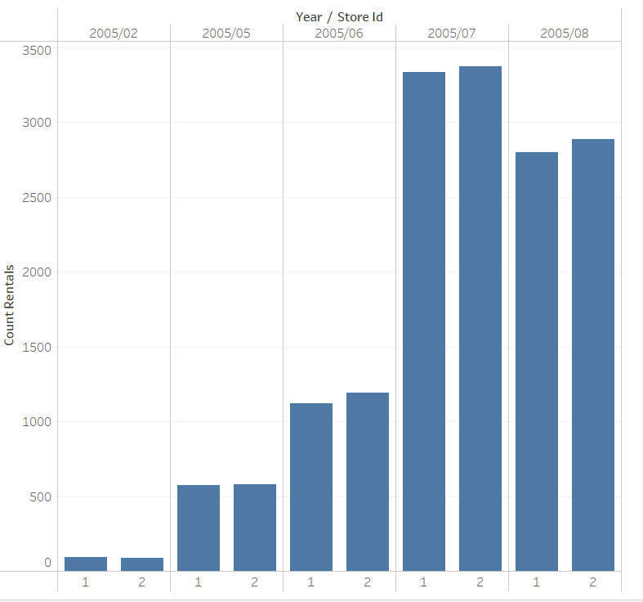
Set 2,Q1: The chart shows the growth of the stores, and you can see in month 7 happened some markable growth and now it’s hitting to recorrect and re grow, either way store 2 has grown more

