Slide 1
Simplifications / Transformations of
Context-Free Grammars
COMP 335

Slide 2
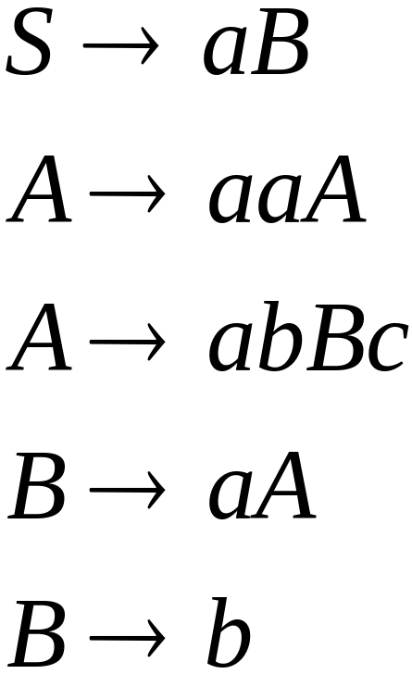
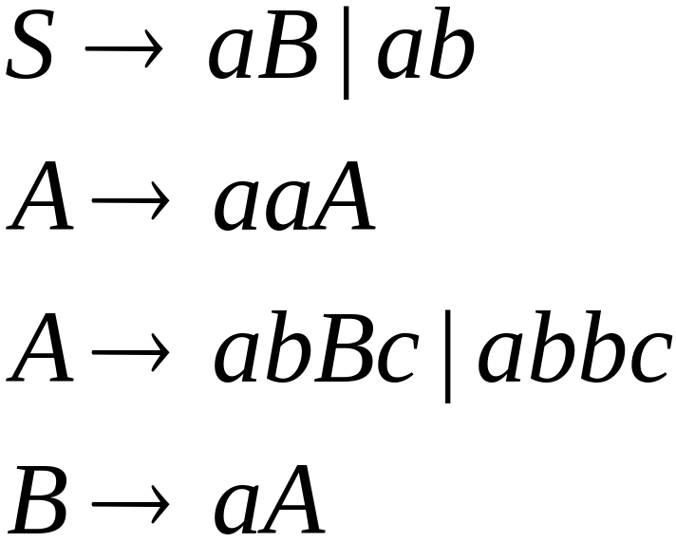

A Substitution Rule
Equivalent
grammar
Substitute
COMP 335

Slide 3


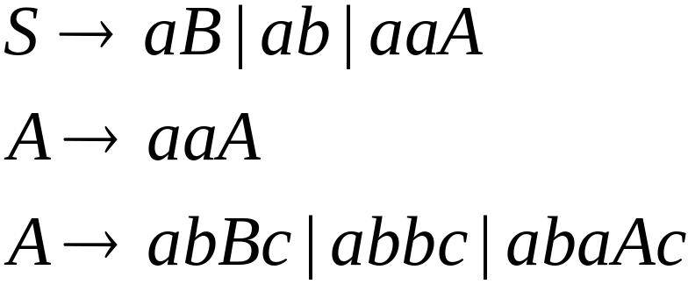
A Substitution Rule
Substitute
Equivalent
grammar
COMP 335

Slide 4
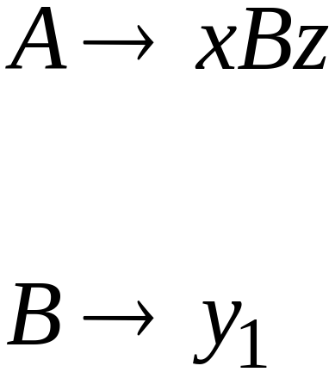
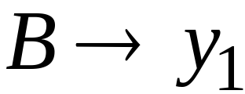
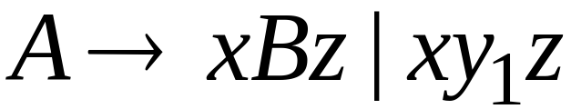
In general:
Substitute
equivalent
grammar
COMP 335

Slide 5
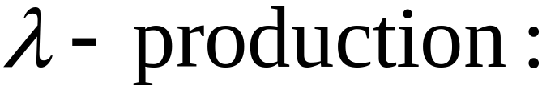


Nullable Variables
Nullable Variable:
COMP 335

Slide 6
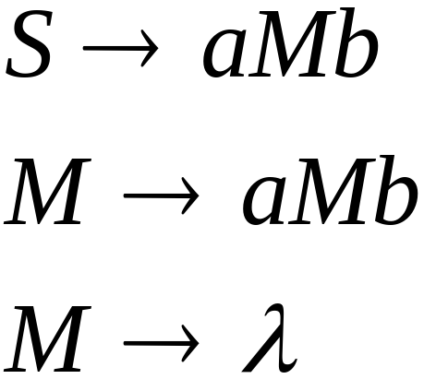
Removing Nullable Variables
Example Grammar:
Nullable variable
COMP 335

Slide 7
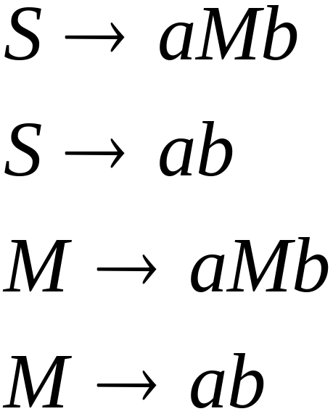

Final Grammar
Substitute
COMP 335

Slide 8

Unit-Productions
Unit Production:
i.e., a production with a single variable
at each side
COMP 335

Slide 9

Removing Unit Productions
Observation:
Is removed immediately!
COMP 335

Slide 10
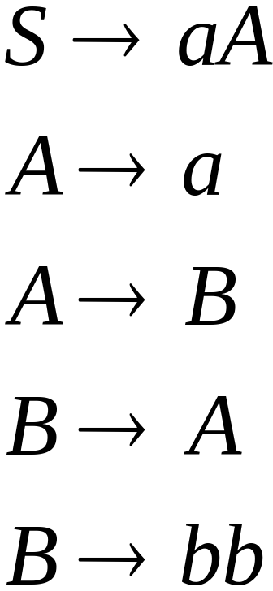
Example Grammar:
COMP 335

Slide 11
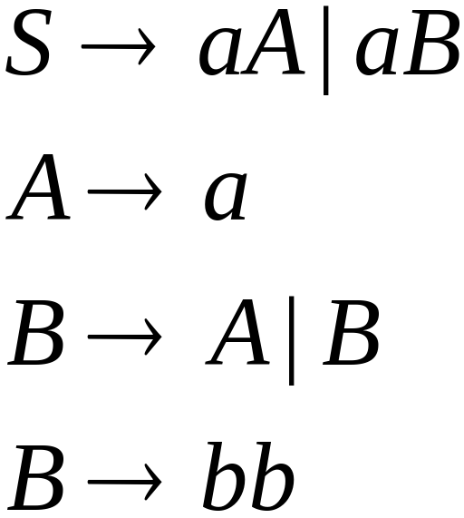

Substitute
COMP 335

Slide 12
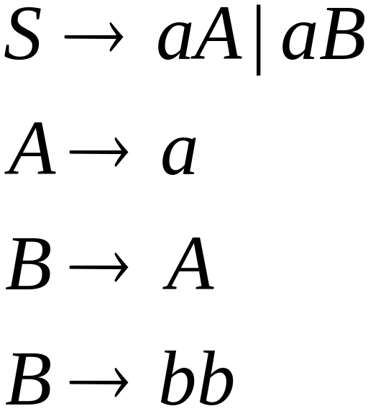

Remove
COMP 335

Slide 13
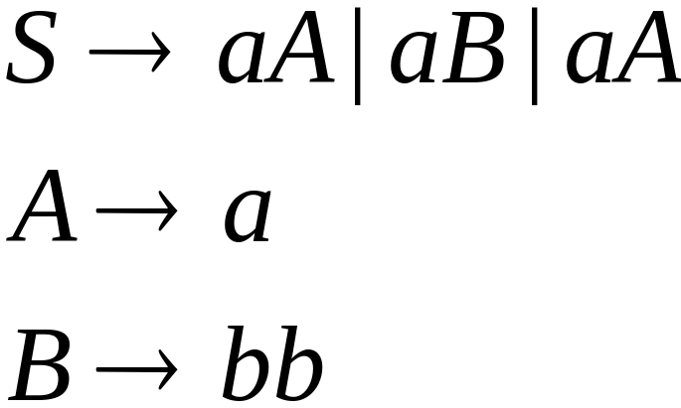

Substitute
COMP 335

Slide 14
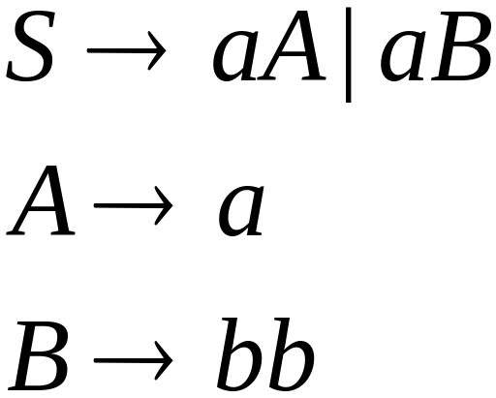
Remove repeated productions
Final grammar
COMP 335

Slide 15
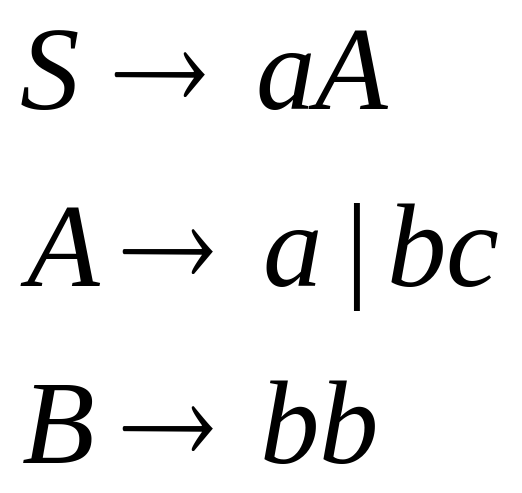
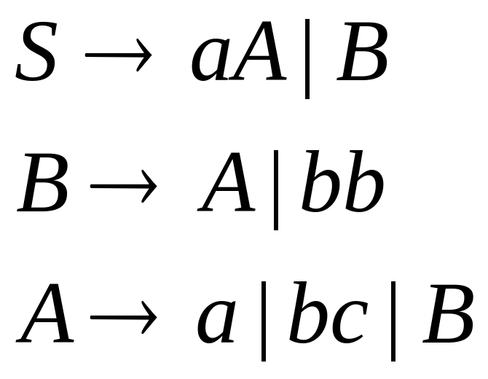
See Thm. 6.4 and Ex. 6.6 for a more general
solution for removing unit-productions
Give grammar:
Final grammar:
S
→
a
|
bc
|
bb
Dependency graph:
A
→
bb
S=>*A; S=>*B;
A=>*B; B=>*A
B
→
a
|
bc
COMP 335

Slide 16
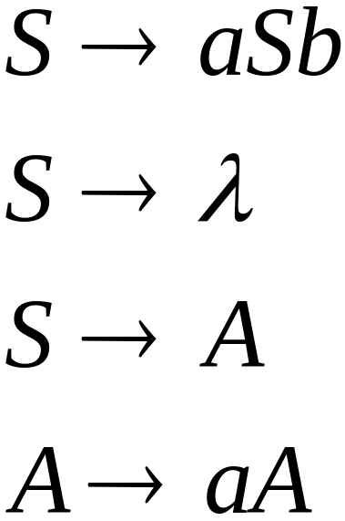
Useless Productions
Useless Production
Some derivations never terminate ...
COMP 335

Slide 17
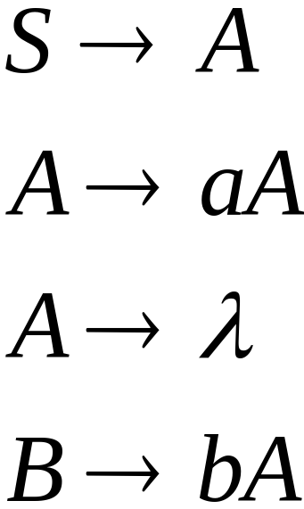
Another grammar:
Useless Production
Not reachable from S
COMP 335

Slide 18

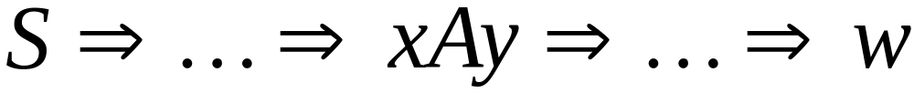


contains
only terminals
In general:
if
then is a useful variable ☺
otherwise, is useless ☹
COMP 335

Slide 19

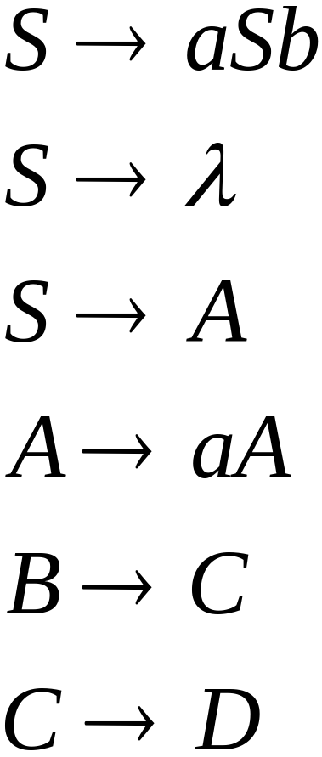
A production is useless
if any of its variables is useless
Productions
Variables
useless
useless
useless
useless
useless
useless
useless
COMP 335

Slide 20
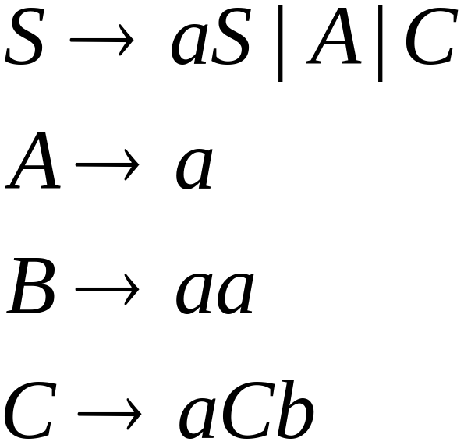
Removing Useless Productions
Example Grammar:
COMP 335

Slide 21
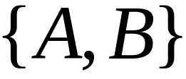

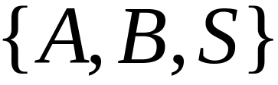
First:
find every variable that
produces strings with only terminals
Round 1:
Round 2:
COMP 335

Slide 22
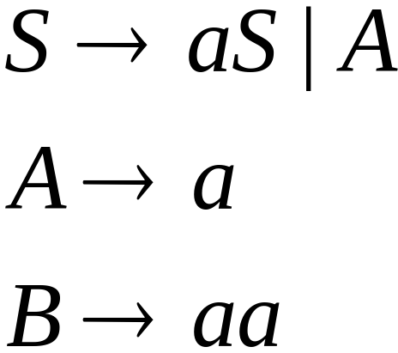
Keep only the variables that
produce terminal symbols: i.e.,
(the rest of the variables are useless)
Remove useless productions
COMP 335

Slide 23




Second:
Find all the variables that
are reachable from
For this, we can use a Dependency Graph
not
reachable
COMP 335

Slide 24
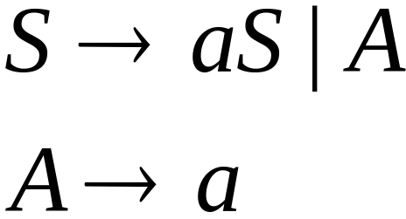
Keep only the variables
reachable from S
(the rest variables are useless)
Final Grammar
Remove useless productions
Note: The order First- Second is important. Why?
Ex: S -> AB | λ; B->b
COMP 335

Slide 25
The order of steps to remove undesired productions
Step 1: Remove nullable variables and
λ-productions
Step 2: Remove Unit-productions
Step 3: Remove Useless productions
COMP 335

Slide 26
Order in Clean-up process is important!
Ex 1: The following example shows that if we do step 2 then step 1, or do step 3 then 1, we may need to do step 2 again!
S -> AC | B S -> AC | b S -> A | b
A -> a ➔ A -> a ➔ A -> a
B -> b B-> b
C -> λ C -> λ
COMP 335

Slide 27
Order in Clean-up process is important!
Ex. 2: The following example shows if we do step 3 and then step 2, we may need to do step 3 again.
S-> Xb | Y S-> Xb | a | c
Y-> X | a ➔ Y-> a | c | Xb
X-> S | c X-> Xb | a | c
All variables are useful Y becomes usesless!
COMP 335

Slide 28
Normal Forms for
Context-free Grammars
COMP 335

Slide 29


Chomsky Normal Form
Each productions has form:
or
variable
variable
terminal
COMP 335

Slide 30
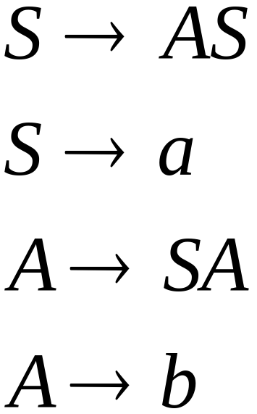
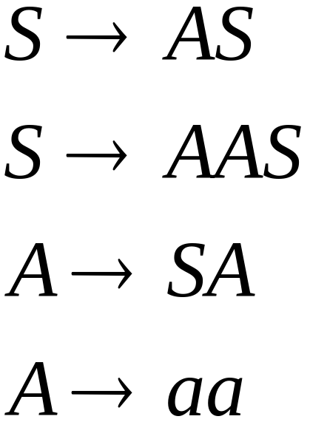
Examples:
Chomsky
Normal Form
Not in Chomsky
Normal Form
COMP 335

Slide 31
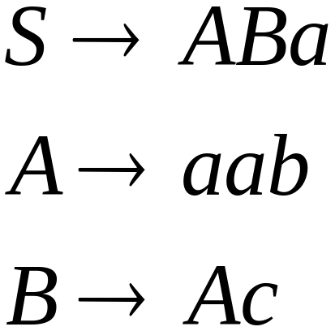
Conversion to Chomsky Normal Form
Example:
Not in Chomsky
Normal Form
COMP 335

Slide 32
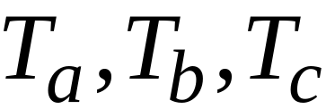
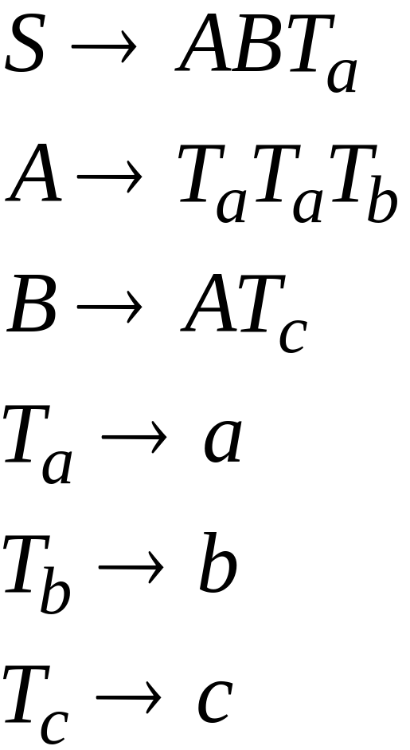
1. Introduce variables for terminals:
COMP 335

Slide 33

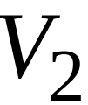
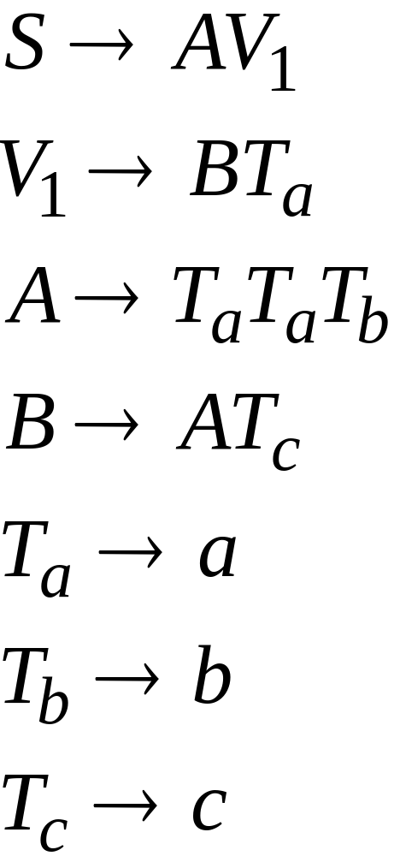
2. Introduce intermediate variables: ,
COMP 335

Slide 34
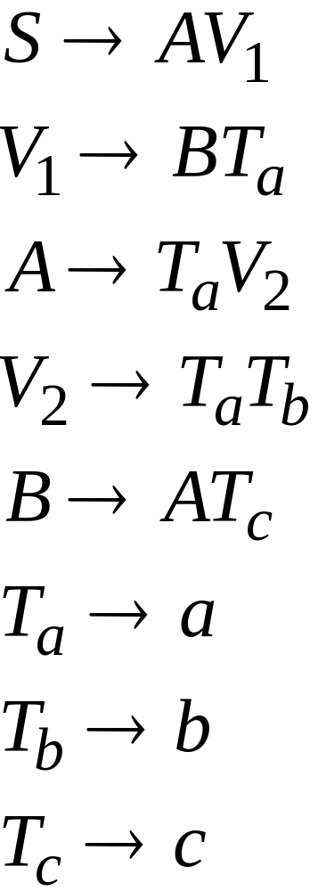
2. Introduce intermediate variables: ,
COMP 335

Slide 35
3. Put the grammar in Chomsky Normal Form
Initial grammar:
COMP 335

Slide 36

In general:
Given any context-free grammar G
which doesn’t produce and is
not in Chomsky Normal Form
we can always obtain:
an equivalent (CFG) grammar
in Chomsky Normal Form
COMP 335

Slide 37
The Procedure?
Step 1: Cleanup
Remove:
    (a) Nullable variables
    (b) Unit productions
COMP 335

Slide 38

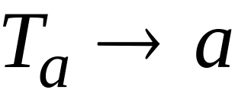

Step 2: For every terminal symbol :
(a) Add the production
where is a new variable.
(b) In every production in which appears
with any other symbol (terminal or variable),
replace with
COMP 335

Slide 39
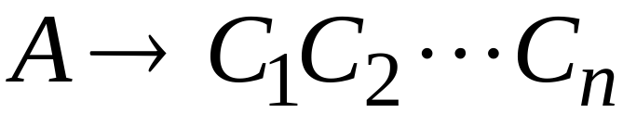
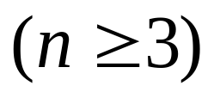
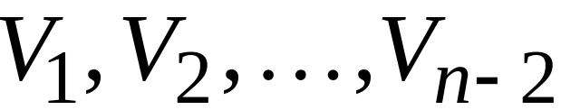
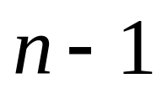
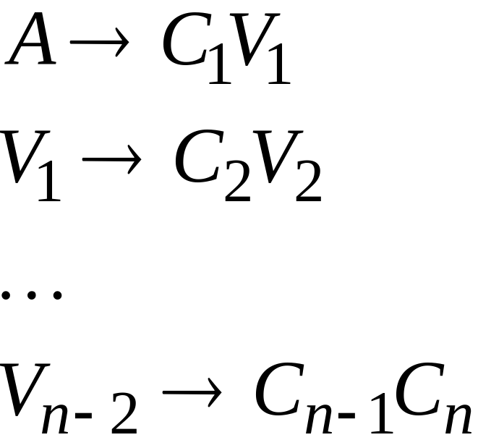
Step 3: For each production p of the form:
introduce new variables and
replace p with the following productions:
COMP 335

Slide 40

We thus have the following result:
Theorem:
For any context-free grammar
(which doesn’t produce )
there is an equivalent grammar
in Chomsky Normal Form.
COMP 335

Slide 41
Remarks
Chomsky normal forms are good
for parsing and proving theorems
It is easy and straightforward
to find a Chomsky normal form
for any context-free grammar
(which does not generate )
COMP 335

Slide 42
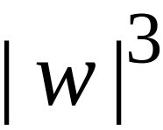
Time Complexity:
Observation:
The CYK algorithm algorithm can be
converted to a (bottom-up) parser
(Cocke & Swartz 1970)-(Younger 1967)
(Kasami 1965)
COMP 335

Slide 43
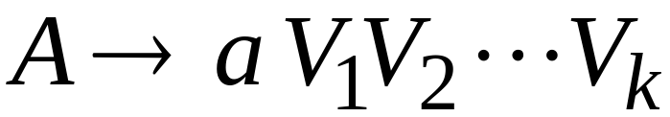

Greibach Normal Form
All productions have form:
terminal
variables
COMP 335

Slide 44
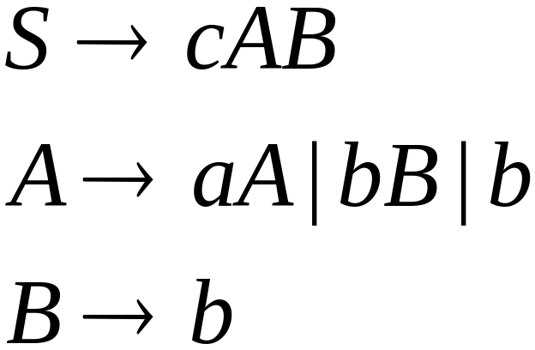
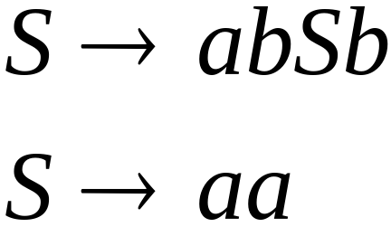
Examples:
Greibach
Normal Form
Not in Greibach
Normal Form
COMP 335

Slide 45
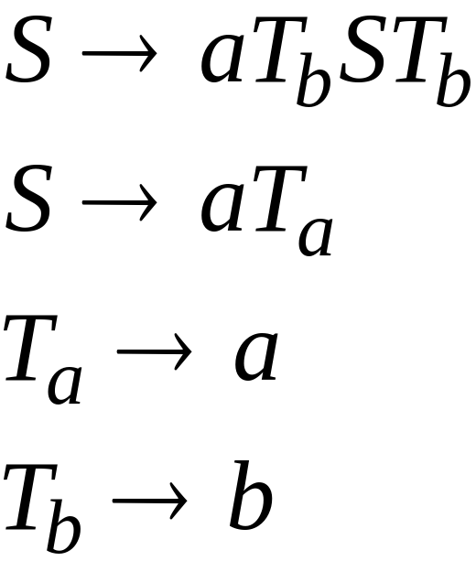
Conversion to Greibach Normal Form:
Greibach
Normal Form
COMP 335

Slide 46
Theorem:
For any context-free grammar
(which doesn’t produce )
there is an equivalent grammar
in Greibach Normal Form
COMP 335

Slide 47
Remarks
Greibach normal forms are very good
for parsing
It is hard in general to find grammars in
Greibach normal forms for context-free
grammars
COMP 335

