Slide 1
Linear Bounded Automata LBAs and the Halting Problem
COMP 335
1

Slide 2
Linear Bounded Automata (LBAs)
are the same as Turing Machines
with the following difference:
The space on the tape for the input
string is the only space allowed to use
COMP 335

Slide 3







Linear Bounded Automaton (LBA)
Input string
Working space
in tape
Left-end
marker
Right-end
marker
All computation is done between end markers
COMP 335

Slide 4
We define LBA’s as NonDeterministic
Open Problem:
NonDeterministic LBA’s
have same power as
Deterministic LBA’s ?
COMP 335

Slide 5
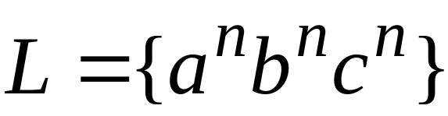
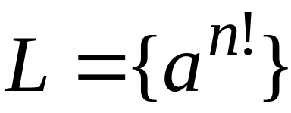
Example languages accepted by LBAs:
LBA’s have more power than NPDA’s
LBA’s have less power than TM’s
COMP 335

Slide 6
The Chomsky Hierarchy
COMP 335

Slide 7

Unrestricted Grammars:
Productions
String of variables
and terminals
String of variables
and terminals
COMP 335

Slide 8
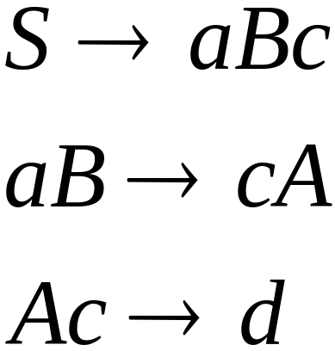
Example: unrestricted grammar:
COMP 335

Slide 9


Theorem:
A language is recursively enumerable
if and only if is generated by an
unrestricted grammar
COMP 335

Slide 10
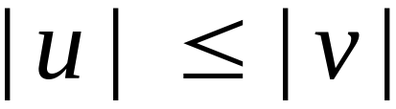
Context-Sensitive Grammars:
Productions
String of variables
and terminals
String of variables
and terminals
where
COMP 335

Slide 11
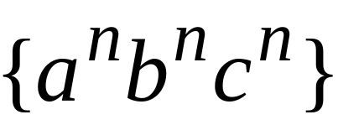
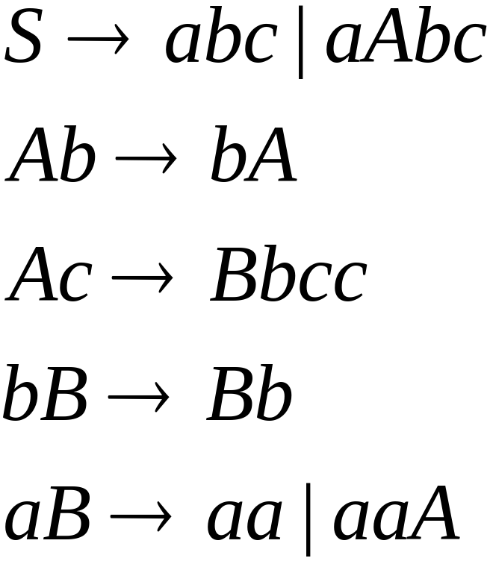
The language
is context-sensitive:
COMP 335

Slide 12
Theorem:
A language is context sensitive iff
is accepted by a Linear-Bounded automaton
Observation:
There are languages which are
context-sensitive but not context-free.
COMP 335

Slide 13
The Chomsky Hierarchy
Non-recursively enumerable
Recursively-enumerable
Recursive
Context-sensitive
Context-free
Regular
COMP 335

Slide 14
Decidability
COMP 335

Slide 15


Consider decisions problems, that is
problems with answer YES or NO
Examples:
Does automaton have 3 states ?
Is string a binary number?
Does DFA accept any input?
COMP 335

Slide 16
A problem is decidable if some Turing machine
decides (solves) the problem
Decidable problems:
Does automaton have 3 states ?
Is string a binary number?
Does DFA accept any input?
COMP 335

Slide 17
A Turing machine that decides (solves)
a problem answers YES or NO
for each input of the problem
Input
problem
instance
YES
Turing Machine
NO
COMP 335

Slide 18
The machine that decides (solves) a problem:
If the answer is YES
then halts in a yes state
If the answer is NO
then halts in a no state
These yes/no states may not be final states
COMP 335

Slide 19
Turing Machine that decides a problem
YES states
NO states
YES and NO states are halting states
COMP 335

Slide 20
Difference between
Recursive Languages and Decidable problems
For decidable problems:
The YES states may not be final states
COMP 335

Slide 21
Some problems are undecidable:
which means:
there is no Turing Machine that
solves all instances of the problem
A simple undecidable problem:
The membership problem
COMP 335

Slide 22



The Membership Problem
Input:
Turing Machine
String
Question:
Does accept ?
COMP 335

Slide 23
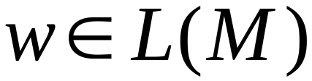
Theorem:
The membership problem is undecidable
(there are and for which we cannot
decide whether )
Proof:
Assume for contradiction that
the membership problem is decidable
COMP 335

Slide 24

Thus, there exists a Turing Machine
that solves the membership problem
YES
accepts
NO
rejects
COMP 335

Slide 25
Let be a recursively enumerable language
Let be the Turing Machine that accepts
We will prove that is also recursive:
we will describe a Turing machine that
accepts and halts on any input
COMP 335

Slide 26

Turing Machine that accepts
and halts on any input
YES
accept
accepts ?
NO
reject
COMP 335

Slide 27
Therefore,
is recursive
Since is chosen arbitrarily, every recursively enumerable language is also recursive
But there are recursively enumerable
languages which are not recursive
Contradiction!!!!
COMP 335

Slide 28
Therefore, the membership problem
is undecidable
END OF PROOF
COMP 335

Slide 29
Another famous undecidable problem:
The halting problem
COMP 335

Slide 30
The Halting Problem
Input:
Turing Machine
String
Question:
Does halt on input ?
COMP 335

Slide 31
Theorem:
The halting problem is undecidable
(there are and for which we cannot
decide whether halts on input )
Proof:
Assume for contradiction that
the halting problem is decidable
COMP 335

Slide 32
Thus, there exists Turing Machine
that solves the halting problem
YES
halts on
NO
doesn’t
halt on
COMP 335

Slide 33
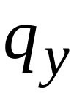



Construction of
Input:
initial tape contents
YES
NO
Encoding
of
String
COMP 335

Slide 34


Construct machine :
If returns YES then loop forever
If returns NO then halt
COMP 335

Slide 35


Loop forever
YES
NO
COMP 335

Slide 36


Construct machine :
Input:
(machine )
If
halts on input
Then loop forever
Else halt
COMP 335

Slide 37

copy
COMP 335

Slide 38
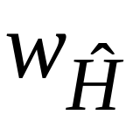
Run machine with input itself:
Input:
(machine )
If
halts on input
Then loop forever
Else halt
COMP 335

Slide 39
on input
:
If halts then loops forever
If doesn’t halt then it halts
NONSENSE !!!!!
COMP 335

Slide 40
Therefore, we have contradiction
The halting problem is undecidable
END OF PROOF
COMP 335

Slide 41
Another proof of the same theorem:
If the halting problem was decidable then
every recursively enumerable language
would be recursive
COMP 335

Slide 42
Theorem:
The halting problem is undecidable
Proof:
Assume for contradiction that
the halting problem is decidable
COMP 335

Slide 43
There exists Turing Machine
that solves the halting problem
YES
halts on
NO
doesn’t
halt on
COMP 335

Slide 44
Let be a recursively enumerable language
Let be the Turing Machine that accepts
We will prove that is also recursive:
we will describe a Turing machine that
accepts and halts on any input
COMP 335

Slide 45
Turing Machine that accepts
and halts on any input
NO
reject
halts on ?
YES
accept
Halts on final state
Run
with input
reject
Halts on non-final
state
COMP 335

Slide 46
Therefore
is recursive
Since is chosen arbitrarily, every
recursively enumerable language
is also recursive
But there are recursively enumerable
languages which are not recursive
Contradiction!!!!
COMP 335

Slide 47
Therefore, the halting problem is undecidable
END OF PROOF
COMP 335

