Slide 1
Language Hierarchy -I
Outer space
?
Recursively enumerable
?
Recursive
{a^{n}b^{n}c^{n} : n ≥ 0}
Context-sensitive
{a^{n}b^{n}c^{n} : n > 0}
Context-free
Palindrome
Deterministic CF
{a^{n}b^{n} : n ≥ 0}
Regular
a*b*

Slide 2
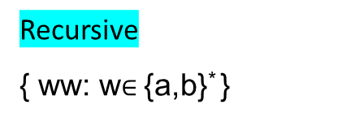
Rec-Enumerable
Recursive
Context-sensitive
Context-free
Regular
Language Hierarchy - II
Undecidable (Outer space!)
Example (in the last lecture)!
Recursively Enumerable
The Halting Problem
Recursive
{ ww: w$∈${a,b}* }
Context-sensitive
{ a^{n}b^{n}c^{n} : n ≥ 0 }
Context-free
{w: n_{a}(w)=n_{b}(w) }
{ a^{n}b^{n}: n ≥ 0 }
CF_{LIN} ∩ CF_{DET}
CF_{DET}
CF_{LIN}
{ w: w = w^{R} }
Regular
a*b*
{a^{n}b^{n}c^{k}: n,k≥0 }

