Slide 1
A Universal Turing Machine
COMP 335
1

Slide 2
A limitation of Turing Machines
we discussed so far is that:
they are “hardwired”
i.e., they execute
only one program
Real Computers are re-programmable
COMP 335

Slide 3
Solution:
Universal Turing Machine
Attributes:
Reprogrammable machine
Simulates any other Turing Machine
COMP 335

Slide 4

The universal Turing Machine simulates
any other Turing Machine
Inputs of Universal Turing Machine:
1. Description of transitions of
2. Initial contents of the tape
COMP 335

Slide 5
Tape 1
Three tapes
Description of
Universal
Turing
Machine
Tape 2
Tape Contents of
Tape 3
State of
COMP 335

Slide 6
Tape 1
Description of
We describe Turing machine
as a string of symbols:
We encode as a string of symbols
COMP 335

Slide 7








Alphabet Encoding
Symbols:
Encoding:
COMP 335

Slide 8






State Encoding
States:
Encoding:
Head Move Encoding
Move:
Encoding:
COMP 335

Slide 9
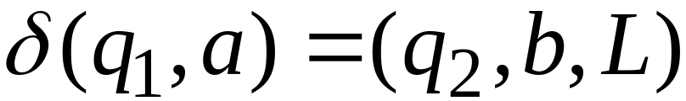
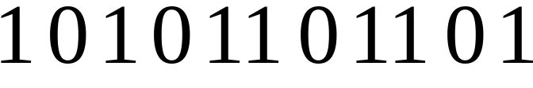
Transition Encoding
Transition:
Encoding:
separator
COMP 335

Slide 10
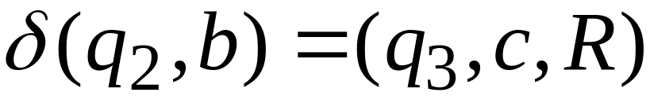

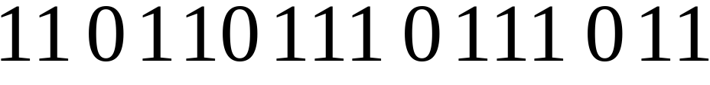
Machine Encoding
Transitions:
Encoding:
separator
COMP 335

Slide 11
Tape 1 contents of Universal Turing Machine:
encoding of the simulated machine
as a binary string of 0’s and 1’s
COMP 335

Slide 12
A Turing Machine is described
using a binary string of 0’s and 1’s
Therefore:
the set of all Turing machines forms a
language where each string of the
language is the binary encoding of
a Turing Machine
COMP 335

Slide 13
Language of Turing Machines
L = { 010100101,
00100100101111,
111010011110010101,
…… }
(Turing Machine 1)
(Turing Machine 2)
……
COMP 335

Slide 14
Countable Sets
COMP 335

Slide 15
Infinite sets are either:
Countable
or
Uncountable
COMP 335

Slide 16
Defn. of Countable sets:
A set S is countable if it is finite or
S is countably infinite if
there is a one to one correspondence
between its elements and the set N of
natural numbers
COMP 335

Slide 17
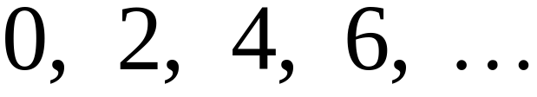
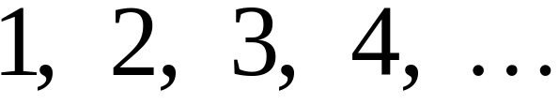


Example:
The set E of even integers
is countable
Even integers:
Correspondence:
Positive integers:
corresponds to
i.e., for any m in E, f(m)=m/2+1
COMP 335

Slide 18
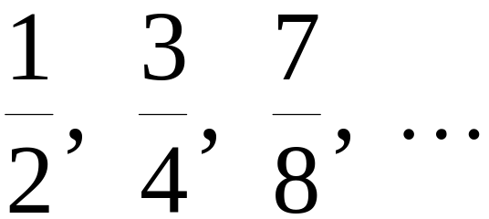
Example:
The set of rational numbers
is countable
Rational numbers:
COMP 335

Slide 19
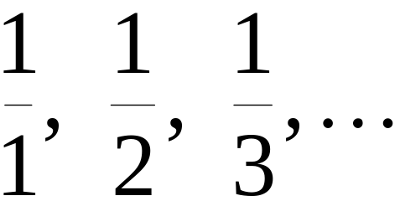
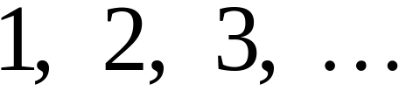
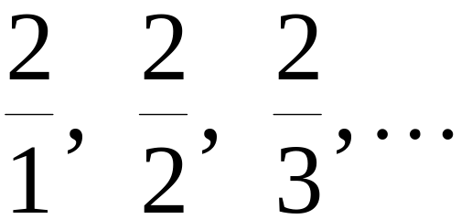
“naïve” approach of counting
Rational numbers:
Correspondence:
Positive integers:
Doesn’t work!
Since we will never “count” the
numbers with nominator 2:
COMP 335

Slide 20










A good approach
COMP 335

Slide 21
COMP 335

Slide 22
COMP 335

Slide 23
COMP 335

Slide 24
COMP 335

Slide 25
COMP 335

Slide 26
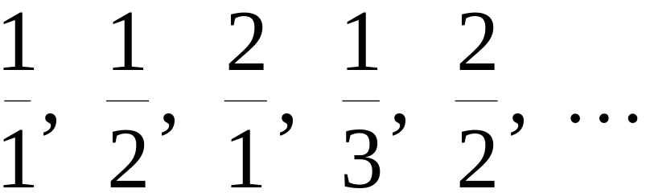
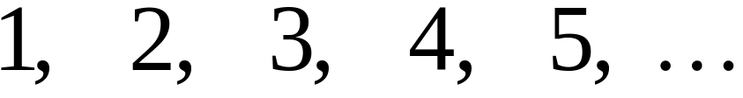
Rational Numbers:
Correspondence:
Positive Integers:
COMP 335

Slide 27
We showed:
the set of rational numbers Q is countable
by describing an enumeration procedure,
which is equivalent to having a one-to-one
correspondence between Q and N
COMP 335

Slide 28

Definition
Let be a set of strings
An enumeration procedure for is a
Turing Machine that generates all strings
of one by one, and
each string is generated in finite time
COMP 335

Slide 29
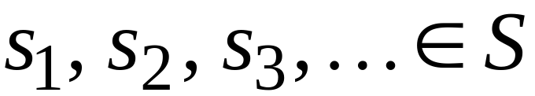
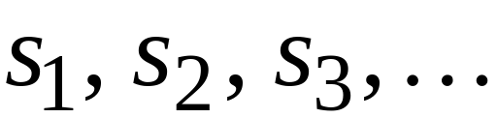

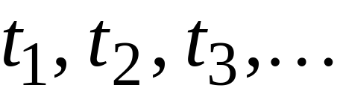
strings
Enumeration
Machine for
output
(on tape)
Finite time:
COMP 335

Slide 30
Observation:
Given a set S, if there is an
enumeration procedure for S,
then S is countable
COMP 335

Slide 31
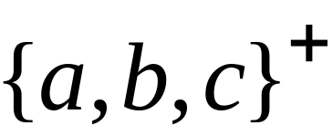
Example:
The set of all strings
is countable
Proof:
We will describe an enumeration procedure
COMP 335

Slide 32



Naive procedure:
Produce the strings in lexicographic order:
Doesn’t work:
strings starting with
will never be produced
COMP 335

Slide 33
Better procedure:
Proper Order
1. Produce all strings of length 1
2. Produce all strings of length 2
3. Produce all strings of length 3
4. Produce all strings of length 4
..........
COMP 335

Slide 34















length 1
Produce strings in
Proper Order:
length 2
length 3
COMP 335

Slide 35
Theorem:
The set of all Turing Machines
is countable
Proof:
Any Turing Machine can be encoded
with a binary string of 0’s and 1’s
Find an enumeration procedure
for the set of Turing Machine strings
COMP 335

Slide 36
Enumeration Procedure:
Repeat
1. Generate the next binary string
of 0’s and 1’s in proper order
2. Check if the string describes a
Turing Machine
if YES: print string on output tape
if NO: ignore string
COMP 335

Slide 37
Uncountable Sets
COMP 335

Slide 38
Definition:
A set is uncountable
if it is not countable
COMP 335

Slide 39
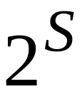
Theorem:
Let be an infinite countable set.
The powerset of is uncountable
COMP 335

Slide 40
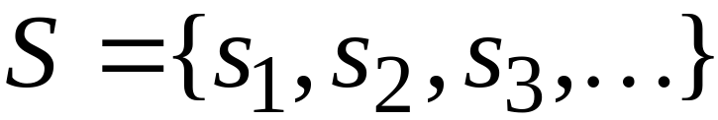
Proof:
Since is countable, we can write
Elements of
COMP 335

Slide 41
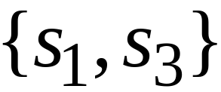
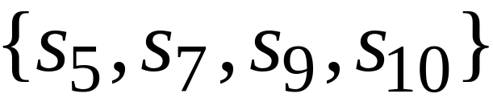
Elements of the powerset have the form:
……
COMP 335

Slide 42




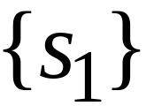

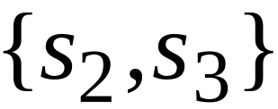
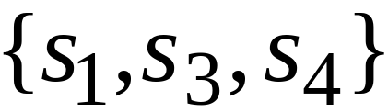
We encode each element of the power set
with a binary string of 0’s and 1’s
Encoding
Powerset
element
COMP 335

Slide 43
Let’s assume (for contradiction)
that the powerset is countable.
Then: we can enumerate
the elements of the powerset
COMP 335

Slide 44




Powerset
elements
Encoding
COMP 335

Slide 45
Take the powerset element
whose bits are the complements
in the diagonal
COMP 335

Slide 46

New element:
(birary complement of diagonal)
COMP 335

Slide 47

The new element must be some
of the powerset
However, that’s impossible:
from definition of
the i-th bit of must be
the complement of itself
Contradiction!!!
COMP 335

Slide 48
Since we have a contradiction:
The powerset of is uncountable
COMP 335

Slide 49
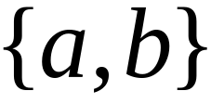
An application in Languages
Example Alphabet :
The set of all Strings:
S is infinite and countable
COMP 335

Slide 50
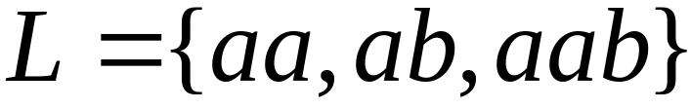
Example Alphabet :
The set of all Strings:
infinite and countable
A language is a subset of :
COMP 335

Slide 51




Example Alphabet :
The set of all Strings:
infinite and countable
The powerset of contains all languages:
uncountable

Slide 52



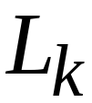
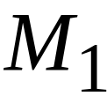
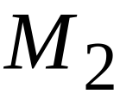
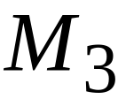

Languages: uncountable
Turing machines: countable
There are more languages
than Turing Machines
COMP 335

Slide 53
Conclusion:
There are some languages that are not
accepted by any Turing Machine
(These languages cannot be described
by algorithms)
COMP 335

Slide 54
Languages not accepted by Turing Machines
Languages
Accepted by
Turing Machines
COMP 335

