Slide 1
- Closure Properties of Regular Languages
- Regular Expressions
COMP 335
1

Slide 2
NFA with Single Final State
COMP 335

Slide 3
Given any NFA, we can always convert
it into an equivalent NFA which has only
ONE final state (how?)
COMP 335

Slide 4



Example
NFA
Equivalent NFA
COMP 335

Slide 5
In General
NFA
Equivalent NFA
Single
final state
COMP 335

Slide 6
Extreme Case
NFA without final state
Add a final state
Without transitions
COMP 335

Slide 7
Properties of
Regular Languages
COMP 335

Slide 8




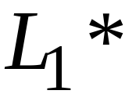
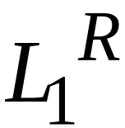


For regular languages and
we will prove that:
Union:
Concatenation:
Are regular
Languages
Star:
Reversal:
Complement:
Intersection:
COMP 335

Slide 9
We say: Regular languages are closed under
Union:
Concatenation:
Star:
Reversal:
Complement:
Intersection:
COMP 335

Slide 10
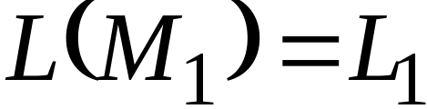
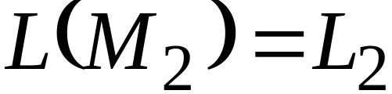


Regular language
Regular language
NFA
NFA
Single final state
Single final state
COMP 335

Slide 11
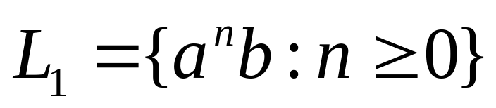
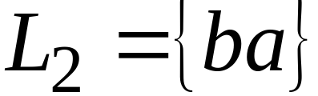
Example
COMP 335

Slide 12
Union
NFA for
COMP 335

Slide 13
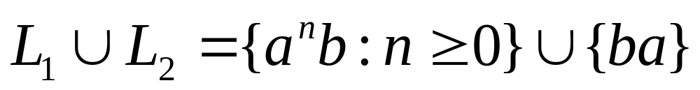
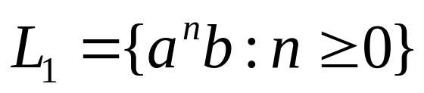
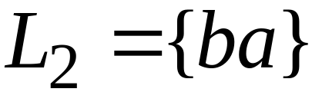
Example
NFA for
COMP 335

Slide 14
Concatenation
NFA for
COMP 335

Slide 15
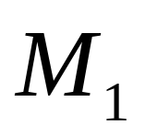
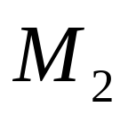
Example
NFA for
COMP 335

Slide 16
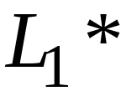
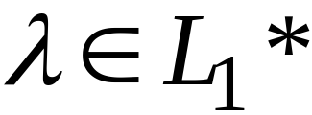
Star Operation
NFA for
COMP 335

Slide 17
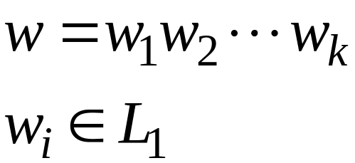
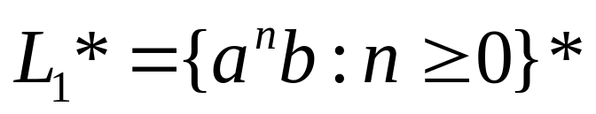
Example
NFA for
COMP 335

Slide 18
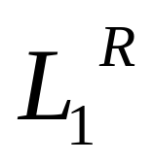

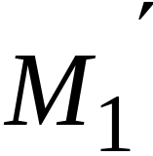
Reverse
NFA for
1. Reverse all transitions
2. Make initial state final state
and vice versa
COMP 335

Slide 19

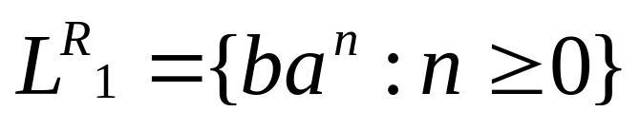
Example
COMP 335

Slide 20
Complement
1. Take a DFA M₁ that accepts
2. Make final states in M₁ non-final,
and vice-versa; this yields a desired DFA
for the complement of
COMP 335

Slide 21


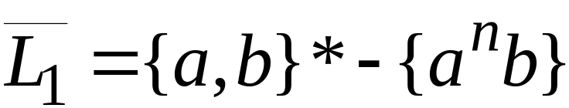
Example
COMP 335

Slide 22




Intersection
DeMorgan’s Law:
regular
regular
regular
regular
regular
COMP 335

Slide 23

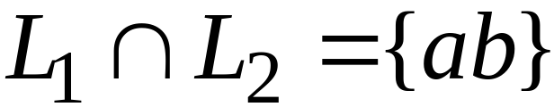
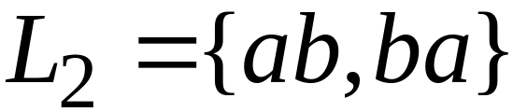
Example
regular
regular
regular
COMP 335

Slide 24
Regular Expressions and their relationships to
Regular Languages
COMP 335

Slide 25
1. Will show that every regular expression represents/denotes a regular language
2. Will show, given any regular language L, how to find a regular expression for L
COMP 335

Slide 26
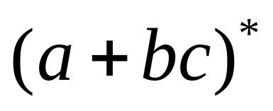
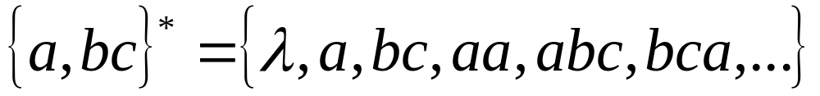
Regular Expressions
Regular expressions
describe regular languages
Example:
describes the language
COMP 335

Slide 27
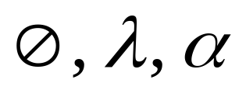


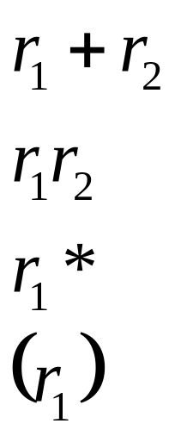
Recursive Definition
Primitive regular expressions:
Given regular expressions and
Are regular expressions
COMP 335

Slide 28
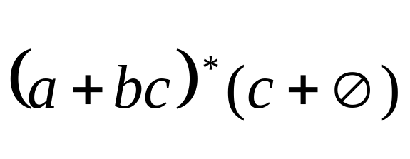
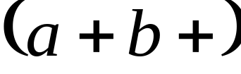
Examples
is a regular expression.
is NOT a regular expression!
COMP 335

Slide 29
Languages of Regular Expressions
When r is a regular expression, we use L(r)
to express the language denoted by r.
For example, if r=(a+bc)*, then
COMP 335

Slide 30
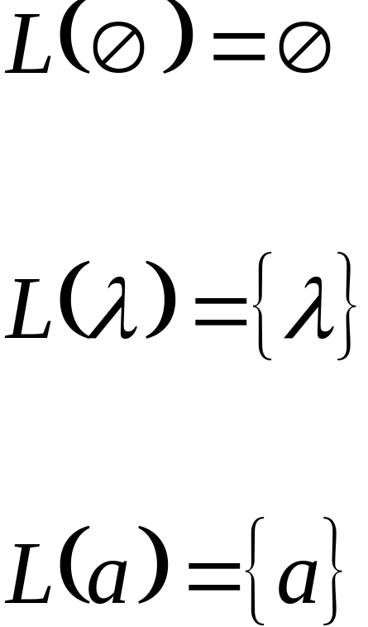
Definition for regular expression
Base case: primitive regular expressions :
COMP 335

Slide 31

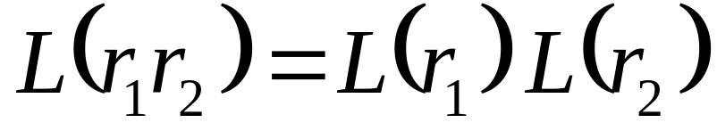

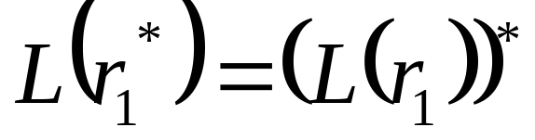
Definition (continued)
Inductive case: if and are regular expressions, then the following are regular expressions as well:
COMP 335

Slide 32
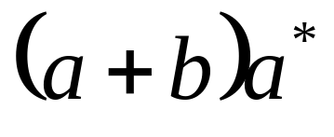
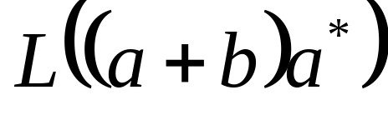
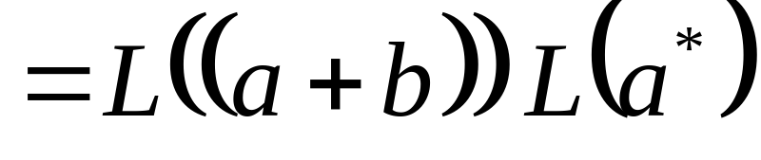
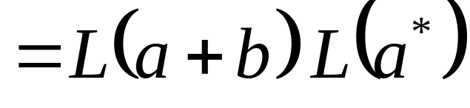
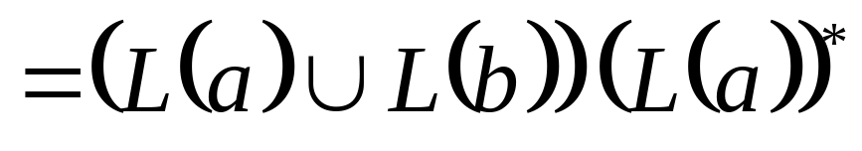
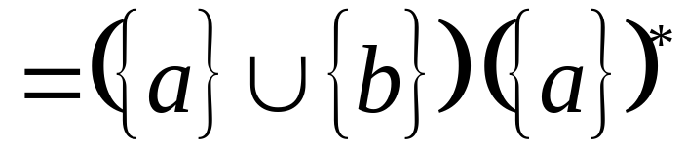
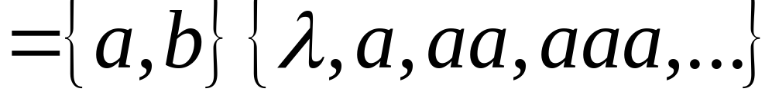
Example 1
Regular expression:
COMP 335

Slide 33
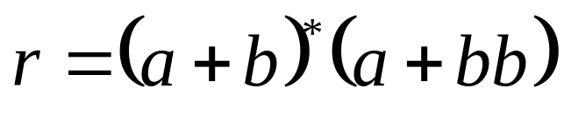
Example 2
Regular expression
COMP 335

Slide 34
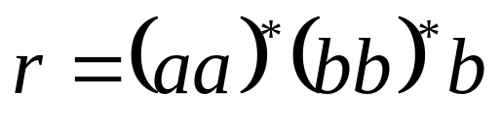

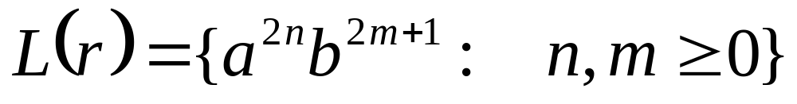
Example 3
Regular expression
or
COMP 335

Slide 35
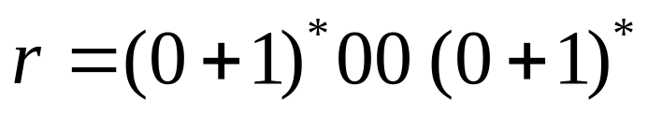

Example 4
Regular expression
= {Binary strings with at least
two consecutive 0’s}
COMP 335

Slide 36
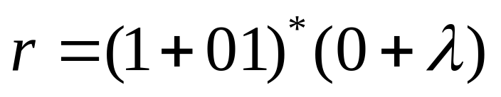
Example 5
Regular expression
= { all strings without
two consecutive 0’s }
COMP 335

Slide 37

Equivalent Regular Expressions
Definition:
We say that regular expressions
and are equivalent (r₁ ≡ r₂)
if
COMP 335

Slide 38

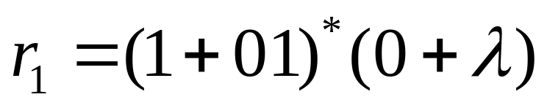
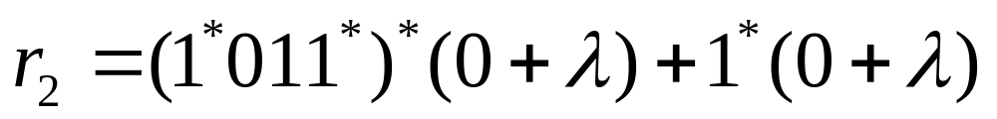

Example
={all strings without two consecutive 0’s}
and
are equivalent
Reg. expressions
COMP 335

Slide 39
Regular Expressions and
Regular Languages
COMP 335

Slide 40

Theorem
Languages
Generated by
Regular Expressions
Regular
Languages
COMP 335

Slide 41


Theorem - Part 1
Languages
Generated by
Regular Expressions
Regular
Languages
1. For any regular expression
the language is regular
COMP 335

Slide 42

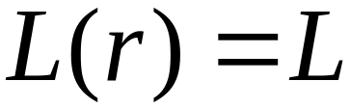
Theorem - Part 2
Languages
Generated by
Regular Expressions
Regular
Languages
2. For any regular language , there is
a regular expression with
COMP 335

Slide 43
Proof - Part 1
1. For any regular expression
the language is regular
Proof by induction on the size of
COMP 335

Slide 44
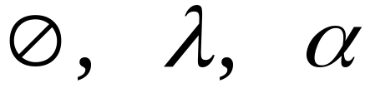
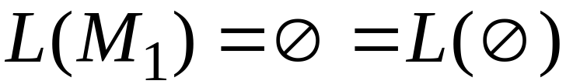
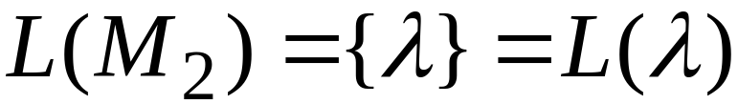

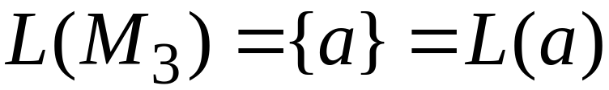
Induction Basis
Primitive Regular Expressions:
NFAs
regular
languages
COMP 335

Slide 45
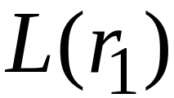

Inductive Hypothesis
Assume for regular expressions and
that and are regular languages
COMP 335

Slide 46

Inductive Step
We will prove:
are regular
Languages.
COMP 335

Slide 47

By definition of regular expressions:
COMP 335

Slide 48

By inductive hypothesis we know that:
and are regular languages
We also know that:
Regular languages are closed under:
Union
Concatenation
Star
COMP 335

Slide 49

Therefore:
are regular
languages
COMP 335

Slide 50
And trivially, for any regular expression r₁
L((r₁)) is a regular language.
COMP 335

Slide 51
Proof – Part 2
2. For any regular language there is
a regular expression with
Proof by construction of a regular expression
COMP 335

Slide 52


Since is regular, take any
NFA that accepts it
Single final state
COMP 335

Slide 53



From , construct an equivalent
Generalized Transition Graph in which
transition labels are regular expressions
Example:
COMP 335

Slide 54



Another Example:
COMP 335

Slide 55


Reducing the states:
COMP 335

Slide 56


Resulting Regular Expression:
COMP 335

Slide 57









In General
Removing states:
COMP 335

Slide 58






The final transition graph:
This graph corresponds to the reg. exp.:
COMP 335

