Slide 1
Standard Representations of Regular Languages
Regular Languages
DFAs
Regular
Grammars
NFAs
Regular
Expressions
COMP 335
1

Slide 2

When we say:
We are given
a regular language
it means that :
is in a standard
representation
COMP 335

Slide 3
Elementary Questions about
Regular Languages
COMP 335

Slide 4


Membership Question
Question:
Given any regular language
and any string in the alphabet,
how can we check if ?
Answer:
Take a DFA that accepts
and check if is accepted
COMP 335

Slide 5


DFA
DFA
COMP 335

Slide 6
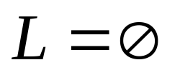
Question:
Given any regular language ,
how can to check if ?
That is, is empty?
Answer:
Take a DFA M that accepts
Then check if there is any path
from the initial state to a final state
COMP 335

Slide 7


DFA
DFA
COMP 335

Slide 8
Question:
Given a regular language ,
how can we check if it is finite?
Answer:
Take a DFA that accepts
Then check if there is a walk with cycle
from the initial state to a final state
COMP 335

Slide 9
DFA
is infinite
DFA
is finite
COMP 335

Slide 10


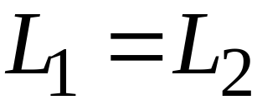
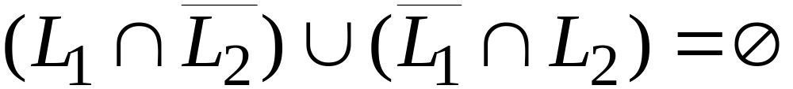
Question:
Given regular languages and ,
how to decide if ?
Answer:
Check if
COMP 335

Slide 11
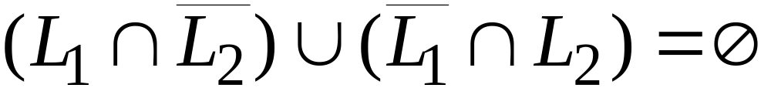
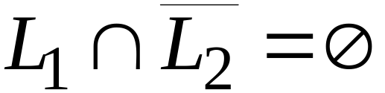
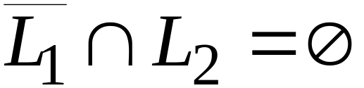


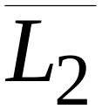
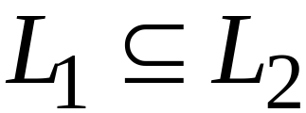
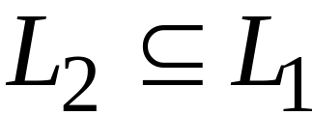
and
COMP 335

Slide 12
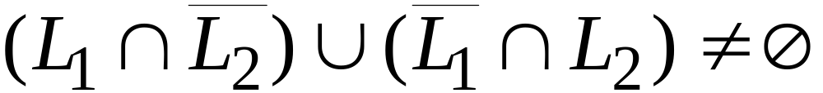
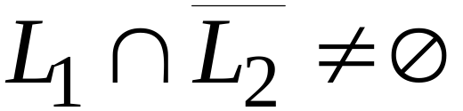
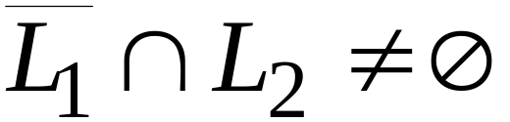
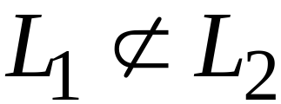
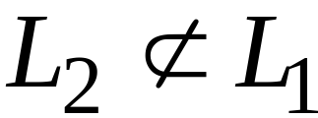
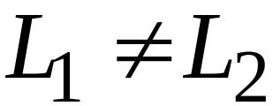
or
COMP 335

Slide 13
Non-regular languages
COMP 335

Slide 14
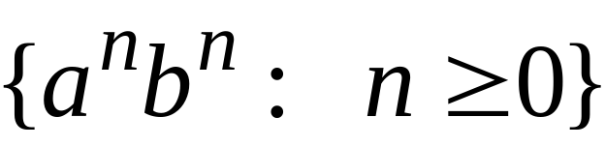
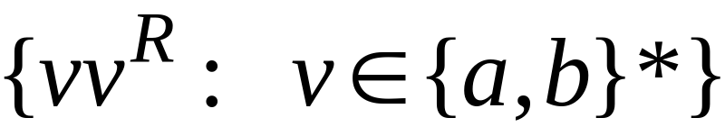


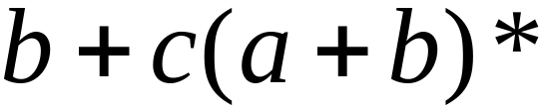

Non-regular languages
Regular languages
COMP 335

Slide 15
How to show that a language is not regular?
Can do this by proving there is no DFA for it
Problem: this is not easy to prove. Why?
Solution: the Pumping Lemma !!!
COMP 335

Slide 16

The Pigeonhole Principle
COMP 335

Slide 17


pigeons
pigeonholes
COMP 335

Slide 18
A pigeonhole must contain
at least two pigeons
COMP 335

Slide 19



pigeons (objects)
...........
pigeonholes (boxes)
...........
COMP 335

Slide 20
The Pigeonhole Principle
Pigeons
pigeonholes
There is a pigeonhole
with at least 2 pigeons
...........
COMP 335

Slide 21
The Pigeonhole Principle and
DFAs
COMP 335

Slide 22





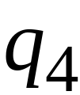


DFA with states
COMP 335

Slide 23
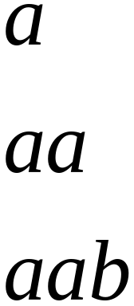
In walks of strings:
no state
is repeated
COMP 335

Slide 24
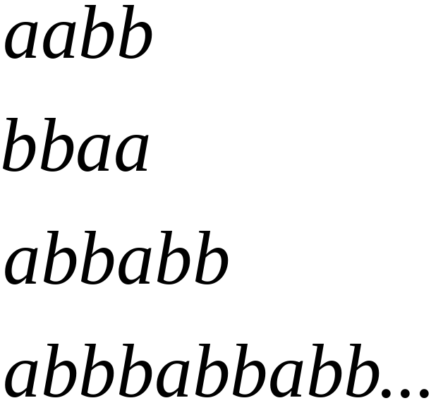
In walks of strings:
a state
is repeated
COMP 335

Slide 25
To accept any string w by M with |w|>=4,
the # of transitions in M (i.e., |w|) to follow is more than the # of states in M ➔ Some states in M must repeat.
COMP 335

Slide 26

In general, given any DFA M, if a string w
is accepted by M, if the length of w >=
# of states in M,
then a state q is repeated in the walk of w.
walk of
......
......
Repeated state
COMP 335

Slide 27
In other words, for a string :
transitions are pigeons
states are pigeonholes
walk of
......
......
Repeated state
COMP 335

Slide 28
The Pumping Lemma
COMP 335

Slide 29

Take an infinite regular language
There exists a DFA M that accepts
M has
states
COMP 335

Slide 30

Take string in
Then there is a walk with label :
.........
walk
COMP 335

Slide 31
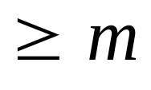
If the length | |
(the number of states in M)
then, from the pigeonhole principle:
a state is repeated in the walk
......
......
walk
COMP 335

Slide 32

Let be the first state repeated in the
walk of
......
......
walk
COMP 335

Slide 33
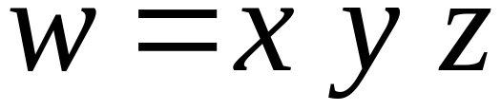



Then we can write:
......
......
COMP 335

Slide 34


Observations:
(1) length
(2) length
......
......
COMP 335

Slide 35

Observation:
The string
is also accepted by M
......
......
COMP 335

Slide 36

Observation:
The string
is also accepted by M
......
......
COMP 335

Slide 37

Observation:
The string
is also accepted by M
......
......
COMP 335

Slide 38
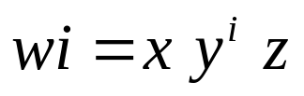

In General:
the strings
are also accepted,
......
......
COMP 335

Slide 39
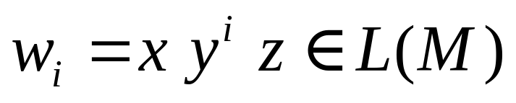
In General:
......
......
COMP 335

Slide 40
In other words, we described:
The Pumping Lemma !!!
COMP 335

Slide 41


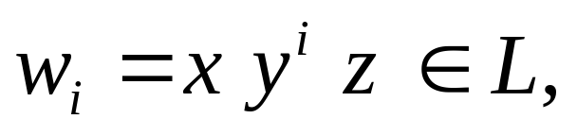
The Pumping Lemma:
Given an infinite regular language
there exists an integer
for any string with length
we can write
with and
such that:
COMP 335

Slide 42
Applications of the Pumping Lemma
COMP 335

Slide 43

Theorem:
The language
is not regular.
Proof:
Use the Pumping Lemma
COMP 335

Slide 44
Assume that is a regular language
Since is an infinite language,
we can apply the Pumping Lemma
COMP 335

Slide 45
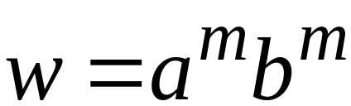
Let be the integer in the Pumping Lemma
Pick a string such that: (1)
and
(2) length
We pick:
COMP 335

Slide 46
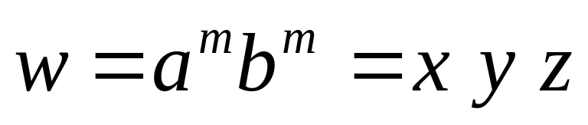

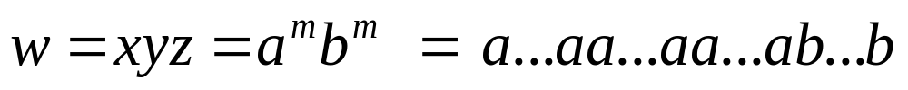
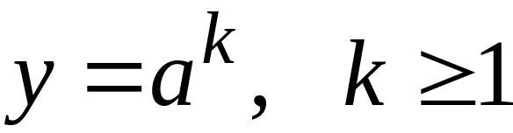
Write:
From the Pumping Lemma
it must be that length
Thus:
COMP 335

Slide 47
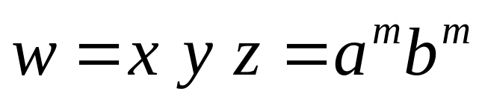
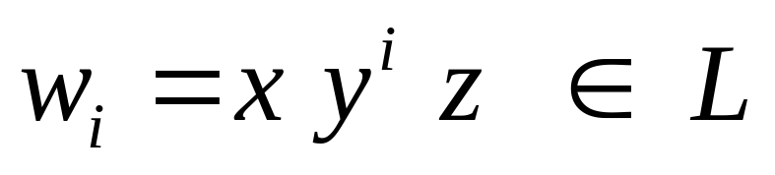
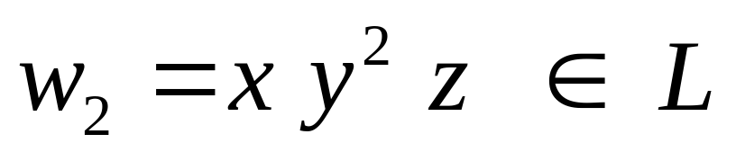
From the Pumping Lemma:
Thus:
COMP 335

Slide 48
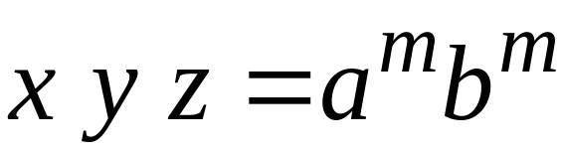


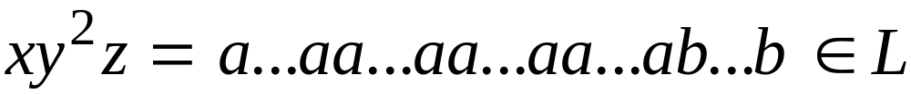
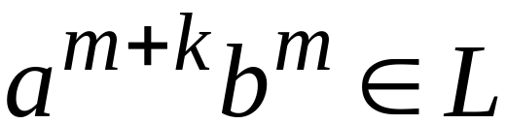
From the Pumping Lemma:
Thus:
COMP 335

Slide 49
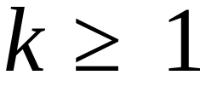
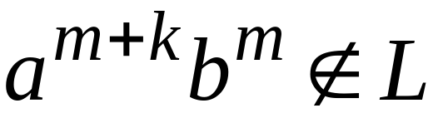
But:
CONTRADICTION!!!
COMP 335

Slide 50
Therefore:
Our assumption that
is a regular language is not true
Conclusion:
is not a regular language
COMP 335

Slide 51
Non-regular languages
Regular languages
COMP 335

Slide 52
More Applications of the Pumping Lemma
COMP 335

Slide 53
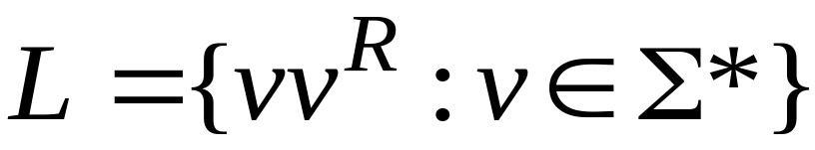
Non-regular languages
Regular languages
COMP 335

Slide 54

Theorem:
The language
is not regular
Proof:
Use the Pumping Lemma
COMP 335

Slide 55
Assume for contradiction
that is a regular language
Since is infinite
we can apply the Pumping Lemma
COMP 335

Slide 56
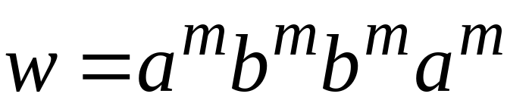
Let be the integer in the Pumping Lemma
Pick a string such that:
and
length
We pick
COMP 335

Slide 57
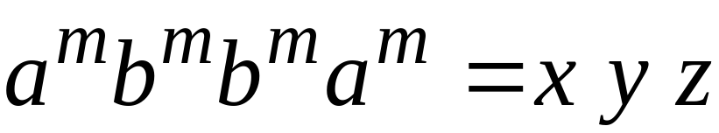
Write
From the Pumping Lemma
it must be that length
Thus:
COMP 335

Slide 58
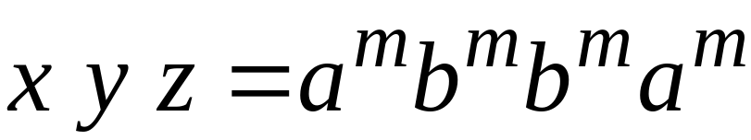

From the Pumping Lemma:
Thus:
COMP 335

Slide 59

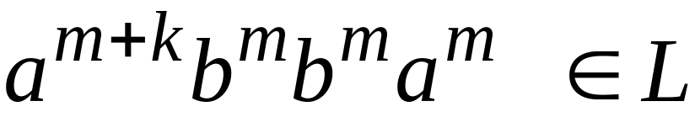
From the Pumping Lemma:
Thus:
COMP 335

Slide 60

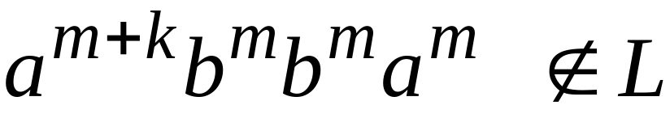
BUT:
CONTRADICTION!!!
COMP 335

Slide 61
Therefore:
Our assumption that
is a regular language is not true
Conclusion:
is not a regular language
COMP 335

Slide 62

Non-regular languages
Regular languages
COMP 335

Slide 63
Theorem:
The language
is not regular
Proof:
Use the Pumping Lemma
COMP 335

Slide 64
Assume for contradiction
that is a regular language
Since is infinite
we can apply the Pumping Lemma
COMP 335

Slide 65
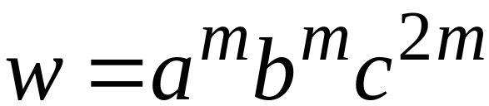
Let be the integer in the Pumping Lemma
Pick a string such that:
and
length
We pick
COMP 335

Slide 66
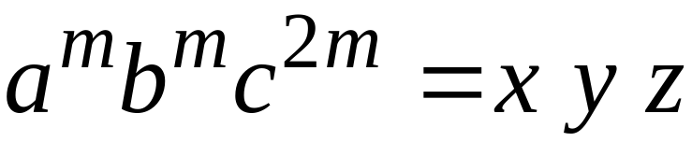

Write
From the Pumping Lemma
it must be that length
Thus:
COMP 335

Slide 67
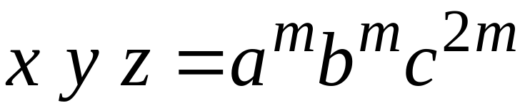
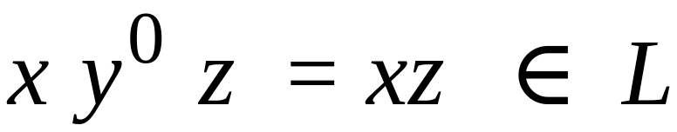
From the Pumping Lemma:
Thus:
COMP 335

Slide 68
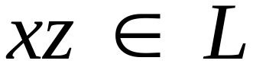

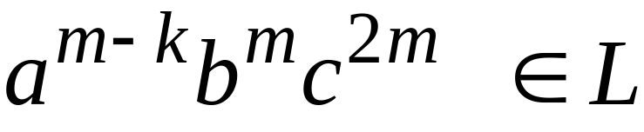
From the Pumping Lemma:
Thus:
COMP 335

Slide 69

BUT:
CONTRADICTION!!!
COMP 335

Slide 70
Therefore:
Our assumption that
is a regular language is not true
Conclusion:
is not a regular language
COMP 335

Slide 71

Non-regular languages
Regular languages
COMP 335

Slide 72

Theorem:
The language
is not regular
Proof:
Use the Pumping Lemma
COMP 335

Slide 73
Assume for contradiction
that is a regular language
Since is infinite
we can apply the Pumping Lemma
COMP 335

Slide 74

Let be the integer in the Pumping Lemma
Pick a string such that:
length
We pick
COMP 335

Slide 75




Write
From the Pumping Lemma
it must be that length
Thus:
COMP 335

Slide 76

From the Pumping Lemma:
Thus:
COMP 335

Slide 77

From the Pumping Lemma:
Thus:
COMP 335

Slide 78



Since:
There must exist such that:
COMP 335

Slide 79





However:
, for
for any integer
COMP 335

Slide 80

BUT:
CONTRADICTION!!!
COMP 335

Slide 81
Therefore:
Our assumption that
is a regular language is not true
Conclusion:
is not a regular language
COMP 335

