Slide 1
Context-Free Grammars (CFG’s)
COMP 335
1

Slide 2


Example
A context-free grammar :
A derivation:
COMP 335

Slide 3
A context-free grammar :
Another derivation:
COMP 335

Slide 4


Describes nested parentheses:
(((( ))))
COMP 335

Slide 5
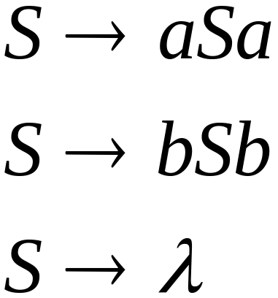
Example
A context-free grammar :
A derivation:
COMP 335

Slide 6
A context-free grammar :
Another derivation:
COMP 335

Slide 7

COMP 335

Slide 8
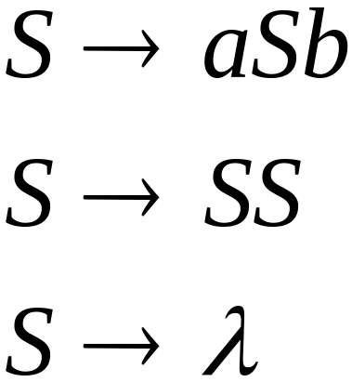
Example
A context-free grammar :
A derivation:
COMP 335

Slide 9
A context-free grammar :
A derivation:
COMP 335

Slide 10
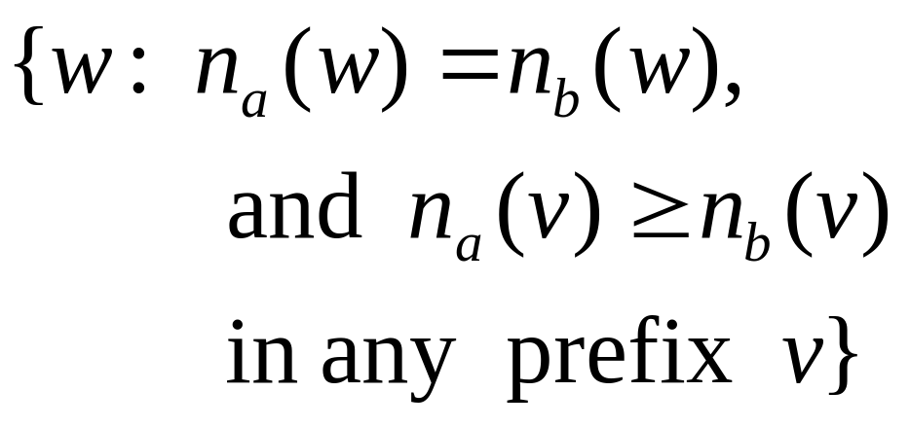
Describes
matched
parentheses:
() ((( ))) (( ))
COMP 335

Slide 11


Definition: Context-Free Grammars
Grammar
Variables
Terminal
symbols
Start
variable
Productions of the form:
Variable
String of variables
and terminals
COMP 335

Slide 12
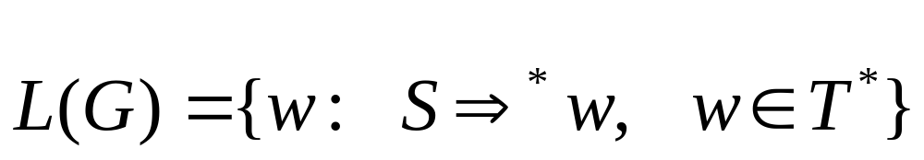
COMP 335

Slide 13

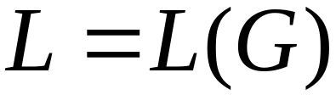
Context-Free Languages
Definition: A language is context-free
if and only if
there is a context-free grammar
that generates it. That is,
COMP 335

Slide 14
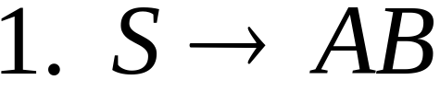
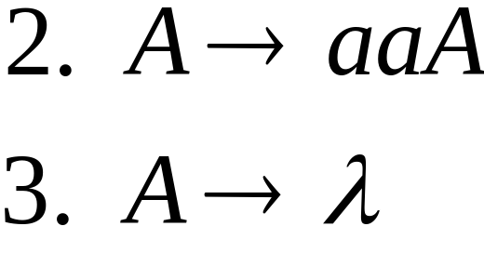
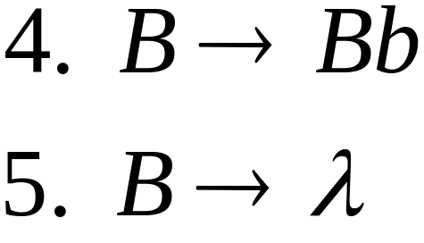


Derivation Order
Leftmost derivation:
Rightmost derivation:
COMP 335

Slide 15
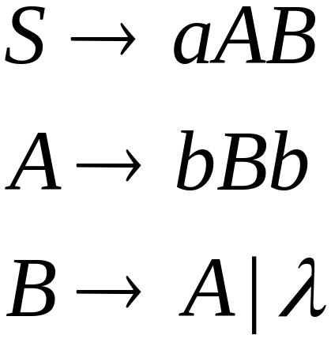
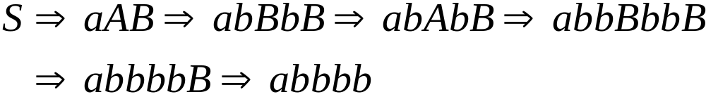
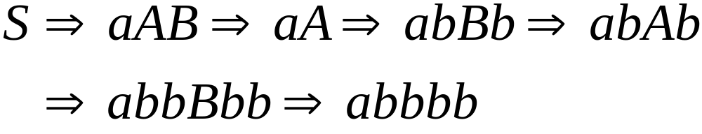
Leftmost derivation:
Rightmost derivation:
COMP 335

Slide 16
Derivation Trees
COMP 335

Slide 17

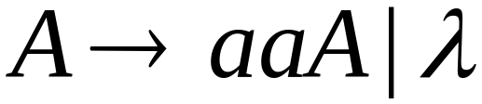
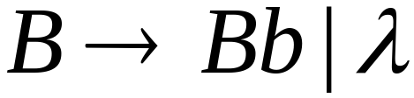




COMP 335

Slide 18


COMP 335

Slide 19

COMP 335

Slide 20

COMP 335

Slide 21
Derivation Tree
COMP 335

Slide 22
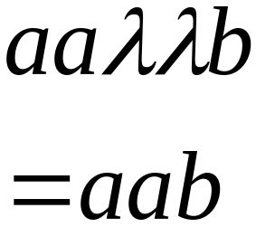
Derivation Tree
yield
COMP 335

Slide 23
Partial Derivation Trees
Partial derivation tree
COMP 335

Slide 24
Partial derivation tree
COMP 335

Slide 25

sentential
form
Partial derivation tree
yield
COMP 335

Slide 26
Sometimes “derivation” matters only, not the
order in which the productions are applied.
Leftmost:
Rightmost:
Same derivation tree
COMP 335

Slide 27
So far, we focused on generative aspect of CF grammars.
What about its analytical aspect?
This aspect relates to Parsing…..
Parsing describes finding a sequence of productions (in a CFG G) by which a given string w is derived
COMP 335

Slide 28
Grammar
Input
string w
Derivation
of w?
Parser
COMP 335

Slide 29
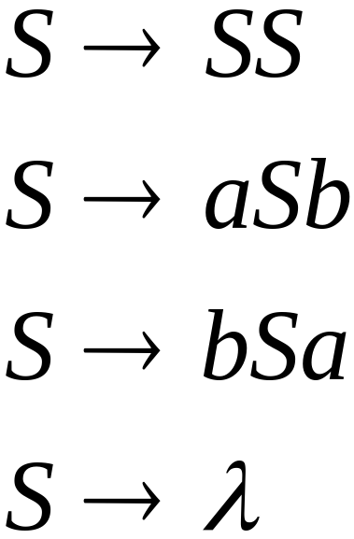

Example:
derivation
Parser
?
COMP 335

Slide 30
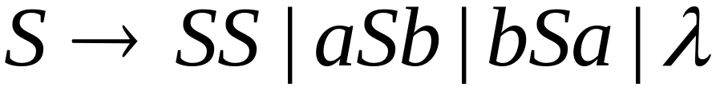
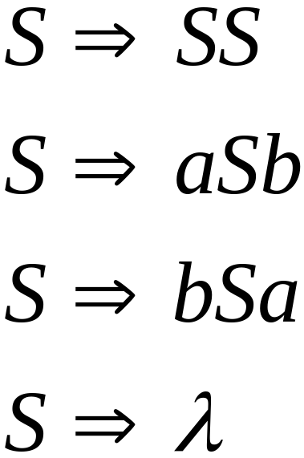
Exhaustive Search
Phase 1:
Find derivation of
All possible derivations of length 1
COMP 335

Slide 31
COMP 335

Slide 32
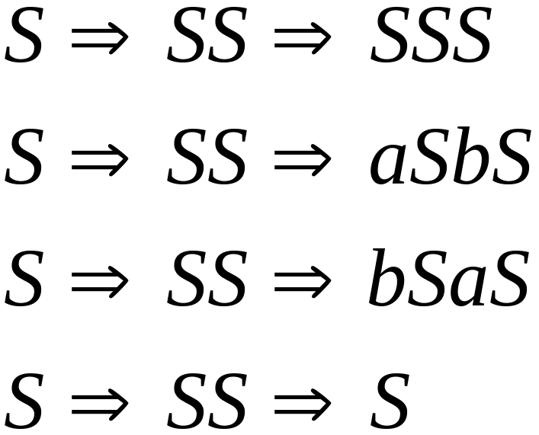
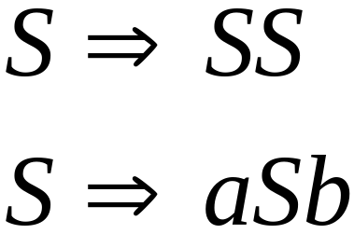
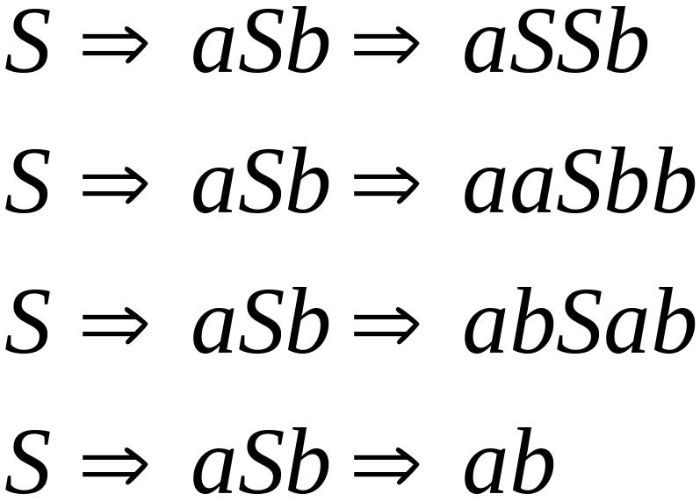
Phase 2
Phase 1
COMP 335

Slide 33
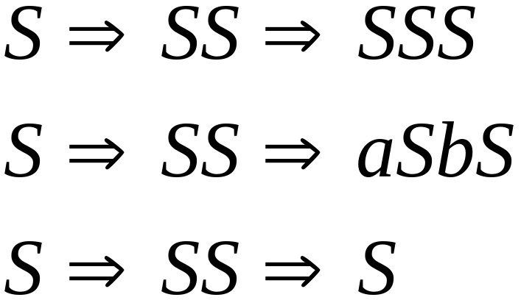
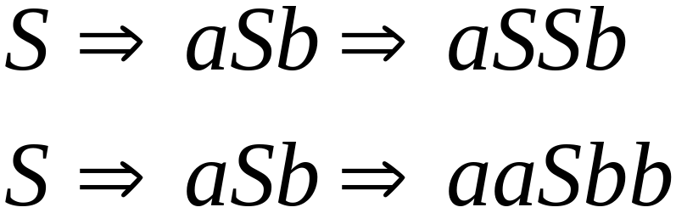
Phase 2
Phase 3
COMP 335

Slide 34
Final result of exhaustive search
(top-down parsing)
Inputs:
Parser
derivation
COMP 335

Slide 35



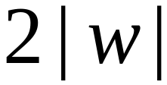
Time complexity of exhaustive search
Suppose there are no productions of the form
# of phases for generating any string is at
most . Why?
COMP 335

Slide 36


For a grammar with rules
Time for phase 1:
possible derivations
COMP 335

Slide 37
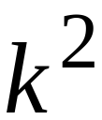
Time for phase 2:
possible derivations
COMP 335

Slide 38
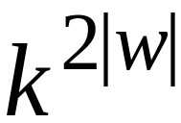
Time for phase :
possible derivations:
which is exponential in the length of w
COMP 335

Slide 39
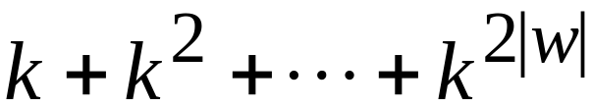
Total time/cost needed for parsing :
Cost at
phase 1
at phase 2
at phase 2|w|
O(k^{2|w|}) is extremely bad!!!
COMP 335

Slide 40

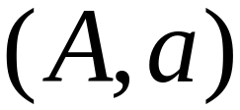
There are faster algorithms for specific grammars. For example, the Simple-grammar
S-grammar:
symbol
string
of variables
where pair
appears once
COMP 335

Slide 41
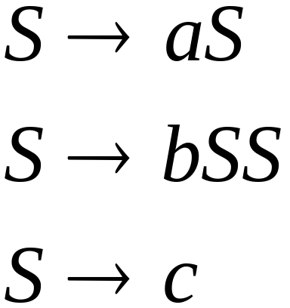
S-grammar example:
Each string w has a unique derivation:
COMP 335

Slide 42

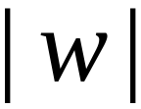
For S-grammars:
In the exhaustive search parsing
there is only one choice in each phase
Time for each phase:
Total time for parsing string :
COMP 335

Slide 43
For general context-free grammars:
There exists an efficient parsing
algorithm for CFG’s in CNF that
parses strings w with n symbols
in time O(n³ |P|), P is the number of
rules in the equivalent CNF grammar
Check out the CYK membership algorithm [1967] in
Sec. 6.3 (as the basis of the above efficient method)
COMP 335

Slide 44
Ambiguity
COMP 335

Slide 45
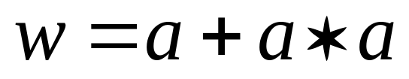
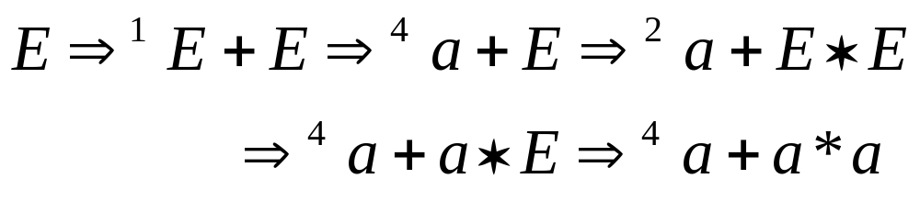



leftmost derivation
COMP 335

Slide 46
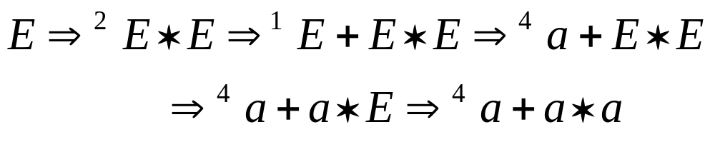
leftmost derivation
COMP 335

Slide 47
Two derivation trees
COMP 335

Slide 48
The grammar
is ambiguous:
since there is a string, namely
, with at least 2 derivation trees
COMP 335

Slide 49

The grammar
is ambiguous:
since string
has at least two leftmost derivations
COMP 335

Slide 50
Definition:
A context-free grammar G is ambiguous
if there exists a string w in L(G) with
two or more “distinct” derivation trees
COMP 335

Slide 51
Alternatively, we may say:
Ambiguity of a grammar implies
existence of two or more leftmost
(or rightmost) derivations
COMP 335

Slide 52
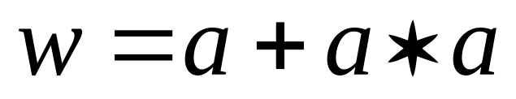

Why do we care about ambiguity?
Consider
COMP 335

Slide 53


COMP 335

Slide 54





COMP 335

Slide 55
Correct result:
COMP 335

Slide 56
Ambiguity is not desired for
programming languages because it
may result in different meanings
of (say a mathematical) expression!
So we should eliminate ambiguity,
when possible
COMP 335

Slide 57
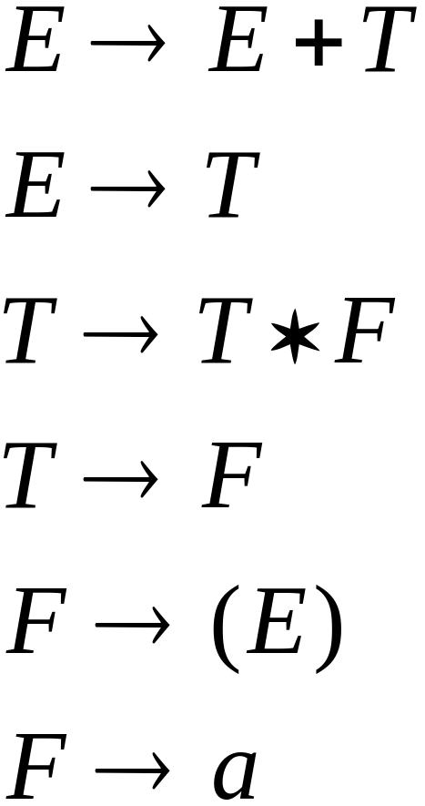
We may be able to fix the ambiguity:
New non-ambiguous grammar:
COMP 335

Slide 58
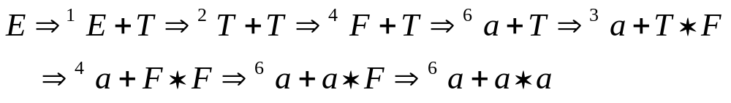

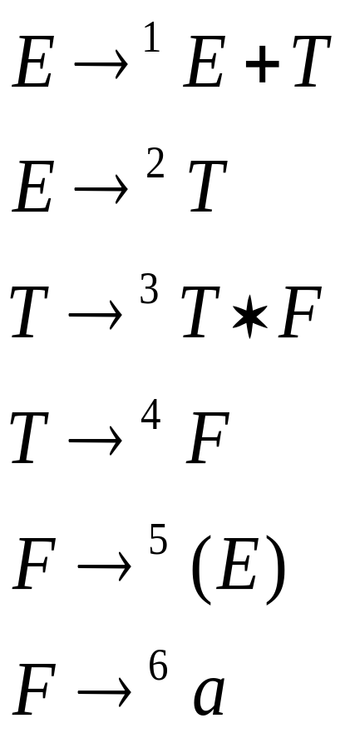


COMP 335

Slide 59
Unique derivation tree
COMP 335

Slide 60

The grammar :
is non-ambiguous:
Every string has
a unique derivation tree
COMP 335

Slide 61

Another Ambiguous Grammar
IF_STMT
if EXPR then STMT
if EXPR then STMT else STMT
COMP 335

Slide 62
if expr1 then if expr2 then stmt1 else stmt2
IF_STMT
if expr1 then (if expr2 then stmt1 else stmt2)
if
expr1
then
STMT
if
expr2
then
stmt1
else
stmt2
IF_STMT
if expr1 then (if expr2 then stmt1) else stmt2
if
expr1
then
STMT
else
stmt2
if
expr2
then
stmt1
COMP 335

Slide 63
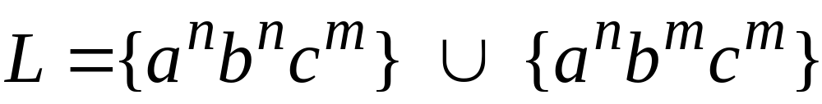

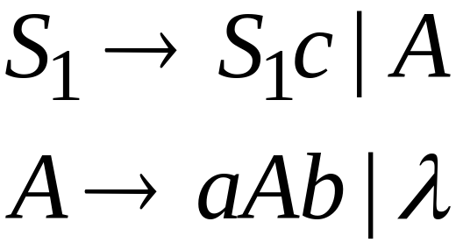
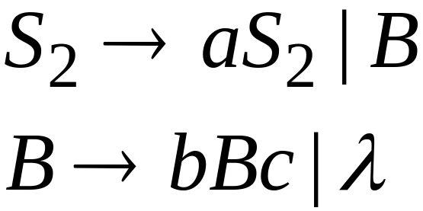
Inherent Ambiguity
Some context-free languages
have only ambiguous grammars
Example:
COMP 335

Slide 64
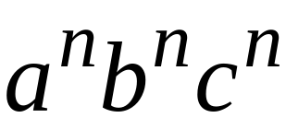



The string
has two derivation trees
COMP 335

