Slide 1
More Applications of
The Pumping Lemma
COMP 335
1

Slide 2


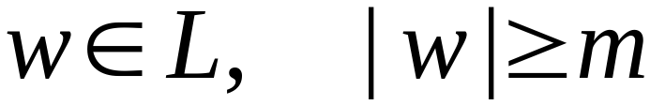

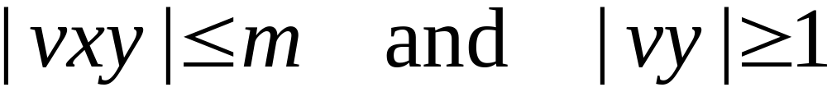
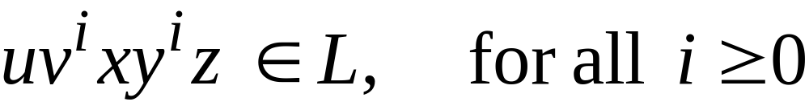
The Pumping Lemma:
For infinite context-free language
there exists an integer such that
for any string
we can write
with lengths
and it must be:
COMP 335

Slide 3
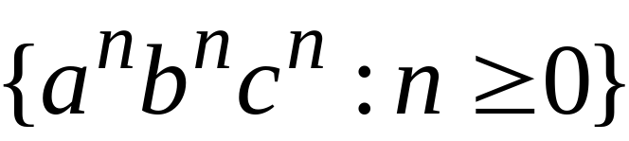
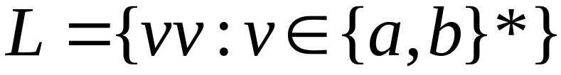

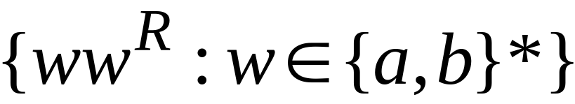
Non-context free languages
Context-free languages
COMP 335

Slide 4
Theorem:
The language
is not context free
Proof:
Use the Pumping Lemma
for context-free languages
COMP 335

Slide 5
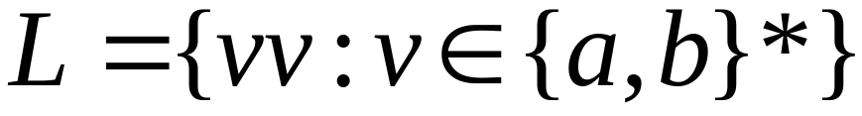
Assume for contradiction that
is context-free
Since is context-free and infinite
we can apply the pumping lemma
COMP 335

Slide 6
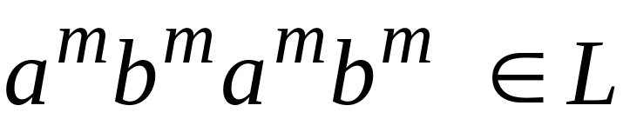
Pumping Lemma gives a magic number
such that:
Pick any string of with length at least
we pick:
COMP 335

Slide 7
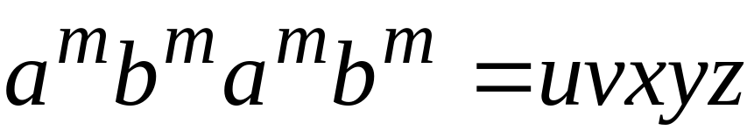
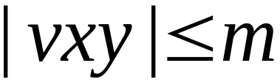
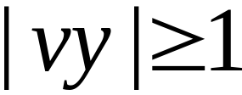
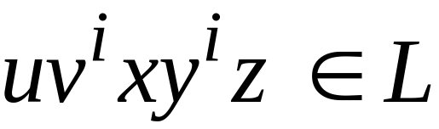

We can write:
with lengths and
Pumping Lemma says:
for all
COMP 335

Slide 8
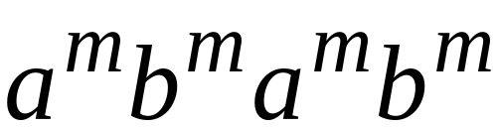

We examine all the possible locations
of string in
COMP 335

Slide 9
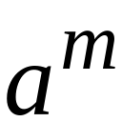
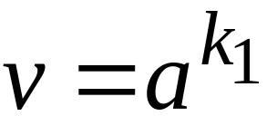
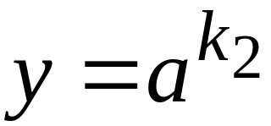
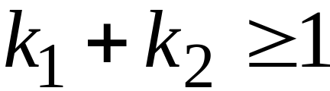





Case 1:
is within the first
COMP 335

Slide 10
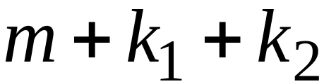
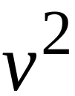
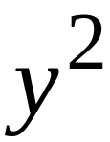
Case 1:
is within the first
COMP 335

Slide 11
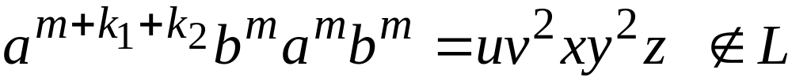
Case 1:
is within the first
COMP 335

Slide 12
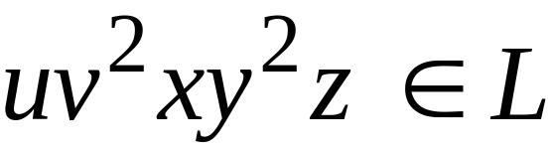
Case 1:
is within the first
However, from Pumping Lemma:
Contradiction!!!
COMP 335

Slide 13
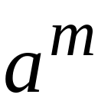
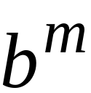
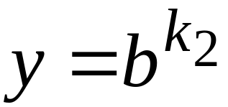
Case 2:
is in the first
is in the first
COMP 335

Slide 14
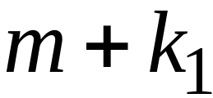
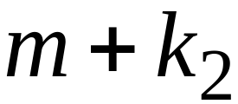
Case 2:
is in the first
is in the first
COMP 335

Slide 15
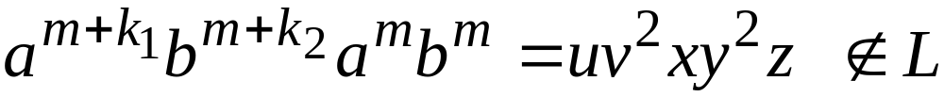
Case 2:
is in the first
is in the first
COMP 335

Slide 16
Case 2:
is in the first
is in the first
However, from Pumping Lemma:
Contradiction!!!
COMP 335

Slide 17
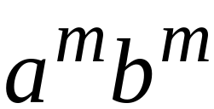
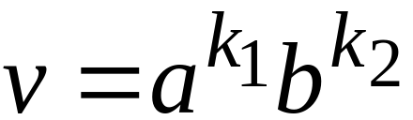
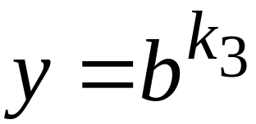
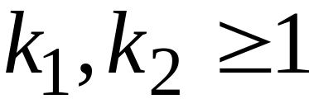
Case 3:
overlaps the first
is in the first
COMP 335

Slide 18


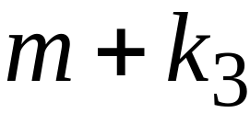
Case 3:
overlaps the first
is in the first
COMP 335

Slide 19
Case 3:
overlaps the first
is in the first
COMP 335

Slide 20
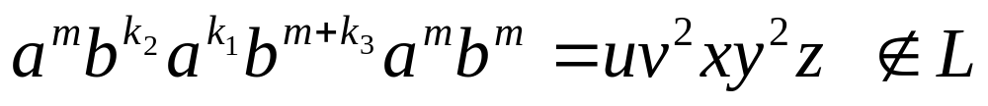
Case 3:
overlaps the first
is in the first
However, from Pumping Lemma:
Contradiction!!!
COMP 335

Slide 21
Case 4:
in the first
Overlaps the first
Analysis is similar to case 3
COMP 335

Slide 22
Other cases:
is within
or
or
Analysis is similar to case 1:
COMP 335

Slide 23
More cases:
overlaps
or
Analysis is similar to cases 2,3,4:
COMP 335

Slide 24
There are no other cases to consider
Since , it is impossible
to overlap:
nor
nor
COMP 335

Slide 25
In all cases we obtained a contradiction
Therefore:
The original assumption that
is context-free must be wrong
Conclusion:
is not context-free
COMP 335

Slide 26
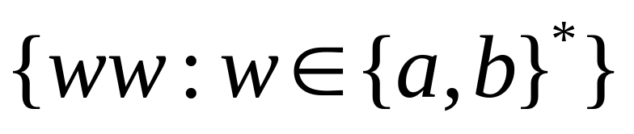
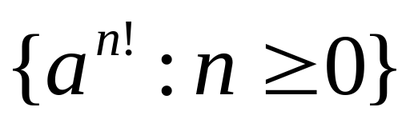
Non-context free languages
Context-free languages
COMP 335

Slide 27
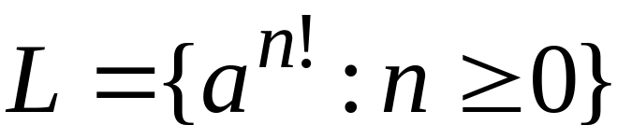
Theorem:
The language
is not context free
Proof:
Use the Pumping Lemma
for context-free languages
COMP 335

Slide 28
Assume for contradiction that
is context-free
Since is context-free and infinite
we can apply the pumping lemma
COMP 335

Slide 29
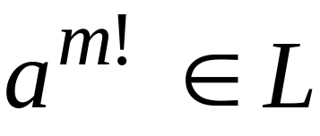
Pumping Lemma gives a magic number
such that:
Pick any string of with length at least
we pick:
COMP 335

Slide 30
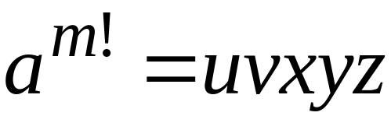
We can write:
with lengths and
Pumping Lemma says:
for all
COMP 335

Slide 31
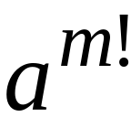
We examine all the possible locations
of string in
There is only one case to consider
COMP 335

Slide 32


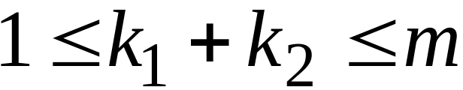
COMP 335

Slide 33
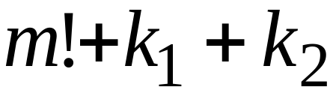

COMP 335

Slide 34

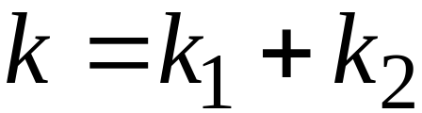

COMP 335

Slide 35
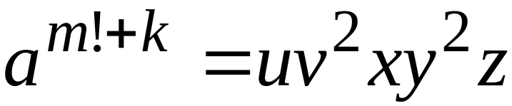
COMP 335

Slide 36

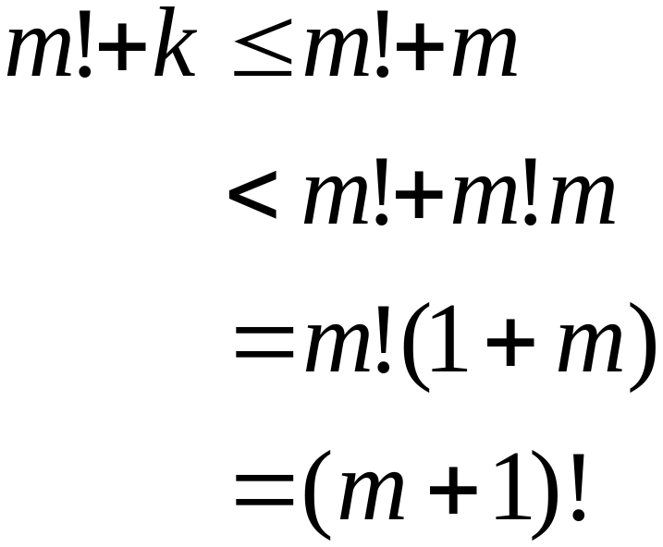
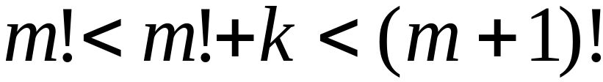
Since , for we have:
COMP 335

Slide 37
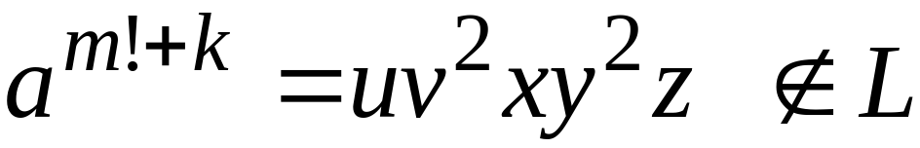
COMP 335

Slide 38
However, from Pumping Lemma:
Contradiction!!!
COMP 335

Slide 39
We obtained a contradiction
Therefore:
The original assumption that
is context-free must be wrong
Conclusion:
is not context-free
COMP 335

Slide 40
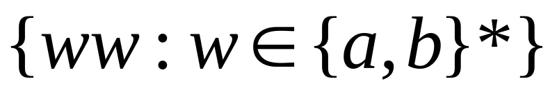
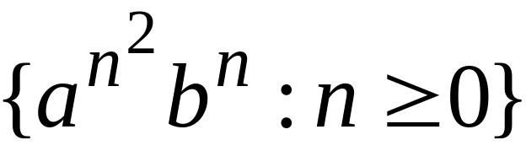
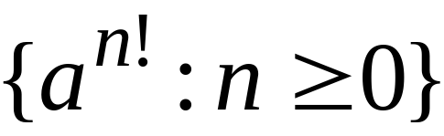
Non-context free languages
Context-free languages
COMP 335

Slide 41

Theorem:
The language
is not context free
Proof:
Use the Pumping Lemma
for context-free languages
COMP 335

Slide 42
Assume for contradiction that
is context-free
Since is context-free and infinite
we can apply the pumping lemma
COMP 335

Slide 43

Pumping Lemma gives a magic number
such that:
Pick any string of with length at least
we pick:
COMP 335

Slide 44


We can write:
with lengths and
Pumping Lemma says:
for all
COMP 335

Slide 45

We examine all the possible locations
of string in
COMP 335

Slide 46


Most complicated case:
is in
is in
COMP 335

Slide 47
COMP 335

Slide 48


Most complicated sub-case:
and
COMP 335

Slide 49





Most complicated sub-case:
and
COMP 335

Slide 50

Most complicated sub-case:
and
COMP 335

Slide 51


and
COMP 335

Slide 52

COMP 335

Slide 53

However, from Pumping Lemma:
Contradiction!!!
COMP 335

Slide 54
When we examine the rest of the cases
we also obtain a contradiction
COMP 335

Slide 55
In all cases we obtained a contradiction
Therefore:
The original assumption that
is context-free must be wrong
Conclusion:
is not context-free
COMP 335

