Slide 1
Closure Properties of
Context-Free languages
COMP 335
1

Slide 2



Union
Context-free languages
are closed under:
Union
is context free
is context free
is context-free
COMP 335

Slide 3
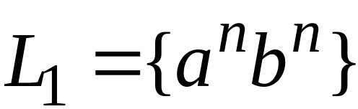
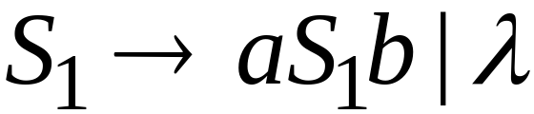
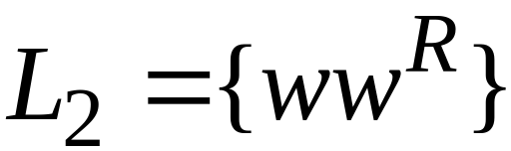
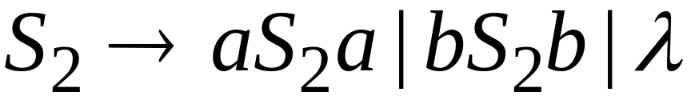
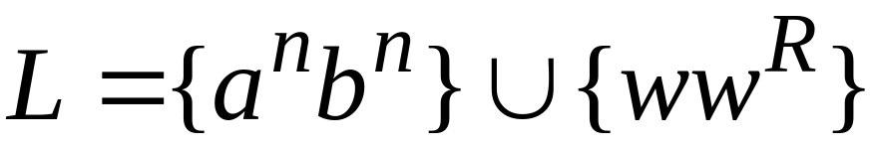

Example
Language
Grammar
Union
COMP 335

Slide 4
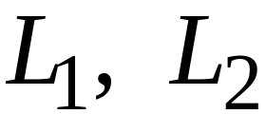
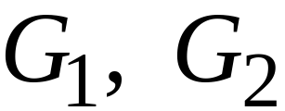
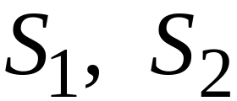

In general:
For context-free languages
with context-free grammars
and start variables
The grammar of the union
has new start variable
and additional production
COMP 335

Slide 5

Concatenation
Context-free languages
are closed under:
Concatenation
is context free
is context free
is context-free
COMP 335

Slide 6
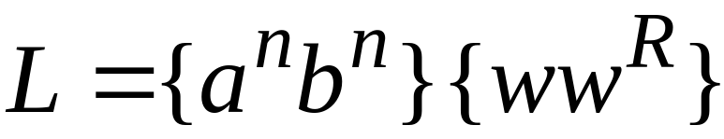
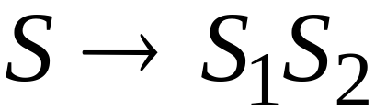
Example
Language
Grammar
Concatenation
COMP 335

Slide 7
In general:
For context-free languages
with context-free grammars
and start variables
The grammar of the concatenation
has new start variable
and additional production
COMP 335

Slide 8


Star Operation
Context-free languages
are closed under:
Star-operation
is context free
is context-free
COMP 335

Slide 9
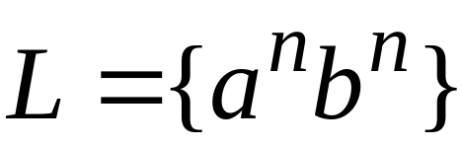
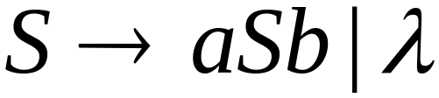
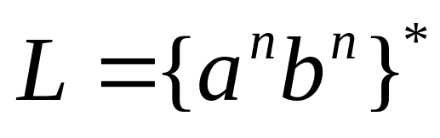
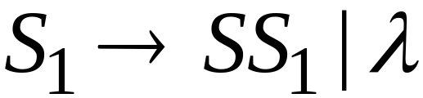
Example
Language
Grammar
Star Operation
COMP 335

Slide 10

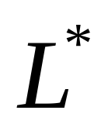

In general:
For context-free language
with context-free grammar
and start variable
The grammar of the star operation
has new start variable
and additional production
COMP 335

Slide 11
“Negative” Properties of
Context-Free Languages
COMP 335

Slide 12

Intersection
Context-free languages
are not closed under:
intersection
is context free
is context free
not necessarily
context-free
COMP 335

Slide 13
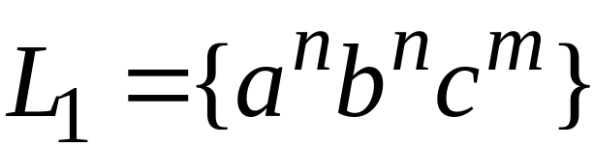
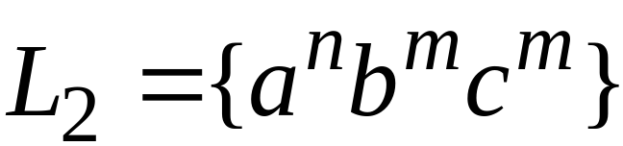
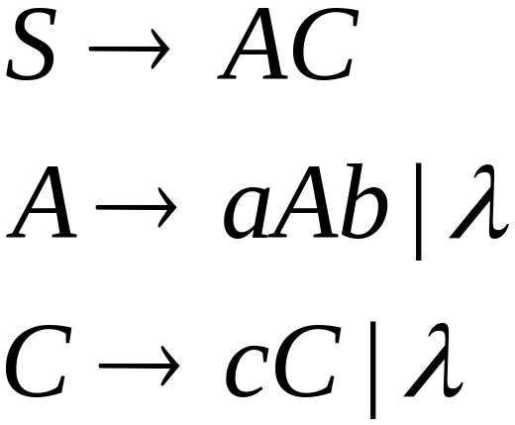
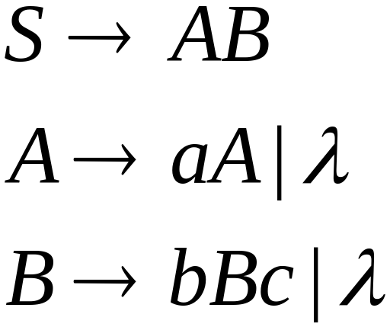
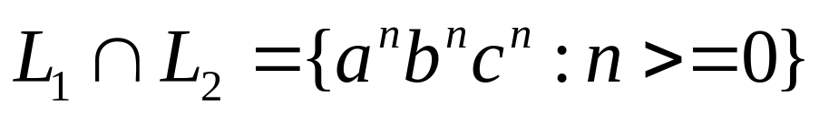
Example
Context-free:
Context-free:
Intersection
is NOT CF.
COMP 335

Slide 14

Complement
Context-free languages
are not closed under:
complement
is context free
not necessarily
context-free
COMP 335

Slide 15
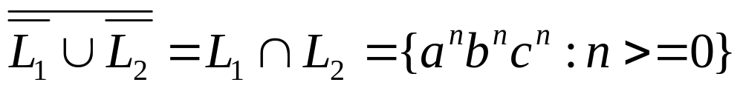
Example
Context-free:
Context-free:
Complement
is NOT CF.
COMP 335

Slide 16
Intersection of
Context-free languages and
Regular Languages
COMP 335

Slide 17
The intersection of
a context-free language and
a regular language
is a context-free language
context free
regular
context-free
COMP 335

Slide 18



Machine
Machine
NPDA
for
DFA
for
context-free
regular
Construct a new NPDA machine
that accepts
simulates in parallel and
COMP 335

Slide 19
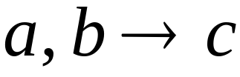




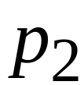
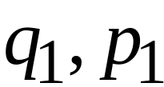
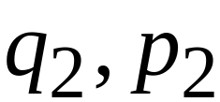
NPDA
DFA
transition
transition
NPDA
transition
COMP 335

Slide 20


NPDA
DFA
transition
NPDA
transition
COMP 335

Slide 21

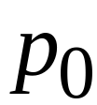
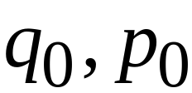
NPDA
DFA
initial state
initial state
NPDA
Initial state
COMP 335

Slide 22
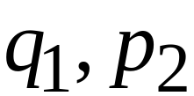
NPDA
DFA
final state
final states
NPDA
final states
COMP 335

Slide 23
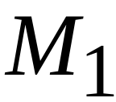








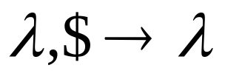

Example:
context-free
NPDA
COMP 335

Slide 24
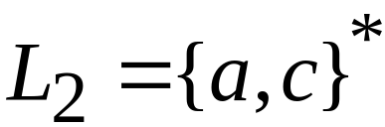
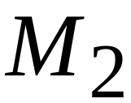


regular
DFA
COMP 335

Slide 25
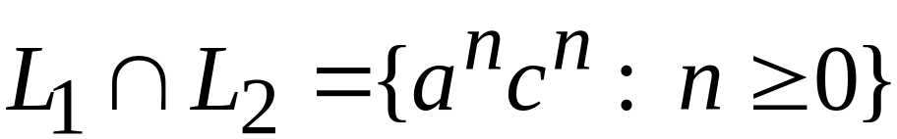





context-free
Automaton for:
NPDA
COMP 335

Slide 26


In General:
simulates in parallel and
accepts string
if and only if
accepts string and
accepts string
COMP 335

Slide 27
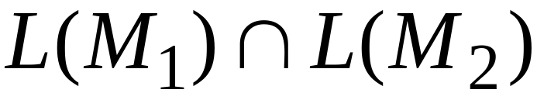
Therefore:
is NPDA
is context-free
is context-free
COMP 335

Slide 28
Applications of
Regular Closure
COMP 335

Slide 29
The intersection of
a context-free language and
a regular language
is a context-free language
Regular Closure
context free
regular
context-free
COMP 335

Slide 30
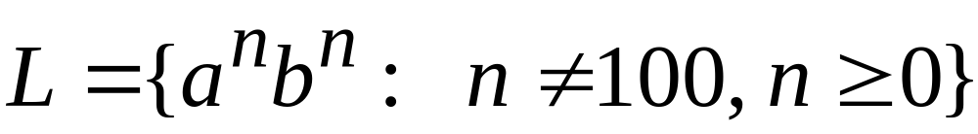
An Application of Regular Closure
Prove that:
is context-free
COMP 335

Slide 31
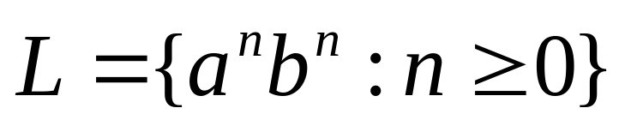
We know that:
is context-free
COMP 335

Slide 32
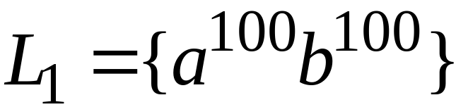
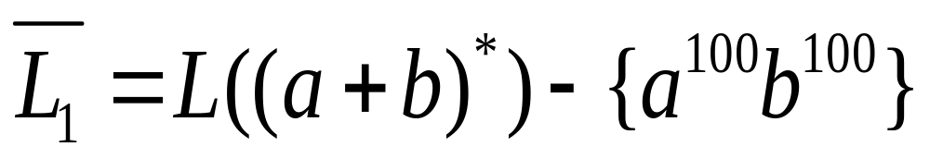
We also know:
is regular
is regular
COMP 335

Slide 33
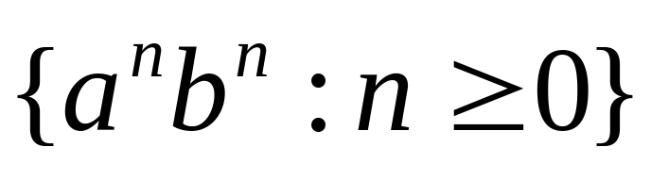
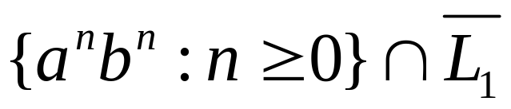
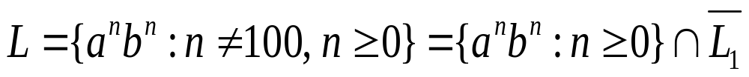
context-free
regular
(regular closure)
context-free
is context-free
COMP 335

Slide 34
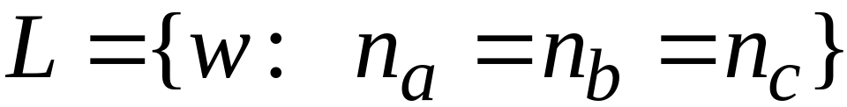
Another Application of Regular Closure
Prove that:
is not context-free
COMP 335

Slide 35
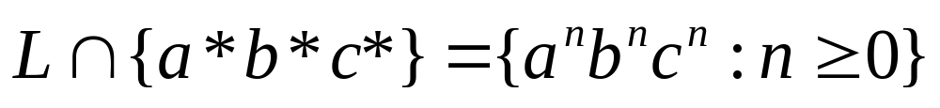
If
is context-free
(regular closure)
Then
context-free
regular
context-free
Impossible!!!
Therefore, is not context free
COMP 335

Slide 36
Decidable Properties of
Context-Free Languages
COMP 335

Slide 37

Membership Question:
Given a string w and CFG
Decide if
Membership Algorithms:
Parsers
Exhaustive search parser
CYK parsing algorithm
COMP 335

Slide 38
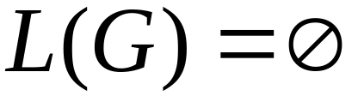
Empty Language Question:
for context-free grammar
find if
Algorithm:
Remove useless variables
Check if the start variable S is useless or not
COMP 335

Slide 39
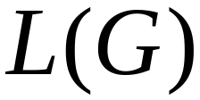

Infinite Language Question:
for a context-free grammar
find if is infinite
Algorithm:
1. Remove useless variables
2. Remove unit and productions
3. Create dependency graph for variables
4. If there is a loop in the dependency graph
then L(G) is infinite
COMP 335

Slide 40
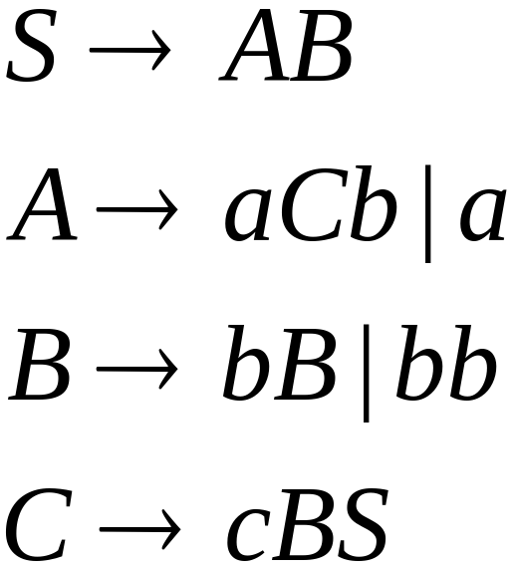




Example:
Infinite language
Dependency graph
COMP 335

Slide 41
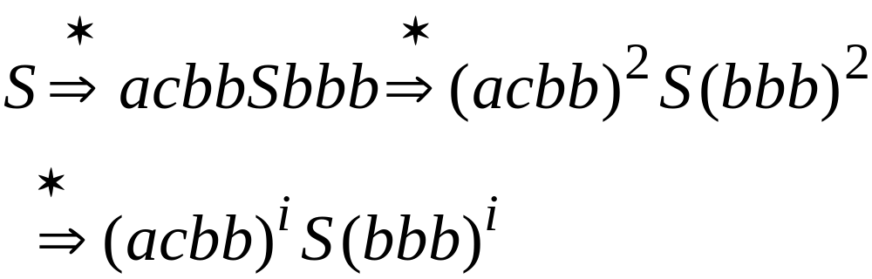
COMP 335

