Slide 1
Recursively Enumerable (r.e.) and
Recursive Languages
COMP 335
1

Slide 2
The Chomsky Hierarchy
Non-recursively enumerable
Recursively-enumerable
Recursive
Context-sensitive
Context-free
Regular
COMP 335

Slide 3
Definition:
A language is recursively enumerable
if some Turing machine accepts it
COMP 335

Slide 4





Let be a recursively enumerable language
and the Turing Machine that accepts it
For string :
if
then halts in a final state
if
then halts in a non-final state
or loops forever
COMP 335

Slide 5
Definition:
A language is recursive
if some Turing machine accepts it
and halts on every input string
In other words:
A language is recursive if there is
a membership algorithm for it
COMP 335

Slide 6
Let be a recursive language
and a Turing Machine that accepts it
For every string :
if
then halts in a final state
if
then halts in a non-final state
COMP 335

Slide 7
We will prove:
1. There is a specific language
which is recursively enumerable
but not recursive
2. There is a specific language
which is not recursively enumerable
(not accepted by any Turing Machine)
COMP 335

Slide 8
Non Recursively Enumerable
Recursively Enumerable
Recursive
COMP 335

Slide 9
A Language which is not
Recursively Enumerable
COMP 335

Slide 10
We want to find a language that
is not Recursively Enumerable
This language is not accepted by any
Turing Machine
COMP 335

Slide 11
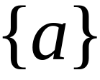

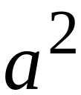
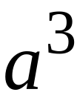
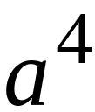
Consider alphabet
Strings:
COMP 335

Slide 12
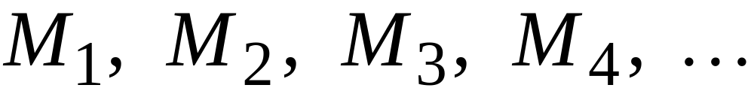
Consider all Turing Machines
that accept languages over alphabet
They are countable:
COMP 335

Slide 13
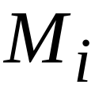
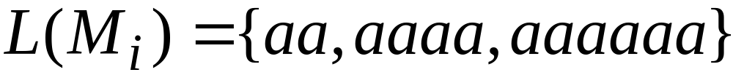
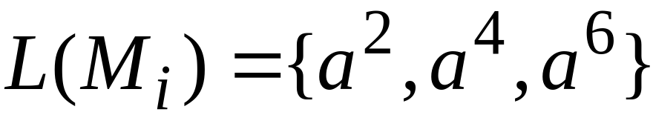







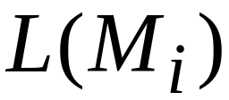


Example language accepted by
Alternative representation:
COMP 335

Slide 14
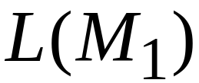
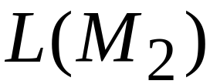
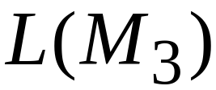
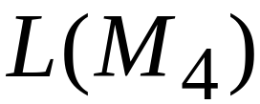
COMP 335

Slide 15
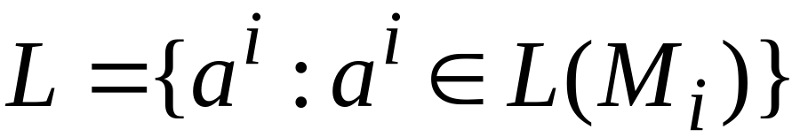
Consider the language
is defined by the 1’s in the diagonal
COMP 335

Slide 16
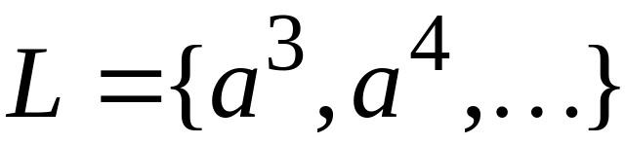
COMP 335

Slide 17

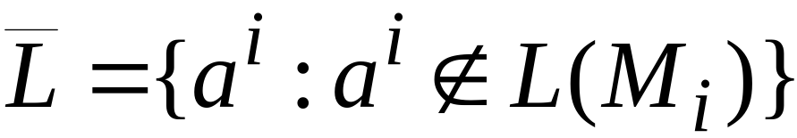

Now consider the language
is defined by the 0’s in the diagonal
COMP 335

Slide 18
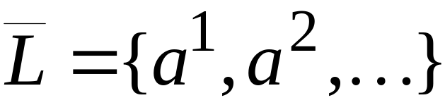
COMP 335

Slide 19
Theorem:
Language is not recursively enumerable
COMP 335

Slide 20
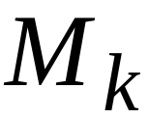
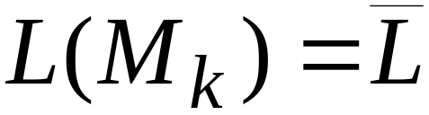
Proof:
Assume for contradiction that
is recursively enumerable
There must exist some machine
that accepts
COMP 335

Slide 21
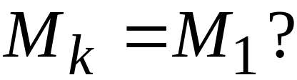
Question:
COMP 335

Slide 22
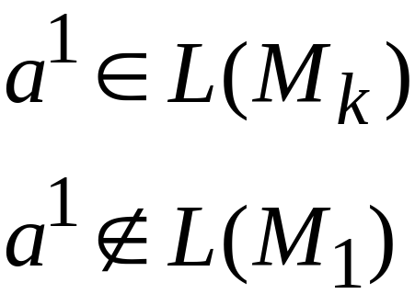
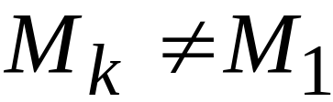
Answer:
COMP 335

Slide 23
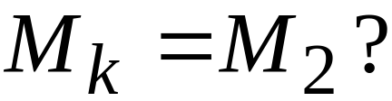
Question:
COMP 335

Slide 24
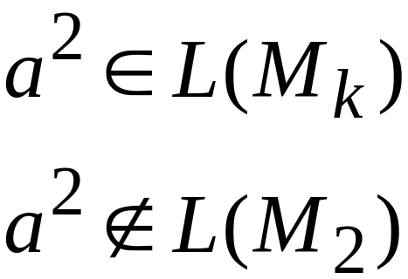
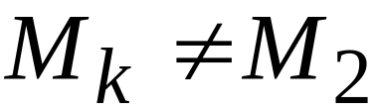
Answer:
COMP 335

Slide 25
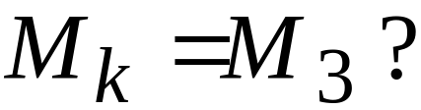
Question:
COMP 335

Slide 26
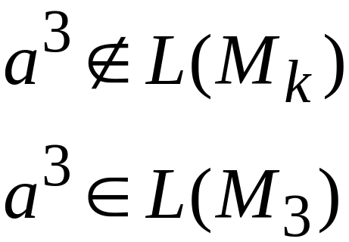
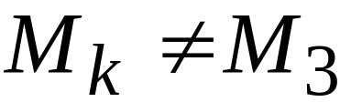
Answer:
COMP 335

Slide 27
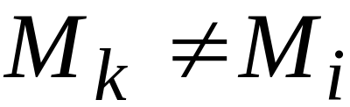

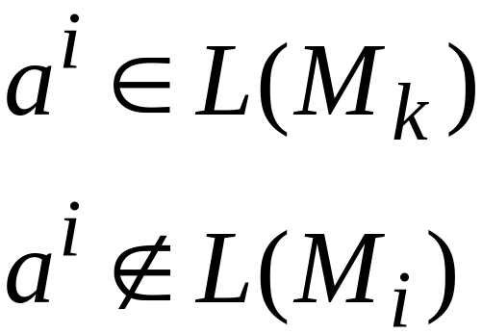
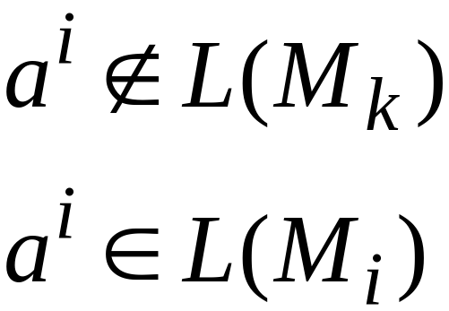
Similarly:
for each
Because either:
or
COMP 335

Slide 28
Therefore, the machine cannot exist
Therefore, the language
is not recursively enumerable
End of Proof
COMP 335

Slide 29
Observation:
There is no algorithm that describes
(otherwise would be accepted by
some Turing Machine)
COMP 335

Slide 30
Non Recursively Enumerable
Recursively Enumerable
L
Recursive
COMP 335

Slide 31
A Language which is
Recursively Enumerable and not Recursive
COMP 335

Slide 32
We want to find a language which
Is recursively
enumerable
But not
recursive
There is a
Turing Machine
that accepts
the language
The machine
doesn’t halt
on some inputs
COMP 335

Slide 33
We will prove that the language
Is recursively enumerable
but not recursive
COMP 335

Slide 34
COMP 335

Slide 35
Theorem:
The language
is recursively enumerable
COMP 335

Slide 36
Proof:
We will give a Turing Machine that
accepts
COMP 335

Slide 37
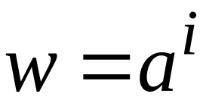

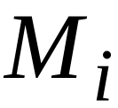

Turing Machine that accepts
For any input string
Compute , for which
Find the ithTuring machine
(using an enumeration procedure
for Turing Machines)
Simulate on input
If accepts, then accept
End of Proof
COMP 335

Slide 38
Observation:
Recursively enumerable
Not recursively enumerable
(Thus, also not recursive)
COMP 335

Slide 39
Theorem:
The language
is not recursive
COMP 335

Slide 40
Proof:
Assume for contradiction that is recursive
Then is recursive:
Take the Turing Machine that accepts
halts on any input:
If accepts then reject
If rejects then accept
COMP 335

Slide 41
Therefore:
is recursive
But we know:
is not recursively enumerable
thus, not recursive
CONTRADICTION!!!!
COMP 335

Slide 42
Therefore, is not recursive
End of Proof
COMP 335

Slide 43
Non Recursively Enumerable
Recursively Enumerable
Recursive
COMP 335

Slide 44
Turing acceptable languages and
Enumeration Procedures
COMP 335

Slide 45
We will prove:
(weak result)
If a language is recursive then
there is an enumeration procedure for it
(strong result)
A language is recursively enumerable
if and only if
there is an enumeration procedure for it
COMP 335

Slide 46

Theorem:
if a language is recursive then
there is an enumeration procedure for it
COMP 335

Slide 47
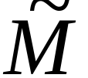
Proof:
Enumeration Machine
Enumerates all
strings of input alphabet
Accepts
COMP 335

Slide 48
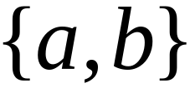









If the alphabet is then
can enumerate strings as follows:
COMP 335

Slide 49
Enumeration procedure
Repeat:
generates a string
checks if
YES: print to output
NO: ignore
End of Proof
COMP 335

Slide 50
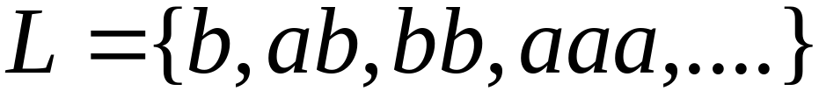
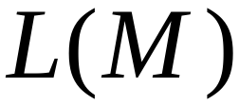
Example:
Enumeration
Output
COMP 335

Slide 51
Theorem:
if language is recursively enumerable then
there is an enumeration procedure for it
COMP 335

Slide 52

Proof:
Enumeration Machine
Enumerates all
strings of input alphabet
Accepts
COMP 335

Slide 53
If the alphabet is then
can enumerate strings as follows:
COMP 335

Slide 54
NAIVE APPROACH
Enumeration procedure
Repeat:
generates a string
checks if
YES: print to output
NO: ignore
Problem:
If
machine may loop forever
COMP 335

Slide 55
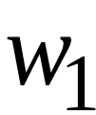
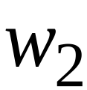
BETTER APPROACH
Generates first string
executes first step on
Generates second string
executes first step on
second step on
COMP 335

Slide 56
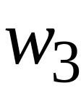
Generates third string
executes first step on
second step on
third step on
And so on............
COMP 335

Slide 57
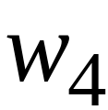
1
1
1
1
Step
in
string
2
2
2
2
3
3
3
3
COMP 335

Slide 58

If for any string
machine halts in a final state
then it prints on the output
End of Proof
COMP 335

Slide 59
Theorem:
If for language
there is an enumeration procedure
then is recursively enumerable
COMP 335

Slide 60
Proof:
Input Tape
Machine that
accepts
Enumerator
for
Compare
COMP 335

Slide 61
Turing machine that accepts
For input string
Repeat:
Using the enumerator,
generate the next string of
Compare generated string with
If same, accept and exit loop
End of Proof
COMP 335

Slide 62
We have proven:
A language is recursively enumerable
if and only if
there is an enumeration procedure for it
COMP 335

