Slide 1
Introduction to Theoretical Computer Science
COMP 335/E
Fall 2023
N. Shiri
(Original slides: K. Busch)
COMP 335

Slide 2
  This is a theoretical course in which we study
  abstract models of computers and computation
  Why theory, when computer is such a practical field?!
  The theory provides principles, concepts, and techniques, for both hardware and software, that help better understand the general nature of the field.
COMP 335

Slide 3
Mathematical Preliminaries
COMP 335

Slide 4
Mathematical Preliminaries
Sets
Functions
Relations
Graphs
Proof Techniques
COMP 335

Slide 5
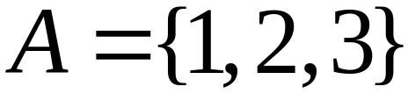


SETS
A set is a collection of elements/objects
We write:
COMP 335

Slide 6
Set Representations
  C = { a, b, c, d, e, f, g, h, i, j, k }
  C = { a, b, …, k }
  S = { 2, 4, 6, … }
  S = { j : j > 0, and j = 2k for k>0 }
  S = { j : j is nonnegative and even }
finite set
infinite set
COMP 335

Slide 7
A = { 1, 2, 3, 4, 5 }
U
6
A
2
8
1
3
7
4
5
9
10
Universal Set: The set that includes all the elements
    Ex. above: U = { 1 , … , 10 }
COMP 335

Slide 8
Set Operations
A = { 1, 2, 3 } B = { 2, 3, 4, 5}
Union
A U B = { 1, 2, 3, 4, 5 }
Intersection
    A B = { 2, 3 }
Difference
    A - B = { 1 }
    B - A = { 4, 5 }
A
B
2
4
1
3
5
U
2
3
1
Venn diagrams
COMP 335

Slide 9
Complement
      Universal set = {1, …, 7}
      A = { 1, 2, 3 } A = { 4, 5, 6, 7}
4
A
A
6
1
3
2
5
7
A = A
COMP 335

Slide 10
{ even integers } = { odd integers }
Integers
odd
1
0
5
even
2
6
4
3
7
COMP 335

Slide 11
DeMorgan’s Laws
A U B = A B
U
A B = A U B
U
COMP 335

Slide 12
Empty, Null Set:
= { }
S U = S
S =
S - = S
- S =
U
= Universal Set
COMP 335

Slide 13
Subset
A = { 1, 2, 3} B = { 1, 2, 3, 4, 5 }
U
A B
Proper Subset:
U
A B
B
A
COMP 335

Slide 14
Disjoint Sets
A = { 1, 2, 3 } B = { 5, 6}
A B =
U
A
B
COMP 335

Slide 15
Set Cardinality/Size
For finite sets
A = { 2, 5, 7 }
|A| = 3
(set size)
COMP 335

Slide 16
Powersets (or Power sets)
Given any set S, the powerset of S is the set of all
subsets of S, including the empty set and S itself.
For example, for S = { a, b, c }
the powerset of S is
2^{S} = { { }, {a}, {b}, {c}, {a, b}, {a, c}, {b, c}, {a, b, c} }
Question: How many sets are there in the powerset
of S? Answer: |2^{S}| = 2^{|S|}
COMP 335

Slide 17
Cartesian Product
A = { 2, 4 } B = { 2, 3, 5 }
A X B = { (2, 2), (2, 3), (2, 5), ( 4, 2), (4, 3), (4, 5) }
|A X B| = |A|*|B|
The cross product operation can be
generalized to more than two sets
A X B X … X Z
COMP 335

Slide 18
FUNCTIONS
domain
range
4
A
B
f(1) = a
1
a
2
b
3
c
5
f : A -> B
If A = domain, then f is called a total function
otherwise f is called a partial function
COMP 335

Slide 19
RELATIONS
Given sets A and B, a relation R from A to B is
defined as: R ⊆ AXB
If R ⊆ AXA, then R is called a relation on A
Supp. R = {(x₁, y₁), (x₂, y₂), (x₃, y₃), …}. We may
then we may write (x_{i},y_{i})ϵR or x_{i} R y_{i}
E.g., for when A is the set of natural numbers N
and relation R = ‘>’, we have: 2 > 1, 3 > 2, 3 > 1, …
COMP 335

Slide 20
Equivalence Relations
A relation R on A is an equivalence relation if the following conditions hold
Reflexive: ∀x in A: x R x
Symmetric: ∀x,y: x R y ➔ y R x
Transitive: ∀x,y,z: (x R y and y R z) ➔ x R z
Special case: if R is the equality relation “=“, then:
x = x
x = y ➔ y = x
(x = y and y = z) ➔ x = z
COMP 335

Slide 21
Equivalence Classes
For any equivalence relation R on A, the equivalence class of an element x in A is:
[x]_{R} = {y : x R y}
Example: Let A={1,2,3,4,5} and
R = { (1, 1), (2, 2), (1, 2), (2, 1), (3, 3),
(4, 4), (3, 4), (4, 3), (5,5) }. Then,
Equi. class of 1 (or 2): [1]_{R} = [2]_{R} = {1, 2}
Equi. class of 3 (or 4): [3]_{R} = [4]_{R} = {3, 4}
Equivalence class of 5: [5]_{R} = {5}
COMP 335

Slide 22
(Directed) GRAPHS
A directed graph G=〈V, E〉
e
b
node
a
d
edge
c
Nodes (Vertices)
V = { a, b, c, d, e }
Edges E ⊆ VxV
E = { (a,b), (b,c), (b,e),(c,a), (c,e), (d,c), (e,b), (e,d) }
COMP 335

Slide 23
Labeled Graph
2
6
e
2
b
1
3
a
d
6
5
c
COMP 335

Slide 24
Walk
e
b
a
d
c
Walk is a sequence of adjacent edges
(e, d), (d, c), (c, a)
COMP 335

Slide 25
Path
e
b
a
d
c
Path is a walk where no edge is repeated
Simple path is a path where no node is repeated
COMP 335

Slide 26
Cycle
e
base
b
3
1
d
a
2
c
Cycle is a walk from a node (base) to itself
Simple cycle: only the base node is repeated
COMP 335

Slide 27
Trees
root
parent
leaf
child
Trees: graphs with no cycles.
Ordered trees : the order
of children is important!
COMP 335

Slide 28
root
Level 0
Level 1
leaf
leaf
Height 3
Level 2
leaf
Level 3
leaf
COMP 335

Slide 29
PROOF TECHNIQUES
Proof by induction
Proof by contradiction
COMP 335

Slide 30
Induction
We have statements P₁, P₂, P₃, …, where P_{i} means P(i)
If we know
    for some b that P₁, P₂, …, P_{b} are true
    and that for any k, we have that:
        P₁, P₂, …, P_{k} imply P_{k+1}
Then
we conclude that every P_{i} is true, that is, ∀i P(i)
COMP 335

Slide 31
Proof by Contradiction
We want to prove that a statement P is true
    we assume that P is false
    then we arrive at an incorrect conclusion
    and hence conclude that P must be true
COMP 335

Slide 32
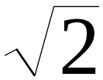
Example
Theorem: is not rational
Proof:
Assume by contradiction that it is rational, i.e.
    = n/m
    where n and m have no common factors
    We will show that this is impossible
COMP 335

Slide 33
= n/m 2 m² = n²
n is even
n = 2 k
Therefore, n² is even
m is even
m = 2 p
2 m² = 4k²
m² = 2k²
Thus, 2 is a common factor for both m and n,
Contradiction!
COMP 335

Slide 34
Pigeon Hole Principle:
If n+1 objects are put into n boxes, then at least
one box must contain 2 or more objects.
Example: Can show if 5 points are placed inside a square whose sides are 2 cm long, then at least two points are at a distance ≤ √2 cm.
According to the PHP, if we divide the square into 4, at least two of the points must be in one of these 4 squares. But the length of the diagonals of these squares is √2.
➔ the two points cannot be further apart than √2 cm.
COMP 335

Slide 35
Languages
COMP 335

Slide 36
Alphabets and Languages
An alphabet Σ is a finite set of symbols characters
A language L is a set of strings (sentences) over Σ
Note: The alphabet includes at least one symbol.
Defn. A string/sentence w is a sequence of characters (or symbols) in Σ.
“cat”, “dog”, “house” are examples of
strings over the English alphabet
Σ = {a,b,c,…,z}
COMP 335

Slide 37


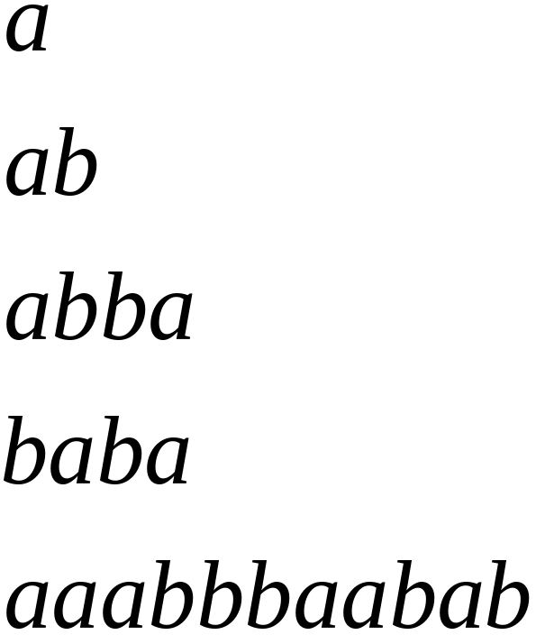
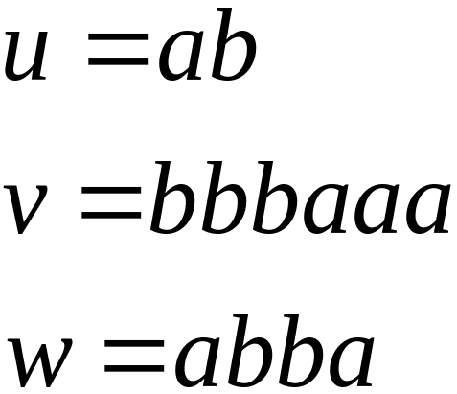
Alphabets and Strings
We will use small letters for the alphabet
symbols. Let be the alphabet.
Example of strings over :
COMP 335

Slide 38






Operations on Strings
Concatenation
abbabbbaaa
bbbaaaabba
COMP 335

Slide 39

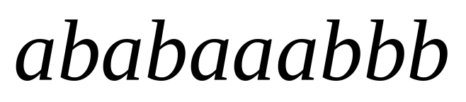

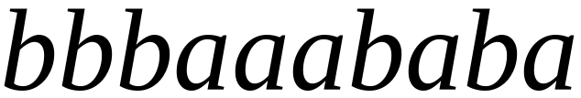
Reverse
COMP 335

Slide 40



Length of a string
Given:
Length:
Examples:
COMP 335

Slide 41


Length of concatenated strings
Example:
COMP 335

Slide 42
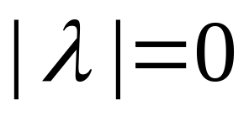
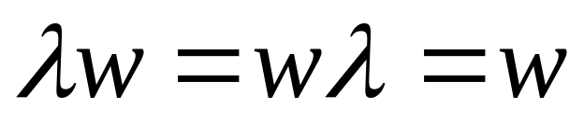
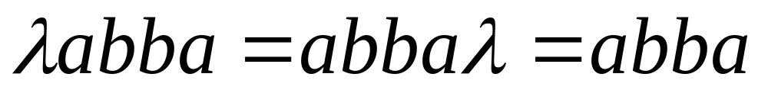
The Empty String
The empty string, shown λ, is the string
that has no symbols. That is, .
Some texts may use ε for the empty string.
Note:
For example:
COMP 335

Slide 43


Substrings
Given any string w, a substring of w is a subsequence of consecutive symbols (characters) in w.
For example, if w =abbab, then examples of different substrings of w are as follows:
String Substring
COMP 335

Slide 44




Prefix and Suffix
Ex: for string w =
Prefixes Suffixes
prefix
suffix
COMP 335

Slide 45



Another Operation
For a string w, we define the exponent of w as W^{n} = ww…w (w copied n times)
Example:
Definition: for any string w,
  E.g.,
COMP 335

Slide 46

The star Operation (*)
Σ* is defined as the set of all strings of length 0, 1, 2, … over the alphabet Σ
For example:
For
COMP 335

Slide 47


The plus Operation (+)
: the set of all strings over Σ except λ.
Σ⁺ = Σ¹ ∪ Σ² ∪ Σ³ ∪ … (What is L₁L₂?)
Σ* = Σ⁰ ∪ Σ¹ ∪ Σ² ∪ Σ³ ∪ …
COMP 335

Slide 48


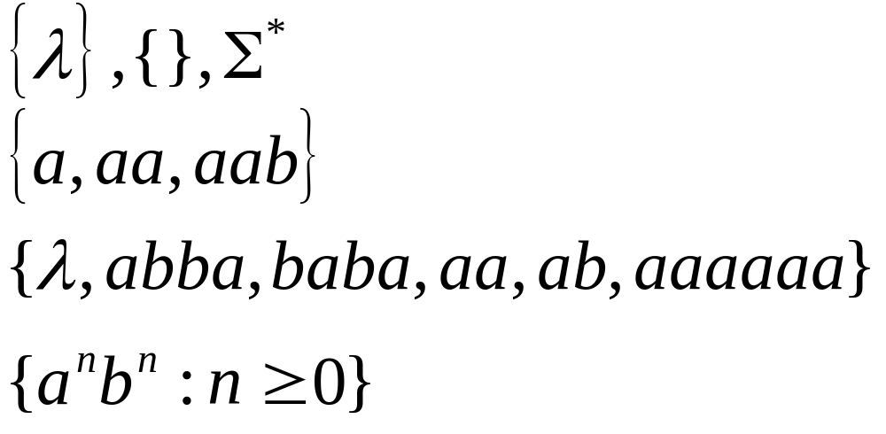
Languages
Given an alphabet , any subset of
is called a language over .
Examples of languages over ={a, b}:
COMP 335

Slide 49




Note: we will use |..| to denote 2 things:
(1) string length and (2) set size/cardinality
Sets
Set size
Set size
String length
COMP 335

Slide 50




An interesting language over {a,b}
COMP 335

Slide 51


Other operations over languages
As languages are sets, the standard set
operations are applicable on languages:
Complement:
COMP 335

Slide 52



The Reverse operation (R)
Definition:
Examples:
COMP 335

Slide 53

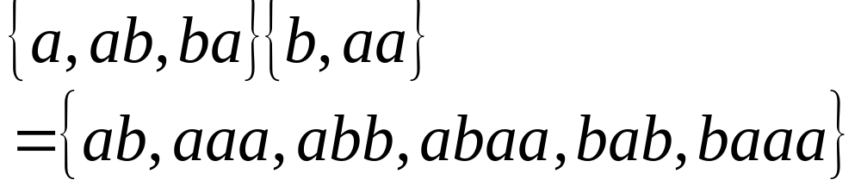
Concatenation
Definition:
Example:
COMP 335

Slide 54


Concatenation Operation
Definition: For any language L, we define:
L^{n}=LL…L. For example: if L={a,b}, then
Note the
special case (n=0):
COMP 335

Slide 55



More Examples
COMP 335

Slide 56


Star-Closure (Kleene *)
Definition: For any language L :
Example:
COMP 335

Slide 57
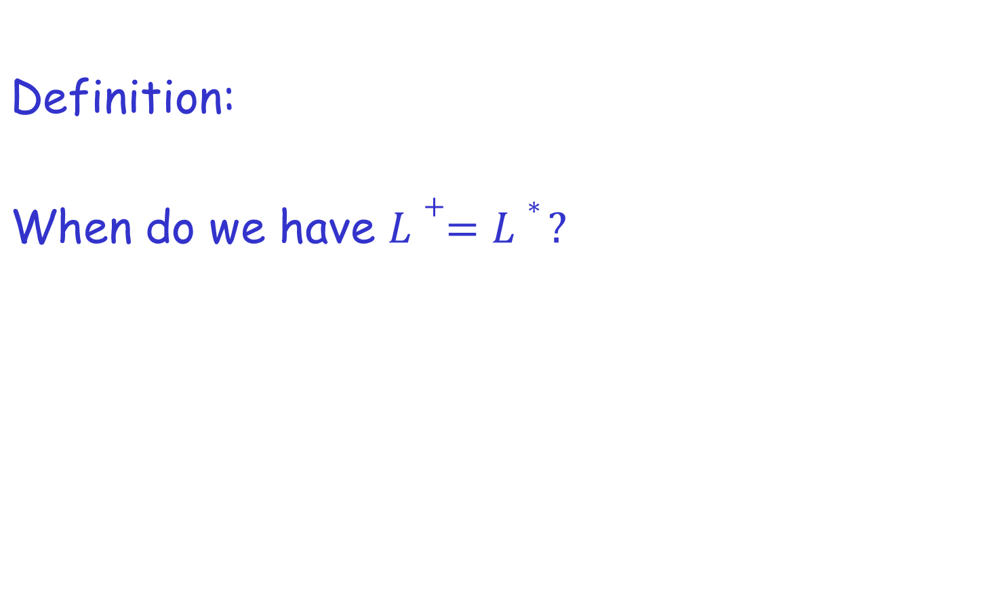



Positive Closure (+) of a language?
COMP 335

