Slide 1
NPDA Accept
Context-Free Languages
COMP 335

Slide 2

Theorem:
Context-Free
Languages
(Grammars)
Languages
Accepted by
NPDAs
COMP 335

Slide 3
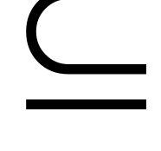



Proof - Step 1:
Context-Free
Languages
(Grammars)
Languages
Accepted by
NPDAs
Convert any context-free grammar
to a NPDA with:
COMP 335

Slide 4

Proof - Step 2:
Context-Free
Languages
(Grammars)
Languages
Accepted by
NPDAs
Convert any NPDA to a context-free
grammar with:
COMP 335

Slide 5
Converting
Context-Free Grammars to
NPDAs
Proof - step 1
COMP 335

Slide 6


We will convert any context-free grammar
to an NPDA automaton
Such that:
Simulates leftmost derivations of
COMP 335

Slide 7

In general:
Given any CFG grammar
We can construct a NPDA
With
COMP 335

Slide 8


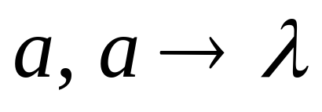
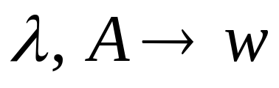
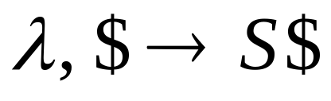
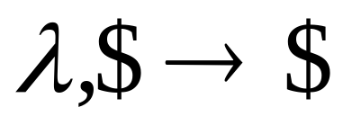



Constructing NPDA from grammar :
For any terminal
For any production
COMP 335

Slide 9







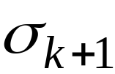



Leftmost derivation
Input
processed
Stack
contents
leftmost variable
Simulation of derivation
Stack
Input
COMP 335

Slide 10
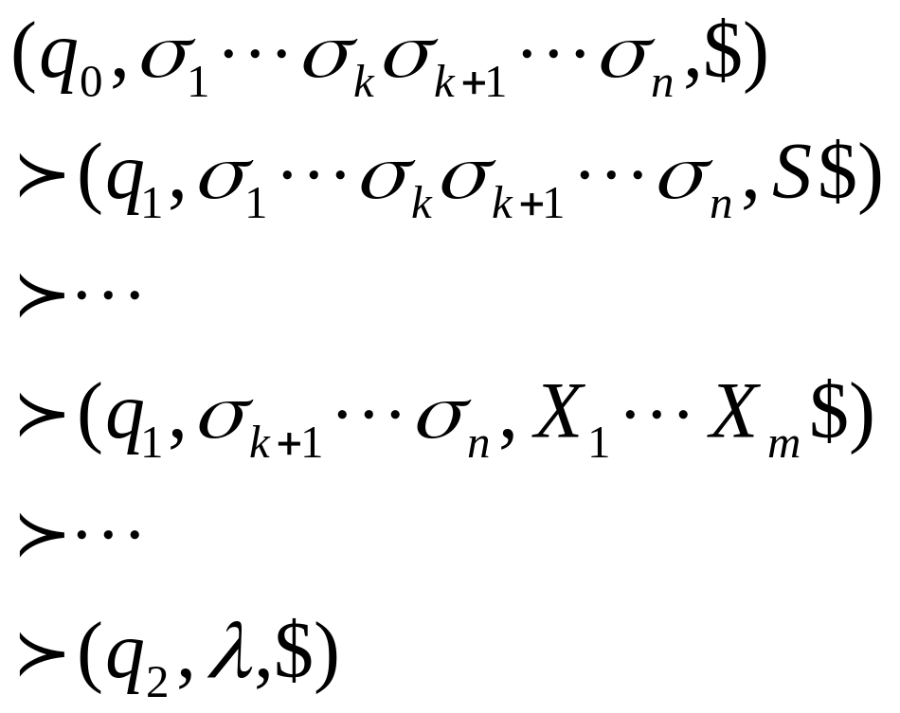
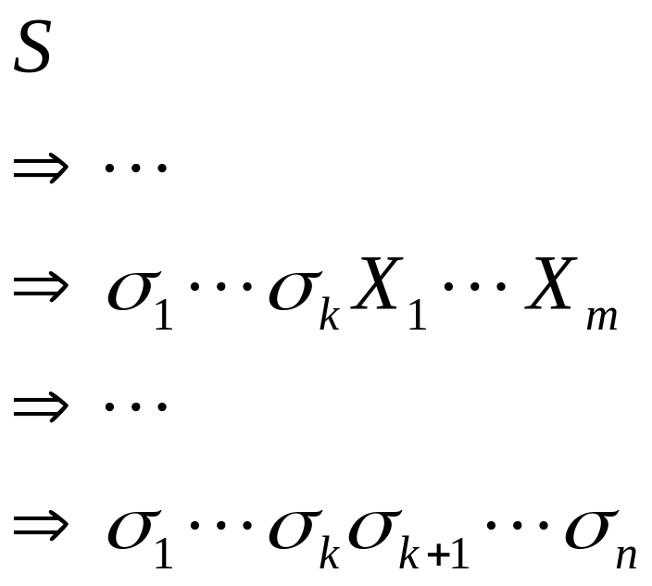
Grammar
leftmost
derivation
PDA computation
Simulates grammar
leftmost derivations
Leftmost
variable
COMP 335

Slide 11
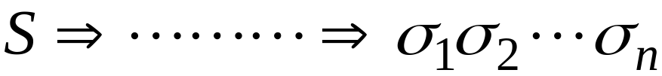


Leftmost derivation
string of all terminals
Simulation of derivation
Stack
Input
end of input is reached
COMP 335

Slide 12
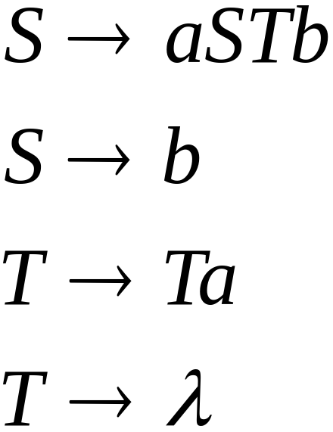
An example grammar G:
What is an equivalent NPDA? That is,
what is an NDPA M such that L(M)=L(G)?
COMP 335

Slide 13
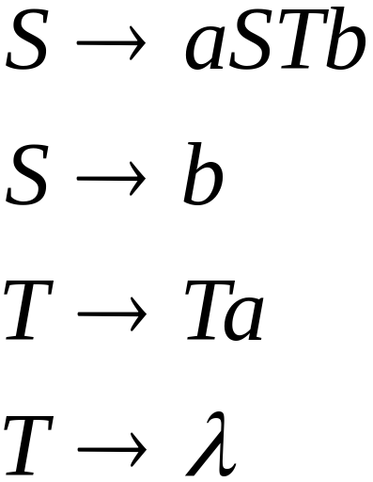
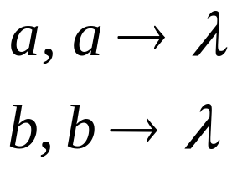
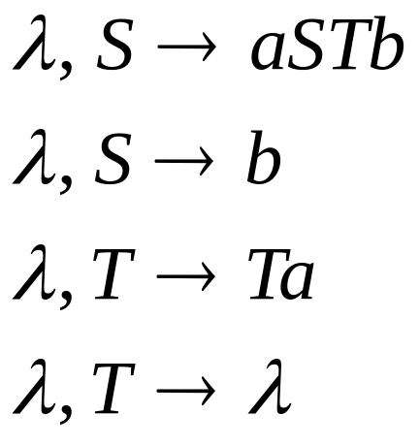
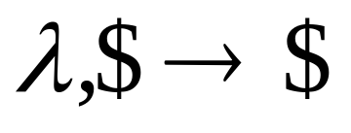
Grammar:
NPDA

Slide 14
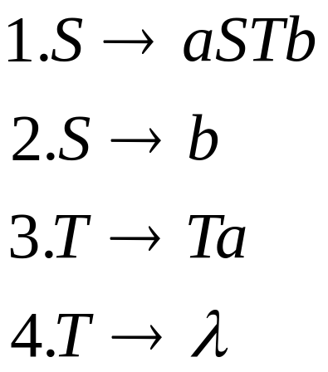
Grammar:
A leftmost derivation:
COMP 335

Slide 15




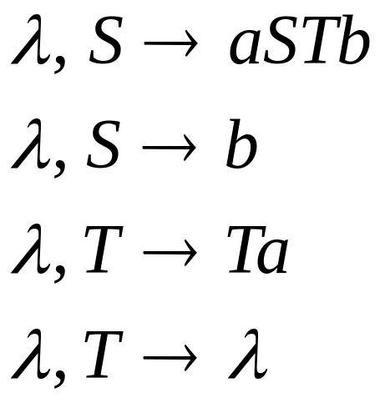
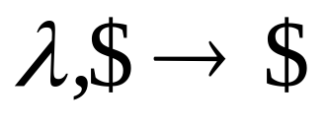

Derivation:
Input
Time 0
Stack
COMP 335

Slide 16


Derivation:
Input
Time 0
Stack
COMP 335

Slide 17


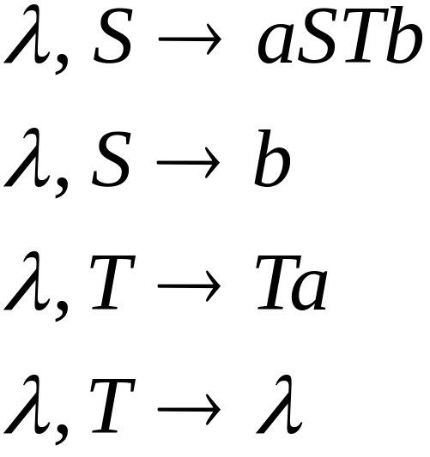
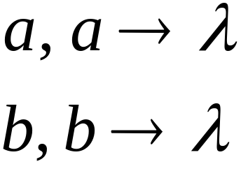

Derivation:
Input
Time 1
Stack
COMP 335

Slide 18
Derivation:
Input
Time 2
Stack
COMP 335

Slide 19

Derivation:
Input
Time 3
Stack
COMP 335

Slide 20
Derivation:
Input
Time 4
Stack
COMP 335

Slide 21
Derivation:
Input
Time 5
Stack
COMP 335

Slide 22
Derivation:
Input
Time 6
Stack
COMP 335

Slide 23
Derivation:
Input
Time 7
Stack
COMP 335

Slide 24
Derivation:
Input
Time 8
Stack
COMP 335

Slide 25
Derivation:
Input
Time 9
Stack
accept
COMP 335

Slide 26
In general:
Given any CFG grammar
We can construct a NPDA
With
COMP 335

Slide 27
Constructing NPDA from grammar :
For any terminal
For any production
COMP 335

Slide 28

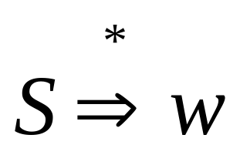
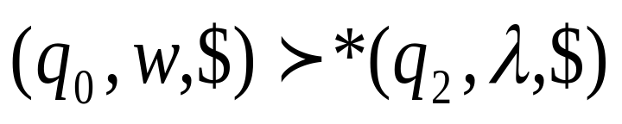
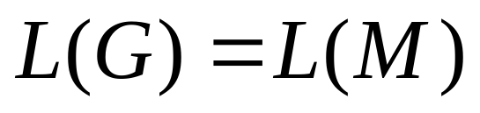
In general, it can be shown that:
if and
only if
generates
accepts
Therefore,
COMP 335

Slide 29

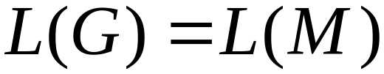
The CFG grammar generates
a string if and only if the
NPDA accepts , i.e.,
COMP 335

Slide 30
Therefore:
Given any context-free language L,
expressed by a context-free grammar G,
there exists an NPDA M that accepts L,
i.e., L(M) = L(G) = L.
Context-Free
Languages
(Grammars)
Languages
Accepted by
NPDAs
COMP 335

Slide 31
Converting
NPDAs to
Context-Free Grammars
Proof - step 2
COMP 335

Slide 32
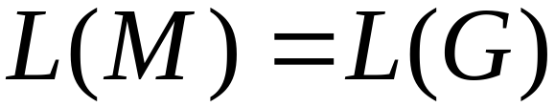
Given any NPDA ,
we will construct a
context-free grammar such that:
COMP 335

Slide 33
Intuition:
The grammar G simulates the
computation of
A derivation in Grammar :
terminals
variables
Input processed
Stack content
Current configuration in NPDA
COMP 335

Slide 34
Some Necessary Modifications
Modify (if necessary) the NPDA M so that:
1) The stack is never empty except at the end
2) has a single final state and empties
the stack when it accepts a string
3) Transitions in M are in a special form:
δ(q_{i},a,A)={c₁,c₂,…,c_{n}}, where c_{i}=(q_{j},λ) or c_{i}=(q_{j},BC)
for every symbol a in ΣU{λ}
COMP 335

Slide 35


1. Modify the PDA so that
the stack is never empty
during computation
Stack
OK
OK
NOT OK
COMP 335

Slide 36

Introduce the new symbol to mark
the bottom of the stack
COMP 335

Slide 37
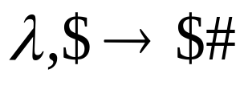
At the beginning, insert into the stack
Original PDA
new
initial state
original
initial state
COMP 335

Slide 38
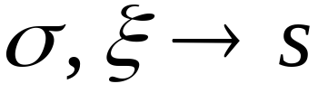


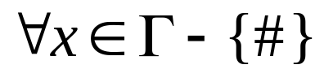
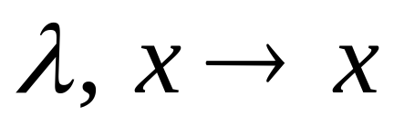

Convert all transitions so that
after popping the automaton halts
pop
pop
λ
,
#
→
#
halting state
COMP 335

Slide 39

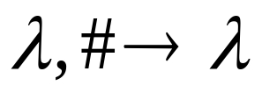
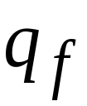
2. Modify the PDA so that at end,
it empties stack and
has a unique accept state
Empty stack
PDA
λ
,
λ
→
λ
λ
,
λ
→
λ
→
λ
λ
,
λ
New
accept
state
Old accept states
COMP 335

Slide 40



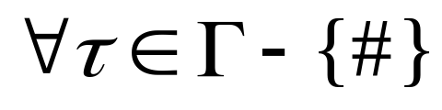
3. Modify the PDA so that it has no
transitions popping :
COMP 335

Slide 41
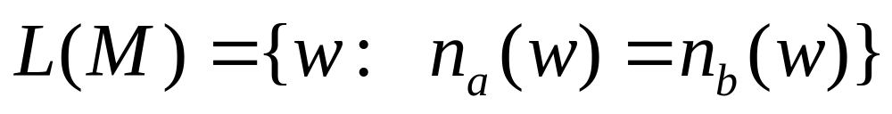







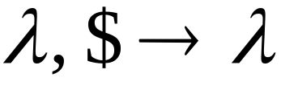

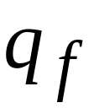
Example of a NPDA in correct form:
COMP 335

Slide 42
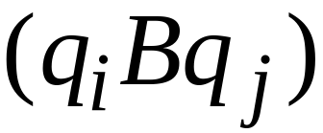
The Grammar Construction
In grammar :
Stack symbol
Variables:
states
Terminals:
Input symbols of NPDA
COMP 335

Slide 43
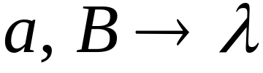
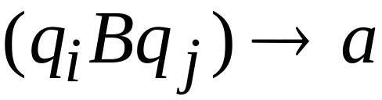
For each transition
We add production
COMP 335

Slide 44
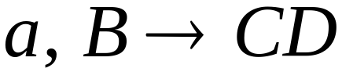
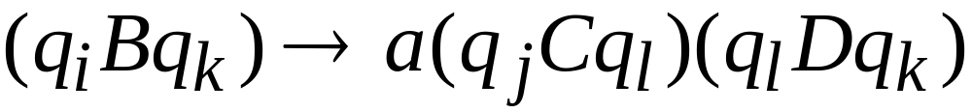
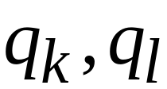
For each transition
We add productions
For all possible states
in the automaton
COMP 335

Slide 45
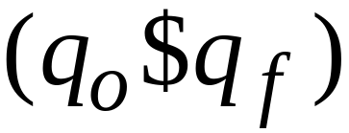
Stack bottom symbol
Start Variable:
Start state
final state
COMP 335

Slide 46
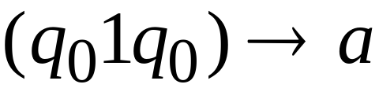
Example:
Grammar production:
COMP 335

Slide 47
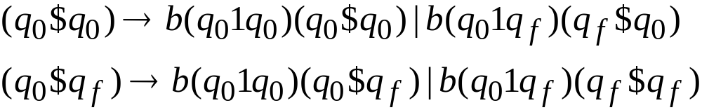
Example:
Grammar productions:
COMP 335

Slide 48
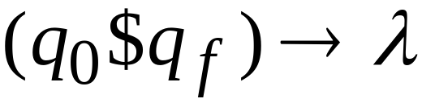
Example:
Grammar production:
COMP 335

Slide 49
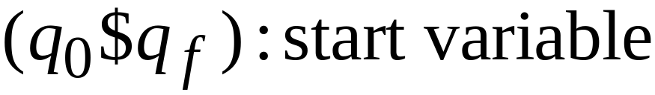
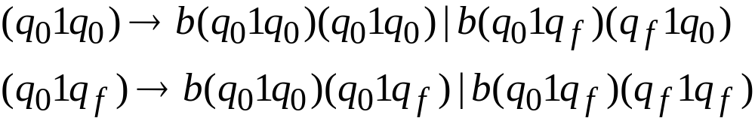
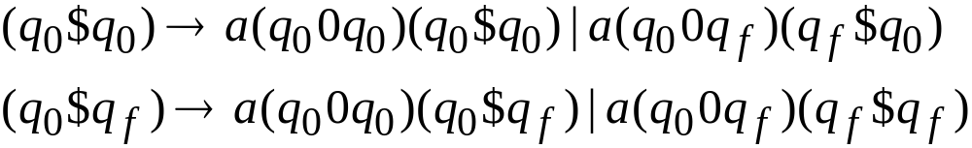
Resulting Grammar:
COMP 335

Slide 50

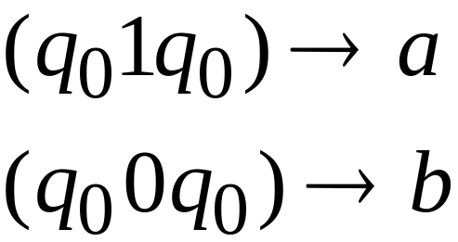
The resulting grammar obtained by converting an NPDA in general includes many useless variables and productions, which can be removed, if you wish ☺
COMP 335

Slide 51
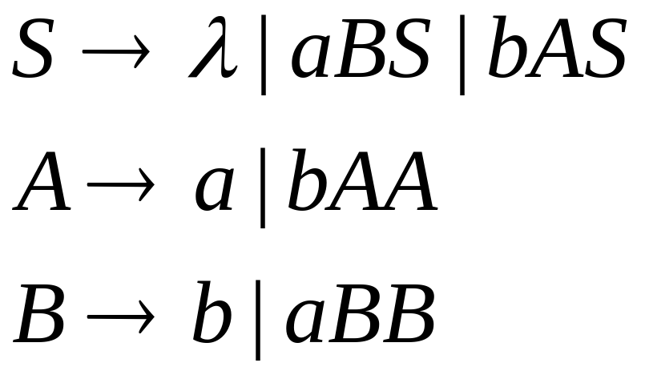
After consistent replacement of the variables and removing useless variables and rules, we get the following equivalent CFG for L(M), where A=(q₀1q₀), B=(q₀0q₀), S=(q₀$q_{f})
COMP 335

Slide 52

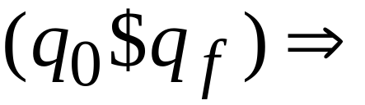




Derivation of string
Using: A=(q₀1q₀), B=(q₀0q₀), S=(q₀$q_{f}), we get:
COMP 335

Slide 53






In general:
if and only if
the NPDA goes from to
by reading string and
the stack doesn’t change below
and then is removed from stack
COMP 335

Slide 54

Therefore:
if and only if
is accepted by the NPDA
COMP 335

Slide 55


In general:
Grammar
If and
Only if
PDA
COMP 335

Slide 56


Thus:
Grammar
generates
If and
Only if
PDA accepts
COMP 335

Slide 57
Therefore:
For any NPDA
there is a context-free grammar
that accepts the same language
Context-Free
Languages
(Grammars)
Languages
Accepted by
NPDAs
COMP 335

Slide 58
Deterministic PDA
DPDA
COMP 335

Slide 59




Deterministic PDA: DPDA
Allowed transitions:
(deterministic choices)
COMP 335

Slide 60





Allowed transitions:
(deterministic choices)
COMP 335

Slide 61

Not allowed:
(non deterministic choices)
COMP 335

Slide 62



DPDA example
COMP 335

Slide 63
The language
is deterministic context-free
COMP 335

Slide 64
Definition:
L is a deterministic context-free language
if there exists some DPDA that accepts it
COMP 335

Slide 65




Example of Non-DPDA (NPDA)
COMP 335

Slide 66
Not allowed in DPDAs, since
it matches the transitions from q₀ to q₀
COMP 335

Slide 67
NPDA’s are more powerful
(expressive) than DPDA’s
COMP 335

Slide 68
It holds that:
Deterministic
Context-Free
Languages
(DPDA)
Context-Free
Languages
NPDAs
Since every DPDA is also a NPDA
COMP 335

Slide 69




We will actually show:
Deterministic
Context-Free
Languages
(DPDA)
Context-Free
Languages
(NPDA)
We will show that there exists
a context-free language which is not
accepted by any DPDA
COMP 335

Slide 70


An example of such a language is:
We will show:
is context-free
is not deterministic context-free
COMP 335

Slide 71







Language is context-free
Context-free grammar for :
COMP 335

Slide 72
Theorem:
The language
is not deterministic context-free
(there is no DPDA that accepts )
COMP 335

Slide 73

Proof:
Suppose that
is a deterministic CFL
Therefore:
there is a DPDA that accepts
COMP 335

Slide 74




DPDA for
accepts
accepts
COMP 335

Slide 75

DPDA for
Such a path exists in M because L is assumed
to be deterministic.
COMP 335

Slide 76


L’={a^{n}b^{n}: n≥0} ∪ {a^{n}b^{2n}:n≥ 0} ∪ {a^{n}b^{n}c^{n}: n≥0}
is not context-free.
(This can be shown later using the pumping
lemma for context-free languages)
Context-free languages
Regular languages
COMP 335

Slide 77
We will use M to construct an NPDA for:
L’={a^{n}b^{n}: n≥0} ∪ {a^{n}b^{2n}:n≥ 0} ∪ {a^{n}b^{n}c^{n}: n≥0}
which is a contradiction!
COMP 335

Slide 78







Modify
Replace
with
COMP 335

Slide 79






Connect final states of to final states of .
This yields the following NPDA that accepts:
L’={a^{n}b^{n}: n≥0} ∪ {a^{n}b^{2n}:n≥ 0} ∪ {a^{n}b^{n}c^{n}: n≥0}
b^{n}
COMP 335

Slide 80

Since L’ is accepted by an NPDA,
we conclude that is CF.
but this is a contradiction
(since is not context-free)
COMP 335

Slide 81
Therefore:
For the non-deterministic CFL:
there is no DPDA that accepts L
COMP 335

