Slide 1
Turing’s Thesis
COMP 335
1

Slide 2
Turing’s thesis:
Any computation carried out
by mechanical means can be
performed by a Turing Machine
(1930)
COMP 335

Slide 3
In Computer Science:
A computation is mechanical if
it can be performed by a TM
There isn’t any known model of computation
that is more powerful than TMs
COMP 335

Slide 4
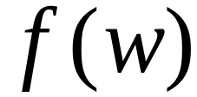
Definition of Algorithm:
An algorithm for function is a TM which computes
COMP 335

Slide 5
Algorithms are Turing Machines
When we say:
There exists an algorithm
We mean that:
There exists a Turing Machine
that executes the algorithm
COMP 335

Slide 6
Variations of
Turing Machines
COMP 335

Slide 7




The Standard Model
Infinite Tape
Read-Write Head
(Left or Right)
Control Unit
Deterministic
COMP 335

Slide 8
Variations of the Standard Model
Turing machines with:
Stay-Option
Semi-Infinite tape
Off-Line tape
Multitape
Multidimensional tapes
Nondeterministic
COMP 335

Slide 9
The variations form different Classes
of Turing Machines
It has been shown that:
Each Class has the same
power as the Standard TM
COMP 335

Slide 10
When we say two classes of TM’s are of
the same power it means that:
The languages accepted by these two classes
are the same
COMP 335

Slide 11
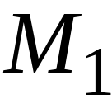
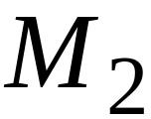
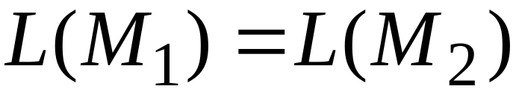
To be more precise, this means:
For any machine of first class
there is a machine of second class
such that:
And vice-versa
COMP 335

Slide 12
Simulation:
Used to prove this equivalence
Simulate the machine of one class
with a machine of the other class
First Class
Original Machine
Second Class
Simulation Machine
COMP 335

Slide 13
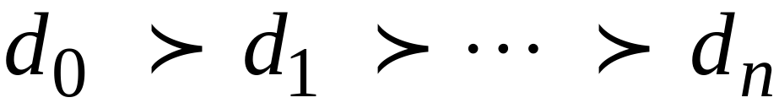
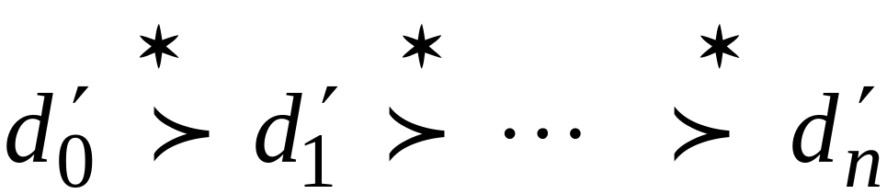
Configurations in the Original Machine
correspond to configurations in the
Simulation Machine
Original Machine:
Simulation Machine:
COMP 335

Slide 14
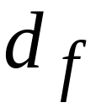
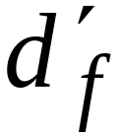
Final Configuration
Original Machine:
Simulation Machine:
The Simulation Machine
and the Original Machine
accept the same language
COMP 335

Slide 15
Turing Machines with Stay-Option
The head can stay in the same position
Left, Right, Stay
L,R,S: moves
COMP 335

Slide 16



Example:
Time 1
Time 2
COMP 335

Slide 17
Theorem:
Stay-Option Machines
have the same power as
Standard Turing machines
COMP 335

Slide 18
Proof:
Part 1: Stay-Option Machines
are at least as powerful as
Standard machines
Proof:
a Standard machine is also
a Stay-Option machine
(that never uses the S move)
COMP 335

Slide 19
Proof:
Part 2: Standard Machines
are at least as powerful as
Stay-Option machines
Proof:
a standard machine can simulate
a Stay-Option machine
COMP 335

Slide 20

Stay-Option Machine
Simulation in Standard Machine
Similar for Right moves
COMP 335

Slide 21


Stay-Option Machine
Simulation in Standard Machine M
For every symbol x in Г, where
q_{s} is a new non-final state we add in M
COMP 335

Slide 22

Example
Stay-Option Machine:
1
2
Simulation in Standard Machine:
1
2
3
COMP 335

Slide 23

Standard Machine--Multiple Track Tape
track 1
track 2
one symbol
COMP 335

Slide 24
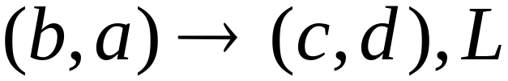
track 1
track 2
track 1
track 2
COMP 335

Slide 25

Semi-Infinite Tape
.........
COMP 335

Slide 26
Standard Turing machines simulate
Semi-infinite tape machines:
Trivial √
COMP 335

Slide 27
Semi-infinite tape machines simulate
Standard Turing machines:
Standard machine
.........
.........
Semi-infinite tape machine
.........
COMP 335

Slide 28

Standard machine
.........
.........
reference point
Semi-infinite tape machine with two tracks
Right part
.........
Left part
COMP 335

Slide 29
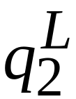
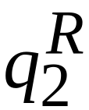
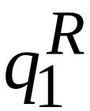
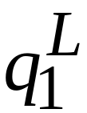
Standard machine
Semi-infinite tape machine
Left part
Right part
COMP 335

Slide 30

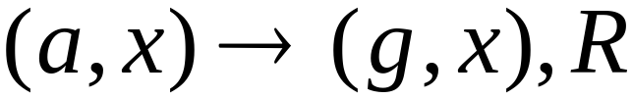
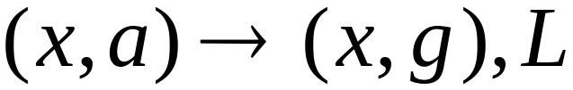

Standard machine
Semi-infinite tape machine
Right part
Left part
For all symbols
COMP 335

Slide 31
Time 1
Standard machine
.........
.........
Semi-infinite tape machine
Right part
.........
Left part
COMP 335

Slide 32

Time 2
Standard machine
.........
.........
Semi-infinite tape machine
Right part
.........
Left part
COMP 335

Slide 33
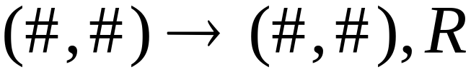
At the border:
Semi-infinite tape machine
Right part
Left part
COMP 335

Slide 34
Semi-infinite tape machine
Time 1
Right part
.........
Left part
Time 2
Right part
.........
Left part
COMP 335

Slide 35
Theorem:
Semi-infinite tape machines
have the same power with
Standard Turing machines
COMP 335

Slide 36
The Off-Line Machine
Input File
read-only
Control Unit
read-write
Tape
COMP 335

Slide 37
Off-line machines simulate
Standard Turing Machines:
Off-line machine:
1. Copy input file to tape
2. Continue computation as in
Standard Turing machine
COMP 335

Slide 38
Standard machine
Off-line machine
Input File
Tape
1. Copy input file to tape
COMP 335

Slide 39
Standard machine
Off-line machine
Input File
Tape
2. Do computations as in Turing machine
COMP 335

Slide 40
Standard Turing machines simulate
Off-line machines:
Use a Standard machine with four track tape
to keep track of
the Off-line input file and tape contents
COMP 335

Slide 41



Off-line Machine
Input File
Tape
Four track tape -- Standard Machine
Input File
head position
Tape
head position
COMP 335

Slide 42
Reference point
Input File
head position
Tape
head position
Repeat for each state transition:
Return to reference point
Find current input file symbol
Find current tape symbol
Make transition
COMP 335

Slide 43
Theorem:
Off-line machines
have the same power with
Stansard machines
COMP 335

Slide 44
Multitape Turing Machines
Control unit
Tape 1
Tape 2
Input
COMP 335

Slide 45
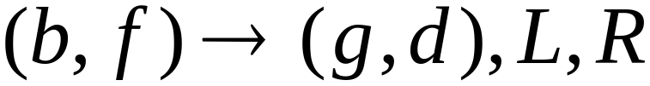
Tape 1
Time 1
Tape 2
Time 2
COMP 335

Slide 46
Multitape machines simulate
Standard Machines:
Use just one tape
COMP 335

Slide 47
Standard machines simulate
Multitape machines:
Standard machine:
Use a multi-track tape
A tape of the Multiple tape machine
corresponds to a pair of tracks
COMP 335

Slide 48

Multitape Machine
Tape 1
Tape 2
Standard machine with four track tape
Tape 1
head position
Tape 2
head position
COMP 335

Slide 49
Reference point
Tape 1
head position
Tape 2
head position
Repeat for each state transition:
Return to reference point
Find current symbol in Tape 1
Find current symbol in Tape 2
Make transition
COMP 335

Slide 50
Theorem:
Multi-tape machines
have the same power with
Standard Turing Machines
COMP 335

Slide 51
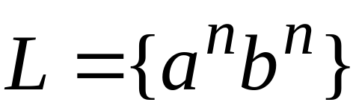
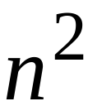

Same power doesn’t imply same speed:
Language
Acceptance Time
Standard machine
Two-tape machine
COMP 335

Slide 52

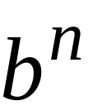

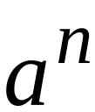
Standard machine:
Go back and forth times
Two-tape machine:
Copy to tape 2
( steps)
Leave on tape 1
( steps)
Compare tape 1 and tape 2
( steps)
COMP 335

Slide 53


MultiDimensional Turing Machines
Two-dimensional tape
MOVES: L,R,U,D
HEAD
U: up D: down
Position: +2, -1
COMP 335

Slide 54
Multidimensional machines simulate
Standard machines:
Use one dimension
COMP 335

Slide 55
Standard machines simulate
Multidimensional machines:
Standard machine:
Use a two track tape
Store symbols in track 1
Store coordinates in track 2
COMP 335

Slide 56


Two-dimensional machine
Standard Machine
symbols
coordinates
COMP 335

Slide 57
Standard machine:
Repeat for each transition
Update current symbol
Compute coordinates of next position
Go to new position
COMP 335

Slide 58
Theorem:
Multidimensional TM’s
have the same power as the
Standard TM’s
COMP 335

Slide 59

NonDeterministic Turing Machines
Non Deterministic Choice
COMP 335

Slide 60
Time 0
Time 1
Choice 1
Choice 2
COMP 335

Slide 61

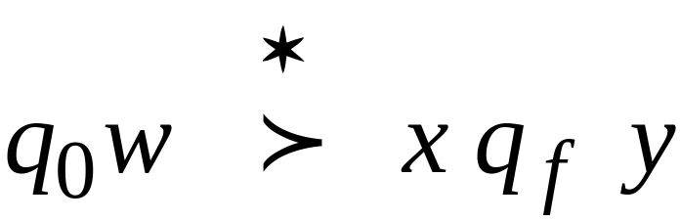
An input string is accepted if
this a possible computation
Initial configuration
Final Configuration
Final state
COMP 335

Slide 62
NonDeterministic Machines simulate
Standard (deterministic) Machines:
Every deterministic machine
is also a nondeterministic machine
COMP 335

Slide 63
Deterministic machines simulate
NonDeterministic machines:
Deterministic machine:
Keeps track of all possible computations
COMP 335

Slide 64




Non-Deterministic Choices
Computation 1
COMP 335

Slide 65
Non-Deterministic Choices
Computation 2
COMP 335

Slide 66
Simulation
Deterministic machine:
Keeps track of all possible computations
Stores computations in a 2D tape
COMP 335

Slide 67
NonDeterministic machine
Time 0
Deterministic machine
Computation 1
COMP 335

Slide 68

NonDeterministic machine
Time 1
Choice 1
Choice 2
Deterministic machine
Computation 1
Computation 2
COMP 335

Slide 69
Repeat
  Execute a step in each computation:
If there are two or more choices
in current computation:
1. Replicate configuration
2. Change the state in the replica
COMP 335

Slide 70
Theorem: NonDeterministic Machines
have the same power with
Deterministic machines
COMP 335

Slide 71
Remark:
The simulation in the Deterministic machine
takes time exponential time compared
to the NonDeterministic machine
COMP 335

