Slide 1

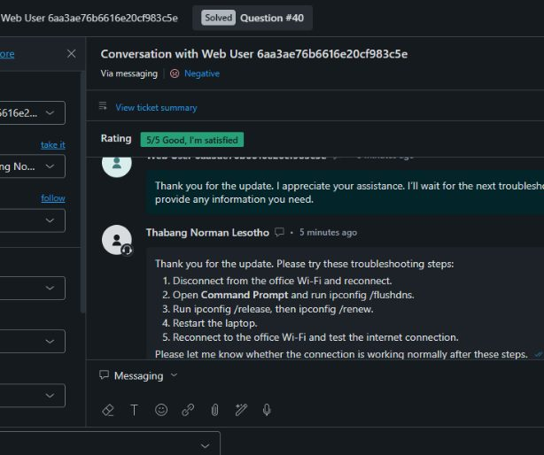
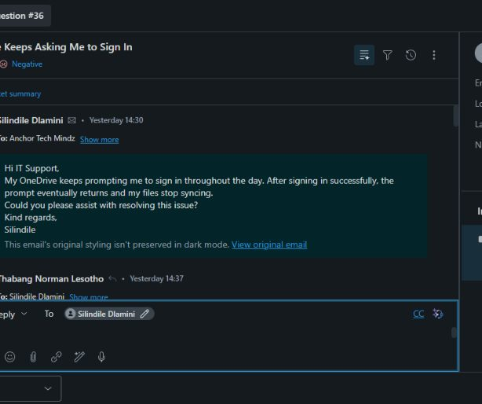
CAPACITI
WEEK 1
Helpdesk Simulation Project
Week 1 — IT Support Investigation, Troubleshooting
and Customer Communication
Candidate: Thabang Norman Lesotho
Microsoft 365 and Network & Performance Support
EVIDENCE SET
FORMAT
Five Zendesk
tickets
Individual
portfolio
FOCUS
RECORD
Process over
guesswork
Screenshots in
order

Slide 2


Selected Scenarios
02
SCENARIO GROUP 01
SCENARIO GROUP 02
Microsoft 365 & Common
Helpdesk Issues
Network & Performance
Support
—Teams and OneDrive support
—Wi-Fi, IP and DNS connectivity
—Five completed Zendesk tickets: two Microsoft
—Five completed Zendesk tickets: two Microsoft
365 and three network tickets
365 and three network tickets
02
05
02 / 03
SCENARIO GROUPS
COMPLETED TICKETS
M365 / NETWORK
CAPACITI | HELPDESK SIMULATION
02

Slide 3


Investigation and Troubleshooting
03
WORKING METHOD
EVIDENCE CAPTURED IN ZENDESK
01Collect the symptom
—Collected symptoms, timing, error messages,
affected devices, and previous attempts
02Isolate the scope
—Compared one affected device with other devices
and networks
03Test one cause
—Used Zendesk internal notes to record findings
04Apply a targeted fix
and next steps
—Used Windows network settings, Command
05Retest before closure
Prompt, Microsoft Teams, OneDrive, and
SharePoint
—Tested each proposed fix before closing the ticket
CAPACITI | HELPDESK SIMULATION
03

Slide 4
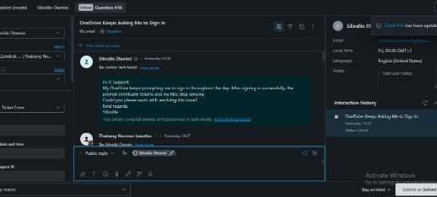
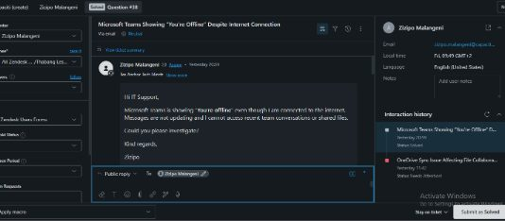
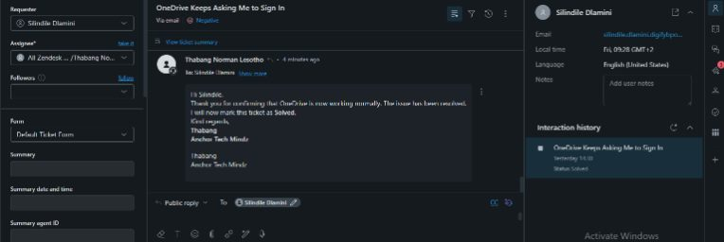
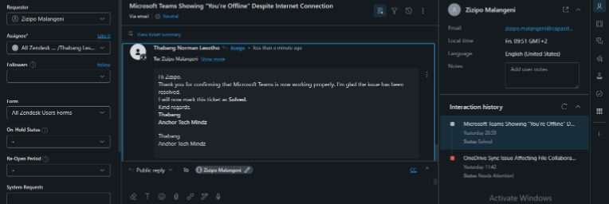
Scenario 1: Microsoft 365 Resolution
04
QUESTION #36
QUESTION #38
OneDrive sign-in
loop
Teams offline status
—Teams offline status: quit, restart,
re-authenticate, test web access, and repair
—OneDrive sign-in loop: sign out and sign
the Teams app
back in through OneDrive Account settings
—Teams result: messages and conversations
—OneDrive result: sign-in prompt stopped
updated normally
and files synced normally
—Both tickets were resolved at first line
RESOLVED AT FIRST LINE
CUSTOMER CONFIRMATION RECORDED
CAPACITI | HELPDESK SIMULATION
04

Slide 5
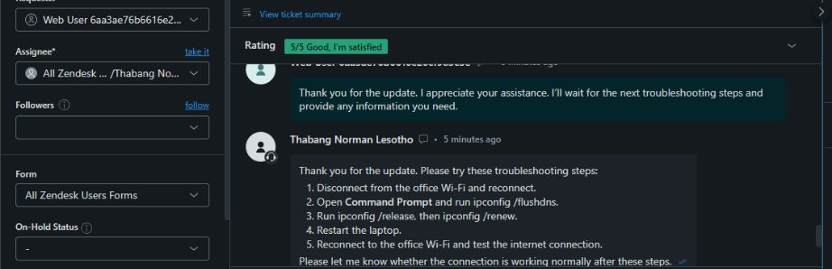
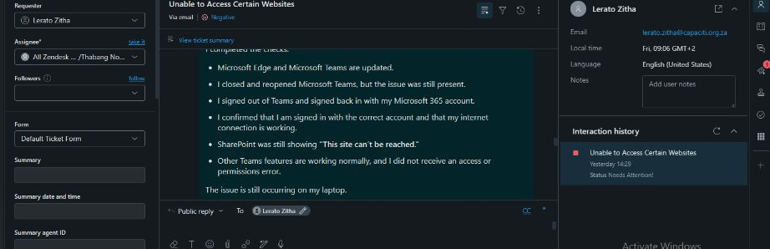
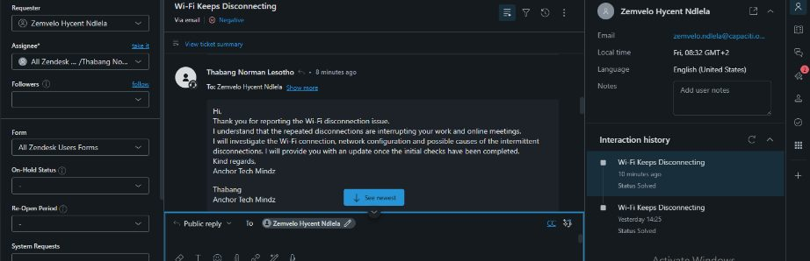
Scenario 2: Network Resolution
05
QUESTION #40
QUESTION #35
QUESTION #39
No internet access
Website access
Wi-Fi drops
—No internet access: flush
—Website access: isolate the
—Wi-Fi drops: compare
DNS, release and renew
laptop, refresh DNS and
devices and networks,
the IP address, restart,
network configuration,
review wireless settings,
reconnect, and retest
then retest SharePoint and
reconnect, and retest
Teams
—The three network tickets were resolved at first
—Customers confirmed service restoration
line
CAPACITI | HELPDESK SIMULATION
05

Slide 6

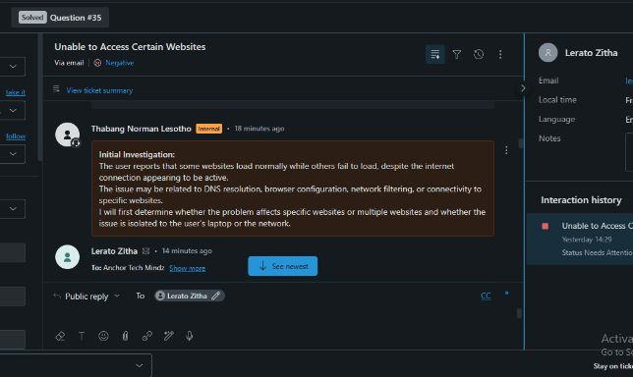
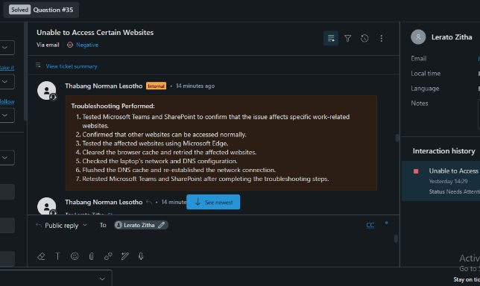
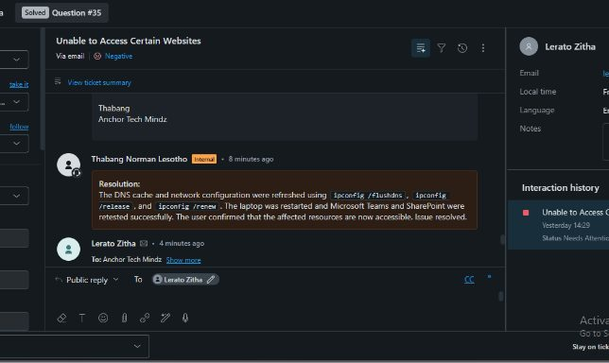
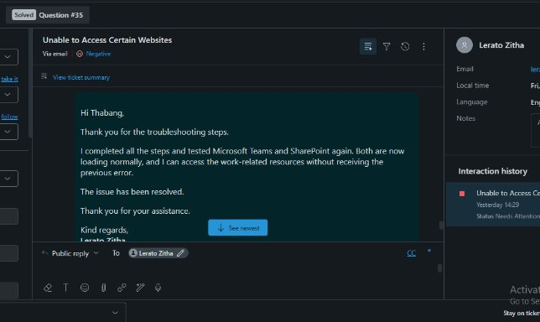
Complex Scenario Walkthrough
06
QUESTION #35 | SHAREPOINT AND TEAMS ACCESS
—User issue: Teams and SharePoint showed “This site
can’t be reached” on one Windows laptop
—Investigation: other devices and other websites worked
normally
—Research: considered DNS resolution, browser
configuration, network filtering, and device connectivity
—Troubleshooting: reviewed settings, flushed DNS,
released and renewed the IP address
—Finding: the issue was isolated to the laptop’s DNS and
network state
—Resolution: work resources loaded normally after the
configuration refresh
ZENDESK SCREENSHOTS: INVESTIGATION → INTERNAL NOTES → TROUBLESHOOTING → CONFIRMATION →
CLOSURE
CAPACITI | HELPDESK SIMULATION
06

Slide 7


User Communication
07
START WITH THE USER
INVESTIGATE WITH PURPOSE
—Acknowledged the user’s problem before
—Asked focused questions instead of assuming
giving instructions
the cause
SET EXPECTATIONS
MAKE ACTION CLEAR
—Explained what would be checked and when
—Used numbered steps for technical actions
an update would follow
CLOSE WITH EVIDENCE
PROTECT THE RECORD
—Confirmed the user’s retest before marking
—Kept public replies separate from internal
the ticket Solved
technician notes
CAPACITI | HELPDESK SIMULATION
07

Slide 8
Technical Skills Learned
08
01
02
STRUCTURED TROUBLESHOOTING
NETWORK DIAGNOSTICS
—Isolate the device, test the symptom, apply
—DNS cache refresh, IP release and renewal,
one change, and retest
device comparison, and connectivity
testing
03
04
APPLICATION SUPPORT
ZENDESK TICKET MANAGEMENT
—OneDrive authentication recovery, Teams
—Internal notes, public replies, evidence, and
session troubleshooting, and application
resolution status
repair
CAPACITI | HELPDESK SIMULATION
08

Slide 9


Customer Service Skills Learned
09
01 | ACTIVE LISTENING
02 | CLEAR COMMUNICATION
—Captured the user’s exact symptoms and
—Translated technical steps into plain language
previous attempts
03 | EXPECTATION MANAGEMENT
04 | PROFESSIONAL WRITING
—Explained the next check and provided
—Used calm, direct, and respectful replies
updates
05 | RESOLUTION CONFIRMATION
—Asked the user to retest before closing
CAPACITI | HELPDESK SIMULATION
09

Slide 10



Reflection and Personal Improvement
10
IMPROVEMENT GOAL
—Build deeper confidence with Microsoft 365
service-side diagnostics
WHY THIS GOAL
—Local fixes resolved the tickets, but tenant-side
service health and account policies can also
affect Teams and OneDrive
Process
IMPROVEMENT PLAN
—Practise Microsoft 365 admin diagnostics,
INVESTIGATE
COMMUNICATE
IMPROVE
document escalation criteria, and compare local
versus tenant-wide causes
PROJECT LESSON
—Strong helpdesk work combines logical
investigation, accurate documentation, and clear
customer communication
CAPACITI | HELPDESK SIMULATION
10

