Slide 1

News Classification Project
Author: Thabang Mmakola

Slide 2

1. Introduction
This project focuses on classifying news articles into categories.
It explores dataset loading, preprocessing, and training of a classification model.

Slide 3
2. Data Preparation
• Loaded the dataset containing labeled news data
• Cleaned and preprocessed text (tokenization, stopword removal, etc.)
• Split data into training and testing sets

Slide 4
3. Model Training
• Used machine learning models for classification (e.g., Naive Bayes, Logistic Regression, or others)
• Vectorized text data using TF-IDF or CountVectorizer
• Trained and validated models

Slide 5
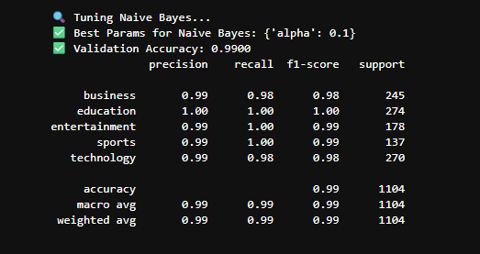
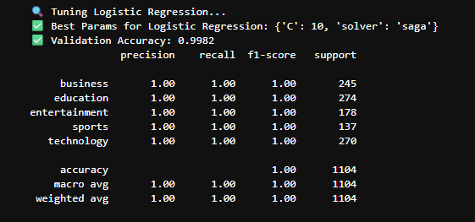
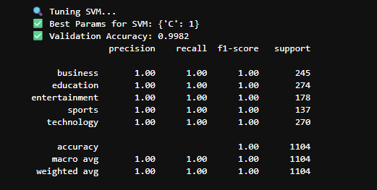
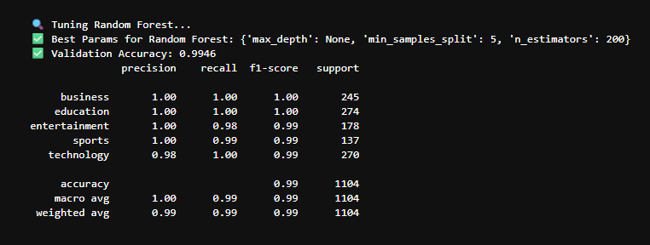
4. Evaluation
• Evaluated models using accuracy, precision, recall, and F1-score

Slide 6
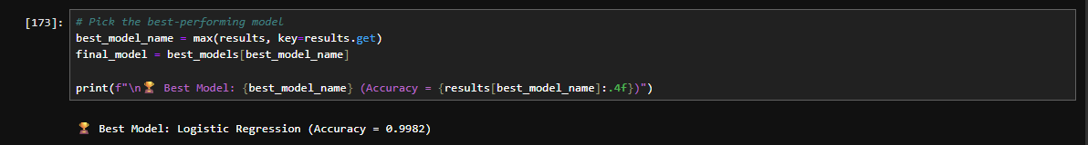
Identified best-performing model

Slide 7
5. Results and Insights
• Highlighted model performance metrics
• Discussed key insights from the classification task
• Suggested potential improvements

Slide 8
6. Conclusion
The Naive Bayes and Logistic Regression models delivered the best accuracy for the news text dataset, these models typically perform well in text classification tasks due to their probabilistic nature and linear decision boundaries.
Random Forest provided interpretability through feature importance but might have been slower and less effective on sparse text data.
SVC achieved balanced results but required parameter tuning (e.g., kernel type, C-value) for optimal performance.
Feature vectorization using TF-IDF or CountVectorizer played a critical role in determining accuracy.
Overall, the models successfully classified news articles into their correct categories with good precision and recall, indicating a well-structured NLP pipeline.

