Slide 1
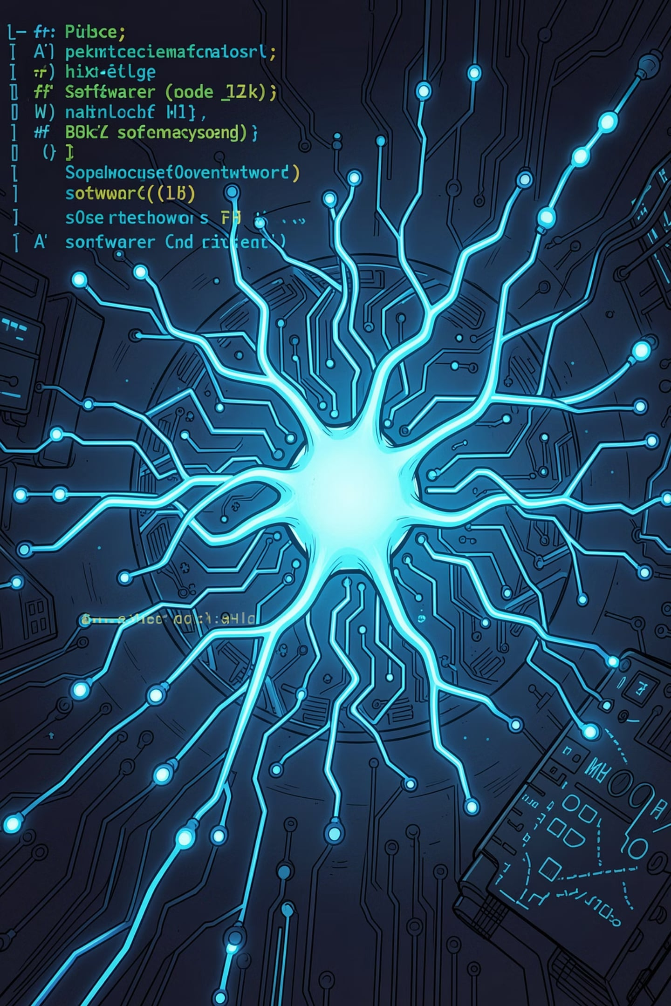

AI Smart Bug Analyzer & Fix Advisor
Infosys Springboard Internship Project · Milestone 1 Submission
Presented by Thabassum Ara

Slide 2

PROJECT OVERVIEW
What This Project Does
RAG-Powered Analysis
Multi-Source Input
Retrieval Augmented Generation enables precise, context-aware bug analysis and fix recommendations.
Analyzes bug reports, system logs, and stack traces from diverse software projects.
AI Fix Recommendations
Automatically recommends fixes by learning from historical defect patterns and similar past bugs.

Slide 3

PROBLEM STATEMENT
The Challenge in Bug Analysis
Time-Consuming Manual Analysis
Duplicate Bug Reports
Unsearchable Repositories
Complex Root Cause Identification
Engineers spend hours diagnosing bugs that could be automated with AI assistance.
Redundant reports waste development effort and inflate backlog size unnecessarily.
Large bug databases lack semantic search, making past fixes difficult to retrieve.
Pinpointing root causes demands significant domain expertise and manual investigation.

Slide 4




OBJECTIVES
Project Objectives
Automate Bug Analysis
Historical Defect Knowledge Base
Reduce manual effort with intelligent, automated defect analysis pipelines.
Build a searchable repository of past bugs and their resolutions for reuse.
Duplicate Detection
AI Fix Recommendations
Identify and flag duplicate bug reports using semantic similarity matching.
Suggest possible fixes by learning from historical defect resolution patterns.

Slide 5






TECHNOLOGY STACK
Tools & Technologies
Python
Streamlit
FAISS
Sentence Transformers
Core language for all AI and backend logic
Interactive web application interface
High-speed vector similarity search engine
Semantic text embedding generation
GitHub
RAG Architecture
Version control and project repository
Retrieval Augmented Generation pipeline

Slide 6
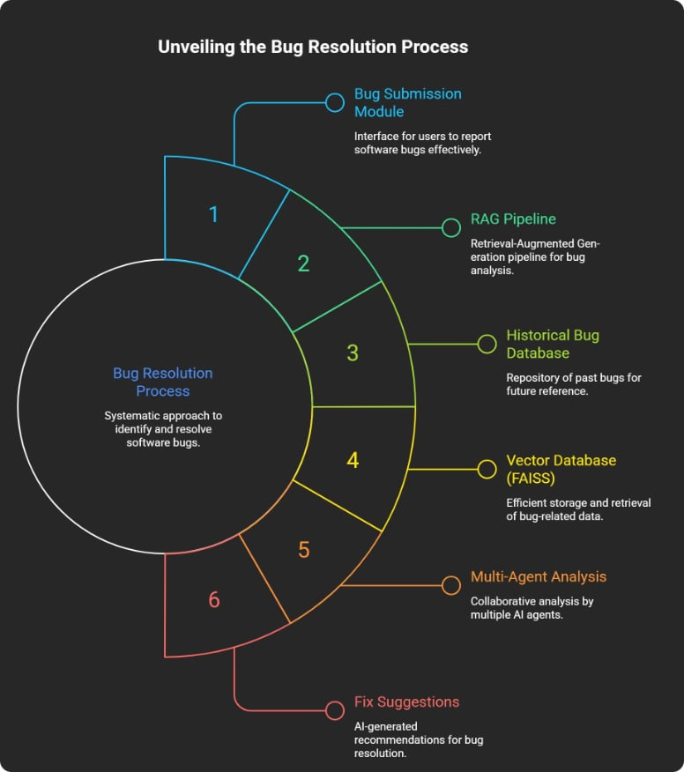
ARCHITECTURE
System Architecture
The pipeline flows from bug ingestion through semantic vector search to AI-powered multi-agent analysis, delivering precise fix recommendations to developers.
01
02
Bug Submission Module
Preprocessing & Embedding Generation
03
04
FAISS Vector Store
Similarity Search
05
06
Multi-Agent Analysis
Fix Recommendation

Slide 7


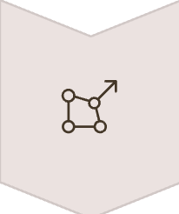



WORKFLOW
Bug Analysis Pipeline
A structured six-step pipeline ensures every bug report is processed, matched, and analyzed before a fix recommendation is generated.
User Uploads Bug Report
Data Processing
Embedding Creation
Similarity Matching
Bug Analysis
Recommendation Generation

Slide 8
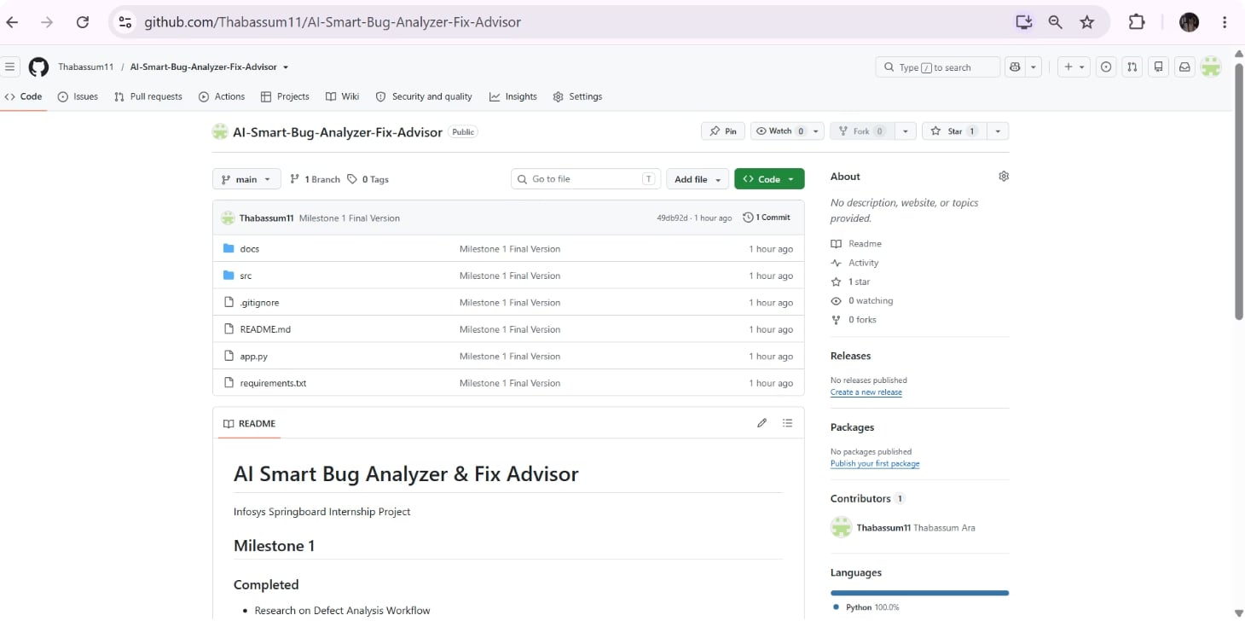

MILESTONE 1
Implementation Completed
Research Completed
Defect Analysis Workflow
RAG Architecture
Semantic Similarity Techniques
Bug Report Structures
Development Delivered
Bug Submission Module
DeepTriage Dataset Processing
GitHub Repository Screenshot
FAISS Vector Store Creation
GitHub Repository Setup

Slide 9
PROGRESS & RESULTS
Current Progress & Achievements
1
1
Streamlit App
Dataset Processed
Bug Submission Module Planned and Partially Implemented
DeepTriage dataset successfully ingested and cleaned
1
1
Knowledge Base
FAISS Index
Historical defect knowledge base initialized
Vector index successfully created and validated
GitHub repository is actively maintained with version control, commit history, and documentation for full transparency and reproducibility.

Slide 10

WHAT'S NEXT
Future Work
Expand Knowledge Base
1
Scale the historical defect repository with more datasets
2
Duplicate Detection Agent
Implement semantic duplicate bug report identification
Root Cause Analysis Agent
3
Build AI agent for automated root cause identification
4
Remediation Agent
Develop agent for automated fix suggestion and validation
Multi-Agent AI Advisor
5
Integrate all agents into a complete AI bug advisor system
🔗 GitHub Repository: https://github.com/Thabassum11/AI-Smart-Bug-Analyzer-Fix-Advisor

