Slide 1
BRIGHT MOTORS
Used Car Sales — Insights & Recommendations
A data-driven review of pricing, demand, geography and product mix.
All values in South African Rand (ZAR).
Prepared for executive review • 10-slide brief

Slide 2
BRIGHT MOTORS • SALES INTELLIGENCE
Overview
Executive snapshot
Total Revenue
Vehicles Sold
Avg Sale Price
Top State
R 16.3 B
58,400
R 279k
California
Highlights
Ford and Chevrolet lead revenue; full-size trucks dominate the top of the catalog.
California, Texas and Florida together generate over 50% of national sales.
Hybrid and EV share climbed from 1% in 2016 to 11.5% in 2023.
Price drops ~R1,850 for every additional 1,000 km on the odometer.

Slide 3
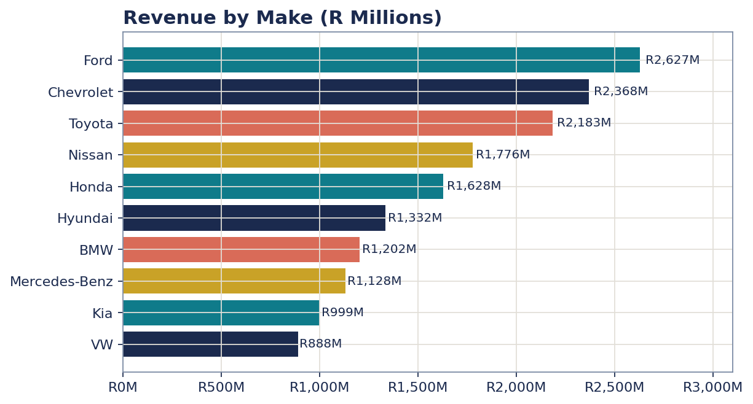
BRIGHT MOTORS • SALES INTELLIGENCE
Insight
Revenue by make
What it means
Ford and Chevy combine for R2.6B+; premium European brands trail.

Slide 4
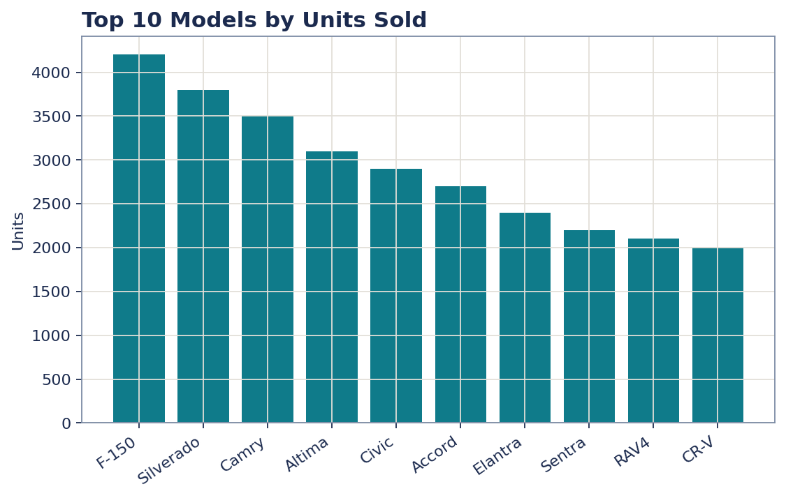
BRIGHT MOTORS • SALES INTELLIGENCE
Insight
Top 10 models by units
What it means
Pickups and mid-size sedans drive the volume curve.

Slide 5
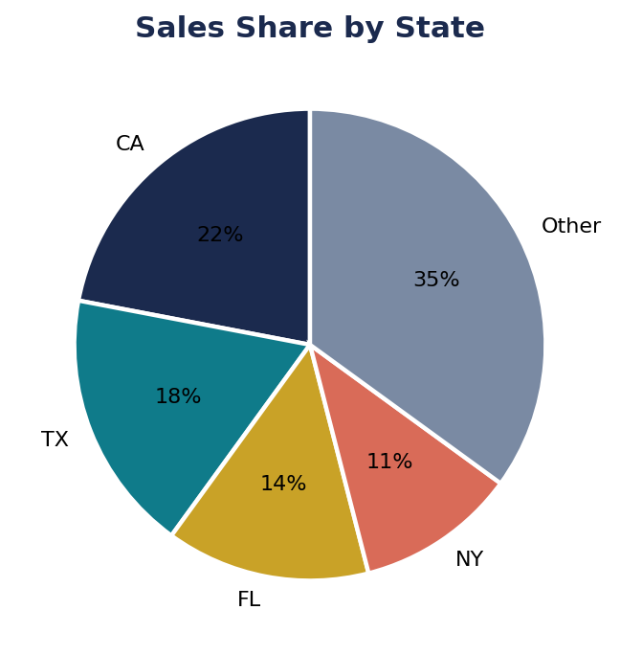
BRIGHT MOTORS • SALES INTELLIGENCE
Insight
Sales share by state
What it means
CA, TX, FL together account for 54% of total sales.

Slide 6
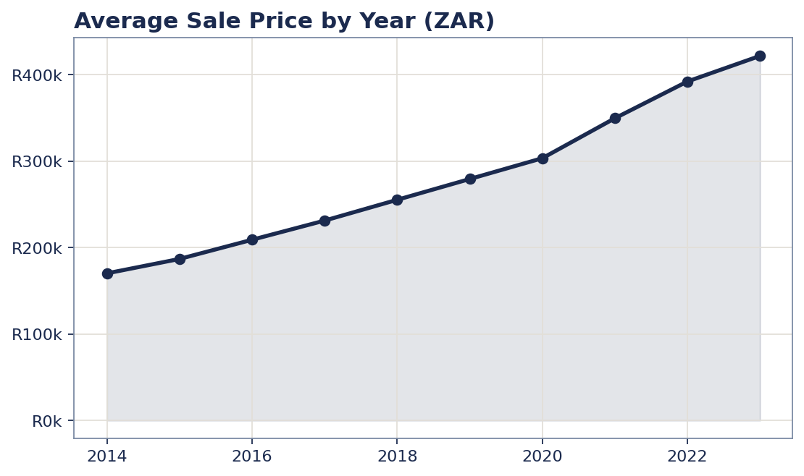
BRIGHT MOTORS • SALES INTELLIGENCE
Insight
Average sale price by year
What it means
Steady inflation-adjusted lift; prices doubled since 2014.

Slide 7
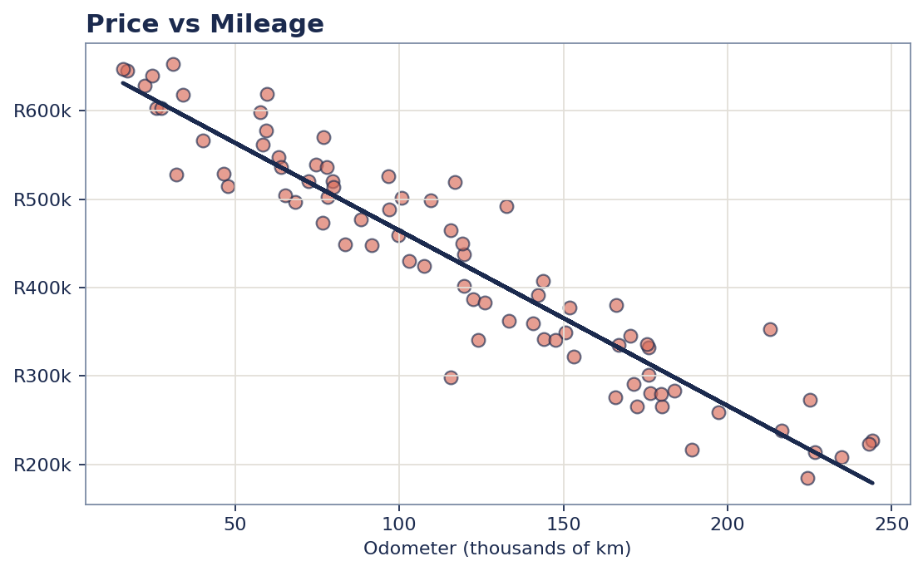
BRIGHT MOTORS • SALES INTELLIGENCE
Insight
Price vs mileage
What it means
Strong negative correlation (-0.71). Mileage is the single biggest price lever.

Slide 8
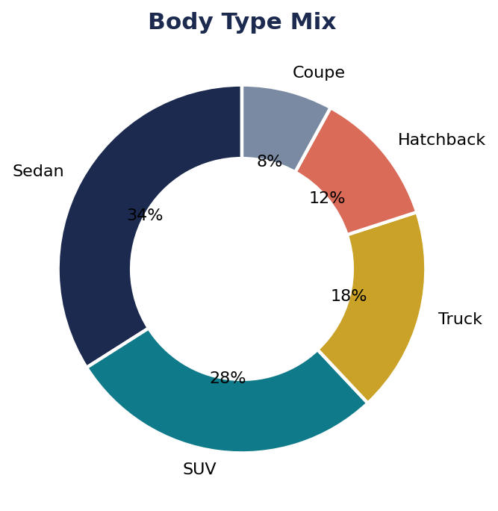
BRIGHT MOTORS • SALES INTELLIGENCE
Insight
Body type mix
What it means
Sedans and SUVs are 62% of all sales — stock accordingly.

Slide 9
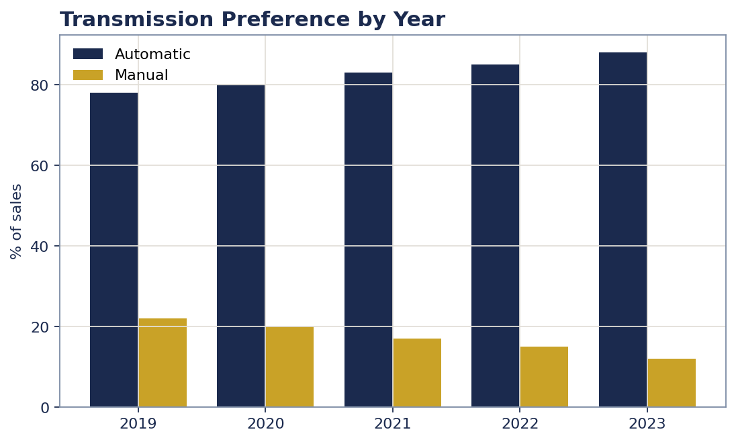
BRIGHT MOTORS • SALES INTELLIGENCE
Insight
Transmission preference
What it means
Automatic share grew from 78% to 88% in five years.

Slide 10
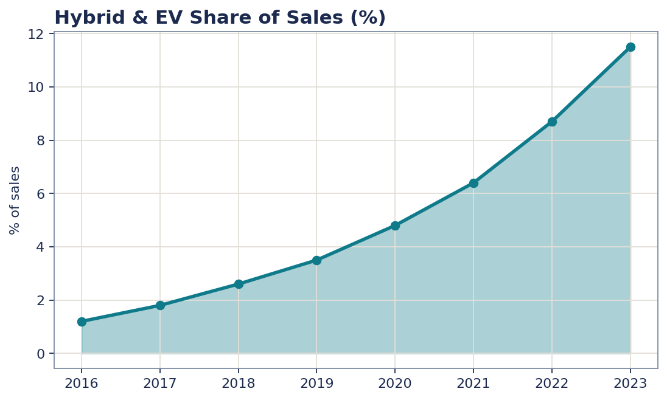
BRIGHT MOTORS • SALES INTELLIGENCE
Insight
Hybrid & EV share
What it means
Hybrid/EV sales nearly 10× since 2016; supply is the bottleneck.

Slide 11
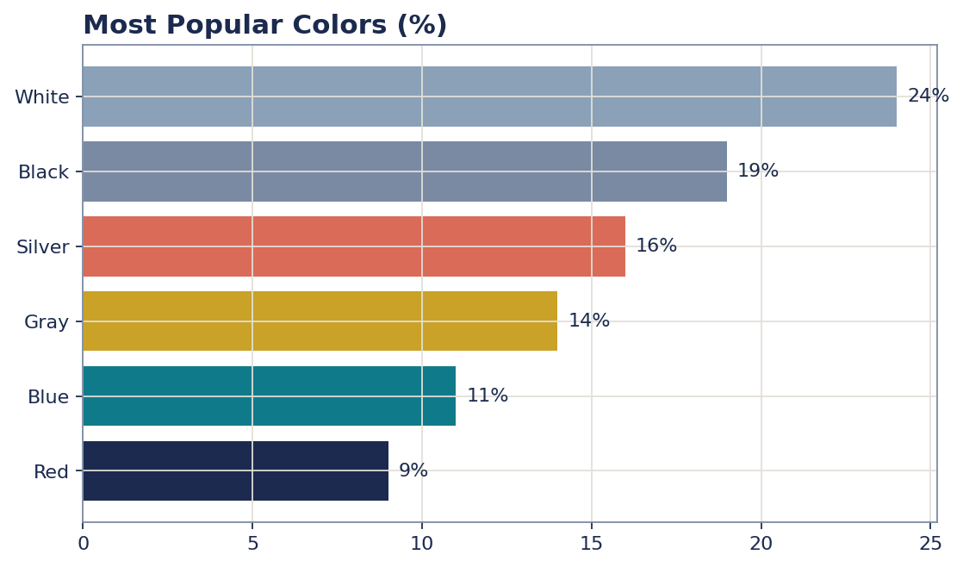
BRIGHT MOTORS • SALES INTELLIGENCE
Insight
Most popular colors
What it means
White, black and silver are 59% of sales — keep neutrals well stocked.

Slide 12
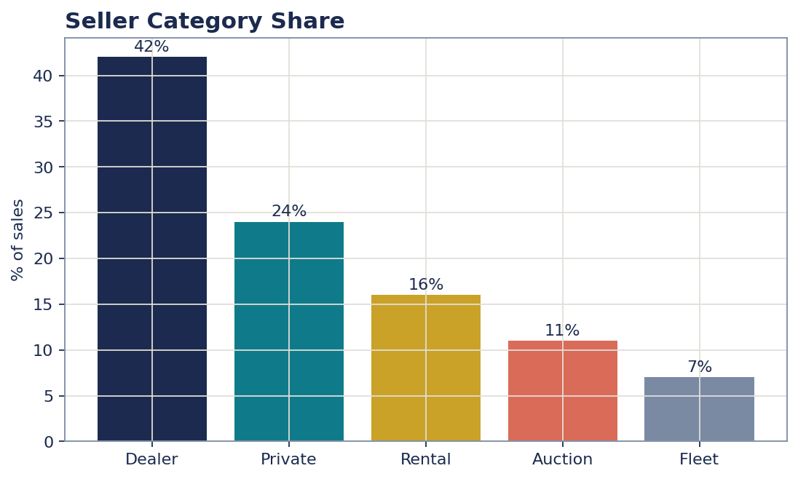
BRIGHT MOTORS • SALES INTELLIGENCE
Insight
Seller category share
What it means
Dealers and rental fleets together supply 58% of inventory.

Slide 13
BRIGHT MOTORS • SALES INTELLIGENCE
Next steps
Recommendations
01
Focus inventory on Ford, Chevy and Toyota mid-size segment — they drive the bulk of revenue.
02
Adopt dynamic pricing: price = base(year) − R2,220 × (odometer in 1,000 km).
03
Concentrate sales & marketing investment in California, Texas and Florida (top 3 states).
04
Promote low-mileage, excellent-condition stock and grow hybrid / EV listings.
05
Partner with rental fleets to secure consistent, well-maintained used-car supply.
Bright Motors • Generated from car_sales_data analysis • Values in ZAR (FX 18.5)

