Slide 1
Using Feature Engineering Techniques to Improve Multivariate Model Forecasting of the South African Unemployment Rate

Slide 2
What this presentation will cover.
Introduction
Related work
Results and Discussions
Conclusions

Slide 3
1. Introduction
What is feature engineering?
Feature Engineering is a machine learning process for extracting useful features out of raw data using domain knowledge.
It aims to find significant features, through processes such as combining relatively insignificant features to contribute to the model.
Notes:
Consider predicting the unemployment rate in South Africa using time series data. This problem requires domain knowledge on what are the best features in predicting the unemployment rate and what features will most likely have no effect

Slide 4
Some well know feature engineering techniques.
Binning,
Log Transforms,
One-Hot encoding,
Scaling,
Feature splitting,
Grouping Operations,
Handling outliers and
Date Extraction.

Slide 5
Case study: Predicting the South African unemployment rate using time series data.
This problem requires domain knowledge on what are the best features in predicting the unemployment rate and what features will most likely have no effect.
An idea would be to select a batch of features randomly and try to model the problem using only those features.
One would then try repeatedly taking a random sample of a set number of features until they find the model that best fits the data.
While keeping bias and high variance low.

Slide 6
Why a paper on feature engineering?
Previous work on improving the performance of multivariate machine learning forecasting models focused on feature selection techniques.
They often do not cover the entire space of feature Optimization, limiting the scope of the problem.
Using feature engineering to improve the performance of the models each feature has the potential to be engineered to have a meaningful impact on the final model.
Every feature in the data set is seen as useful rather than selecting only a subset and leaving other features unexplored.

Slide 7
Why we chose to model the south African unemployment rate?
South Africa’s unemployment rate shows no sign of slowing down, in the fourth quarter of 2020 the rate was 32.5% the highest ever recorded
This raises concerns regarding the well-being of the country. The South African market is still not creating enough jobs as more people enter the labour market.
Accurately predicting the unemployment rate can help policymakers deal with the unemployment crisis.

Slide 8
2. Related Work.
What will be covered in this section.
Data
Models
Feature Engineering
Measures of performance
Conclusion

Slide 9
2.1 Data
Data is one of the most important components of research. The most common datasets used for time series forecasting is usually around 100–160 features and over 700 observations
The data is extracted from different sources.
For forecasting of South African unemployment, the data is typically sourced from the Bureau of Economic Research, South African Reserve bank, Quantec, and Statistics South Africa.
Sources for other research not predicting the South African unemployment rate include the Federal Reserve Bank of St Louis, Eurostat database etc

Slide 10
What to do with missing data?
A couple of feature selection techniques have been applied in the literature
Filter, Embedded and methods.
Various missing data imputation techniques are used in literature.
With the most common being
mean value
imputation, constant
imputation,
forward imputation,
k- nearest neighbour (kNN) imputation, multivariate imputation by chained equations,
and last known value imputation

Slide 11
2.2 Models
The models can be split into two camps, Statistical and Machine Learning models.
Statistical Models
Machine learning Models
There is a disagreement in the literature on whether machine learning models can hold their own and perform better than statistical methods.
Some literature claiming that most machine learning methods models still have to go a long way to achieve an accuracy of statistical methods.

Slide 12
2.3 Feature Engineering
For ratio of difference, descent-based features can be useful for various models.
For example, support vector machines and neural networks can benefit from these features.
Also, count-based engineering features are very helpful for random forests and reinforcement machines.

Slide 13
2.4 Measures of Performance
Which models use what measure of accuracy changes a lot of things.
The most popular performance measure is The R-squared
We also have a common performance measure in time-series analysis.
The Mean Absolute Percentage Error (MAPE). Since MAPE penalizes large positive errors more than negative ones,
MASE is usually introduced as a band-aid to this problem

Slide 14
2.5 Conclusion
Statistical forecasting has progressed due to the demand for empirical studies by both practitioners who want to utilise the most accurate models as well as the academic community.
These studies helped establish two ideas in the statistical world.
Firstly, models that best fitted sampled data did not necessarily fit real world data that well.
Secondly, the post sample forecasting of simple models is as good as the sophisticated ones.

Slide 15
Much must be done to improve the forecasting ability of machine learning models.
While providing new machine learning models that can forecast better than the currently available models can be a solution
This approach is time-consuming and very costly. At the same time, empirical proof needs to be provided that test these models against benchmarks such as the naive method.
One area that shows light in improving the accuracy of machine learning models is feature optimisation techniques.

Slide 16

Results and Discussion
Data Preparation
experiments
Analysis and Results

Slide 17
3.1 Data Preparation
The Data used in this paper was sourced from the South African Reserve Bank.
It consists of 794 rows and 47 features.
The features can be categorized as monthly, quarterly and annually. Each feature is a time series from 1960 January to December 2019.
The data had missing values due to mixed frequencies. The issue was addressed by deleting quarterly and annual data.
To further address missing values in the monthly data, 7 imputation techniques were applied to the data. The techniques are as follows.

Slide 18
Filling missing values with 0’s,
Multivariate feature imputation
Forward fill
Univariate feature imputation (mean, median and most frequent imputation techniques. )
Nearest neighbours' imputation.
Each method was evaluated using a 5-fold cross-validation technique. The following Table shows the R-squared score for each k-th fold.
For each k-th fold the testing set was restricted to 24 while the training set kept changing due to out data being time series data and can not be split at random.

Slide 19
3.2 Experiments
SVR was used as the model for testing various techniques
The choice was motivated by the fact that it had the highest R-squared score as compared to other models when feature selection was applied.
The process of engineering features can be summarised into four categories.

Slide 20
Lags This process explores the impact of adding lags to the data. The focus is on how many lags are best suited to improve the models forecasting ability. For this experiment, two lags were added to the data.
Statistical Features These features were sourced using statistical measures. For each feature in our base dataset.
Fast-Fourier transform (FFT) The Fourier transform is a function that takes time-domain signals into the frequency domain. These features were created by taking the Fourier transform of the base dataset and applying statistical transformations to obtain a total of 611 features.
tsFresh features Before these features were extracted a correlation between the original 47 features and the target variable revealed the most highly correlated feature.
This feature is Domestic output: All groups Using the python package tsFresh, 787 features were extracted from Domestic output: All groups feature.
Extracting features only on this feature and not on the other 46 was motivated by the fact that the correlation of the other 46 was less than |0.5|. It was wiser to pursue the features with a correlation of above 0.9.

Slide 21
The total number of features that were engineering ended up at 3237.
Feature selection was applied to reduce the dimensionality of the problem
Model features selection was applied with the model of choice being linear regression.
This reduced the number of new features to a value of 359.

Slide 22
3.3 Analysis and Results
The first feature engineering technique that was applied in this paper was imputation.
five imputation methods namely Forward fill, mean imputation, median imputation, most frequent imputation, multivariate imputation and KNN imputation were applied to the original data.
SVR was run on each dataset and the R-squared score of the model for each set was recorded

Slide 23
Forward fill imputation gave the best R-squared score of 0.496.
The lowest forward fill score recorded is -0.61, and the lowest score overall was -0.67 and comes from Multivariate imputation.
The highest score obtained by Multivariate imputation is - 0.015.

Slide 24
Table 1: The R-squared score
Imputation techniques
k-th Fold | benchmark | mean | ffill | median | KNN | multi | most frequent
0 | 0.209985 | -0.214164 | -0.532729 | -0.411825 | -0.214164 | -0.214164 | -0.524148
1 | 0.202815 | 0.155969 | -0.24731 | -0.00322 | 0.155969 | 0.155969 | -0.582374
2 | 0.078732 | 0.004216 | 0.09134 | -0.164357 | 0.004216 | 0.004216 | - 0.802993
3 | 0.41782 | 0.037753 | -0.612516 | -0.066482 | 0.037753 | 0.037753 | -0.985309
4 | 0.274759 | -0.056978 | 0.496297 | -0.101263 | -0.056978 | -0.056978 | -1.307616

Slide 25
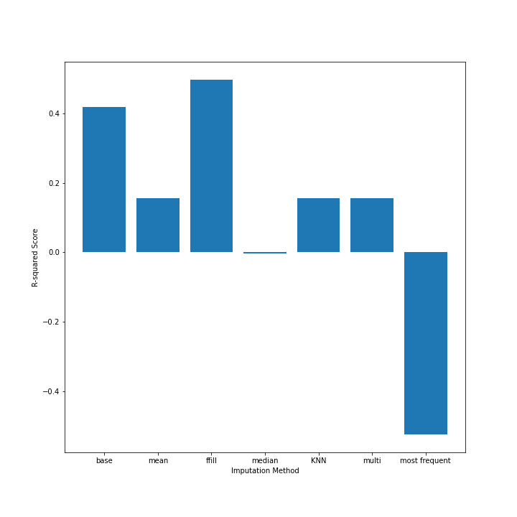
R-squared scores of different Imputation techniques

Slide 26
Following imputation techniques, experiments were run on the 359 features that were extracted across the different categories.
Each feature was added to the base data set one at a time and an SVR model was run on it after the addition of the feature.
Then the feature will be removed, and a new feature would be added in its place.
This was done to measure the impact of each feature on the dataset

Slide 27
Across all four categories of selected features, the tsFresh category had 272 features out of 359 features.
The average R-squared score for this category is 0.547083.
The feature that improved the base data set the best also came from this category with an R-squared score of 0.580946.
The worst performing category is Fourier Transform Features. No features from this category were selected.
The graph shows the top 3 features relative to the rest of the
features which are labelled as other.
The lowest R-squared score recorded is 0.477384 this is lower than our base dataset score with no added features.

Slide 28
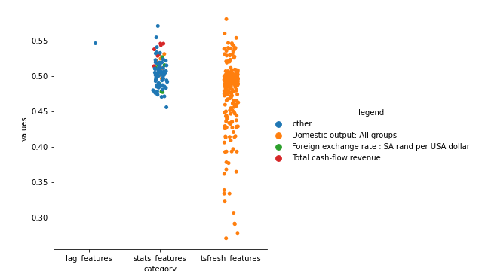
R-squared for different
feature engineering techniques

