Slide 1
CSC2001F: Priority Queues
Omowunmi Isafiade
Email: omowunmi.isafiade@uct.ac.za Office: Room 306

Slide 2
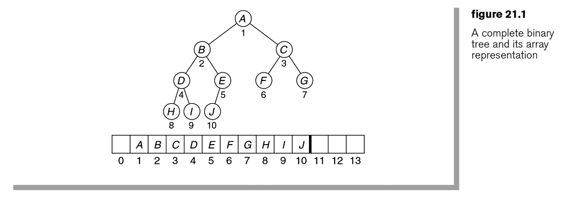

Slide 4
Binary heap – structure property
11
15
24
10
11
17
15
14
24
20
19

Slide 5
Binary heap – structure property
11
15
24
10
11
17
15
14
24
20
19

Slide 6




Binary heap – insertion
Consider a binary heap formed from the set {15, 11, 24} Insert the elements {14, 10, 17, 20, 19} into the heap above
11
15
24
10
Resulting heap!
11
17
15
14
24
20
19

Slide 7
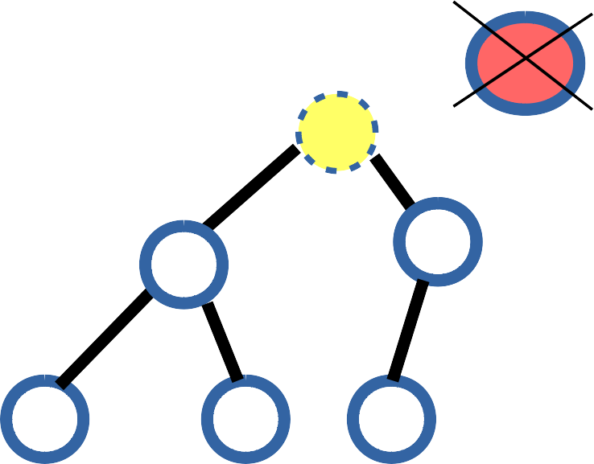
Heap Operations – Deletions Example
1100
12
11
Compare empty slot's (node 10's) immediate children nodes
to find the min of both and Compare “20” to the min
14
13
22
20

Slide 8
Heap Operations – Deletions Example
1100
11
12
Now compare the children nodes of the current empty slot
to find the min. 20< 22, so 20
moves into the empty position
14
13
22
20

Slide 9
Heap Operations – Deletions Example
11
12
20
14
13
22
Final binary heap: satisfying both Ordering and structure property

Slide 10

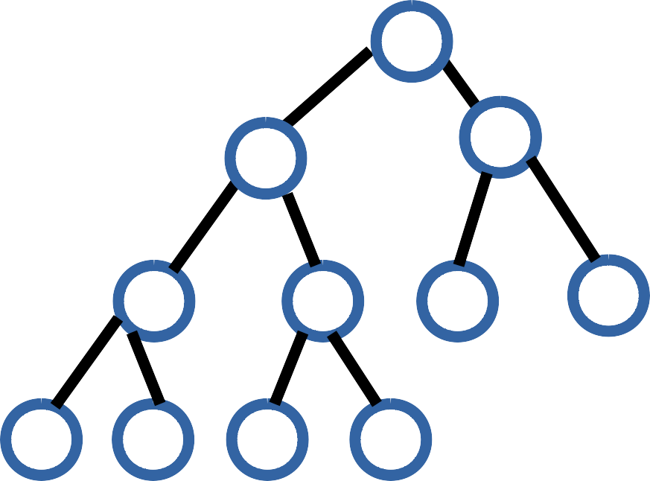
Binary Heap – Deletion Exercise
Exercise: Delete “11” and “12” from the binary heap below and show the resulting heap
11
12
14
17
23
18
54
57
29
31
27

Slide 11
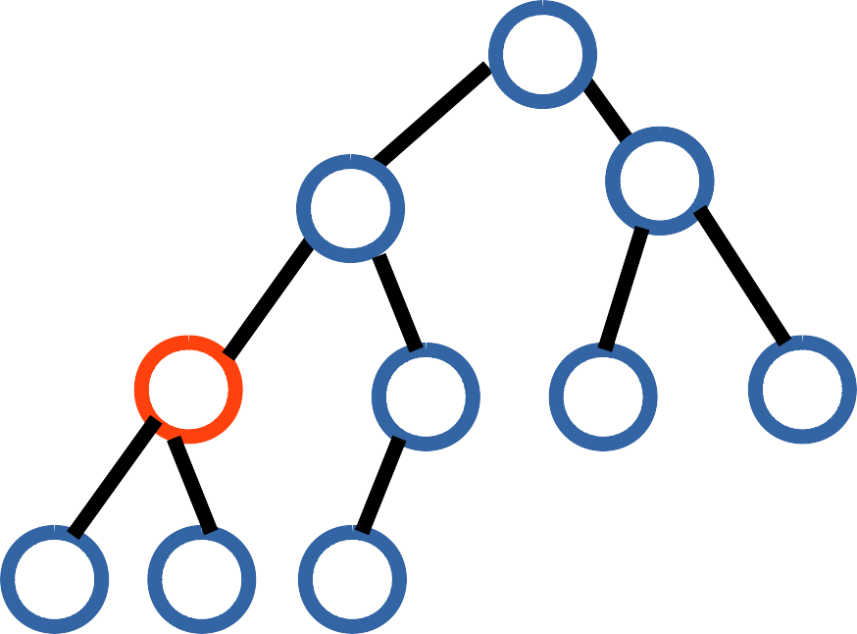
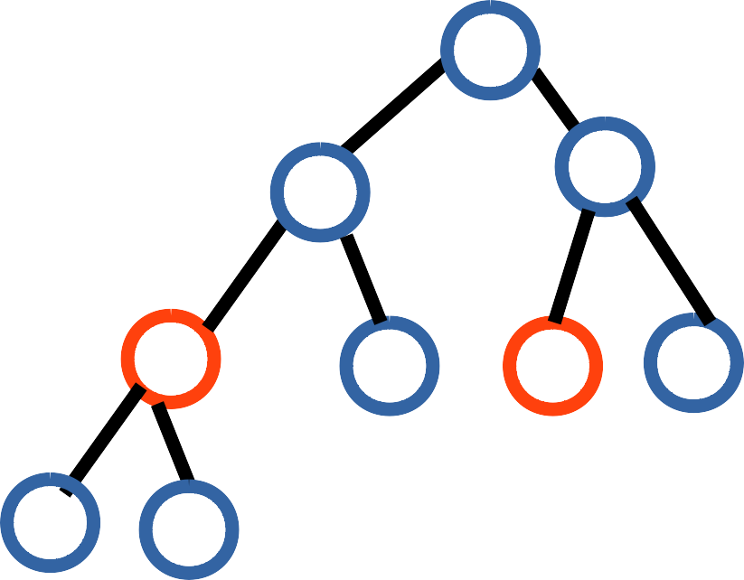
Binary Heap – Deletion Exercise (Solution)
If you follow the procedure you will eventually get the following:
12
14
17
14
18
17
27
23
18
54
27
23
31
54
57
29
31
57
29
After deleting 11
After deleting 12
Note: Structure and ordering property must be maintained at all times.

Slide 12
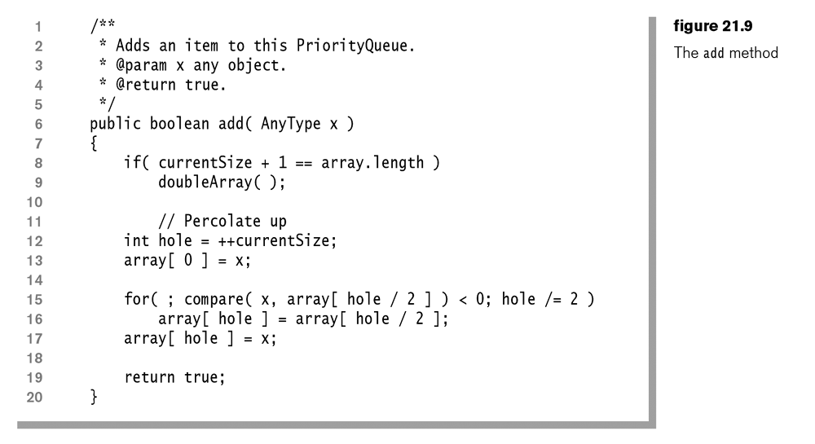
// while x < its parent, swap it and its parent (hole moves up) :

Slide 13
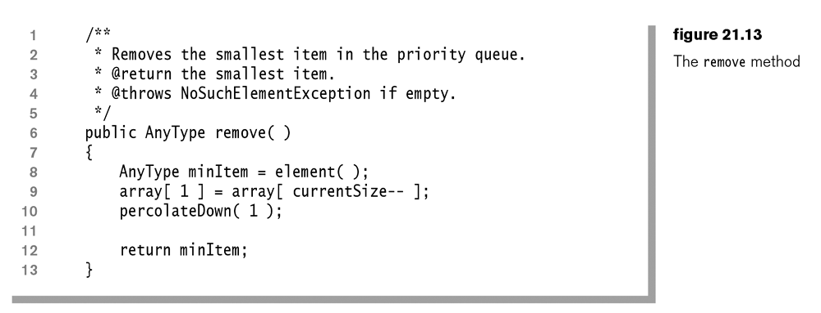
// pop top element, it’s the smallest
// make last item the new root
// move this new root down to right place

Slide 14
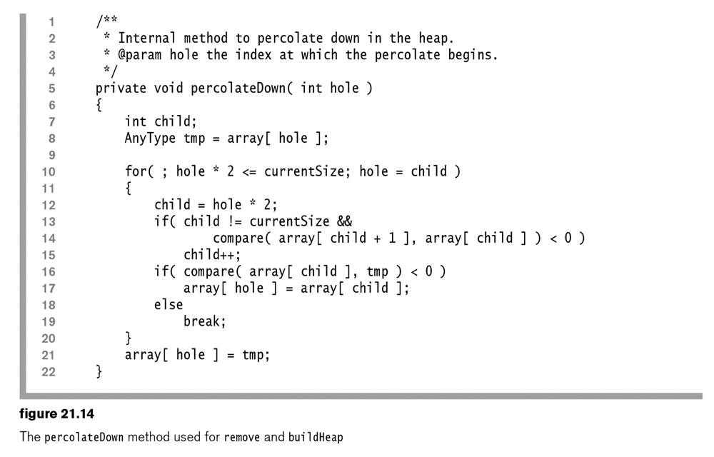
// while hole has children : make hole min of it & its child/ren then move hole down
// if there were 2 children, child is now the smaller of the 2
// child < parent:move child up
// child was NOT smaller than parent, so we are finished
// nothing below here < tmp, so we have its place

Slide 15
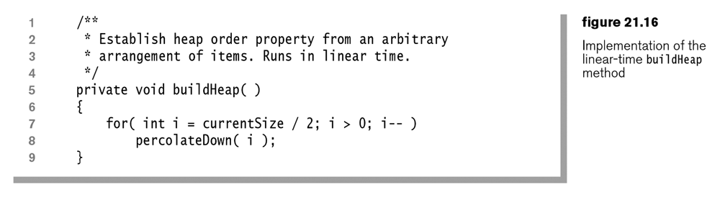
// loop from last parent in tree upto root of tree
// move value down far as nec.

Slide 16
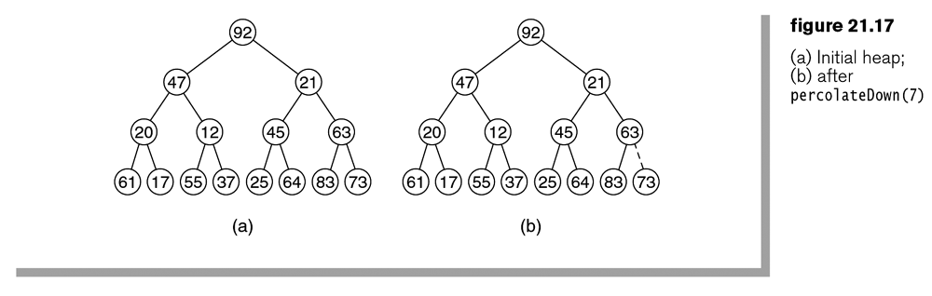

Slide 17
What is the complexity of creating a binary heap using sequential insertion?
O(log N)
O(N)
O(N log N)
O(N²)
What is the complexity of creating a binary heap using buildheap?
O(log N)
O(N)
O(N log N)
O(N²)

Slide 18
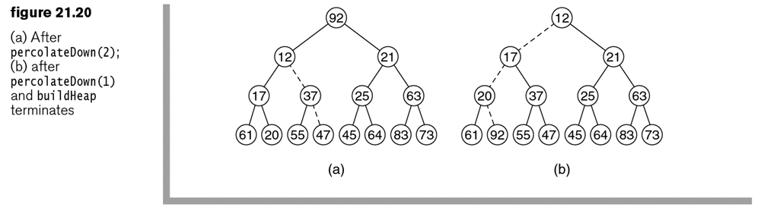

Slide 19
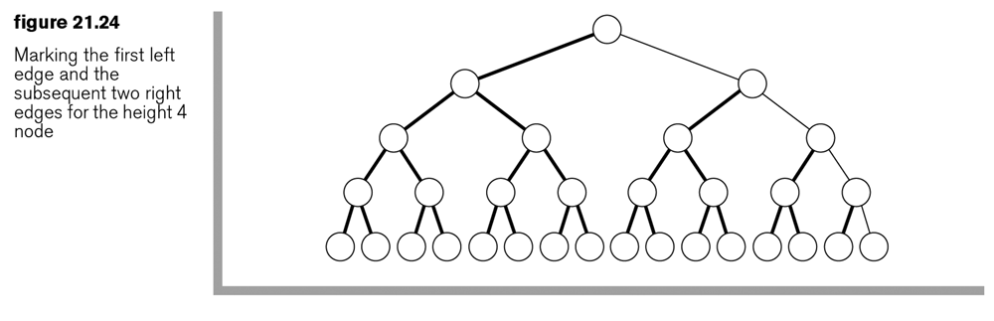
what is the most swaps that can be needed to heapify this tree?

Slide 20





Internal Sorting Example : Heapsort
20
45
Call DeleteMin N times
Call DeleteMax N times
32
45
32
20
 |  | 20 | 32 | 45
 |  | 45 | 32 | 20
Increasing order
Decreasing order
Note:
If we use a max heap – obtain items in increasing order If we use a min heap – obtain items in decreasing order
decreasing order
increasing order

Slide 21
Heapsort – Internal Sorting: Exercise
Sort the following input sequence in descending order using heap sort
{59, 36, 58, 21, 41, 97, 31, 16, 26, 53}
Note: show the resulting heap and array representation at every step (do we need (1) max heap or (2) min heap?)
Solution Strategy
First represent the sequence of items in a (complete) binary tree
Apply “buildHeap” to the resulting tree (order property)
Then call deleteMax N times (insert max value at empty slot in the array each time deleteMax is called)

Slide 22





Internal Sorting: heapsort (Observations)
Sorting like this with a binary heap is termed “heapsort”
By using empty slots of the array, we can perform the sort in place
If we use a max heap – obtain items in increasing order
decreasing order
Heapsort:
Duplicates themselves
do not retain their
initial
ordering
amongst
Not a stable sorting algorithm
Internal sorting: assumes all data will fit in memory

