Slide 1
CSC2001F: Priority Queues
Omowunmi Isafiade
Email: omowunmi.isafiade@uct.ac.za Office: Room 306

Slide 2
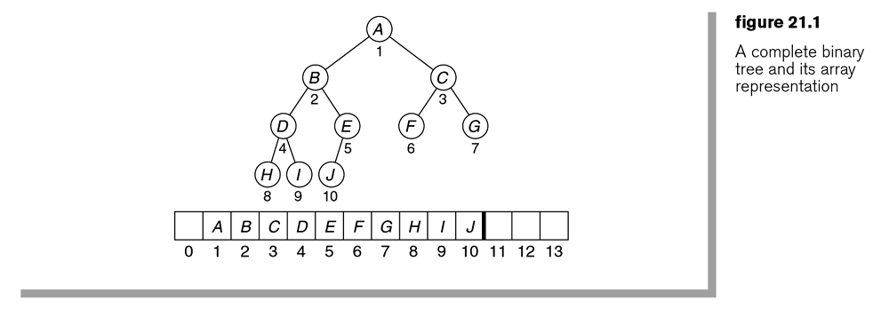

Slide 4
Binary heap – structure property
11
15
24
10
11
17
15
14
24
20
19

Slide 5
Binary heap – structure property
11
15
24
10
insert 22
insert 8
11
17
15
14
24
20
19

Slide 6
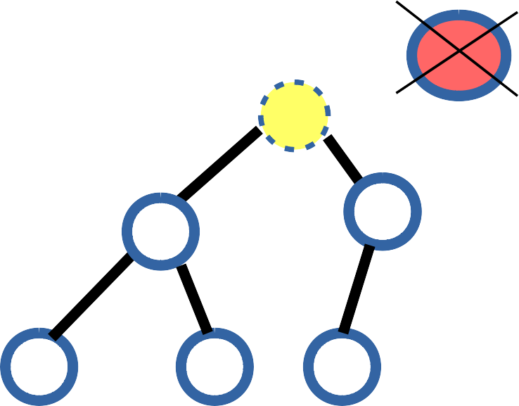
Heap Operations – Deletions Example
1100
12
11
Compare empty slot's (node 10's) immediate children nodes
to find the min of both and Compare “20” to the min
14
13
22
20

Slide 7

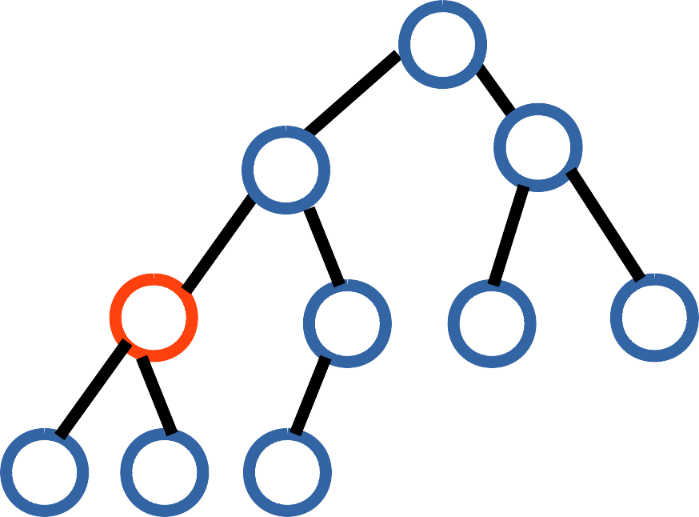
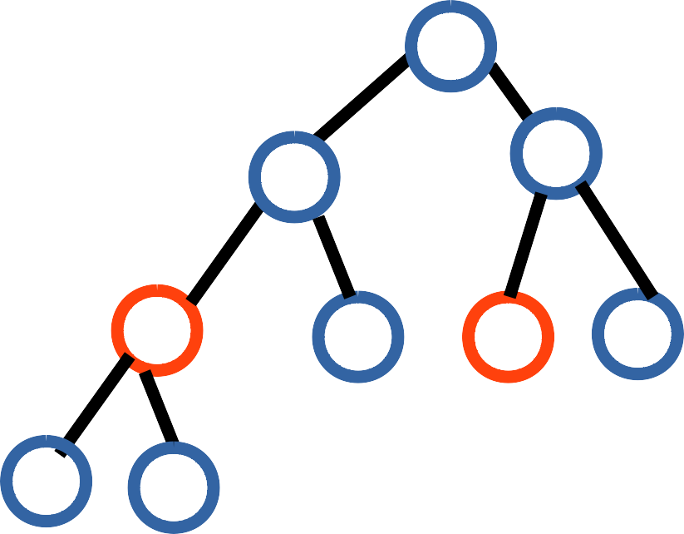
Binary Heap – Deletion Exercise (Solution)
If you follow the procedure you will eventually get the following:
12
14
17
14
18
17
27
23
18
54
27
23
31
54
57
29
31
57
29
After deleting 11
After deleting 12
Note: Structure and ordering property must be maintained at all times.

Slide 8
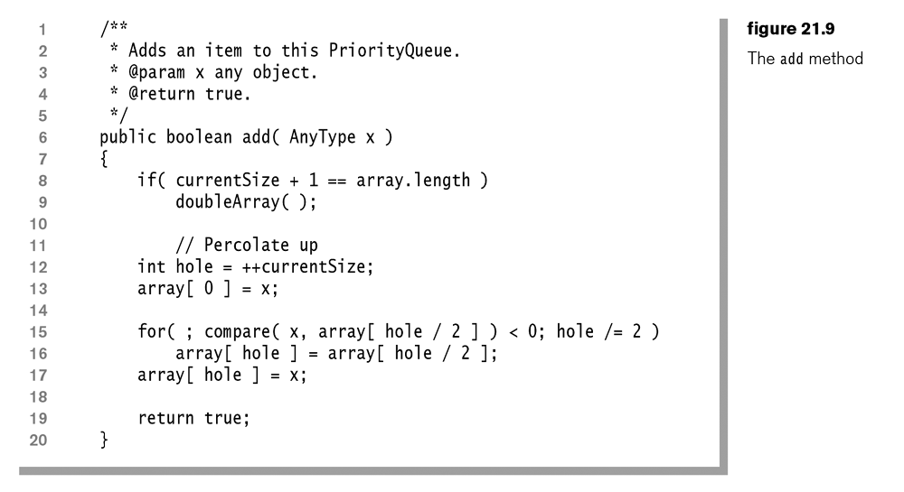
// while x < its parent, swap it and its parent (hole moves up) :

Slide 9
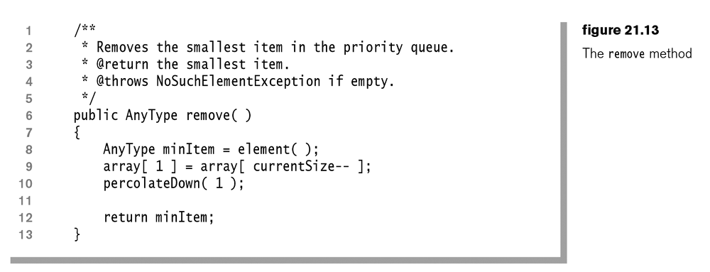
// pop top element, it’s the smallest
// make last item the new root
// move this new root down to right place

Slide 10
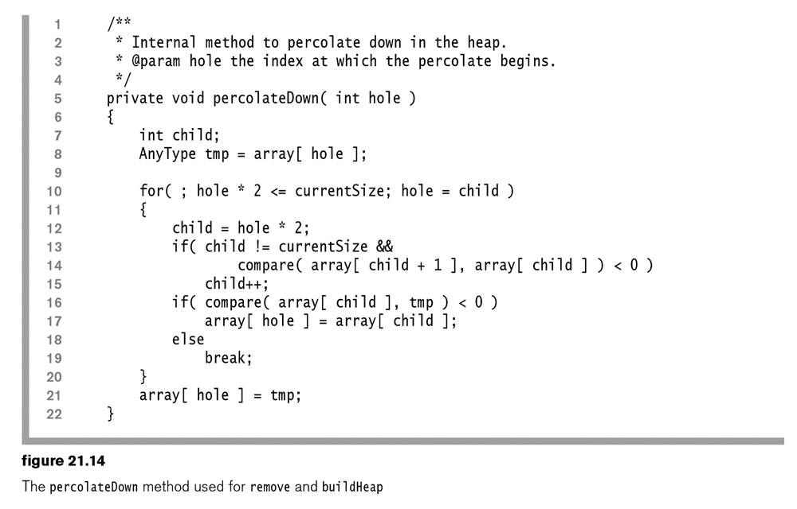
// while hole has children : make hole min of it & its child/ren then move hole down
// if there were 2 children, child is now the smaller of the 2
// child < parent:move child up
// child was NOT smaller than parent, so we are finished
// nothing below here < tmp, so we have its place

Slide 11
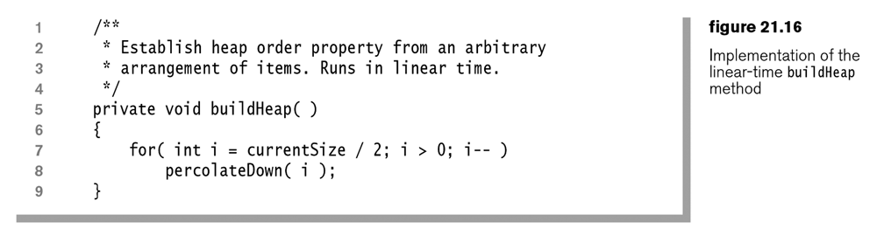
// loop from last parent in tree upto root of tree
// move value down far as nec.

Slide 12
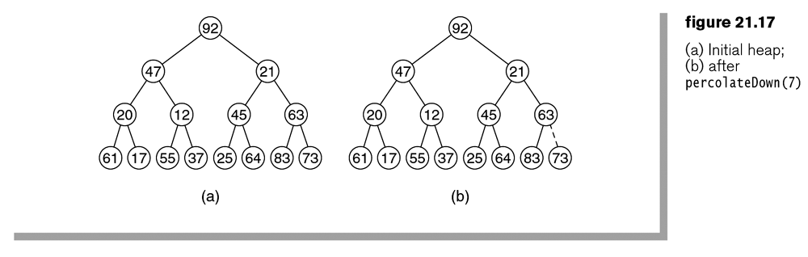

Slide 13
What is the complexity of creating a binary heap using sequential insertion?
O(log N)
O(N)
O(N log N)
O(N²)
What is the complexity of creating a binary heap using buildheap?
O(log N)
O(N)
O(N log N)
O(N²)

Slide 14
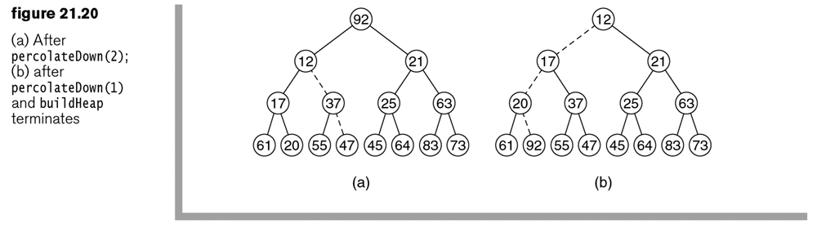

Slide 15
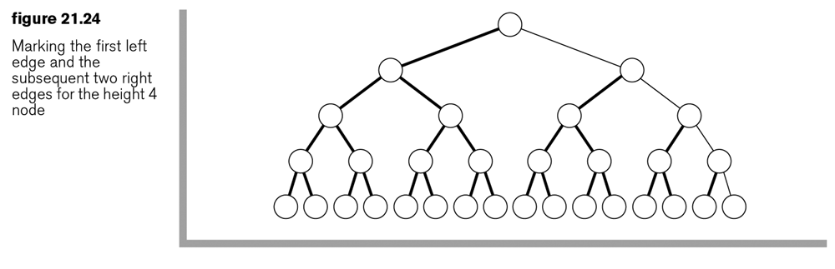
what is the most swaps that can be needed to heapify this tree?

Slide 16





Internal Sorting Example : Heapsort
20
45
Call DeleteMin N times
Call DeleteMax N times
32
45
32
20
 |  | 20 | 32 | 45
 |  | 45 | 32 | 20
Increasing order
Decreasing order
Note:
If we use a max heap – obtain items in increasing order If we use a min heap – obtain items in decreasing order
decreasing order
increasing order

Slide 17
Heapsort – Internal Sorting: Exercise
Sort the following input sequence in descending order using heap sort
{59, 36, 58, 21, 41, 97, 31, 16, 26, 53}
Note: show the resulting heap and array representation at every step (do we need (1) max heap or (2) min heap?)
Solution Strategy
First represent the sequence of items in a (complete) binary tree
Apply “buildHeap” to the resulting tree (order property)
Then call deleteMax N times (insert max value at empty slot in the array each time deleteMax is called)

Slide 18





Internal Sorting: heapsort (Observations)
Sorting like this with a binary heap is termed “heapsort”
By using empty slots of the array, we can perform the sort in place
If we use a max heap – obtain items in increasing order
decreasing order
Heapsort:
Duplicates themselves
do not retain their
initial
ordering
amongst
Not a stable sorting algorithm
Internal sorting: assumes all data will fit in memory

Slide 19
Double Ended PQ: Min – Max Heap
A double ended priority queue (PQ) supports the following:
Inserting an element with an arbitrary key Deleting an element with the smallest key Deleting an element with the largest key
A Min-Max Heap supports all of the above operations.
Even Depth
Min
Max
Max
Odd Depth
Min
Min
Min
Min
Even Depth

Slide 20




Min–Max Heap: Example
Example: A 7- element min-max heap
5
Min (Even Depth)
30
67
Max (Odd Depth)
10
7
25
33
Min (Even Depth)
Note:
For every node X at even depth, the key stored at X is the smallest in its subtree
For every node X at odd depth, the key stored at X is the largest in its subtree (root is at even depth)

Slide 21






Min-Max Heap Operations - Insertions
Note: Structure and order properties must always be obeyed Methodology:
Create a new node in the tree in next available position (to avoid violating structure property – complete binary tree) Check to ensure that min-max order property is satisfied
General Strategy (“Percolate up”)
Create a hole at the next available location
If heap order is not violated, place item in the hole else “bubble-up” the hole toward the root

Slide 22
Min-Max Heap Insertion - Questions
We add a new item X at the next available leaf location in a min-max heap.
Call its parent P.
if X < P and P is a “min-level” node, then
1. leave X where it is, nothing needs changing
2. swap X and P and then stop, nothing else needs changing
3. swap X and P and then call percolateUp
4. none of the above
if X < P and P is a “max-level” node, then
1. leave X where it is, nothing needs changing
2. swap X and P and then stop, nothing else needs changing
3. swap X and P and then call percolateUp
4. none of the above

Slide 23
Min-Max Heap Operations - Insertion
Place new item X at the next available location (for complete tree).
If the heap order (structure property) is violated, “bubble-up” as follows:
Compare X with its parent P.
if X < P then X is guaranteed < all max-level nodes above it (this was true for P, and X is smaller than P). So, only check nodes on min levels.
(X is definitely not too big for where it is if X < P, but it may be too small)
if X > P then X is guaranteed > all min-level nodes above it (this was true for P, and X is bigger than P). So, only check nodes on max levels (X is definitely not too small for where it is if X > P, but it may be too big)

Slide 24
percolateUp for min-max heap
percolateUp( j ) {
// j is the leaf where the new value was put
// if arr[j] has the same value as its parent, all is ok
// if arr[j] > its parent, it may need to be a new max
// if arr[j] < its parent, it may need to be a new min
if (arr[ j ] > arr[ parent(j) ] percolateUpMax(j) // check maxima
else
percolateUpMin( j ) // check minima
}

Slide 25
percolateUp for min-max heap
percolateUpMax (int j) { // like insert in max heap
// except only look at max-levels
while ( hasGran(j) && arr[j] > arr [ granOf(j) ] )
{ swap (j, granOf(j) );
j = granOf(j);
}
}
percolateUpMin (int j) {// like insert in min heap
// except only look at min-levels
while ( hasGran(j) && arr[j] < arr [ granOf(j) ] )
{ swap (j, granOf(j) );
j = granOf(j);
}
}

Slide 26
Min–Max Heap Exercise in Class: insert 3
Example: A 7-element min-max heap. Insert 3 into the heap.
5 Min (Even Depth)
5
30
67
Max (Odd Depth)
30
67
Min (Even Depth)
10
7
25
33
10
7
25
33
h
3

Slide 27



Min–Max Heap: Insertion Exercise in Class
Example: A 7-element min-max heap. Insert 3 into the heap.
5
min
3
30
67
max
30
67
10
7
25
33
min
5
7
25
33
10
So, only need to compare at min level(s) afterwards.
Since 3 < 5 => 5 moves down

Slide 28
percolateDown for min-max heap
percolateDown( j ) {
// could be deleting min or max
if isMinLevel( j ) percolateDownMin(j)
else
percolateDownMax( j )
}

Slide 29
percolateDown for min-max heap
percolateDownMin(int j) {
while hasGrandchild(j)
{ m = minGrandchild(j); // grandchildren are min-level nodes
if (arr[m] > arr[j]) return;
swap (m, j);
if (arr[m] > arr[ parent(m) ] // new arr[m] value may be too big
swap (m, parent(m) );
j = m;
}
if hasChild(j) // reached 2nd last level i.e. has kids but not grandkids
{ m = minOfChildren (j); // in case this leaf < its new parent
if (arr[m] > arr[j]) return;
swap (m, j);
}
}
// percolateDownMax is similar, except comparisons are <

Slide 30
MIN-MAX Heaps – Deletion of min
Remove and output the element in the root.
Let item be the last element in the min-max heap.
Delete must take this tree that has an empty root, along with the “orphaned”/ “homeless” item, and placing item correctly in this tree.
There are two cases:
The root has no children
Item is inserted into the root and we are done.
The root has at least one child.
The smallest key in the min-max-heap is a child or grandchild of the root. Let this be node k.
Three possibilities need to be considered.

Slide 31
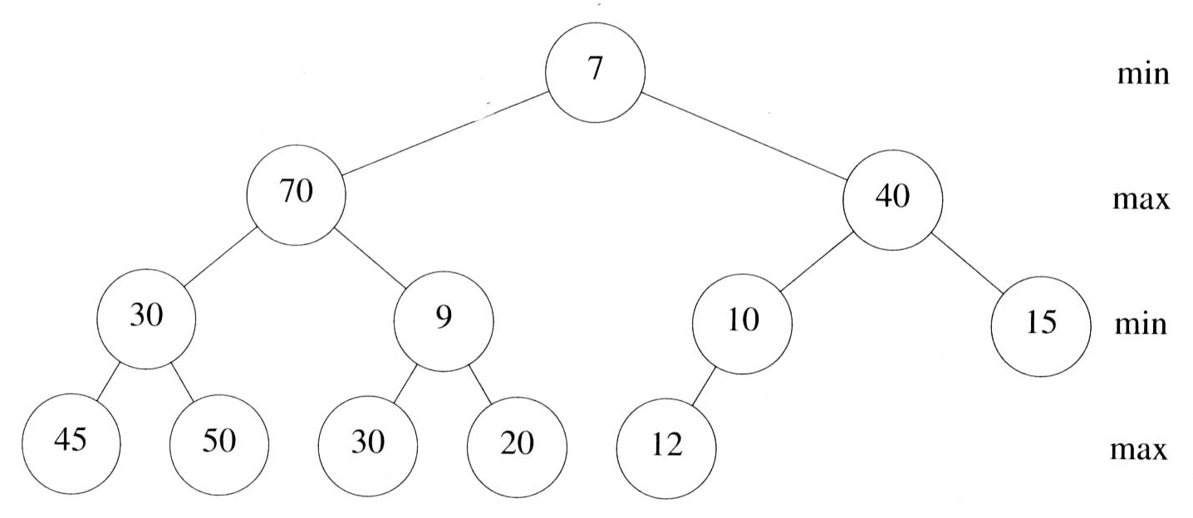
MIN-MAX Heaps – Deletion of min
item ≤ heap[k]
Means no element in heap is smaller than item.
So item is inserted into the root and we are done.
k is a child of the root (and item > heap[k])
Since k is a max node, it has no descendants > heap[k].
So k has no descendants > item.
So move heap[k] to the root & item to node k; and we’re done

Slide 32
MIN-MAX Heaps – Deletion of min
k is a grandchild of the root (and item > heap[k])
heap[k] moves to the root, leaving heap[k] empty.
Let parent be the parent of k.
If item > heap[parent], to ensure the max node is the largest in that sub-heap, we swap them: item is put in heap[parent], and heap[parent] becomes the new item needing to be placed.
Now repeat this process to place item in the subtree rooted at k

Slide 33
Min–Max Heap: Exercise in Class
Example: A 12-element min-max heap. deleteMin from the heap and show the resulting solution
5
70
39
30
7
10
12
45
50
18
20
15
Note: You need to find a new slot for 15, since order and structure properties Must be satisfied

Slide 34
Min–Max Heap: Exercise in Class
Example: A 12-element min-max heap. deleteMin from the heap and show the resulting solution
15 > 7,
5
So 7 goes to root
Find a new position
70
39
for “15”.
structure & order
properties maintained
30
7
10
12
45
50
18
20
15
Note: You need to find a new slot for 15, since order and structure properties Must be satisfied

Slide 35
Min–Max Heap: Exercise in Class
Example: A 12-element min-max heap. deleteMin from the heap and show the resulting solution
7
Min
Resulting heap!
70
39
Max
30
15
10
12
Min
45
50
18
20
Max
Note: In this case, minimum item is found in root node's grandchildren after comparison. Therefore the nodes are swapped accordingly

Slide 36
Min–Max Heap: Exercise in Class
Example: A 12-element min-max heap. deleteMax from the heap and show the resulting solution
5
70
39
30
7
10
12
45
50
18
20
15
Note: You need to find a new slot for 15, since order and structure properties Must be satisfied. 70 is the max and deleted in this case

Slide 37
Min–Max Heap: Exercise in Class
Example: A 12-element min-max heap. deleteMax from the heap and show the resulting solution
5
Min
Resulting heap!
50
39
Max
15
7
10
12
Min
45
30
18
20
Max

Slide 38

Priority Queues - Exercise
For the following key sequence determine the binary heap obtained when the keys are inserted sequentially (one at a time) into an initially empty heap
Assume maximum value at root node (max-heap) 0,1,2,3,4,5,6,7,8,9

Slide 39
Priority Queues - Exercise
For the following key sequence determine the binary heap obtained after 3 consecutive DequeueMax (DeleteMax) operations
0, 1, 2, 3, 4, 5, 6, 7, 8, 9

Slide 40


Min–Max Heap: Exercise
Example: Insert the following sequence into a min-max heap {10, 11, 5, 13, 19, 22, 9, 8, 25, 7, 2} and show the final heap
Perform a DeleteMin operation on the heap and show the resulting min-max heap

Slide 41


IMPORTANT NOTE
You are strongly advised to practice all the exercises and examples in the lecture notes.
Remember to also work on your hash table assignment.
Good luck and enjoy the vac!

