Slide 1
CSC2001F: Data Structures II
Omowunmi Isafiade
Email: omowunmi.isafiade@uct.ac.za Office: Room 306

Slide 2
Priority Queues – Specification
Stores tasks based on some priority and supports access and deletion of the minimum or maximum item (priority metric)
E.g. process scheduling, bandwidth management, and ?
Priority queues support the operation on a set S:
Insert (S,x): inserts x into the set S
Max (S): returns the maximum element in S
Extract-Max (S): removes and returns the element of S with the largest key
Increase-key (S, x, k): increases the value of x's key to the new value k (k is assumed to be as large as x)
Note: Same operations possible with min

Slide 3
Priority Queues - Implementation Strategy
Option #1: Use a simple linked list (unordered)
Head
...
15
11
25
Null

Slide 4
Priority Queues - Implementation Strategy
Option #2 :
Ensure list is always sorted (ordered linked list)
Head
...
11 15
25
Null

Slide 5
Priority Queues - Implementation Strategy
Option #3: Use a binary search tree (BST)
Option #4: Could use balanced search trees but implementation is cumbersome and performance in practice is not good
Option #5 – (our focus) Binary Heap
A classic priority queue data structure
Compromise between a queue and a search tree

Slide 6


Binary Heap – Ordering Property
Heap-order property - “in a heap, for every node X with parent
P, the key in P is smaller than or equal to the key in X, (P≤ X)”
P
P≤ X
X
Note (conversely): A max heap supports access maximum. Can be implemented with minor changes.
to the

Slide 7


Binary Heap – Structure Property
The heap is a complete binary tree
Complete Binary Tree:
Each level is completely filled, with the possible exception of the bottom level (filled from left to right)
An incomplete
No missing nodes
A
A complete
binary tree
A
B
C
B C
binary tree
D
E
F
D
E
F

Slide 8
Complete Binary Tree – Structure Property
Note: Root node in position 1 (not 0- reserved for a dummy item)
So for an item in position i, its left child is in position 2i, right child→2i+1
An incomplete
No missing nodes
A
A complete binary tree and
binary tree
A
B
C
B C
Missing node
Its array representation
D
E
F
D
E
F
 | A | B | C | D | E | F
 | A | B | C | D | E | * | F
0 1
2 3 4 5 6 7 8
0 1
2 3 4 5 6 7 8

Slide 9






Binary Heaps – Some Considerations
An array can be used to store a tree (e.g instead of doing it with a linked list)
Advantage:
No child links required
Operations required to traverse tree are simple to implement and efficient (performance)
Heap entity: array of objects and an integer (current heap size)
Disadvantage:
Dynamic adjustments of table size can become expensive

Slide 10

Binary Heap - Properties Overview
The heap is a complete binary tree with each (parent) key less than or equal to its two children (note: case of “min” heap)
A heap ! NOT a heap !
12
12
18
15
18
15
21
33
19
7
33
19

Slide 11



Binary Heap - Properties Overview (Exercise)
The heap is a complete binary tree with each (parent) key less than or equal to its two children (note: case of “min” heap)
Which of the trees (a or b) below is a binary heap?
12 12
18
15 15
18
33
21
19
21
33
19
a
b
Only “a” is a heap
Only “b” is a heap
Both are binary heaps

Slide 12
Heap Operations - Insertions
General Strategy (“Percolate up”)
Create a hole at the next available location
If heap order is not violated, place item in the hole else “bubble-up” the hole toward the root

Slide 13

Heap Operations – Insertion (Example)
Consider a binary heap formed from the set {14, 13, 22}
13
14
22
Insert the elements {12, 11, 10, 20} into the heap above

Slide 14




Heap Operations - Deletions
Deleting the minimum element (“percolate down”) Methodology:
Find the minimum element (easy at root node) Delete minimum
Restructure tree to form a complete binary tree
Note: Structure and ordering properties need to be maintained (before your operation terminates)

Slide 15


Binary Heaps – Some Considerations
A priority queue is not a heap (or a binary heap)
Priority queue is an abstract concept like a list
A list can be implemented as a linked list or an array
Likewise – a heap is just a (classical) method of implementing the concept of a priority queue

Slide 16
Heap Operations – Insertion (Example)
Consider a binary heap formed from the set {14, 13, 22}
13
14
22
Insert the elements {12, 11, 10, 20} into the heap above

Slide 17


Exercise
Note:
* All operations are aimed at finding
a new slot for “12”
* Ordering and structure property must be strictly obeyed
Case 1: Inserting 12
Step 1: add a node (hole) at next available location Step 2: compare “12” to immediate parent node
Step 3: bubble up as necessary (until correct location is found)
13
13
12
12 < 14
22
14
12 < 14
22
Percolate up
12
14

Slide 18
Exercise
Note:
* All operations are aimed at finding
a new slot for “12”
* Ordering and structure property must be strictly obeyed
Case 1: Inserting 12
Step 4: compare “12” to immediate parent node Step 5: bubble up as necessary
12
13
Percolate up
12 < 13
12
12 < 13
22
22
13
14
14
12 is finally at the correct position.
Note: structure and order properties obeyed

Slide 19
Exercise
Repeat the procedure for other items Resulting binary heap...
Note:
* All operations are aimed at finding a new slot for “an item”
* Ordering and structure property must be strictly obeyed
10
12
11
14
13
22
20

Slide 20
Exercise in Class – Insertion Operation
Consider a binary heap formed from the set {15, 11, 24}
Note:
* All operations are aimed at finding a new slot for “an item”
* Ordering and structure property must be strictly obeyed
11
15
24
Insert the elements {14, 10, 17, 20, 19} into the heap above

Slide 21



Exercise Solution – Insertion Operation
Consider a binary heap formed from the set {15, 11, 24} Insert the elements {14, 10, 17, 20, 19} into the heap above
Note:
* All operations are aimed at finding a new slot for “an item”
* Ordering and structure property must be strictly obeyed
11
15
24
10
Resulting heap!
11
17
15
14
24
20
19

Slide 22

Exercise in Class – Insertion Operation
Consider a binary heap formed from the set {15, 24, 11}
Note:
* All operations are aimed at finding a new slot for “an item”
* Ordering and structure property must be strictly obeyed
24
15
11
Insert the elements {14, 10, 17, 20, 19} into the heap above Note: assume max-heap (I.e maximum element @ root node)

Slide 23




Exercise in Class – Insertion Operation
Consider a binary heap formed from the set {15, 24, 11} Insert the elements {14, 10, 17, 20, 19} into the heap above
Assume max-heap (P >= X)
Note:
* All operations are aimed at finding a new slot for “an item”
* Ordering and structure property must be strictly obeyed
24
15
11
24
19
20
15
10
11
17
Result!
14

Slide 24



Heap Operations – Deletions
Easy to find “min” (@ root)
But!!! deleting “min” creates a hole at the root.
Heap shrinks by 1 (find a new slot for last item @ bottom level) Restructuring Principle:
Re-order items to ensure structure ^{satisfied} Initial Heap
Structure
and ordering properties are
Modified
Heap Structure
Element deleted

Slide 25



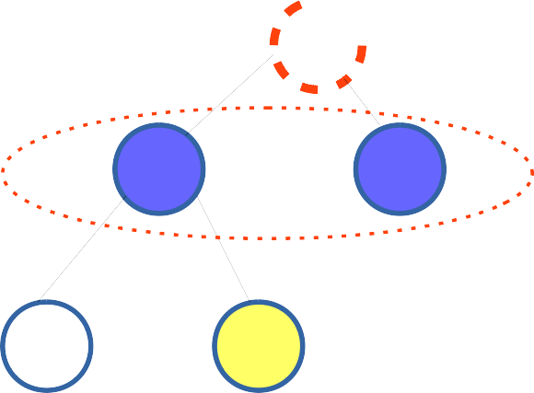
Heap Operations – Deletions
Restructuring Principle (“percolate down”):
Re-order items to ensure structure and ordering properties are satisfied.
Comparison is between yellow and blue nodes
1. Modified heap structure: Compare nodes at next level (blue nodes) to decide which one is smaller than “yellow node”
2. If the smaller of the blue nodes is
<= the yellow node, It is moved
up to the
empty slot (root) and the empty slot moved down
3. The procedure is repeated until the item (yellow node) can be correctly placed – a Process called percolate down

Slide 26



Heap Operations - Deletions
Restructuring Principle:
Re - order items to ensure structure and ordering properties are obeyed
Exercise: Delete the items {10, 11, 12, 13, 14} from the binary heap hereafter
Think about how you would re-organise the heap to obey both the structuring and ordering properties!

Slide 27




Heap Operations – Deletions Example
Restructuring Principle (Percolate down):
Re-order items to ensure structure and ordering properties are satisfied.
Exercise: Delete {10, 11, 12, 13, 14} from the binary heap below
10
12
11
14
13
22
20
Be sure to re-organise the heap to obey both the structuring and ordering properties!

Slide 28
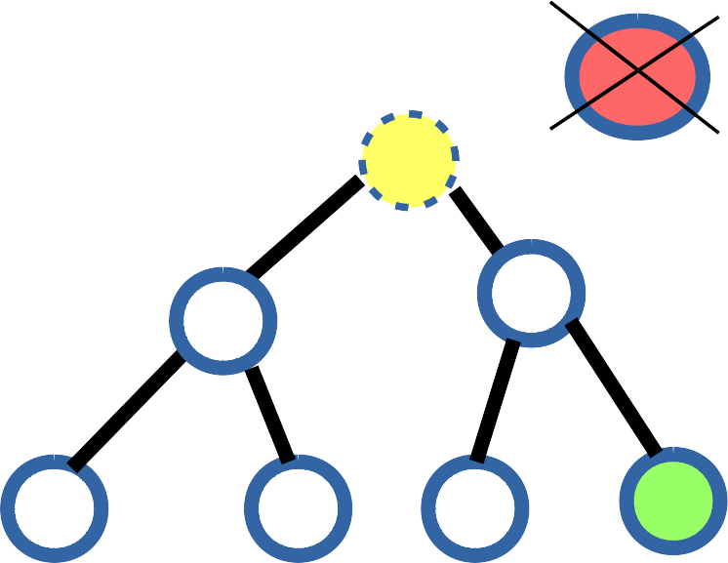

Heap Operations – Deletions Example
Step 1: Deleting 10 ...
Note:
* All operations are aimed at finding a new slot for “20”
* Ordering and structure property
must be strictly obeyed
1100
12
11
14
13
22
20
Find new position for “20”

Slide 29
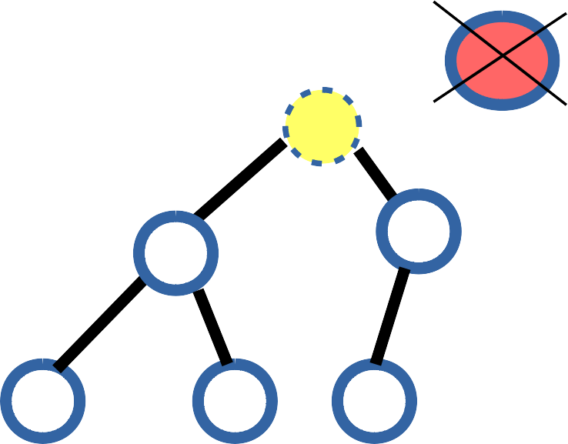
Heap Operations – Deletions Example
Note:
* All operations are aimed at finding a new slot for “20”
* Ordering and structure property
must be strictly obeyed
Step 2: Deleting 10 ...
1100
12
11
Compare empty slot's (node 10's) immediate children nodes
to find the min of both and Compare “20” to the min
14
13
22
20
Find new position for “20”

Slide 30
Heap Operations – Deletions Example
Note:
* All operations are aimed at finding a new slot for “20”
* Ordering and structure property
must be strictly obeyed
Step 3: Deleting 10 ...
1100
11
12
11 < 12 and also less than 20. So, 11 is moved to the “hole”, pushing the hole down one level
14
13
22
20
Find new position for “20”

Slide 31
Heap Operations – Deletions Example
Note:
* All operations are aimed at finding a new slot for “20”
* Ordering and structure property
must be strictly obeyed
Step 4: Deleting 10 ...
1100
11
12
Now compare the children nodes of the current empty slot
to find the min. 20< 22, so 20
moves into the empty position
14
13
22
20
Find new position for “20”

Slide 32
Heap Operations – Deletions Example
Note:
* All operations are aimed at finding a new slot for “20”
* Ordering and structure property
must be strictly obeyed
Step 4: Deleting 10 ...
11
12
20
14
13
22
Final binary heap: satisfying both Ordering and structure property
Find new position for “20”

Slide 33
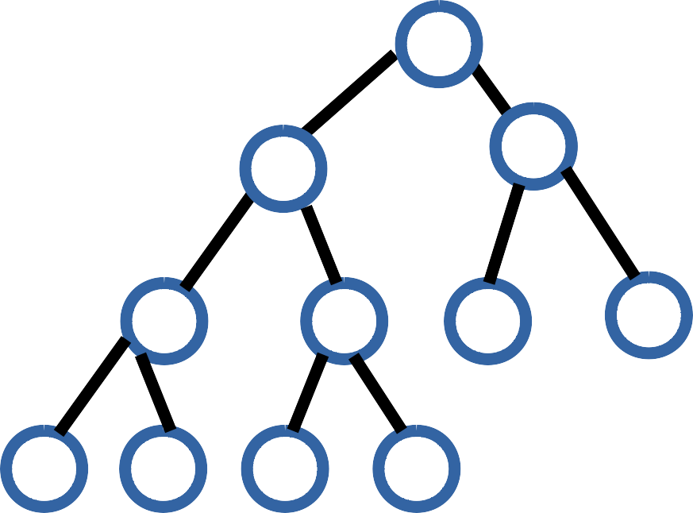
Binary Heap – Deletion Exercise
Exercise: Delete “11” and “12” from the binary heap below and show the resulting heap
11
12
14
17
23
18
54
57
29
31
27

Slide 34
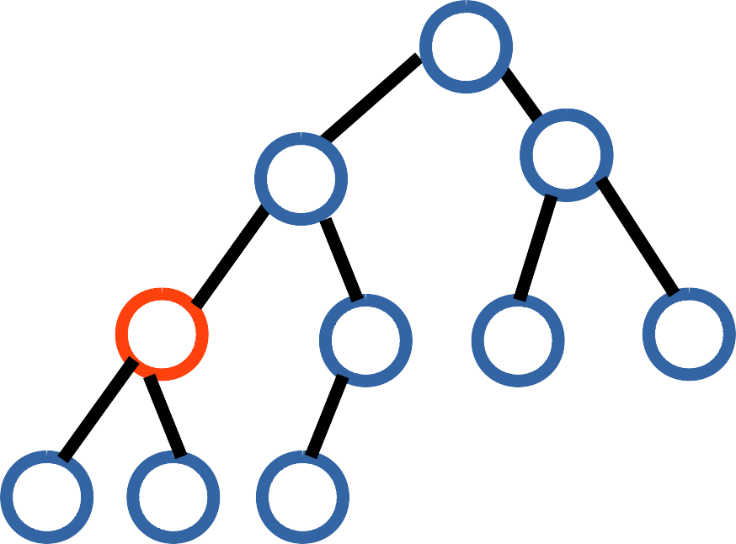
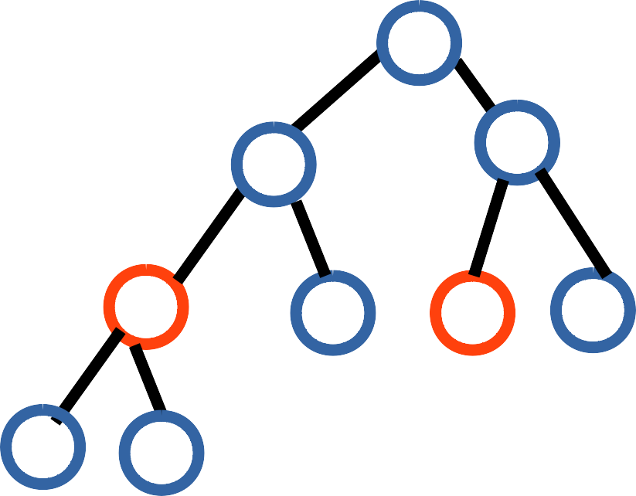
Binary Heap – Deletion Exercise (Solution)
If you follow the procedure you will eventually get the following:
12
14
17
14
18
17
27
23
18
54
27
23
31
54
57
29
31
57
29
After deleting 11
After deleting 12
Note: Structure and ordering property must be maintained at all times.

