Slide 1
Key decisions
Cutoff point – percentage of reads
Data to present
Interpretation

Slide 2
% Reads Num. reads Classified Rank ID Taxon
12.1080 127702 127702 no rank 0 unclassified
87.8920 926986 0 no rank 1 root
87.8920 926986 0 cellular root 131567 cellular organisms
87.8920 926986 0 domain 2759 Eukaryota
87.8920 926986 0 clade 33154 Opisthokonta
87.8920 926986 0 kingdom 33208 Metazoa
87.8920 926986 0 clade 6072 Eumetazoa
87.8920 926986 0 clade 33213 Bilateria
87.8920 926986 0 clade 33511 Deuterostomia
87.8920 926986 0 phylum 7711 Chordata
87.8920 926986 0 subphylum 89593 Craniata
87.8920 926986 0 clade 7742 Vertebrata
87.8920 926986 57 clade 7776 Gnathostomata
87.8858 926921 0 clade 117570 Teleostomi
87.8858 926921 4105 clade 117571 Euteleostomi
87.4173 921980 0 superclass 8287 Sarcopterygii
87.4173 921980 0 clade 1338369 Dipnotetrapodomorpha
87.4173 921980 35 clade 32523 Tetrapoda
87.3845 921634 1158 clade 32524 Amniota
84.9335 895783 0 clade 8457 Sauropsida
84.9335 895783 59 clade 32561 Sauria
84.9243 895686 5 clade 1329799 Archelosauria
84.9236 895679 1 clade 8492 Archosauria
84.9235 895678 0 clade 436486 Dinosauria
84.9235 895678 0 clade 436489 Saurischia
84.9235 895678 0 clade 436491 Theropoda
84.9235 895678 0 clade 436492 Coelurosauria
84.9235 895678 11 class 8782 Aves
84.9225 895667 4098 infraclass 8825 Neognathae
84.4484 890667 1070 clade 3078114 Neoaves
84.2767 888856 327 clade 3073808 Telluraves
84.2333 888399 157 clade 3073809 Australaves
84.1960 888005 13178 order 9126 Passeriformes
66.9637 706258 2379 superfamily 175121 Passeroidea
66.5754 702163 79 family 9158 Passeridae
66.5469 701862 699528 genus 9159 Passer
0.0597 630 630 species 48849 Passer domesticus
0.0561 592 592 species 56115 Passer hispaniolensis
0.0450 475 475 species 150919 Passer simplex
0.0323 341 341 species 9160 Passer montanus
0.0073 77 77 species 498210 Passer moabiticus
0.0056 59 59 species 150918 Passer rutilans
0.0032 34 34 species 1069440 Passer italiae
0.0029 31 31 species 58821 Passer luteus
0.0021 22 22 species 1930199 Passer iagoensis
0.0018 19 19 species 150917 Passer melanurus
0.0018 19 19 species 150914 Passer ammodendri
0.0018 19 19 species 1117246 Passer diffusus
0.0009 9 9 species 2796153 Passer eminibey
0.0006 6 6 species 150915 Passer flaveolus
0.0001 1 1 species 150916 Passer griseus
0.0090 95 17 genus 667179 Pyrgilauda
0.0064 67 67 species 1477527 Pyrgilauda davidiana
0.0006 6 6 species 667180 Pyrgilauda blanfordi
0.0005 5 5 species 221976 Pyrgilauda ruficollis
0.0083 88 2 genus 221975 Montifringilla
0.0067 71 71 species 356903 Montifringilla nivalis
0.0012 13 13 species 356906 Montifringilla adamsi
0.0002 2 2 species 2557930 Montifringilla henrici

Slide 3
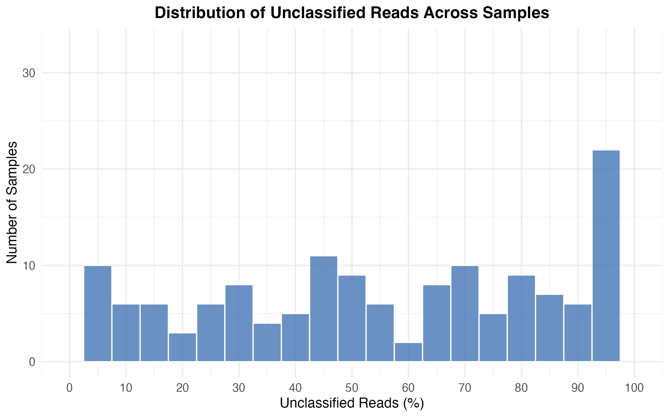
"Summary Statistics for Unclassified Reads (%):”
n_samples mean_pct median_pct sd_pct min_pct max_pct
1 177 63.2 68.8 32.0 1.28 100

Slide 4
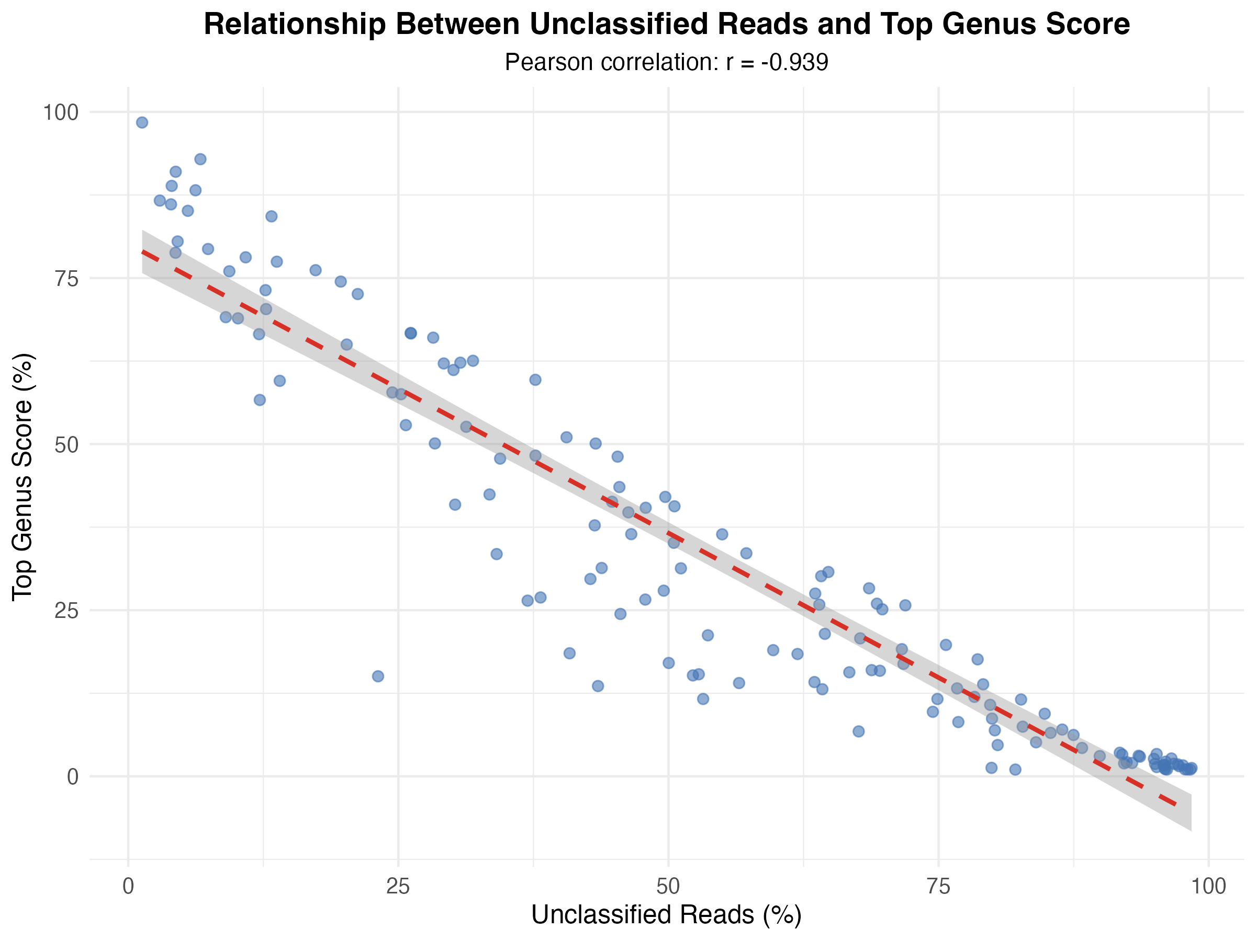

Slide 5
Cutoff of 1% of reads
mean_genera | sd_genera | min_genera | max_genera | n_samples
1.992481 | 1.479641 | 1 | 11 | 133
Cutoff of 3% of reads
mean_genera | sd_genera | min_genera | max_genera | n_samples
1.54717 | 0.9271778 | 1 | 6 | 106
Cutoff of 5% of reads
mean_genera | sd_genera | min_genera | max_genera | n_samples
1.3125 | 0.6037166 | 1 | 4 | 96

Slide 6
Genus N Mean % Mean Rank Mean N. Reads Mean N Genera Mean Unclassified (%) % Top Hit (excl. Homo)
1 Homo 65 17.3 1.37 636291 2.3 56.4 0
2 Ovis 45 30.4 1.82 965296 2.3 43.5 66.7
3 Sus 24 19.1 1.96 620148 2.7 47.6 75
4 Passer 18 22.8 2.33 529443 3.6 39.4 55.6
5 Ptilotula 17 26 1.94 749781 3.1 36.7 58.8
6 Stomiopera 11 30.6 1.64 1518496 2 52.7 81.8
7 Gymnorhina 7 10.6 2.29 505033 3 60.2 71.4
8 Anthochaera 6 15.9 2.5 415039 3.3 36.3 33.3
9 Vulpes 5 58 1.2 1055651 1.4 34.6 80
10 Nycticorax 4 6.7 2 268402 2.5 72.2 50
11 Corcorax 3 58.9 1 1997550 1 29.7 100
12 Manorina 3 54.9 1.33 2486128 1.7 35.3 100
13 Trichosurus 3 18.7 2.67 608537 3.3 38.9 33.3
14 Wallabia 3 41.5 1.67 1370932 2.3 38.9 66.7
15 Galaxias 2 3.2 3.5 108582 3.5 56.5 50
16 Cacatua 1 42.1 1 1199855 2 49.7 100
17 Copsychus 1 3.1 2 168996 2 9.4 0
18 Egretta 1 36.5 5 1905612 2 46.6 100
19 Eolophus 1 10 2 510269 4 50 0
20 Epthianura 1 10.1 2 106919 3 12.1 0
21 Falco 1 25.1 1 48434 1 69.8 100
22 Macropus 1 5.1 2 267950 2 45.5 100
23 Penelope 1 4.3 2 226944 2 46.6 0
24 Phalacrocorax 1 5.2 3 212199 6 23.1 0
25 Pomatostomus 1 8.2 2 424384 2 38.2 0

Slide 7
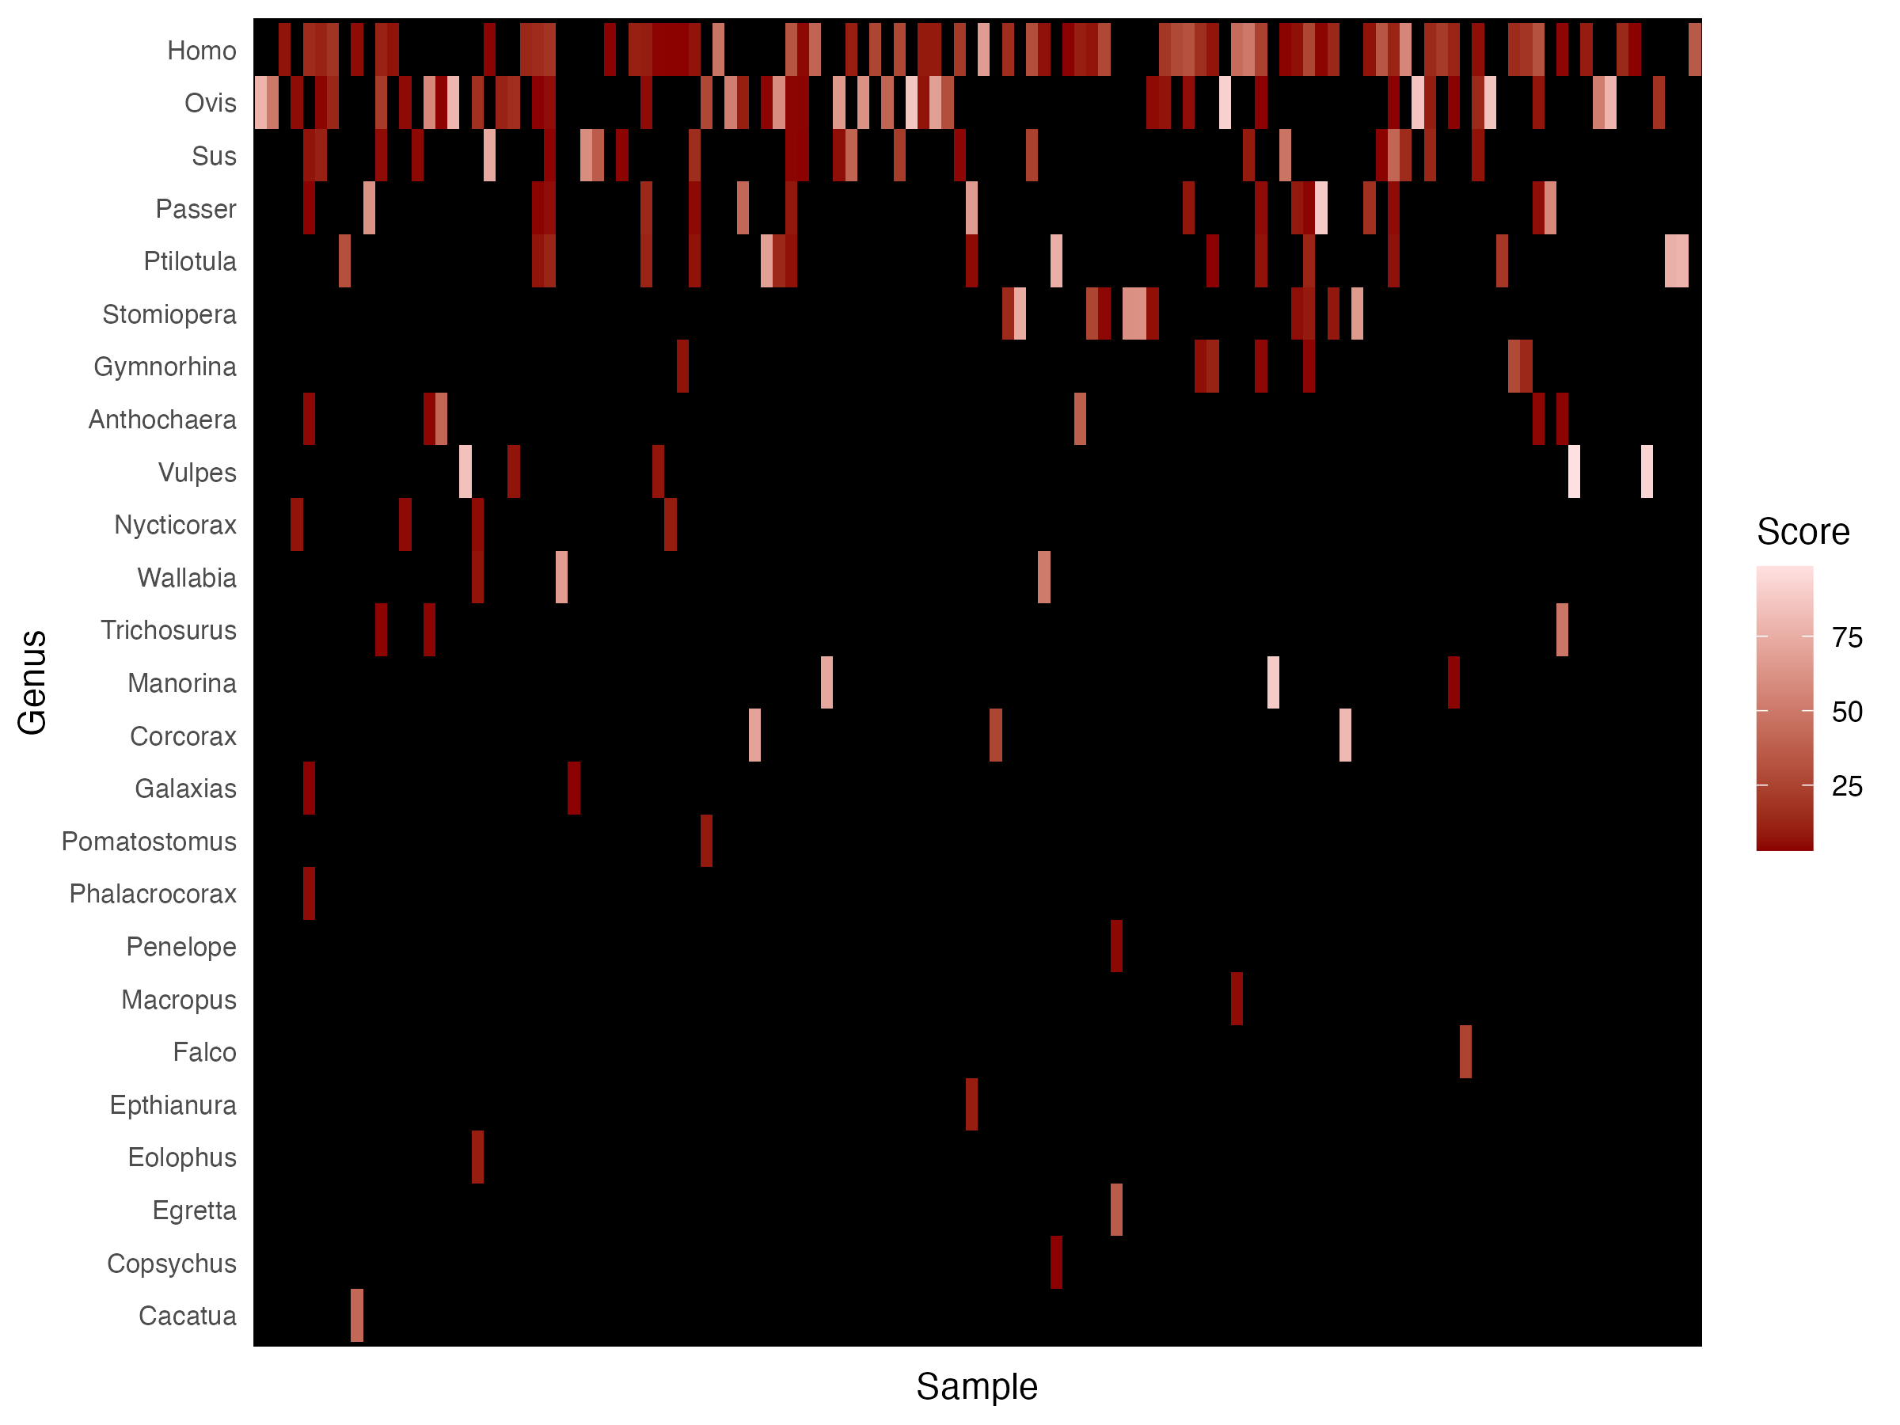
Percentage reads cutoff of 3%

Slide 8
