Slide 1
Employee Data Analysis using Excel
STUDENT NAME:THABSERA BEGAM.A
REGISTER NO:422200121(asunm119422200121)
DEPARTMENT:B.com(ISM)
COLLEGE:Sindhi College of arts and science

Slide 2
PROJECT TITLE:
Employee Performance Analysis using Excel:
Employee performance analysis in Excel can be done by creating a performance tracking spreadsheet and using it to track and analyze employee performance data.

Slide 3


AGENDA
Problem Statement
Project Overview
End Users
Our Solution and Proposition
Dataset Description
Modelling Approach
Results and Discussion
Conclusion
3/21/2024 Annual Review

Slide 4

PROBLEM STATEMENT:
1. Develop an integrated Excel-based system for tracking employee performance metrics
2. Automate data consolidation and analysis
3. Enhance accuracy and efficiency in performance evaluations
4. Improve visibility into departmental performance trends

Slide 5

PROJECT OVERVIEW
Employee Performance Analysis using Excel:
Project Description:Develop an integrated Excel-based system to track and analyze employee performance metrics, providing insights for data-driven decision-making, improved performance evaluations, and targeted training programs.

Slide 6

WHO ARE THE END USERS?
1. HR Representatives: Responsible for collecting and analyzing performance data, identifying training needs, and developing targeted programs
2. Managers: Utilize insights to inform performance evaluations, coaching, and development plans for team members..
3. Department Heads: Leverage dashboard visualizations to track departmental performance trends, identify areas for improvement, and allocate resources effectively
4. Employees: Benefit from data-driven performance evaluations, targeted training programs, and personalized development plans.

Slide 7

OUR SOLUTION AND ITS VALUE PROPOSITION
Conditional formatting-missing
Filter-remove
Formula-performance
Pivot-summary
Graph- data visualiztion

Slide 8
DATASET DESCRIPTION
The employee dataset download in the kaggle website. There are 26 features in the employee dataset. The employee data set comprise only 15 features there are:
1.Employee id.
2.First name.
3.Last name.
4.Tile.
5.Email id.
6.Business unit.
7.Employee status.
8.Employee type.

Slide 9
9.Department type. 10.Division. 11.Date of birth. 12.Gender code. 13.Performance score. 14.Current employee rating. 15.Performance level.

Slide 10

THE "WOW" IN OUR SOLUTION
Performance level=IFS(Z8>=5,"VERY HIGH",Z8>=4, "HIGH",Z8>=3,"MED", TRUE, "LOW")
3/21/2024 Annual Review
10

Slide 11
MODELLING:
Data collection:
a) Data quality
b) Data relevance
c) Data granularity
Feature collection:
a) Performance metrics
b) Training and development
11

Slide 12
Data cleaning: a)Performance metrics
b)Employee development Perfomance level:
a) High b)Medium
c) low Summary: a)Data quality and preparation b)Performance metrics and levels

Slide 13
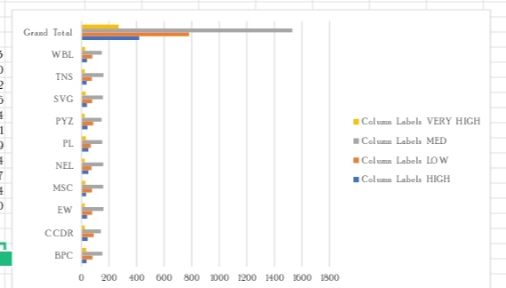
RESULTS
13

Slide 14
conclusion
By leveraging data-driven insights and modeling techniques, organizations can optimize employee performance, drive business success, and foster a culture of continuous improvement.

