Slide 1
CINE
A MOVIE ANALYTICS
RESTful API
METRICS
Python FastAPI · SQLite · TMDB API
PythonAnywhere · 7,479 Films
API
COMP3011 | University of Leeds | March 2026

Slide 2
01
INTRO-
DUCTION

Slide 3
02
PROJECT OVERVIEW
01
02
03
04
MOVIE
SEARCH
REVIEWS
& TAGS
BOX OFFICE
ANALYTICS
LIVE
DEPLOYMENT
Real-time search via TMDB API. Popular films, detailed metadata, genre & cast info.
Full CRUD for user reviews and tags. Stored in SQLite with API key auth for writes.
5 analytics endpoints. Historical data from 7,479 Kaggle films (1986–2016).
Fully deployed on PythonAnywhere. Swagger UI at /docs, 16 endpoints total.

Slide 4
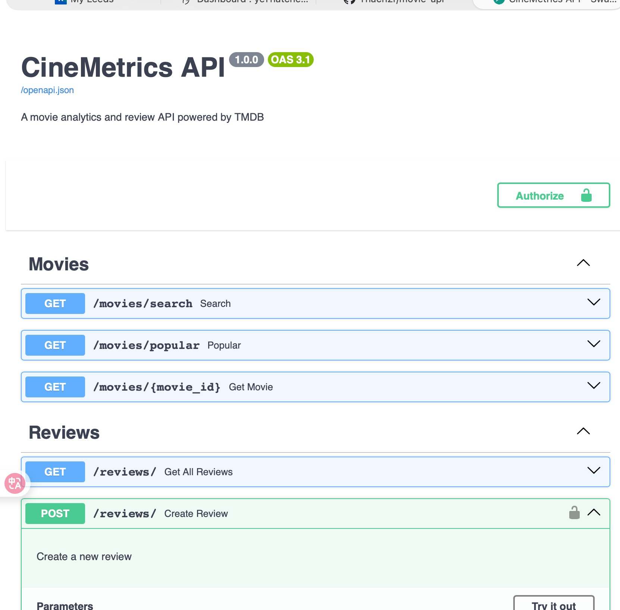
03
API DOCS
Auto-generated via FastAPI OpenAPI
Exported as PDF — in GitHub repository
16 endpoints · 4 modules documented
Example requests & responses included
GET
Public — no key
POST
X-API-Key required
DELETE
X-API-Key required
401
Missing key
403
Wrong key
yeThatcher.pythonanywhere.com/docs

Slide 5
04
ARCHITECTURE
main.py
auth.py
models.py
schemas.py
Entry point
Router + DB init
API Key
401 / 403
SQLAlchemy
ORM tables
Pydantic
Validation
movies.py
reviews.py
tags.py
analytics.py
services/tmdb.py → TMDB API
MCP Server (fastapi-mcp) → 22 tools, local
SQLite (reviews · tags · kaggle)

Slide 6
05
DEPLOY
CHALLENGE
VERSION
CONTROL &
DEPLOYMENT
PythonAnywhere → WSGI only
FastAPI → ASGI framework
a2wsgi → failed (requests hung)
github.com/Thach2r/movie-api
mangum → wrong platform (AWS)
Consistent commits throughout development
README · API docs PDF · Technical report PDF
Custom asyncio adapter → success

Slide 7
06
TESTING
36
COVERAGE
Full CRUD — Reviews & Tags
Auth enforcement: 401 & 403
Analytics response structure
404 error handling
TOOLS
CHALLENGE
FastAPI TestClient
Isolated SQLite DB
All 36 pass
UNIQUE constraint on
tmdb_id caused conflicts.
Fix: random ID per test.
TEST CASES

Slide 8
07
GENERATIVE
AI USAGE
Tool: ChatGPT (OpenAI)
01
02
03
04
Code Scaffolding
Debugging
Report Writing
Critical Review
FastAPI routers, SQLAlchemy models, Pydantic schemas
WSGI deployment, UNIQUE constraints, missing packages
Drafting & editing the technical report + README
All AI output was reviewed and modified before use

Slide 9
ALL
DELI-
VERA-
BLES
✅ CODE REPOSITORY
github.com/Thach2r/movie-api · Public · commit history visible
✅ API DOCUMENTATION
CineMetrics API - Swagger UI.pdf in repository root · Swagger UI exported
✅ TECHNICAL REPORT
technical_report.pdf in repository root · GenAI declaration included
✅ LIVE DEPLOYMENT
yeThatcher.pythonanywhere.com · /docs available
08
Thank you — ready for Q&A

