Slide 1
Team One
Members:
Tayo Elelu (Developer)
John Hale (Developer)
Isaiah Thacker (Product Owner)
Aaron Trusty (Scrum Master)
Project: Record Breaker
Notes:
Isaiah Thacker

Slide 2
App Description
Platformer along the lines of Metroid/Mario
Ranged Attacks
Level-based
Collect Records - One goal Record per level, zero or more bonus Records
Records used as music-based power-ups
Objective: Collect goal Record as fast as possible
Notes:
Isaiah Thacker

Slide 3
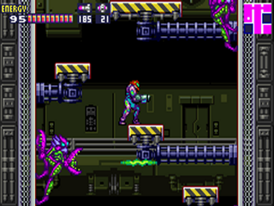
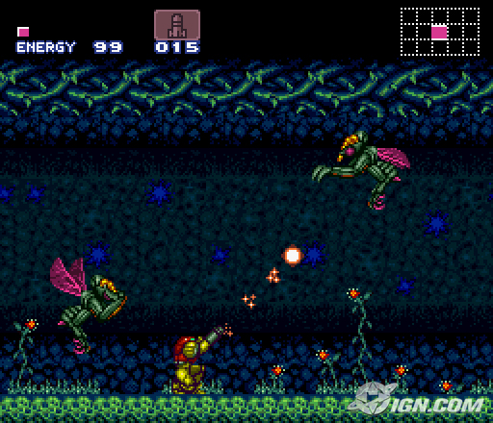
Similar Software: Metroid Series
Platformer/shooter
Both required and hidden power-ups scattered around large world.
Variety of Enemies
Some puzzle-like elements to reach hidden items.
Manage power-up resources
Notes:
Isaiah Thacker

