Slide 1
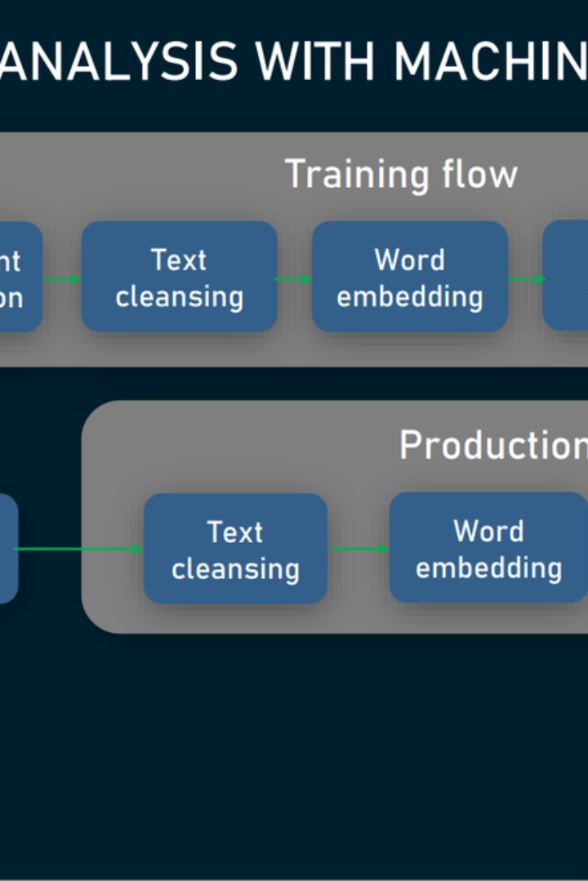

Sentiment Analysis Using Natural Language Processing (NLP) Techniques in Hotel Reviews
Unlocking the power of NLP techniques to analyze sentiment in hotel reviews, revolutionizing the way we understand customer feedback and enhance guest experiences.
group X

Slide 2
Purpose of Sentiment Analysis in Hotel Reviews
Detecting customer satisfaction
Identifying pain points
Gain insights into guests' sentiments and emotions to evaluate their overall satisfaction with hotel services and amenities.
Uncover areas where guests are unhappy or encounter issues, helping hotels to address problems and provide higher-quality experiences.
Monitoring brand reputation
Competitor analysis
Analyze online feedback to understand the perception of a hotel brand and track changes in customer sentiment over time.
Compare sentiment scores with competitors to gain a competitive edge, discover unique selling points, and improve market positioning.

Slide 3

NLP Techniques for Sentiment Analysis
1
Preprocessing of Hotel Reviews
Transform raw text data into a manageable format through tokenization, removal of stopwords, and stemming or lemmatization.
2
Feature Extraction
Extract relevant features from hotel reviews using methods such as the bag-of-words model and TF-IDF (Term Frequency-Inverse Document Frequency).
3
Sentiment Classification Algorithms
Implement classification algorithms like Naive Bayes, Support Vector Machines, or Deep Learning models to classify sentiment in hotel reviews accurately.

Slide 4

Evaluation of Sentiment Analysis Results
1
Accuracy Metrics
2
Confusion Matrix
Quantify the performance of sentiment analysis with precision, recall, and F1 Score, ensuring the reliability and effectiveness of the algorithms.
Analyze the outcome of sentiment classification in a confusion matrix to understand false positives, false negatives, and overall quality of prediction.

Slide 5
Challenges and Limitations
Subjectivity in Reviews
Contextual Understanding
Handling Negations and Sarcasm
Dealing with subjective language and emotions expressed in hotel reviews, which require contextual understanding for accurate sentiment analysis.
Recognizing nuances and understanding the context in which certain words or phrases are used to avoid misinterpretations and improve sentiment classification.
Overcoming challenges posed by negations and sarcasm in hotel reviews, as these can often result in misleading sentiment analysis outcomes.

Slide 6

Applications and Benefits
Improving Customer Experiences
Identifying Areas of Improvement
Utilizing sentiment analysis insights to enhance guest experiences, personalize services, and exceed customer expectations.
Pinpointing specific areas that require attention and improvement to provide better services and increase customer satisfaction.
Competitor Analysis
Benchmarking sentiment scores against competitors to identify market trends, enhance differentiation, and stay ahead in the industry.

Slide 7
Conclusion
Recap of Key Points
Future
Summarizing the significance of sentiment analysis in hotel reviews, the implementation of NLP techniques, and the challenges faced.
Exploring the potential of sentiment analysis in uncovering hidden insights, transforming the hospitality industry, and driving continuous improvement.

