Slide 1

Smart Doorbell with Camera and Ultrasonic Sensor
by
G. THAHASEEN
Roll No. 224G1A33B9
K. SOUMYA LATHA
Roll No. 224G1A33A6
M. SIMHADRI
Roll No. 234G5A3309
P. JAGADEESWARA
Roll No. 234G5A3312
Under the guidance of
G. Gayathri
M.Tech , Assistant Professor.
Department of Computer Science and Engineering (AI & ML)
Srinivasa Ramanujan Institute of Technology
(Affiliated to JNTUA & Approved by AICTE) (Accredited by NAAC with ‘A’ Grade & Accredited by NBA (EEE, ECE & CSE)
Rotarypuram Village, B K Samudram Mandal, Ananthapuramu – 515701.
2025 - 2026
Dept. of Computer Science and Engineering (AI&ml)
Srinivasa Ramanujan Institute of Technology

Slide 2
Contents
Smart Doorbell with Camera and Ultrasonic Sensor
• Abstract
• Problem statement
• Objectives of Project
• Literature survey for objectives
• Existing System
• Proposed System
• References
• GitHub Link
• Queries
Srinivasa Ramanujan Institute of Technology

Slide 3
Abstract
Smart Doorbell with Camera and Ultrasonic Sensor
Smart doorbells often fail to detect visitors in real time and lack automated control, resulting in security delays. Manual verification and limited communication reduce overall safety and efficiency..
To build a smart, automated doorbell system using sensors and camera-based detection.
To capture visitor images, send them instantly to the homeowner via Telegram, and allow remote door control.
The system uses Arduino, ultrasonic sensor, USB camera, GSM alerts, and motor control to provide secure, automated, and reliable home entry management.
Keywords:
Smart Doorbell, Home Security, Ultrasonic Sensor, Camera Monitoring, Remote Access, Telegram Automation, Image Transmission, Door Automation, GSM Alerts, IoT System, Real-time Monitoring
B-15
Dept. of Computer Science and Engineering (AI&ml)
Srinivasa Ramanujan Institute of Technology

Slide 4
Problem Statement:
Traditional doorbell systems depend on manual button operation and provide only basic alerts, offering limited security and no remote verification. Existing smart doorbells are often expensive, require proprietary hardware, lack sensor-based automatic detection, and do not support flexible user control or backup alert mechanisms. There is a need for a cost-effective, automated, and secure doorbell system that can detect visitors automatically, capture real-time images, enable remote approval for door access, and provide reliable alerts during unauthorized access or emergency situations.

Slide 5
Objectives
Smart Doorbell with Camera and Ultrasonic Sensor
Automatic Visitor Detection : Identify the presence of visitors instantly using an ultrasonic sensor without requiring manual action.
Image Capture : Captures real-time visitor images through a USB camera.
Remote Verification : Sends captured images to the homeowner via Telegram.
Access Control : Opens the door automatically after user approval.
Security Alerts : Provides alerts using GSM, buzzer, and LED indicators.
Voice Interaction : Uses a voice module to provide confirmation or guidance to visitors.
Scalability : Allows future upgrades such as mobile app or cloud integration.
Srinivasa Ramanujan Institute of Technology

Slide 6
Literature Survey for objectives
Smart Doorbell with Camera and Ultrasonic Sensor
No | Title | Author | Journal Name & Year | Methodology Adapted | Key Findings | Gaps
1. | IoT-Enabled Smart Doorbell with Real-Time Alerts | J. Lee, S. Kumar | IEEE Access, 2154 | Combined ultrasonic sensor and camera with IoT notification | Automatic visitor detection + image capture + app/notification | Lacks integrated motor control for door opening
2. | GSM Integrated Smart Security Framework | L. Chen, Y. Wang | Springer Nature, 2153 | GSM module for alert messaging during unauthorized events | Effective emergency alert via GSM + buzzer + LED | Does not incorporate visitor presence detection or real-time capture
3. | Automated Door Access Control Using Arduino | S. Reddy, V. Naresh | IRJET, 2150 | Motor driver controlled door automation using Arduino | Motor driver controlled door automation using Arduino | No visitor verification or security alert features
Srinivasa Ramanujan Institute of Technology

Slide 7
Existing System
Smart Doorbell with Camera and Ultrasonic Sensor
In most current doorbell and home entry security systems, visitor handling is managed using basic manual alert mechanisms such as button-based ringing. These systems have several limitations:
Manual Operation: Visitors are required to physically press a doorbell button to notify the homeowner about their arrival.
Limited Alert Mechanism: The system provides only a basic ringing or chime sound, without smart notifications, logs, or any advanced alert features.
No Visitor Verification: There is no facility to capture images or visually verify the identity of visitors before opening the door.
Srinivasa Ramanujan Institute of Technology

Slide 8
Existing System
Smart Doorbell with Camera and Ultrasonic Sensor
4. Lack of Remote Access: Homeowners cannot monitor visitor activity or respond to door alerts when they are away from home or outside the premises.
5. No Automation: Door locking and unlocking operations are carried out manually, without any form of intelligent or automated control.
6. Poor Security Features: The system does not include GSM alerts, buzzers, or LED indicators to warn about unauthorized access or emergency situations.
7. Dependency on Physical Presence: The homeowner must be physically present at the location to manage visitors, which reduces convenience and security.
Srinivasa Ramanujan Institute of Technology

Slide 9
Proposed System
Smart Doorbell with Camera and Ultrasonic Sensor
t
Step 1 – Automatic Visitor Detection:
Ultrasonic sensor detects visitor presence automatically.
Step 2 – Real-Time Image Capture:
USB camera captures visitor image instantly.
Step 3 – Remote Verification :
Visitor image sent to homeowner via Telegram.
Step 4 – Automated Door Access Control:
Motor driver opens door after user approval.
Step 5 – Voice Interaction System:
Voice module gives audio confirmation to visitors.
Step 6 – Security Alerts:
GSM, buzzer, and LED alert unauthorized access.
Output: Real-time visitor detection, remote verification, instant alerts, and automated door operation.
Srinivasa Ramanujan Institute of Technology

Slide 10
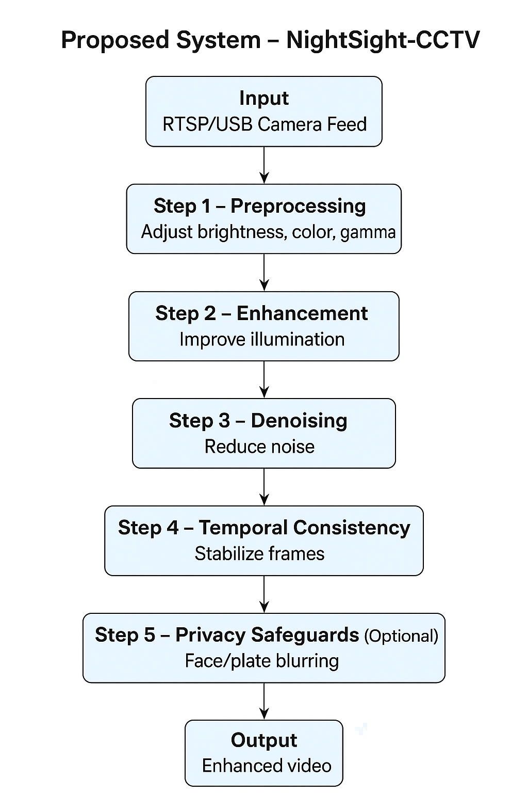
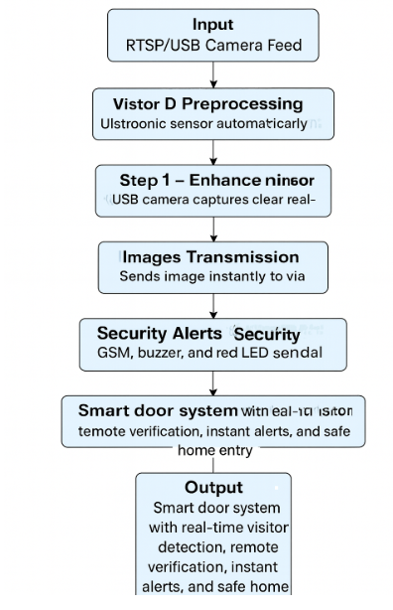
Proposed System
Smart Doorbell with Camera and Ultrasonic Sensor
t
Srinivasa Ramanujan Institute of Technology

Slide 11
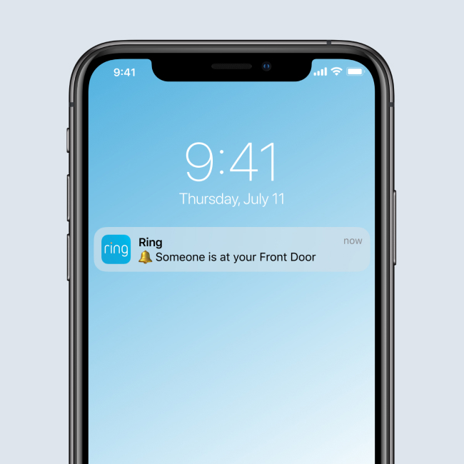
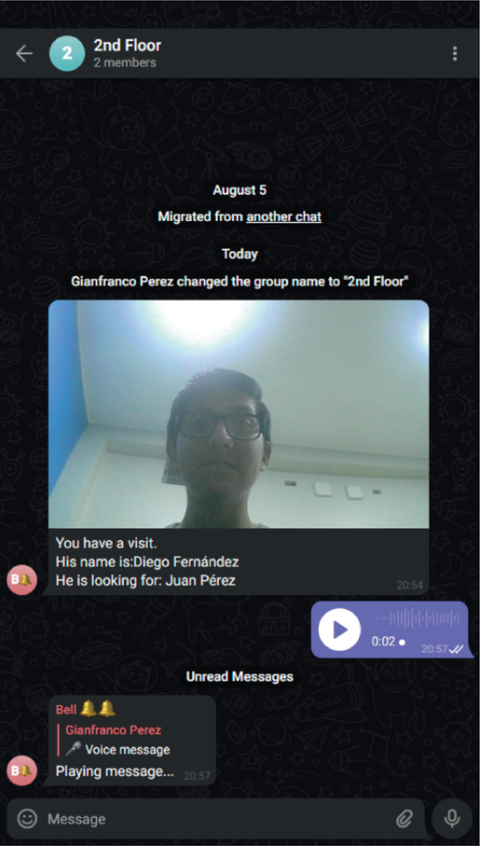
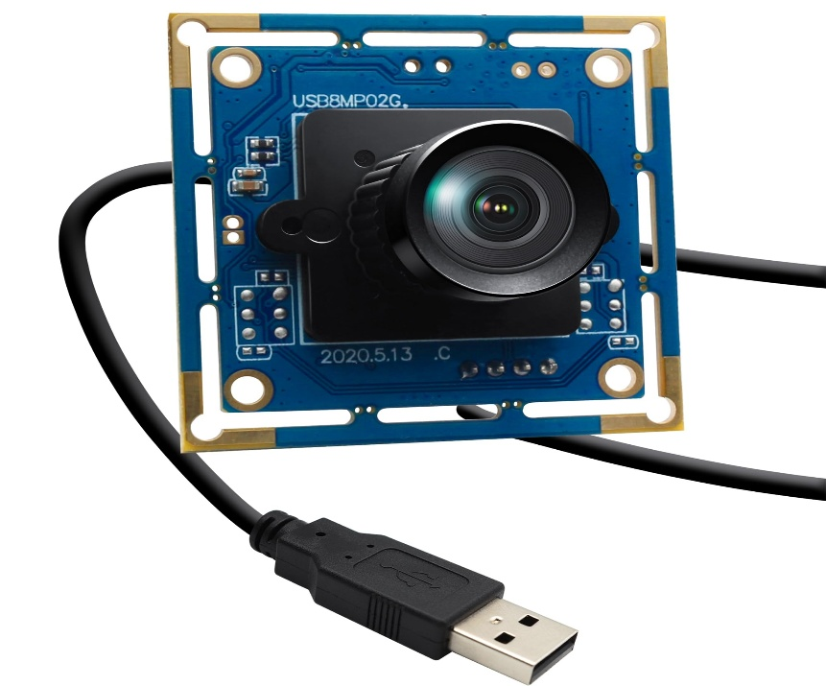
Proposed System
Smart Doorbell with Camera and Ultrasonic Sensor
t
Srinivasa Ramanujan Institute of Technology

Slide 12
References
Smart Doorbell with Camera and Ultrasonic Sensor
1. S. Singh, R. Kaur, “Smart Door Security System using IoT,” International Journal of Engineering Research & Technology (IJERT), 2019.
2. A. K. Sharma, P. K. Jain, “IoT Based Home Security System,” International Journal of Advanced Research in Computer Science, 2018.
3. R. S. Raj, K. M. Reddy, “Arduino Based Smart Door Lock System Using IoT,” Journal of Engineering Science and Technology, 2017.
Srinivasa Ramanujan Institute of Technology

Slide 13
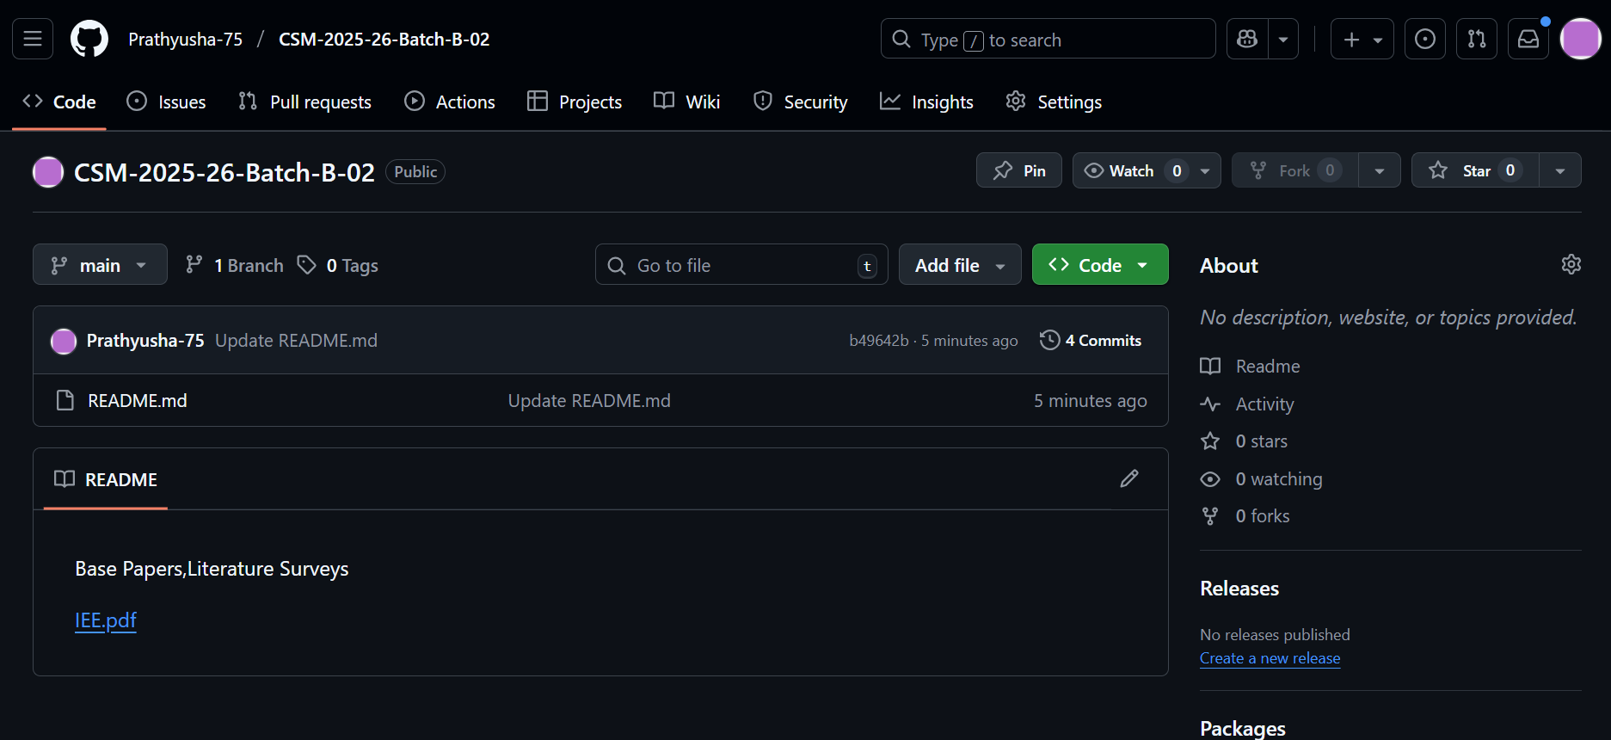
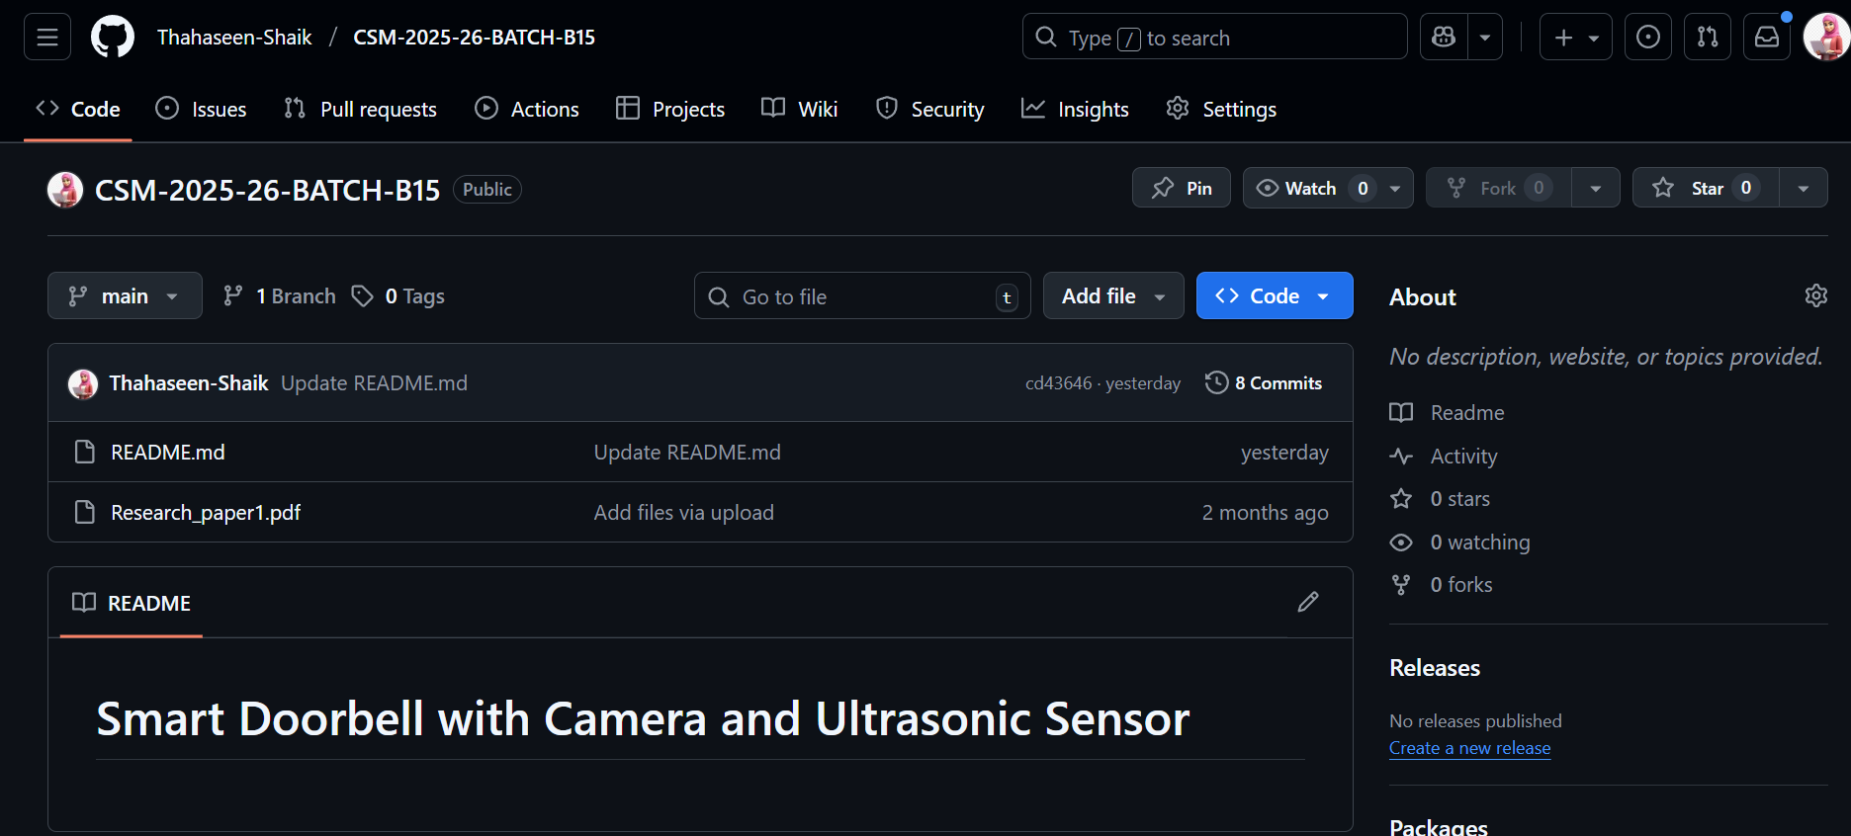
Smart Doorbell with Camera and Ultrasonic Sensor
Git Hub Dashboard of Batch
Srinivasa Ramanujan Institute of Technology

Slide 14
Any Queries?
Smart Doorbell with Camera and Ultrasonic Sensor
Srinivasa Ramanujan Institute of Technology

Slide 15
Thank You!!!
Smart Doorbell with Camera and Ultrasonic Sensor
Srinivasa Ramanujan Institute of Technology

