Slide 1


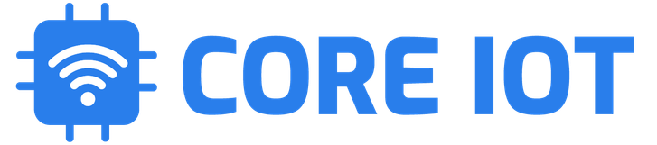
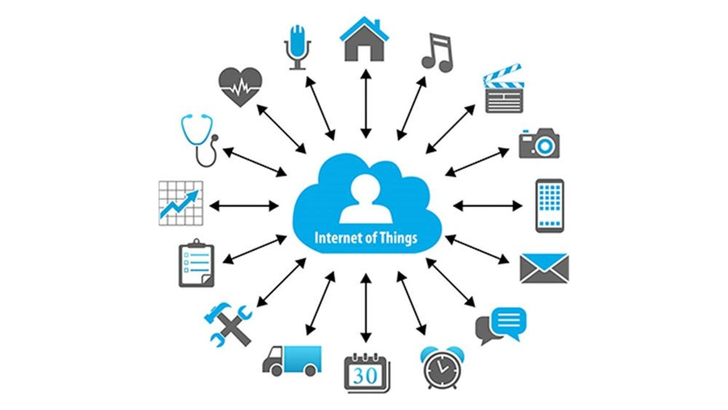
COREIOT - OPEN SOURCE FRAMEWORK
Open-source & Free Cloud IoT Platform
CoreIOT is an open-source IoT platform for data collection, processing, visualization, and device management. It enables device connectivity via industry standard IoT protocols - MQTT, CoAP and HTTP and supports both cloud and on-premises deployments.
https://www.coreiot.io

Slide 2
Create CoreIOT Account
Introduction to CoreIOT
Create Devices
Manual Videos:
  https://www.youtube.com/watch?v=l7AqpsF1ByQ
  https://www.youtube.com/watch?v=bigeRVU2iSE
  https://www.youtube.com/watch?v=Qdan24IpoH4
  https://www.youtube.com/watch?v=c5fX7SeRQsQ
Create Dashboard
IOT Client using Python
Testing and Validate
Summary

Slide 3
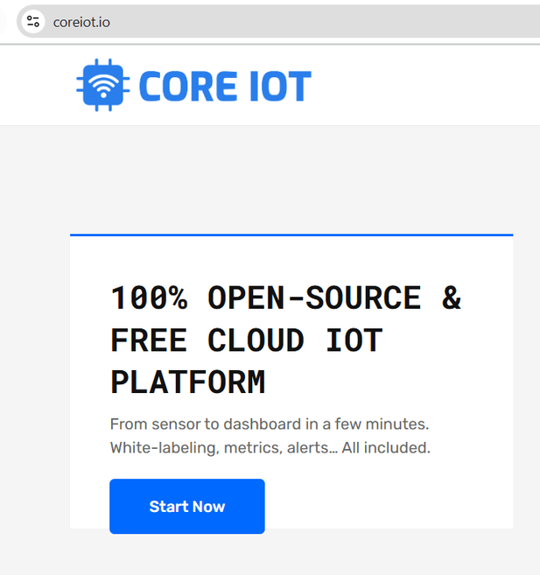
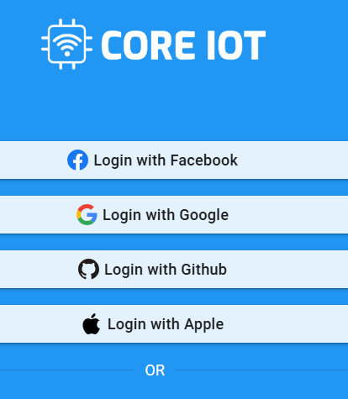
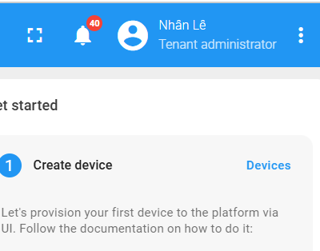
Create Core IOT Account
An account having administrator role is required to login to CoreIOT Platform
https://www.youtube.com/watch?v=l7AqpsF1ByQ
Navigate to coreiot.io, click on Start Now
Login by using your Google Account
You are Tenant administrator now!!

Slide 4
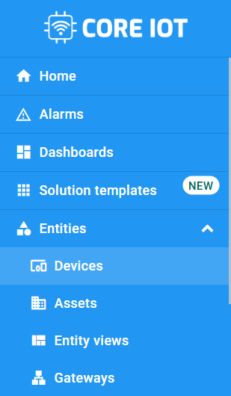
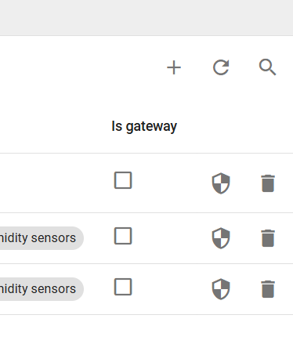
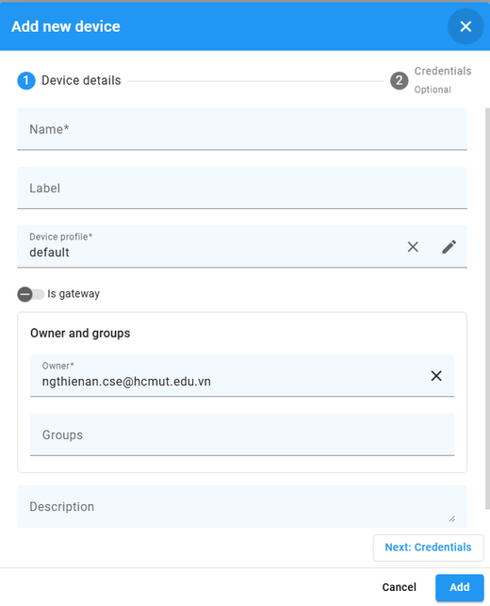
Create Device and Credential
Create your device and manage the credential
https://www.youtube.com/watch?v=l7AqpsF1ByQ
Go to Entities
Select Devices
Press ADD icon on the screen (top-right corner)
Choose Add new device

Slide 5
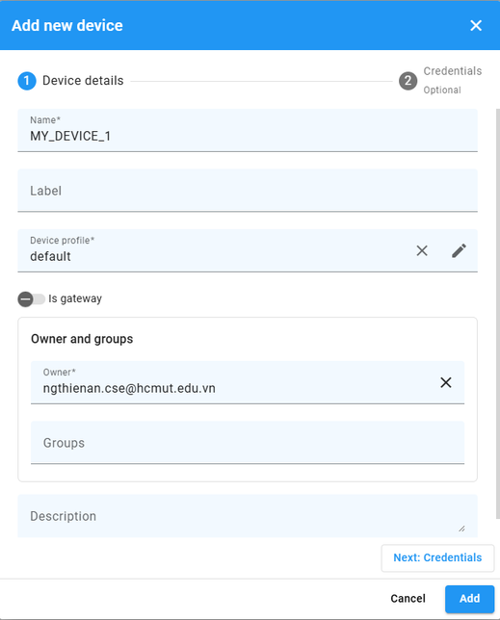
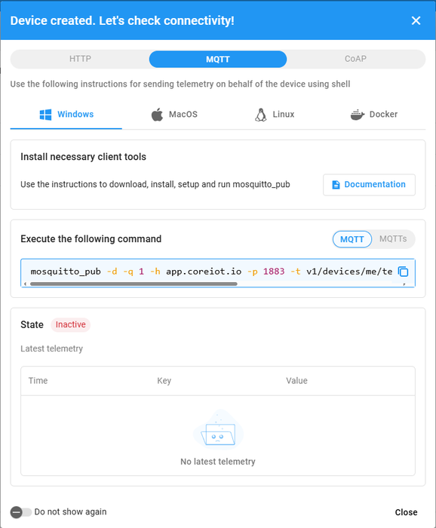
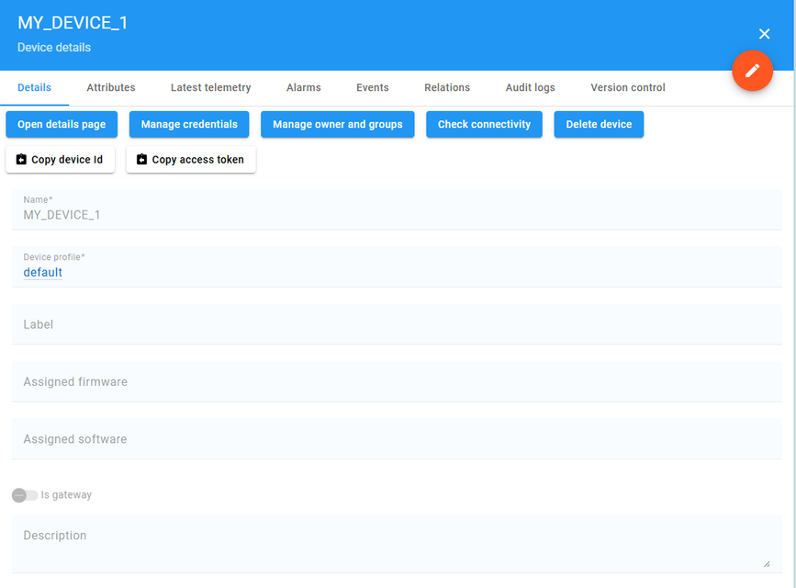
Create Device and Credential
Create your device and manage the credential
https://www.youtube.com/watch?v=l7AqpsF1ByQ
Fill in the name for your device
View the connectivity settings of the device
Select your newly created device to show more details

Slide 6
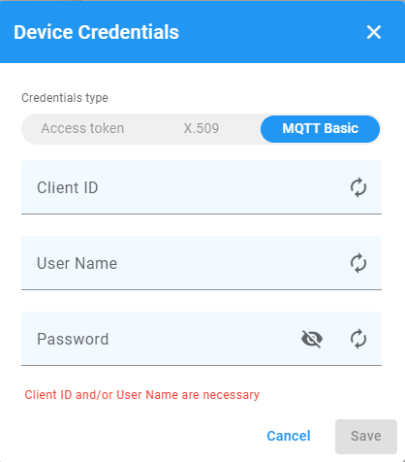
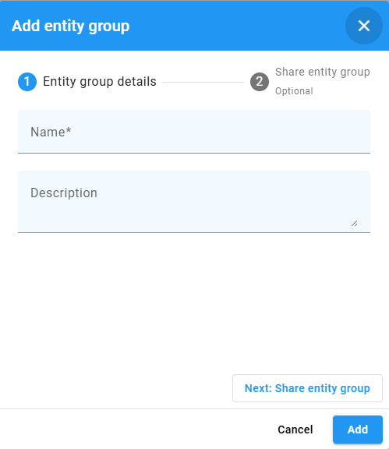
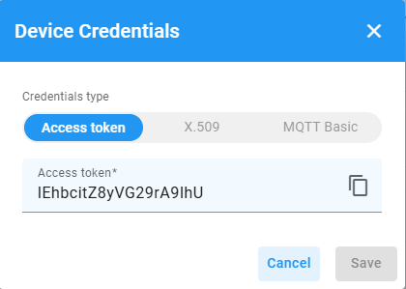
Create Device and Credential
Create your device and manage the credential
https://www.youtube.com/watch?v=l7AqpsF1ByQ
Click on Manage Credentials to view the access token
Or setup ID and password for access
Create a group of devices with the Groups tab

Slide 7
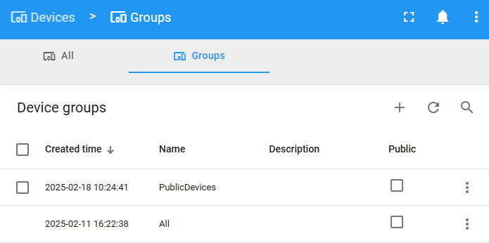
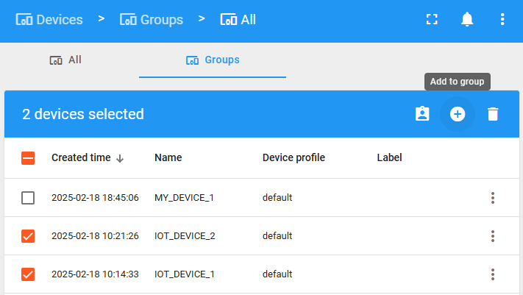
Create Device and Credential
Create your device and manage the credential
https://www.youtube.com/watch?v=l7AqpsF1ByQ
Add devices to group by choosing “All” group
Then Add to group

Slide 8
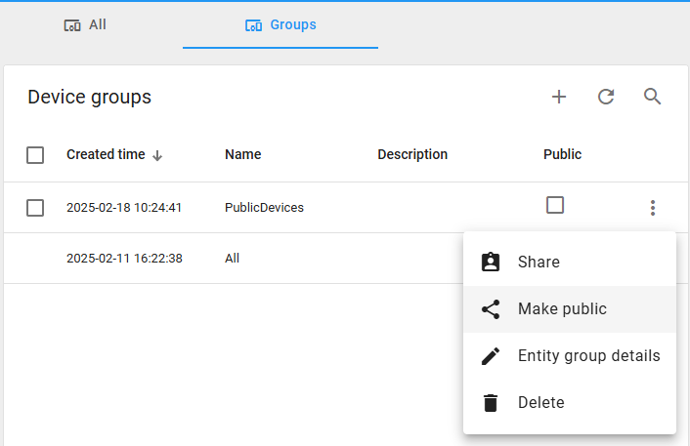
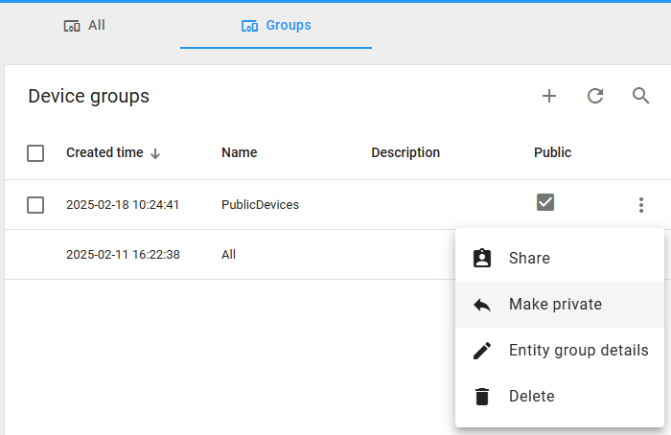
Create Device and Credential
Create your device and manage the credential
https://www.youtube.com/watch?v=l7AqpsF1ByQ
You can make a group public
Or private

Slide 9
01
02
03
CLIENT ATTRIBUTE
SHARED ATTRIBUTE
SERVER ATTRIBUTE
  These are attributes that are typically set by the device and sent to the CoreIOT platform.
  Client attributes represent the state or configuration of a device as reported to the server
  Shared attributes are intended for shared use between the device and the server. Both the device and server can update and read the attributes.
  These are attributes that are solely managed by the IOT server. They are intended to maintain server-side metadata about devices or other entities.
USE CASE
USE CASE
USE CASE
  These are usually read-only from the dashboard and cannot be modified directly through the server.
  Used to configure device behavior, such as setting thresholds, mode of operation, schedule settings, etc
  Typically used for information that is only relevant to the server: device ownership, last configuration change timestamp, access permissions, etc

Slide 10
04
TELEMETRY ATTRIBUTES
Definition
Connection
  Telemetry attributes are data points associated with a specific timestamp that record the behavior or state of a device at a given time. These data points are continuously updated and collected to provide insights into the device's operations
  Devices send telemetry data to the ThingsBoard platform via protocols like MQTT, HTTP, or CoAP. The data is stored in a time-series database, which allows for efficient querying and analysis over time.
Access and Visulization
Use Case
  Telemetry data can be accessed through the dashboard and is often visualized using widgets such as charts, graphs, and real-time indicators. This allows users to monitor real-time events and historical trends and make informed decisions based on the data.
  They are used for capturing and analyzing real-time data such as temperature, humidity, pressure, battery level, speed, or any other measurement that can vary over time. This data is crucial for monitoring trends, generating alerts, and performing analytics

Slide 11
REMOTE PROCEDURE CALL - RPC
RPC stands for Remote Procedure Call. RPC is a protocol that one program can use to request a service or procedure to be executed on another program, typically on a remote machine or device, as if it were a local procedure call.
Purpose
Functional
Use Cases
Implementation
RPCs are primarily used for commands or remote control actions that you want a device to execute.
With RPC, you can send commands from the platform down to the device. For instance, trigger an action like turning a light on or off.
RPC is used in scenarios where real-time control and management are needed, such as managing fleets of devices,
or quering the device state
On the client side (device), a handler or listener for RPC requests needs to be implemented to process incoming commands and execute the appropriate actions.
On the server side (ThingsBoard platform), RPC requests can be configured and triggered using dashboards and server-side scripts or APIs.

Slide 12
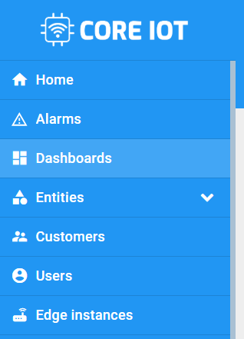
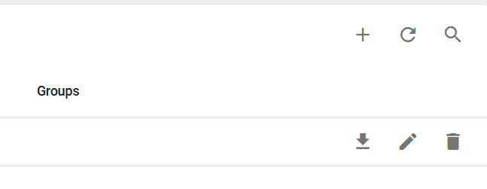
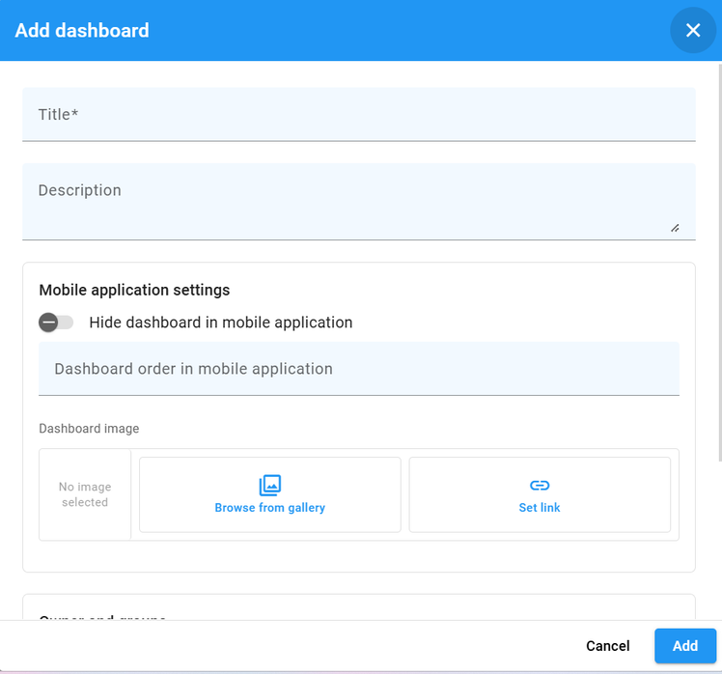
CREATE DASBOARD
https://www.youtube.com/watch?v=bigeRVU2iSE
Select Dashboard
Select Add Icon
Add dashboard

Slide 13
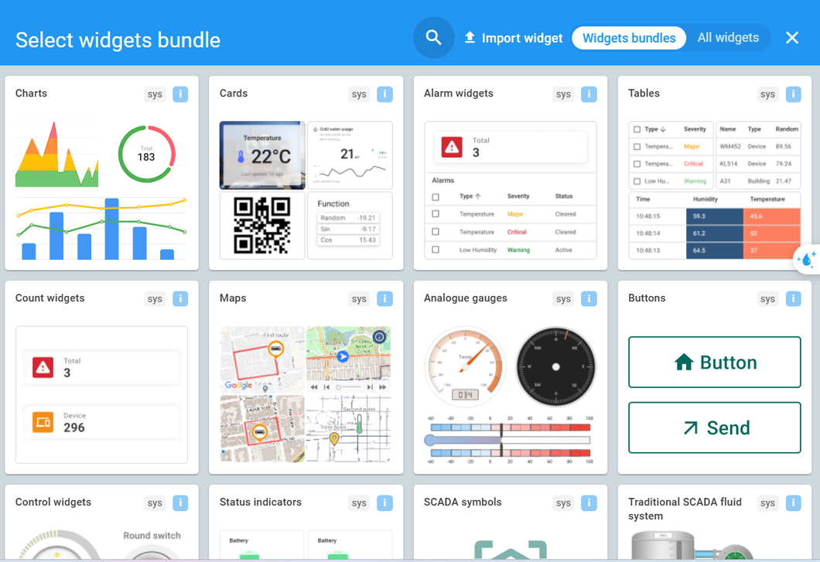
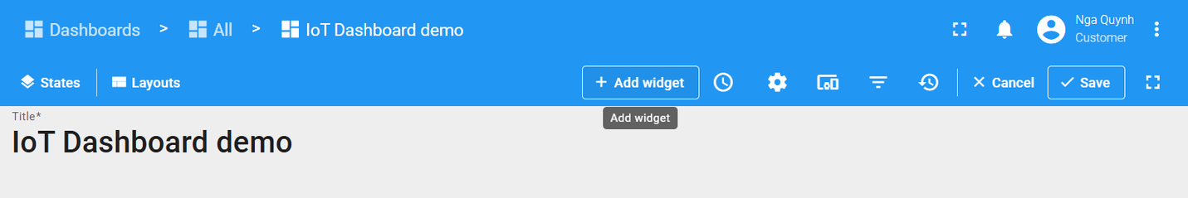
CREATE DASBOARD
Add widget
Select widget from Lib

Slide 14
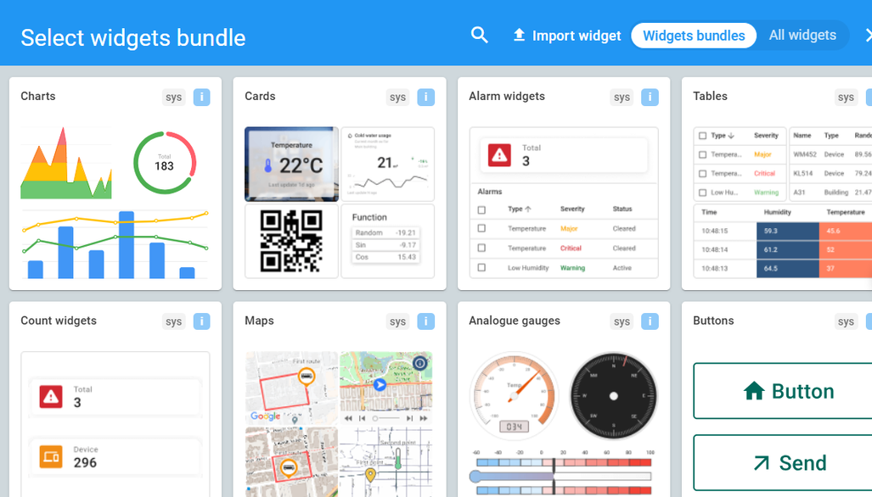
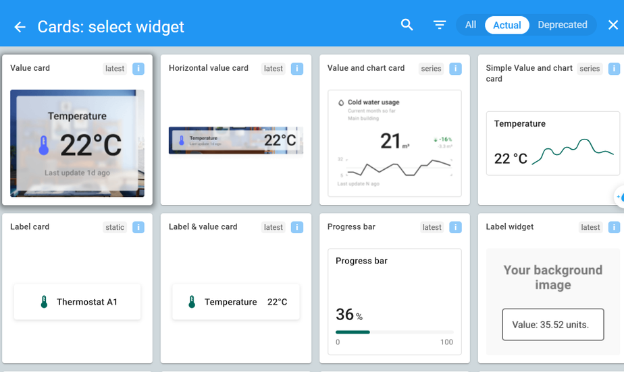
CREATE DASHBORD FOR TEMP AND HUMI
Widget “Card”
Widget “Value card”

Slide 15
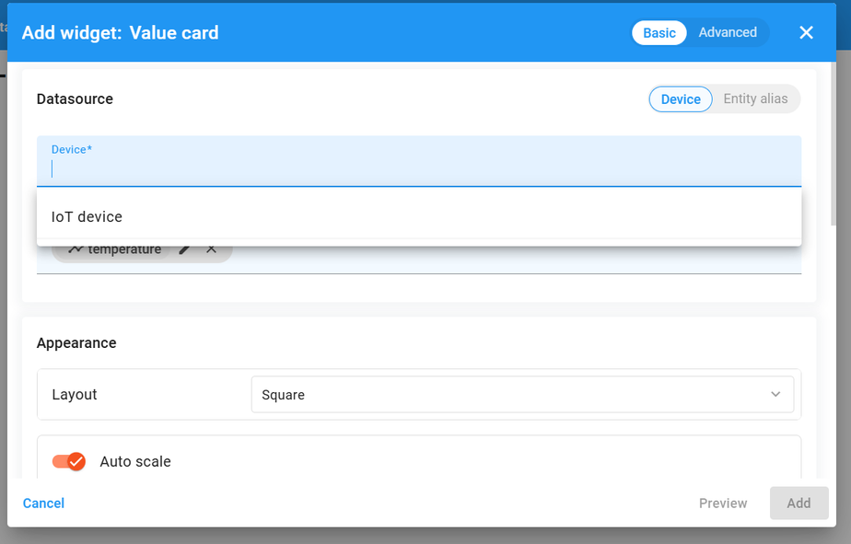
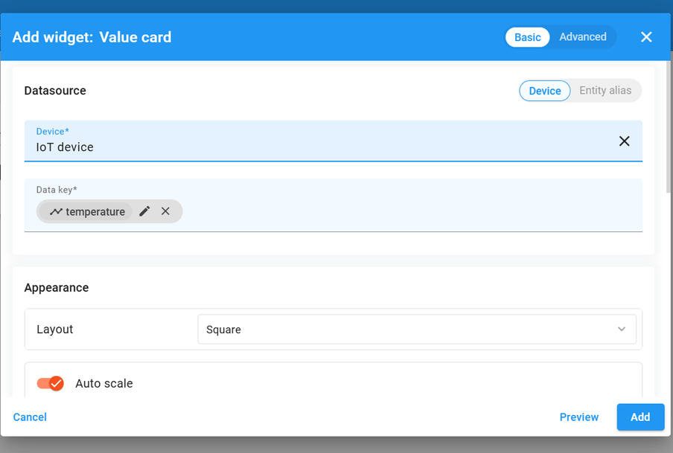
CREATE DASBOARD
Choose your Device
Select your data field

Slide 16
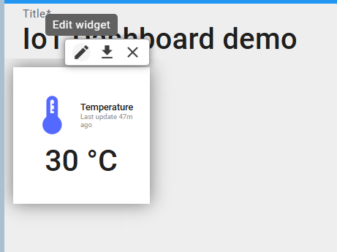
CREATE DASBOARD
Click on Edit icon to modify the widget if needed

Slide 17
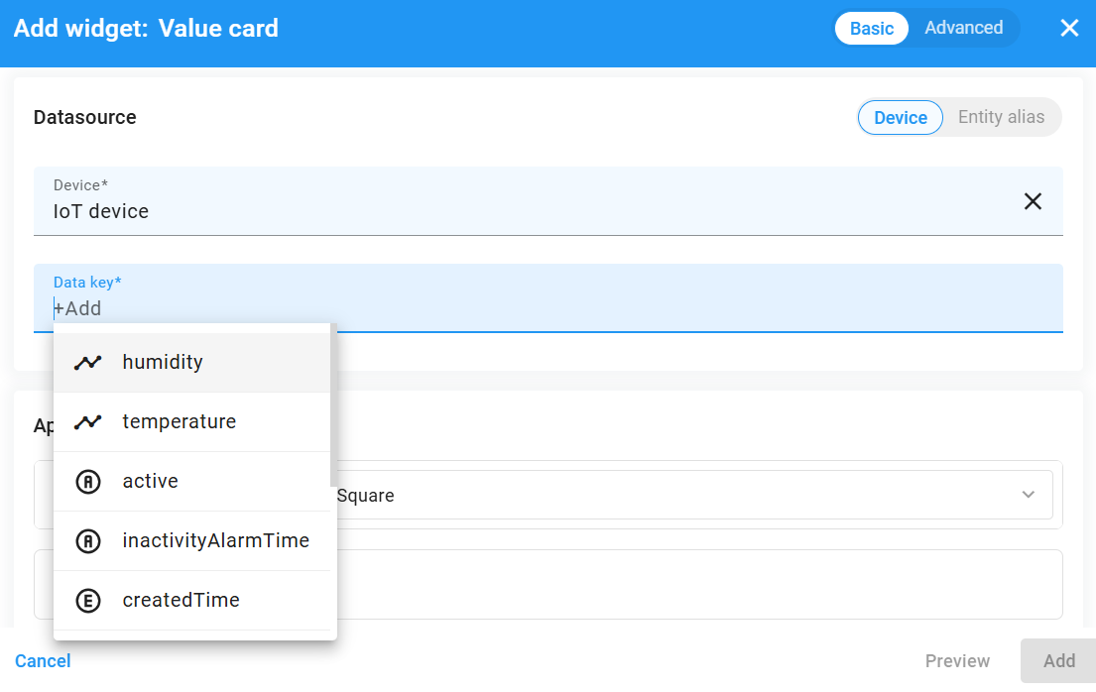
CREATE DASBOARD
Create one more widget “Value card”
Select “humidity”

Slide 18
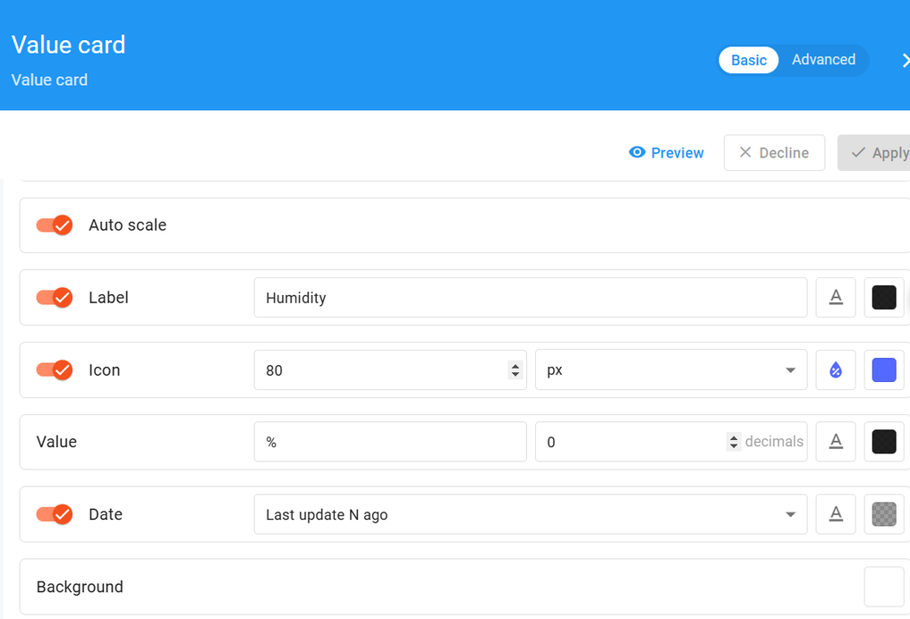
CREATE DASBOARD
Change Apperance and Click on Add icon

Slide 19
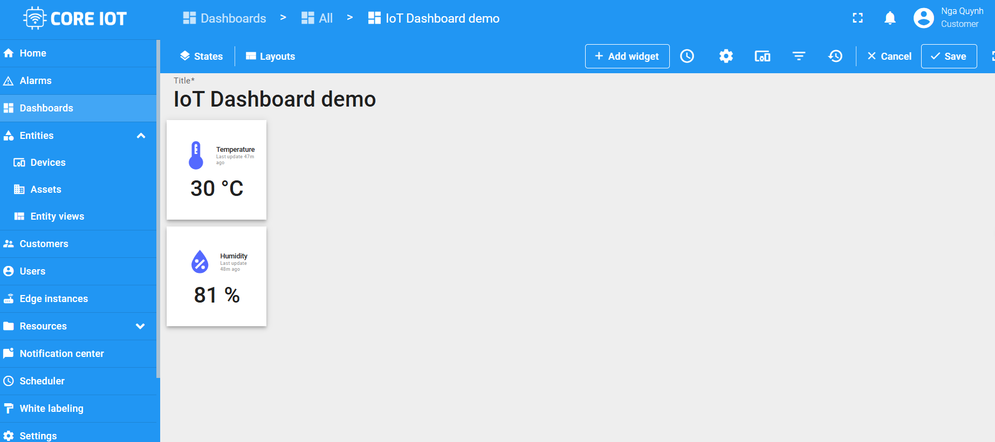
CREATE DASBOARD
Two widgets are created

Slide 20
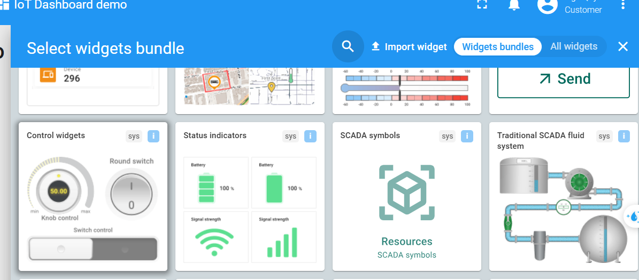
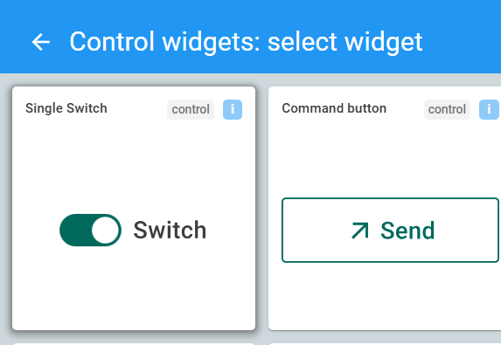
CREATE DASBOARD
Create a control switch

Slide 21
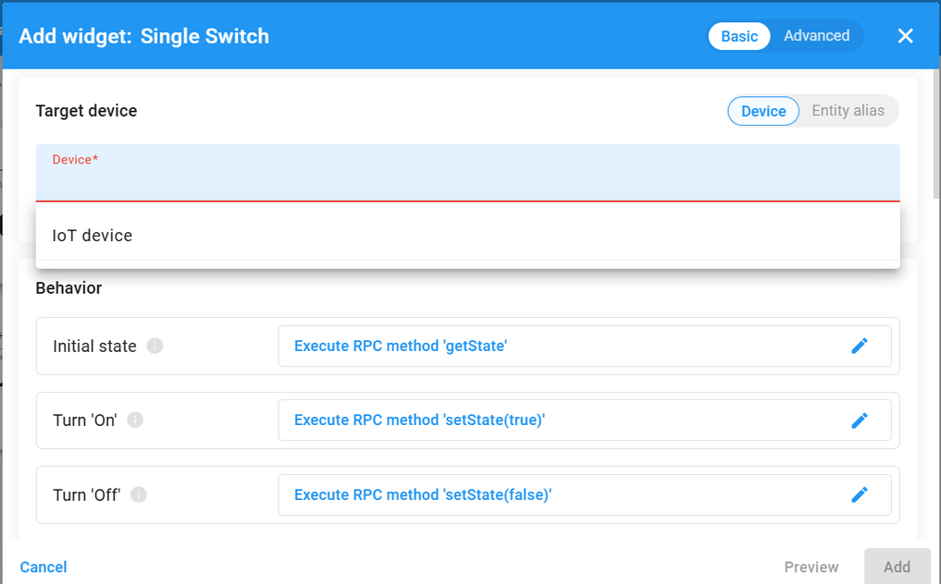
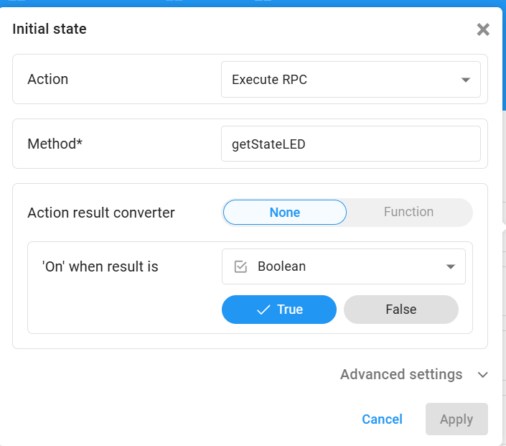
CREATE DASBOARD

Slide 22
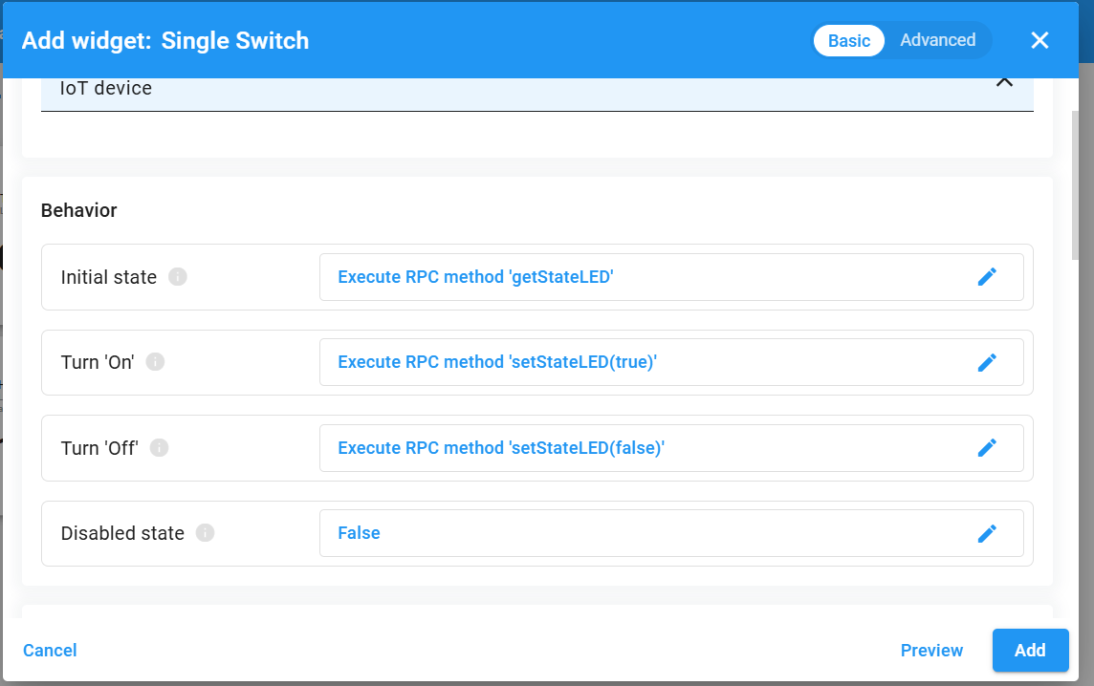
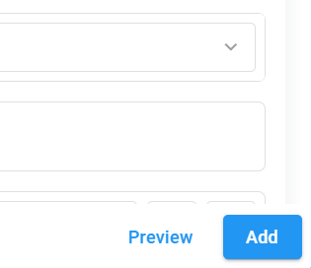
CREATE DASBOARD
Change RPC Method
Click Add button

Slide 23
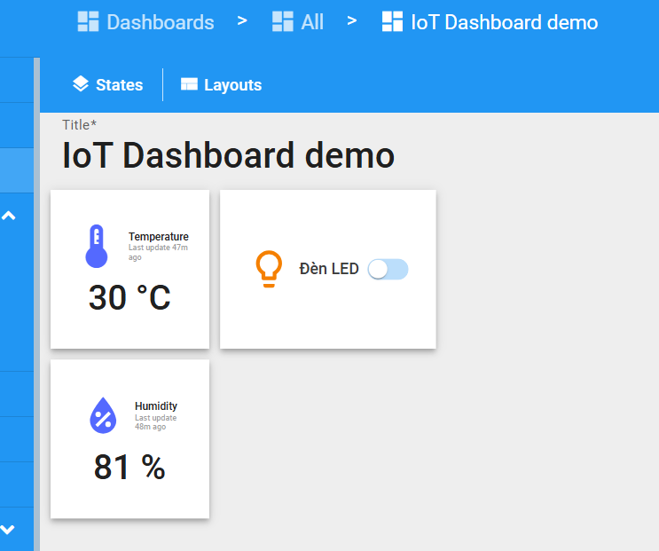
CREATE DASBOARD

Slide 24
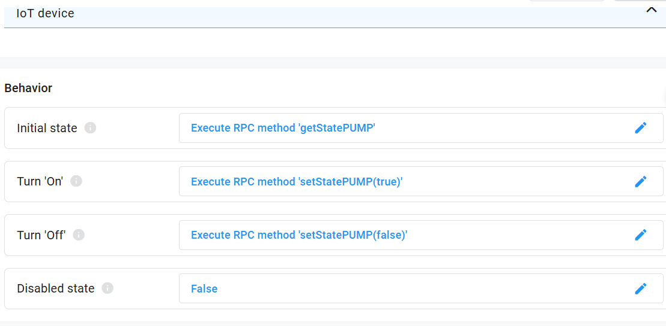
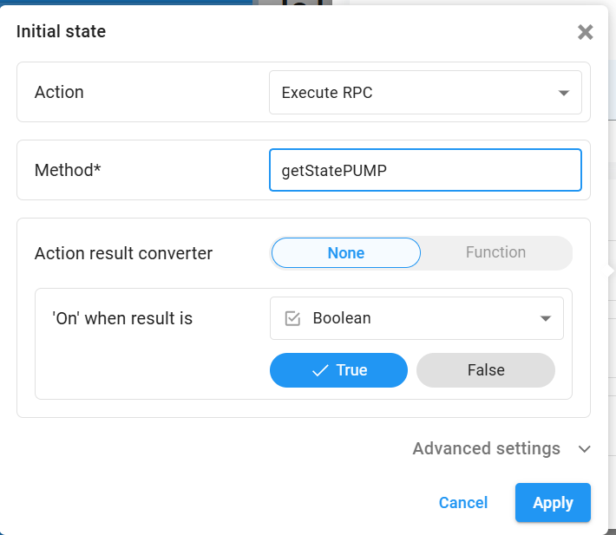
CREATE DASBOARD
Create another switch control

Slide 25
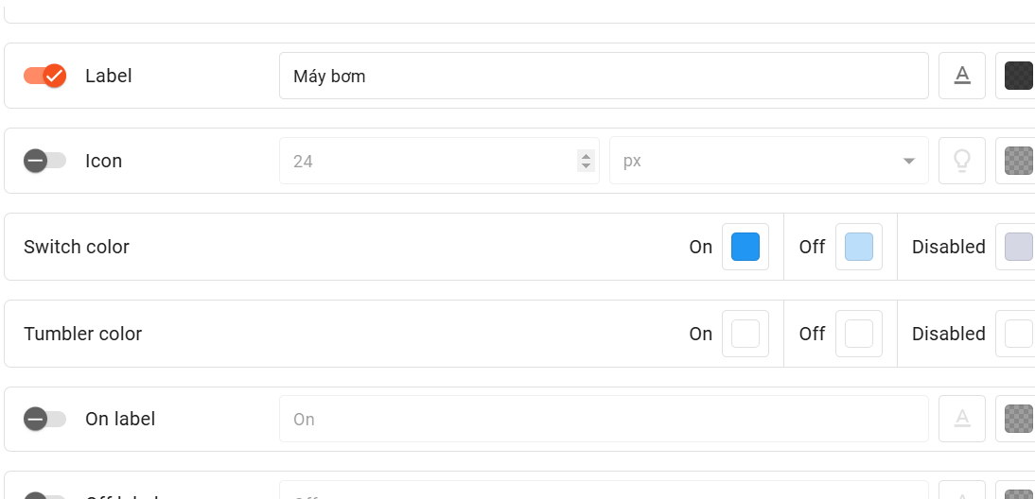
CREATE DASHBOARD

Slide 26
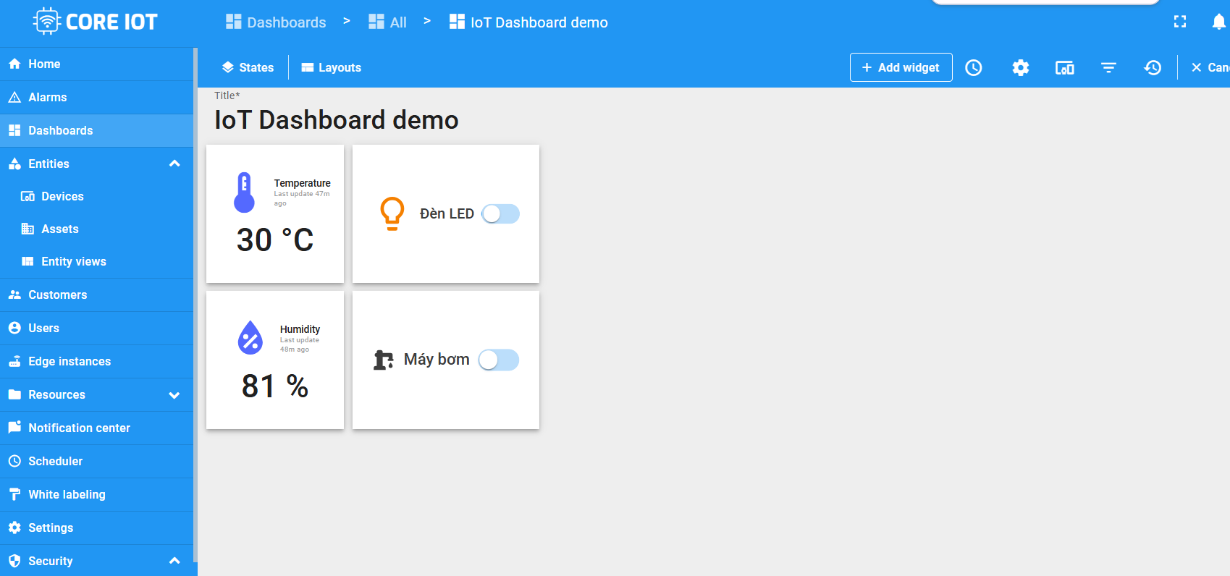
CREATE DASBOARD

Slide 27
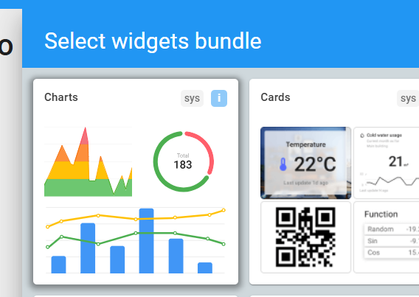
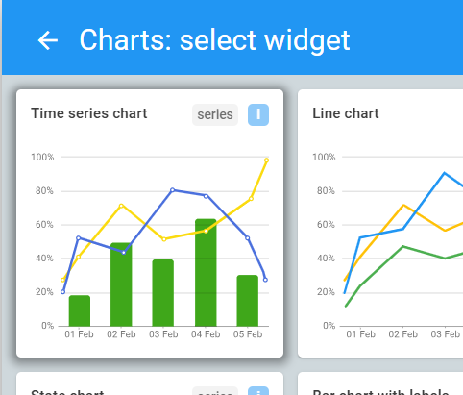
CREATE DASBOARD
Select widget “Time series chart”
Create a Chart

Slide 28
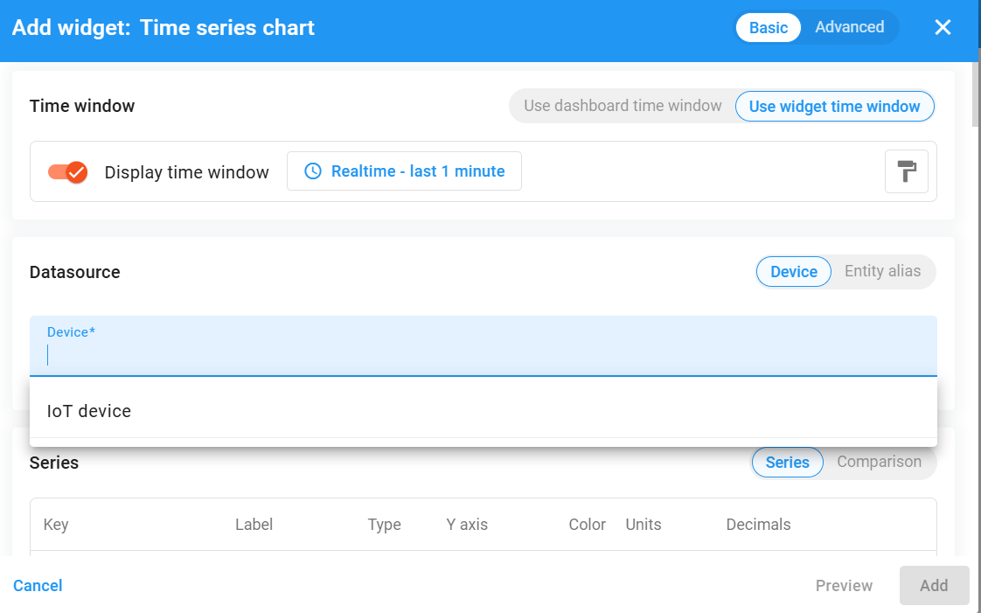
CREATE DASBOARD
Select your device

Slide 29
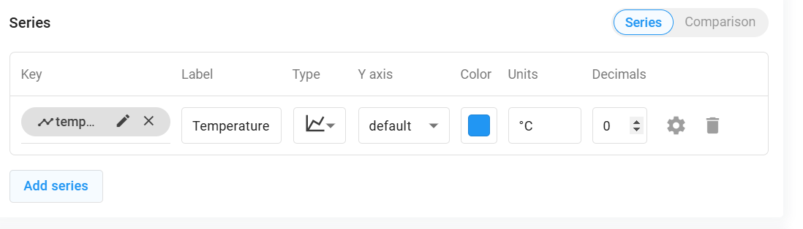
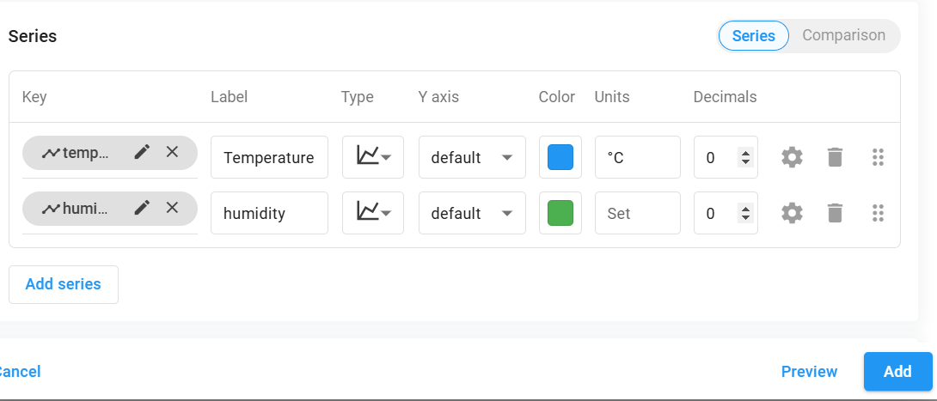
CREATE DASBOARD
Select “Add series”
Select “humidity”, then “Add”

Slide 30
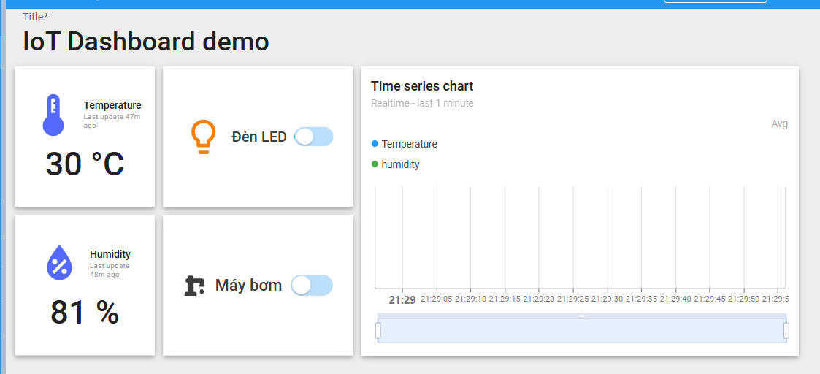
CREATE DASBOARD
An example of your Dashboard

Slide 31
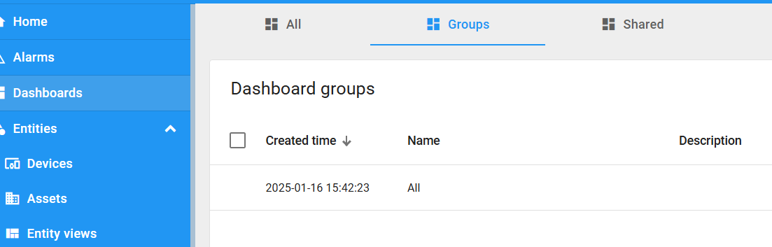
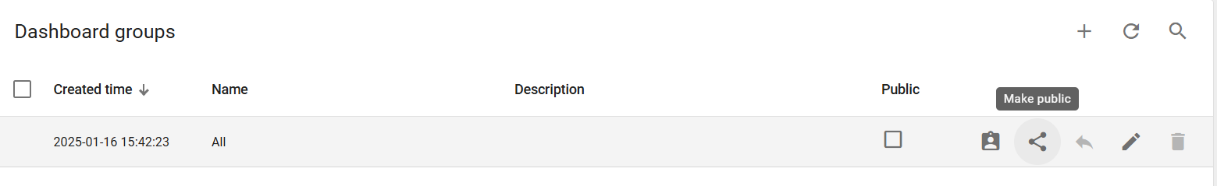
SHARING YOUR DASHBOARD
Select Dashboard >> Groups
Click on the “Make public” icon

Slide 32

SHARING YOUR DASHBOARD
The public link of your dashboard
You have to public both Dashboard And Device

Slide 33


Implement a Client using Python
Test your device by a simulated python client
https://www.youtube.com/watch?v=bigeRVU2iSE
https://github.com/nhanksd85/CoreIOT/blob/CoreIOT_Lab1/thingsboard.py

Slide 34
Thank You!

