Slide 1


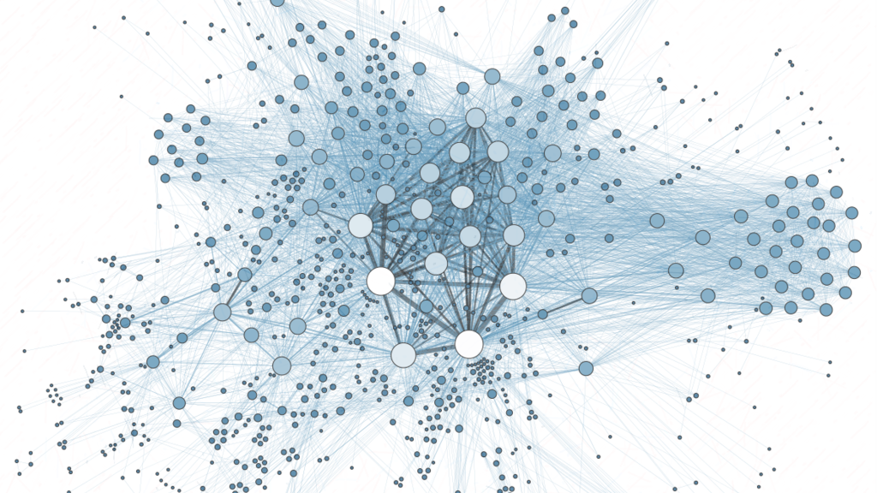
Hanoi University of Science and Technology
School of Electronics and Telecommunication
Weekly Practice: Image Binary
Presenter: Vu Duc Thai
ĐTVT.08-K62
Instructor: Associate Prof. Le Thi Lan
Ha Noi, 5-2021

Slide 2
Outline
Boundary extraction and Region filling algorithm
Applications
Theoretical basic
Connected Components algorithm
Applications
Theoretical basic
Convex Hull algorithm
Applications
Theoretical basic
References
Practice code

Slide 3
I. Boundary Extraction and Region Filling Algorithm

Slide 4
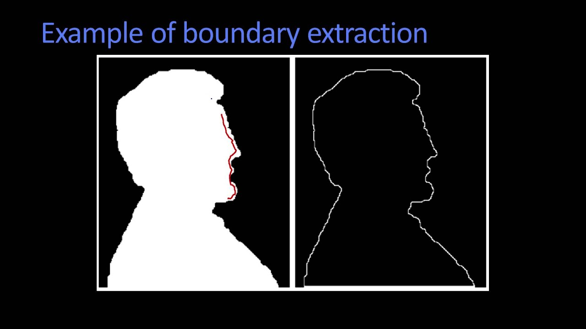

I.a Boundary Extraction and Region Filling Algorithm
Boundary Extraction Algorithm | Region Filling Algorithm

Slide 5


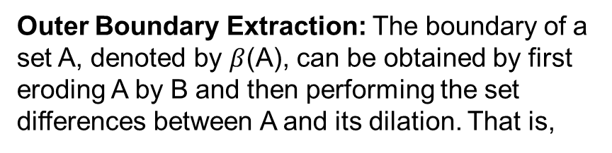
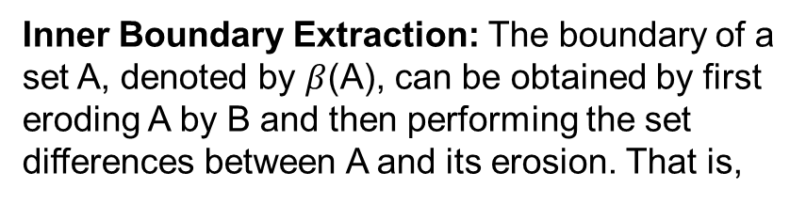
I.b Boundary Extraction and Region Filling Algorithm
Boundary Extraction Algorithm | Region Filling Algorithm
Inner Boundary Extraction: The boundary of a set A, denoted by $β$(A), can be obtained by first eroding A by B and then performing the set differences between A and its erosion. That is,
Let p be a pixel in a region surrounded by an 8-connected boundary, A. Region filling can be accomplished using an iterative procedure, mathematically expressed as follows:
Outer Boundary Extraction: The boundary of a set A, denoted by $β$(A), can be obtained by first eroding A by B and then performing the set differences between A and its dilation. That is,
Where X0 = p and B is the cross-shaped structuring element. The algorithm stops at the kth iteration if Xk = Xk-1. The union of Xk and A contains the original boundary (A) and all the pixels within it labeled as 1

Slide 6
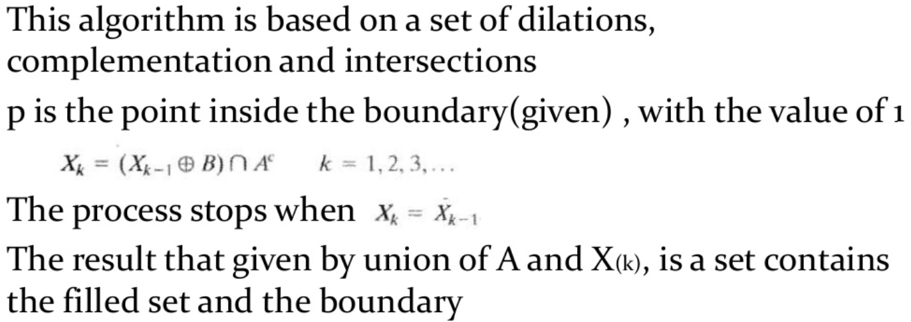
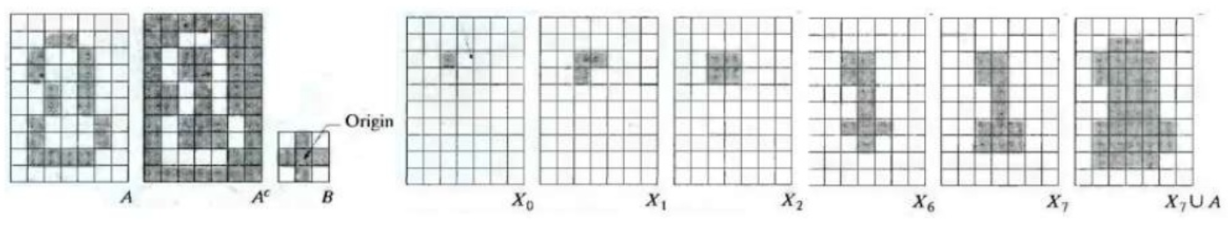
I.b Boundary Extraction and Region Filling Algorithm
Region Filling Algorithm

Slide 7
II. Connected Components Algorithm

Slide 8
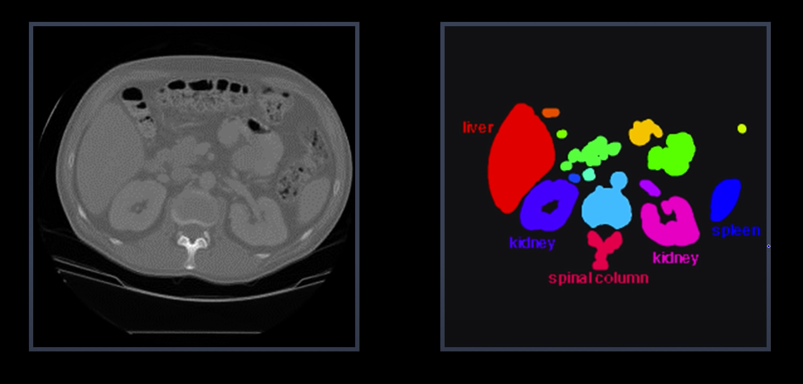
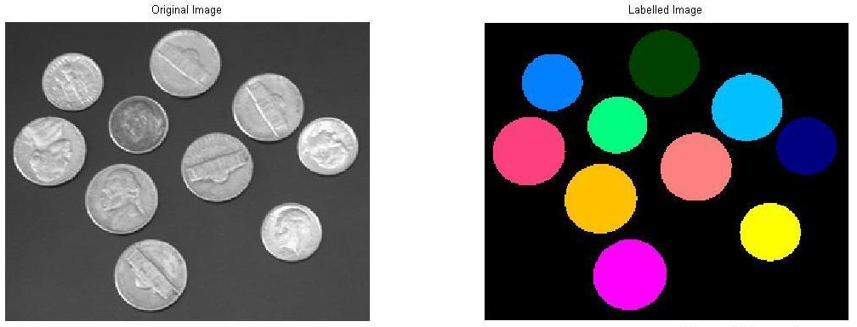
II.a Connected Components Algorithm (Applications)
CT image of the chest
Image Segmentation

Slide 9
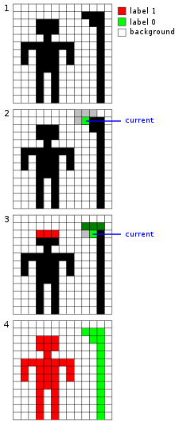
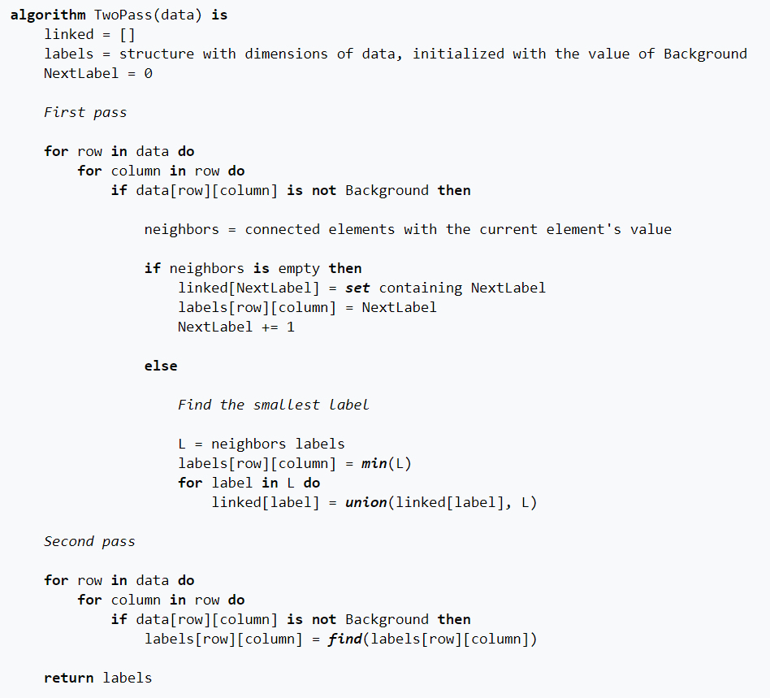


II.b Connected Components Algorithm
Presudo code for this algorithm:
4-connectivity
8-connectivity

Slide 10
III. Convex Hull Algorithm

Slide 11
III.a Convex Hull Algorithm

Slide 12
III.b Convex Hull Algorithm

Slide 13
III.b Convex Hull Algorithm

Slide 14
IV References
Boundary extraction and Region filling algorithm
https://www.youtube.com/watch?v=NTTVQYEG6XM&t=109s&ab_channel=KnowledgeAmplifier
https://www.slideshare.net/daouddodo/chapter-9-morphological-image-processing-71788791
Connected Components algorithm
https://en.wikipedia.org/wiki/Connected-component_labeling
Convex Hull algorithm

Slide 15
V. Practice Code

Slide 16

Thank you for listening

