Slide 1





Group AI_65
AI FOR SE
AI-Assisted Spending Planner
01

Slide 2
Group AI_65
TEAM MEMBERS
Huỳnh Bá Thái Hùng
Phan Thanh Bảo
Trần Minh Quang
Nguyễn Văn Việt Hưng
Nguyễn Hữu Huy
02

Slide 3


Group AI_65
PROBLEM / BACKGROUND
60% OF YOUNG ADULTS IN VIETNAM DO NOT HAVE A CLEAR SPENDING PLAN (MOMO 2023).
LACK OF SPENDING TRACKING, UNCLEAR SAVING GOALS, AND NO PERSONALIZED PLANNING TOOL.
MANY PEOPLE STILL “RUN OUT OF MONEY BEFORE THE END OF THE MONTH,” EVEN WITH A STABLE INCOME.
02

Slide 4




Group AI_65
SOLUTION OBJECTIVES
INPUT INCOME AND SAVING GOALS.
LET AI GENERATE A PERSONALIZED SPENDING PLAN BASED ON HABITS.
TRACK DAILY EXPENSES VIA APP OR CHATBOT.
RECEIVE SMART ALERTS WHEN SPENDING EXCEEDS LIMITS.
03

Slide 5

Group AI_65
HOME
SERVICE
ABOUT US
CONTACT US
SCOPE & CORE FEATURE
Core Feature: Budget Planner + Daily Tracking
AI ANALYZES SPENDING HISTORY AND USER BEHAVIOR.
PREDICTS FUTURE CONSUMPTION TRENDS.
SUGGESTS OPTIMAL SPENDING PATTERNS TO MEET SAVING GOALS.
04

Slide 6
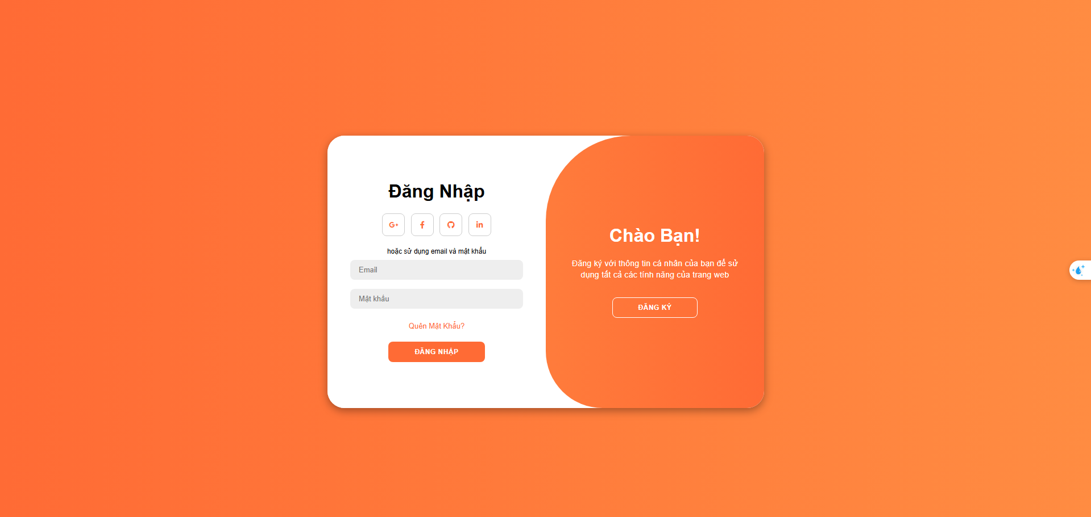
Group AI_65
HOME
SERVICE
ABOUT US
CONTACT US
LOGIN - REGISTER
04

Slide 7
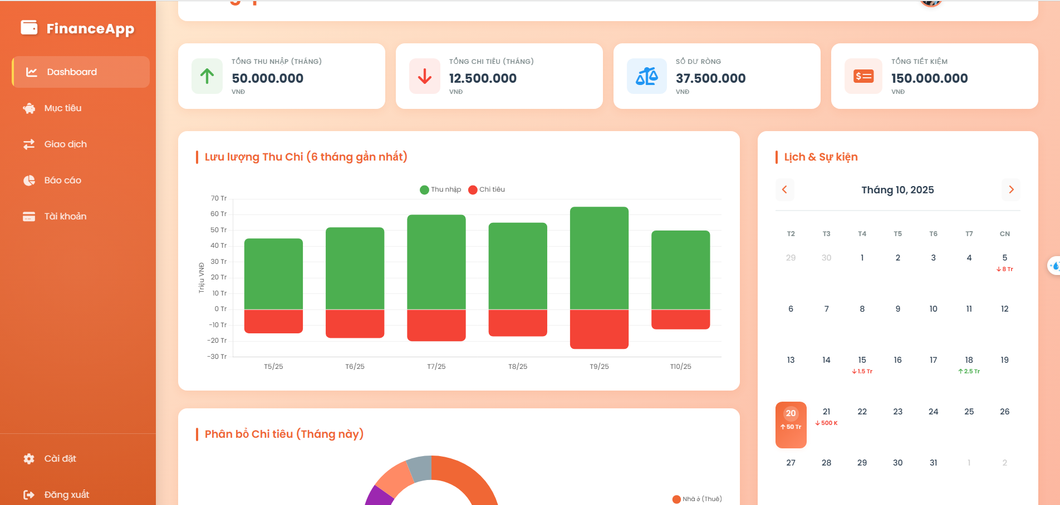
Group AI_65
HOME
SERVICE
ABOUT US
CONTACT US
HOMEPAGE
04

Slide 8
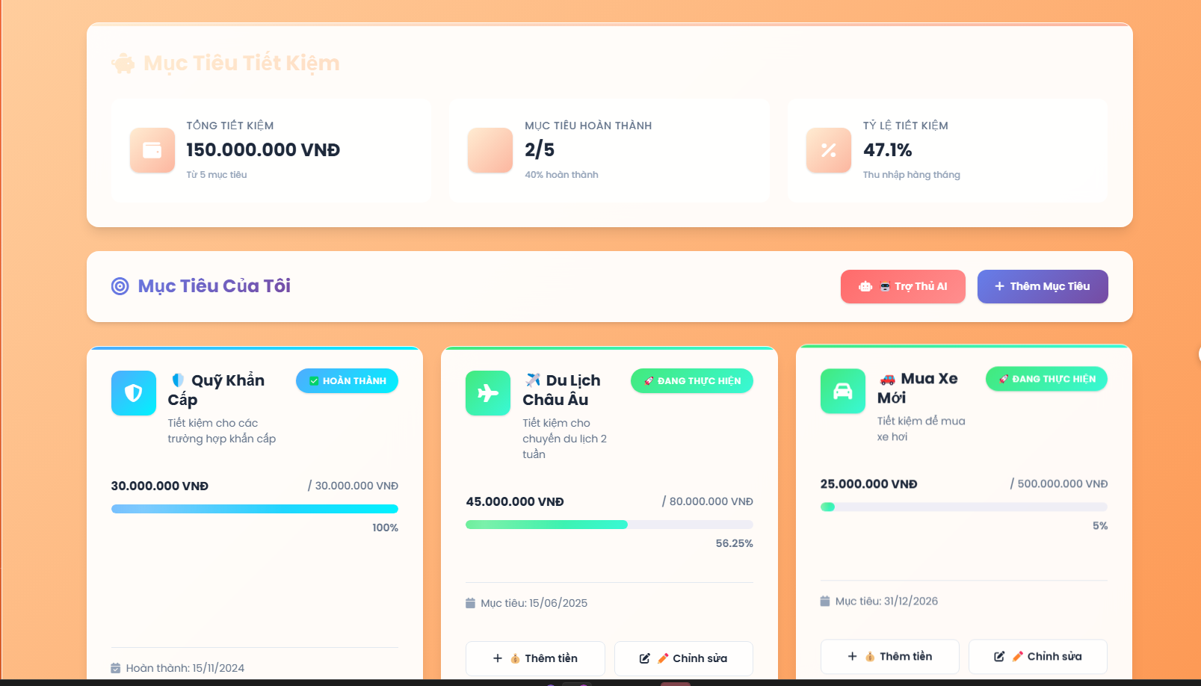
Group AI_65
HOME
SERVICE
ABOUT US
CONTACT US
FEATURES - SAVING GOAL
04

Slide 9
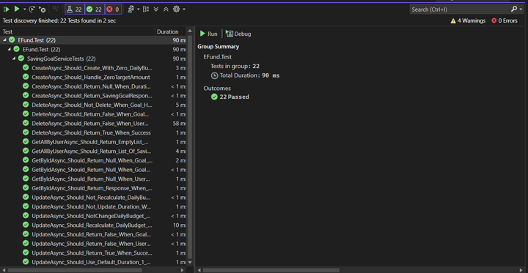
Group AI_65
HOME
SERVICE
ABOUT US
CONTACT US
TEST RESULT
05

Slide 10
Group AI_65
HOME
SERVICE
ABOUT US
CONTACT US
THANK YOU
01

