Slide 1
Price management in SAP
JEU_PI_CO_076 A

Slide 2
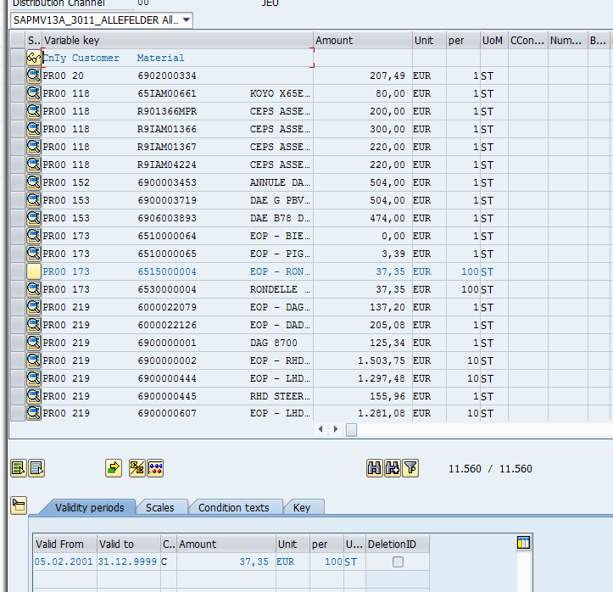
Transaction VK31 / VK32 / VK33
Only PR00 condition used for Automotive
Fields keys are :
Sales Organization (OC00…)
Distribution channel (00…)
Condition Type (PR00)
Customer (Sold To)
Material (JTEKT code)
No scales used

Slide 3
Organization in SAP for Automotive
JEU – Jtekt Europe Company code 550
Sales Org. OC00
Distrib. Chan. 00
JHPI –Jtekt 560
HPI OC05
05
JALY –Jtekt 510
Automotive Lyon OC01
01
JADS –Jtekt DSE
Automotive Dijon OC02
Saint-Etienne 02
JALY –Jtekt 520
Automotive Plzen OC03
03

Slide 4
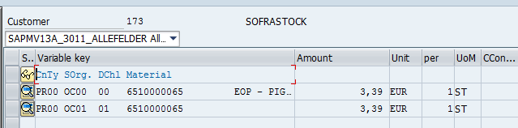
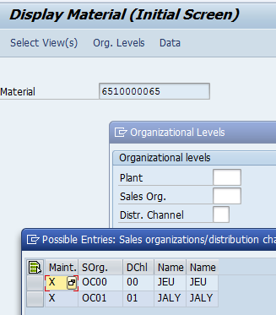
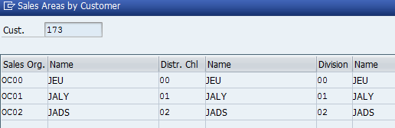
Copy of prices
All prices are created in JEU (OC00-00) and duplicated to the corresponding plant (OC01-01)
when material is created in the plant
when customer is created in the plant

Slide 5
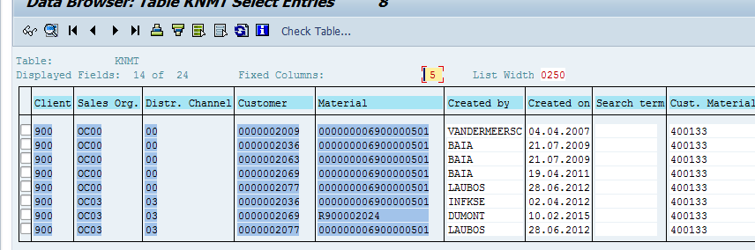
Material code
A customer material code could be used for several Jtekt materials
Depending to :
- the plant (but not always)
- the destination (Ship To)
- the use (serial, after-market)

Slide 6
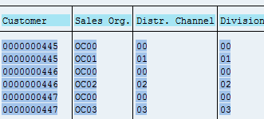
Customer code
A Sold To code is used for each delivery address (Ship To)
A Sold To code is used for each plant

