Slide 1




BANK ANALYTICS PROJECT
Loan Analytics + Credit & Debit Transaction Analysis
Excel • SQL • Power BI • Tableau
A practical dashboard-based approach to understanding banking performance, risk and transactions.
Bank Analytics Project | 1/10

Slide 2
1. Project Objective
Convert raw banking data into meaningful business information.
Measure loan portfolio size, collections, interest and delinquency.
Analyse credit and debit transactions, activity and risk flags.
Compare the same business questions across Excel, Power BI and Tableau.
Use SQL to clean, aggregate and validate the underlying data.
Loan Analytics
Portfolio & Credit
Transaction Analytics
Credit & Debit
Tools
4 technologies
Bank Analytics Project | 2/10

Slide 3
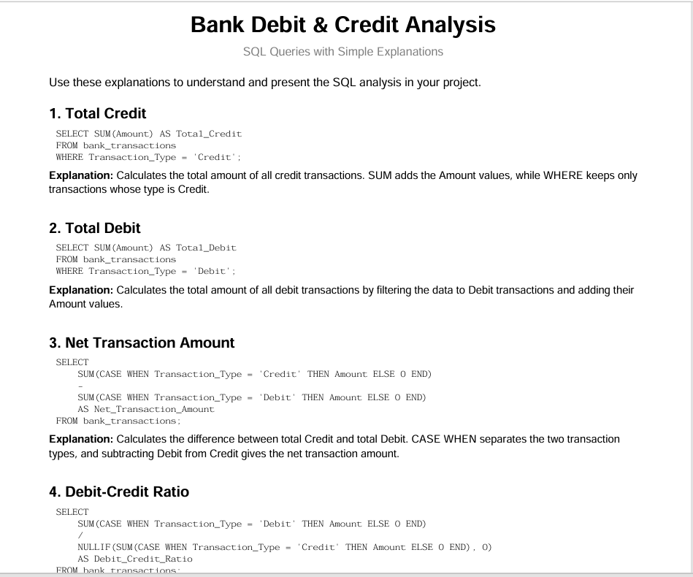
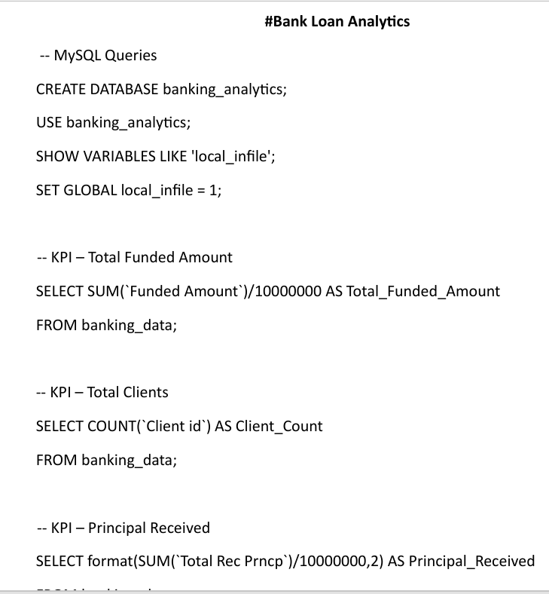
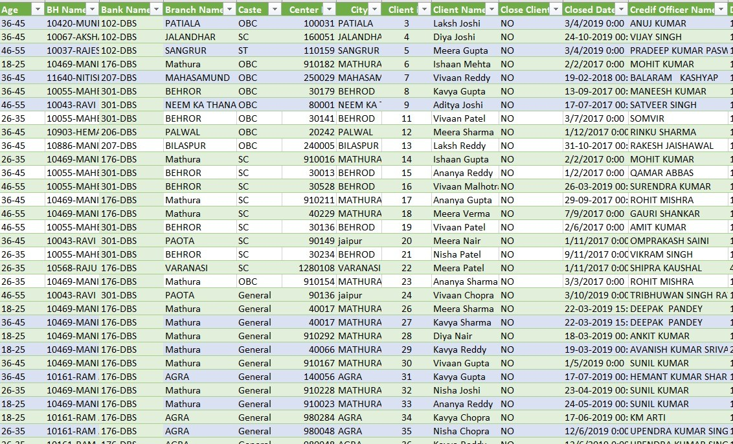
2. Tools & Workflow
1
2
3
4
SQL
Filtering, grouping, calculations and validation
Raw data
Loans, customers, branches, transactions
Excel
Cleaning, pivot analysis and initial dashboard
Power BI / Tableau
Interactive visuals, slicers and KPI storytelling
Bank Analytics Project | 3/10

Slide 4
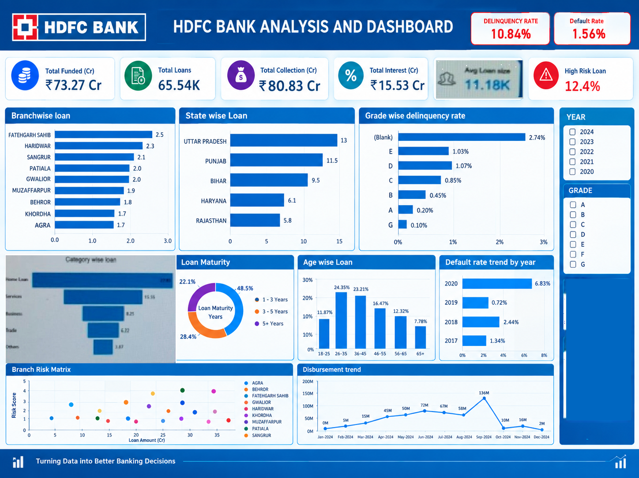
3. Loan Analytics: Key KPIs
po
The loan dashboard focuses on portfolio performance and credit risk
Total Funded
₹73.27 Cr
Total Loans
65,535
Total Collections
₹80.84 Cr
Interest
₹15.53 Cr
Delinquency
10.84%
Total funded amount shows the scale of lending.
Collection and interest KPIs indicate cash recovery and income generation.
Delinquency and default rates highlight portfolio quality.
Average loan size helps understand the typical exposure per loan.
Bank Analytics Project | 4/10

Slide 5
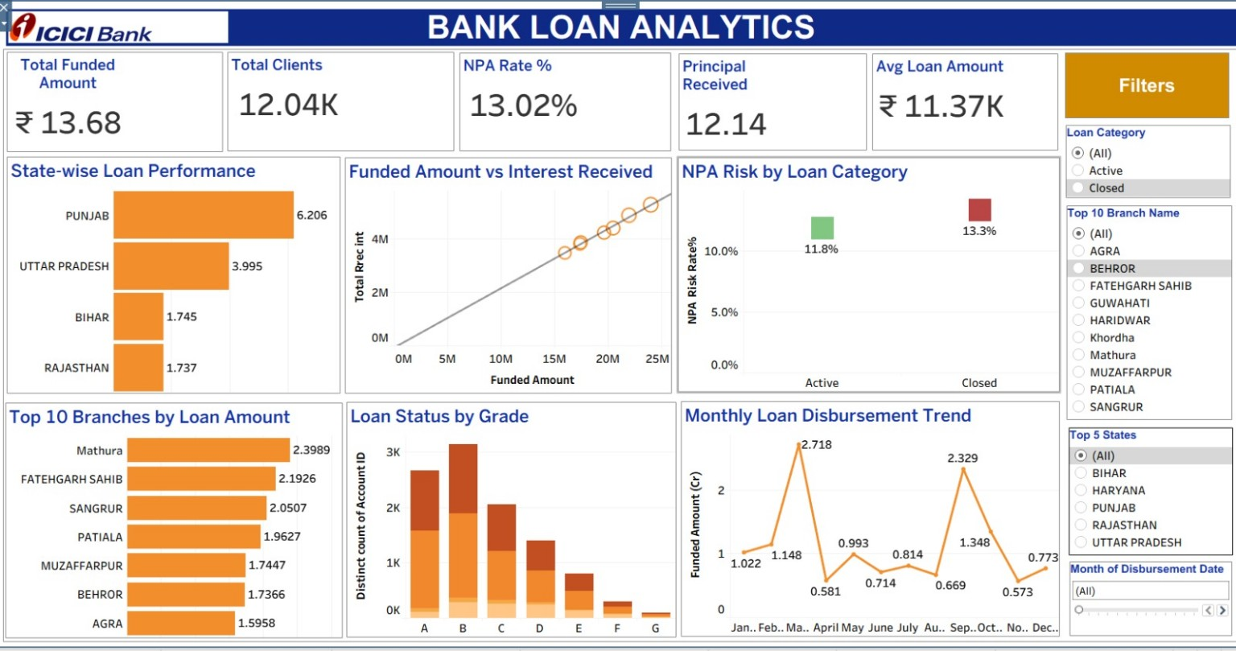
4. Loan Dashboard: Insights
State-wise and branch-wise charts identify major lending locations.
Category-wise analysis shows which products contribute most to the portfolio.
Age-group and grade analysis supports customer and credit segmentation.
The yearly trend highlights changes in disbursement and default behaviour.
A risk matrix can be used to compare branch exposure and performance.
Bank Analytics Project | 5/10

Slide 6
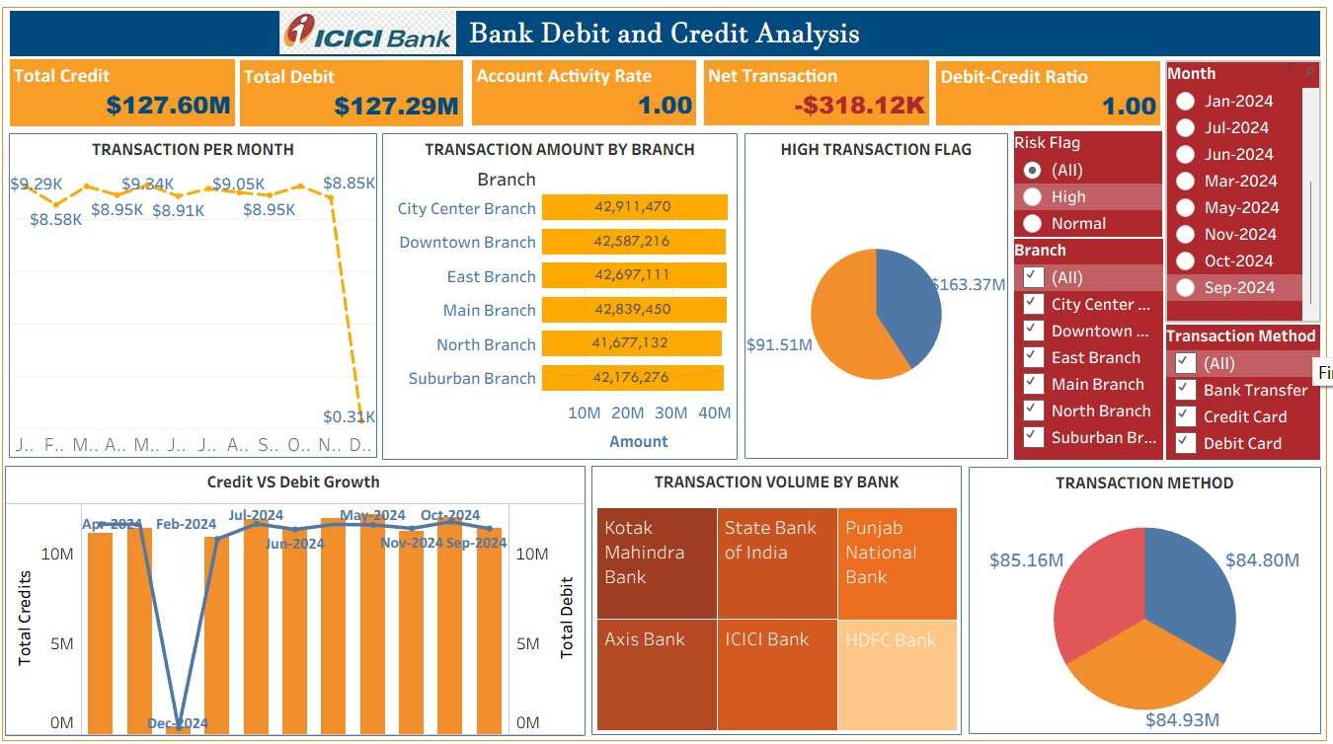
5. Credit & Debit Analytics: Key KPIs
The second dashboard evaluates transaction behaviour
Total Credit
₹127.60M
Total Debit
₹127.29M
Net Transaction
-₹318.12K
Credit/Debit Ratio
100.25%
High-Risk Share
40.81%
Credit and debit totals show the overall money movement.
Net transaction amount indicates whether credits or debits are higher.
The credit-debit ratio compares inflows with outflows.
High-risk flags help identify transactions requiring further review.
Bank Analytics Project | 6/10

Slide 7
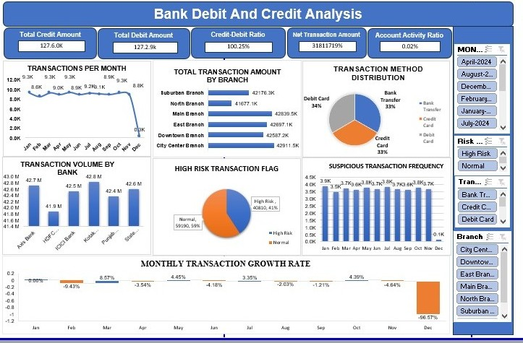
6. Credit & Debit Dashboard: Insights
Monthly transaction frequency shows stability or unusual changes in activity.
Bank-wise and branch-wise charts reveal concentration of transaction volume.
Transaction-method distribution compares bank transfer, credit card and debit card usage.
High-risk versus normal transactions provide a first-level monitoring view.
Growth-rate visuals help identify months with sharp increases or declines.
Bank Analytics Project | 7/10

Slide 8
7. Tools Used & Their Contribution
Each tool served a different purpose
Tool
Main use in the project
Output
SQL
Data extraction, filtering, grouping and validation
Reliable analytical dataset
Excel
Cleaning, pivots, formulas and quick exploration
Initial analysis and dashboard
Power BI
Interactive KPIs, slicers and cross-filtering
Management dashboard
Tableau
Alternative visual storytelling and comparisons
Interactive visual dashboard
Bank Analytics Project | 8/10

Slide 9
8. What I Learned & Challenges Faced
✓
What I Learned
!
Challenges Faced
—
The same KPI has to be rebuilt three different ways — Excel formulas, Power BI DAX, Tableau calculated fields — and the numbers can drift between them.
—
Reconciling totals that shifted between dashboard iterations, traced back to different data refreshes.
—
How to design a dashboard that answers a question in one glance: KPI tiles on top, drill-down charts below, slicers to the side.
—
Handling incomplete year-end data — every transaction chart needed the December drop called out, not smoothed over.
—
Why SQL-level cleaning — standardising branch names, flagging blanks and unverified records — has to happen before a single chart is built.
—
Keeping one consistent visual language (colours, KPI cards, slicer placement) while switching between Excel, Power BI and Tableau.
—
How to turn a raw metric into a decision-ready KPI, not just a number on a card.
—
Accounting for '(Blank)' and unverified records (16,921 unverified loans) without silently dropping them from the KPIs.
Bank Analytics Project | 9/10

Slide 10
9. Conclusion
The project combines loan portfolio analysis with credit and debit transaction analysis.
Excel supported exploration, while Power BI and Tableau improved interactivity and presentation. SQL provided the foundation for structured and repeatable analysis.
The dashboards can support monitoring of lending performance, transaction behaviour and potential risk.
Bringing Loan Analytics and Credit & Debit Analysis into one project shows how the same banking data can answer two different questions: who is likely to stop paying, and how is money actually moving day to day.
The result is a KPI framework — funding, collection, delinquency, NPA, transaction risk — that a bank team could act on directly: which branches to support, which accounts to review, and where risk is concentrating.
Bank Analytics Project | 10/10

Slide 11

Group 1
HITESH M.
SHIVALINGESH P.
PRACHI SHINDE
BHAGYALAKSMI P.
SANDHYA
TARUN KUMAR
Bank Analytics Project | 10/10

