Slide 1
Can Subscriber Churn Be Predicted Early?
From data requirements to model evaluation and recommendations
Thakgalo Sehlola
26304731
CAP182 Data Science Capstone.
STADIOchoice churn prediction.
October 2026

Slide 2
The business problem
Subscriber cancellations can affect recurring revenue and customer retention.
Retention teams need to identify where intervention may be worthwhile.
Predictive analytics could help prioritise subscribers for attention.
A model is useful only if its predictions provide sufficiently reliable information.
WHY DOES SUBSCRIBER CHURN MATTER?

Slide 3
From Problem Definition to Model Evaluation
Assignment | Main contribution
SS1 | Defined the business problem and data requirements.
SS2 | Investigated churn prediction using the KKBox public dataset.
SS3 | Applied and evaluated a modelling workflow using STADIOchoice data.

Slide 4
Understanding the STADIOchoice Dataset
Accounts
Subscriptions
Viewing
Engagement
Content
Billing
Outcomes
7 Source tables
28,999 Modelling observations
2103 Unique subscribers
36 Modelling features/columns
THE MODELLING TABLE CONTAINS REPEATED SUBSCRIBER OBSERVATIONS ACROSS 26 MONTHLY SNAPSHOTS.

Slide 5
Preparing the Data
Data integration: combine the seven source tables.
Feature engineering: construct predictors from available subscriber history.
Preprocessing: handle missing values and encode categorical variables.
Leakage prevention: exclude information unavailable at the prediction date.
Chronological splitting: train, validate and test using separate time periods.

Slide 6
SPLIT DATES AND SIZES
Partition | Rows | Positive cases | Churn prevalence
Train | 15,834 | 94 | 0.59%
Validation | 6,279 | 109 | 1.74%
Test | 6,886 | 163 | 2.37%
Train: 30 April 2024 to 22 September 2025
Validation: 22 October 2025 to 20 January 2026
Test: 19 February 2026 to 20 May 2026

Slide 7
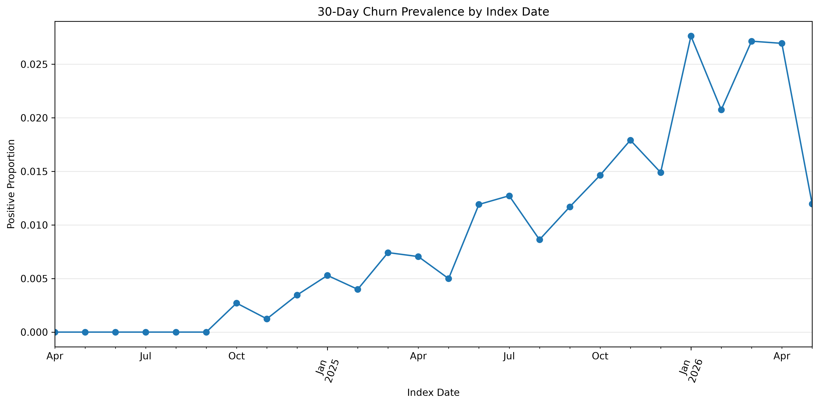
What Did the Data Reveal?

Slide 8
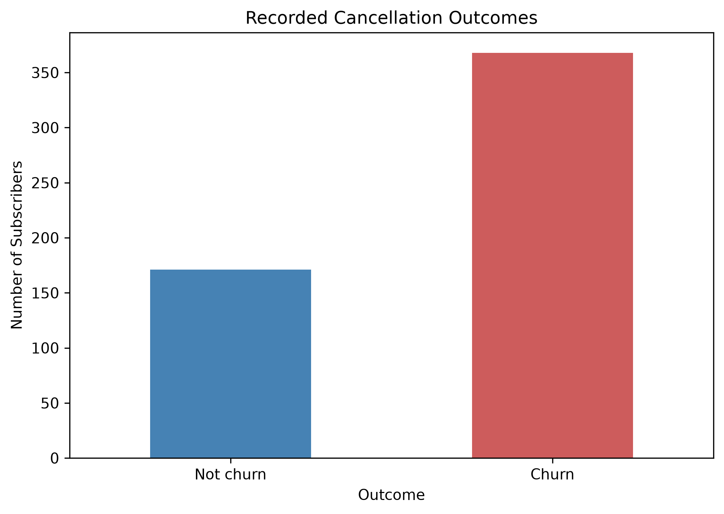
Target DISTRIBUTION
Target class | Snapshot rows
No qualifying churn | 28,633
Qualifying churn | 366
The positive class represents approximately 1.26% of all modelling rows.

Slide 9
Building and Evaluating the Churn Model
Prepared training data
Preprocessing and encoding
XGBoost classifier
Validation and threshold selection
Final test evaluation

Slide 10
CHOSEN MODEL APPROACH
Primary model: XGBoost shallow configuration.
Reference models: dummy classifier.
Primary selection metric: validation average precision.
Classification threshold: selected using validation F1.
Final evaluation: untouched chronological test set.

Slide 11
How Well Did the Model Generalise?
Average precision 0.0244
ROC-AUC 0.3925
Precision 0.0230
Recall 0.1200
THRESHOLD SELECTED ON VALIDATION DATA = 0.6568.
TEST POSITIVE-CLASS PREVALENCE = 2.17%

Slide 12
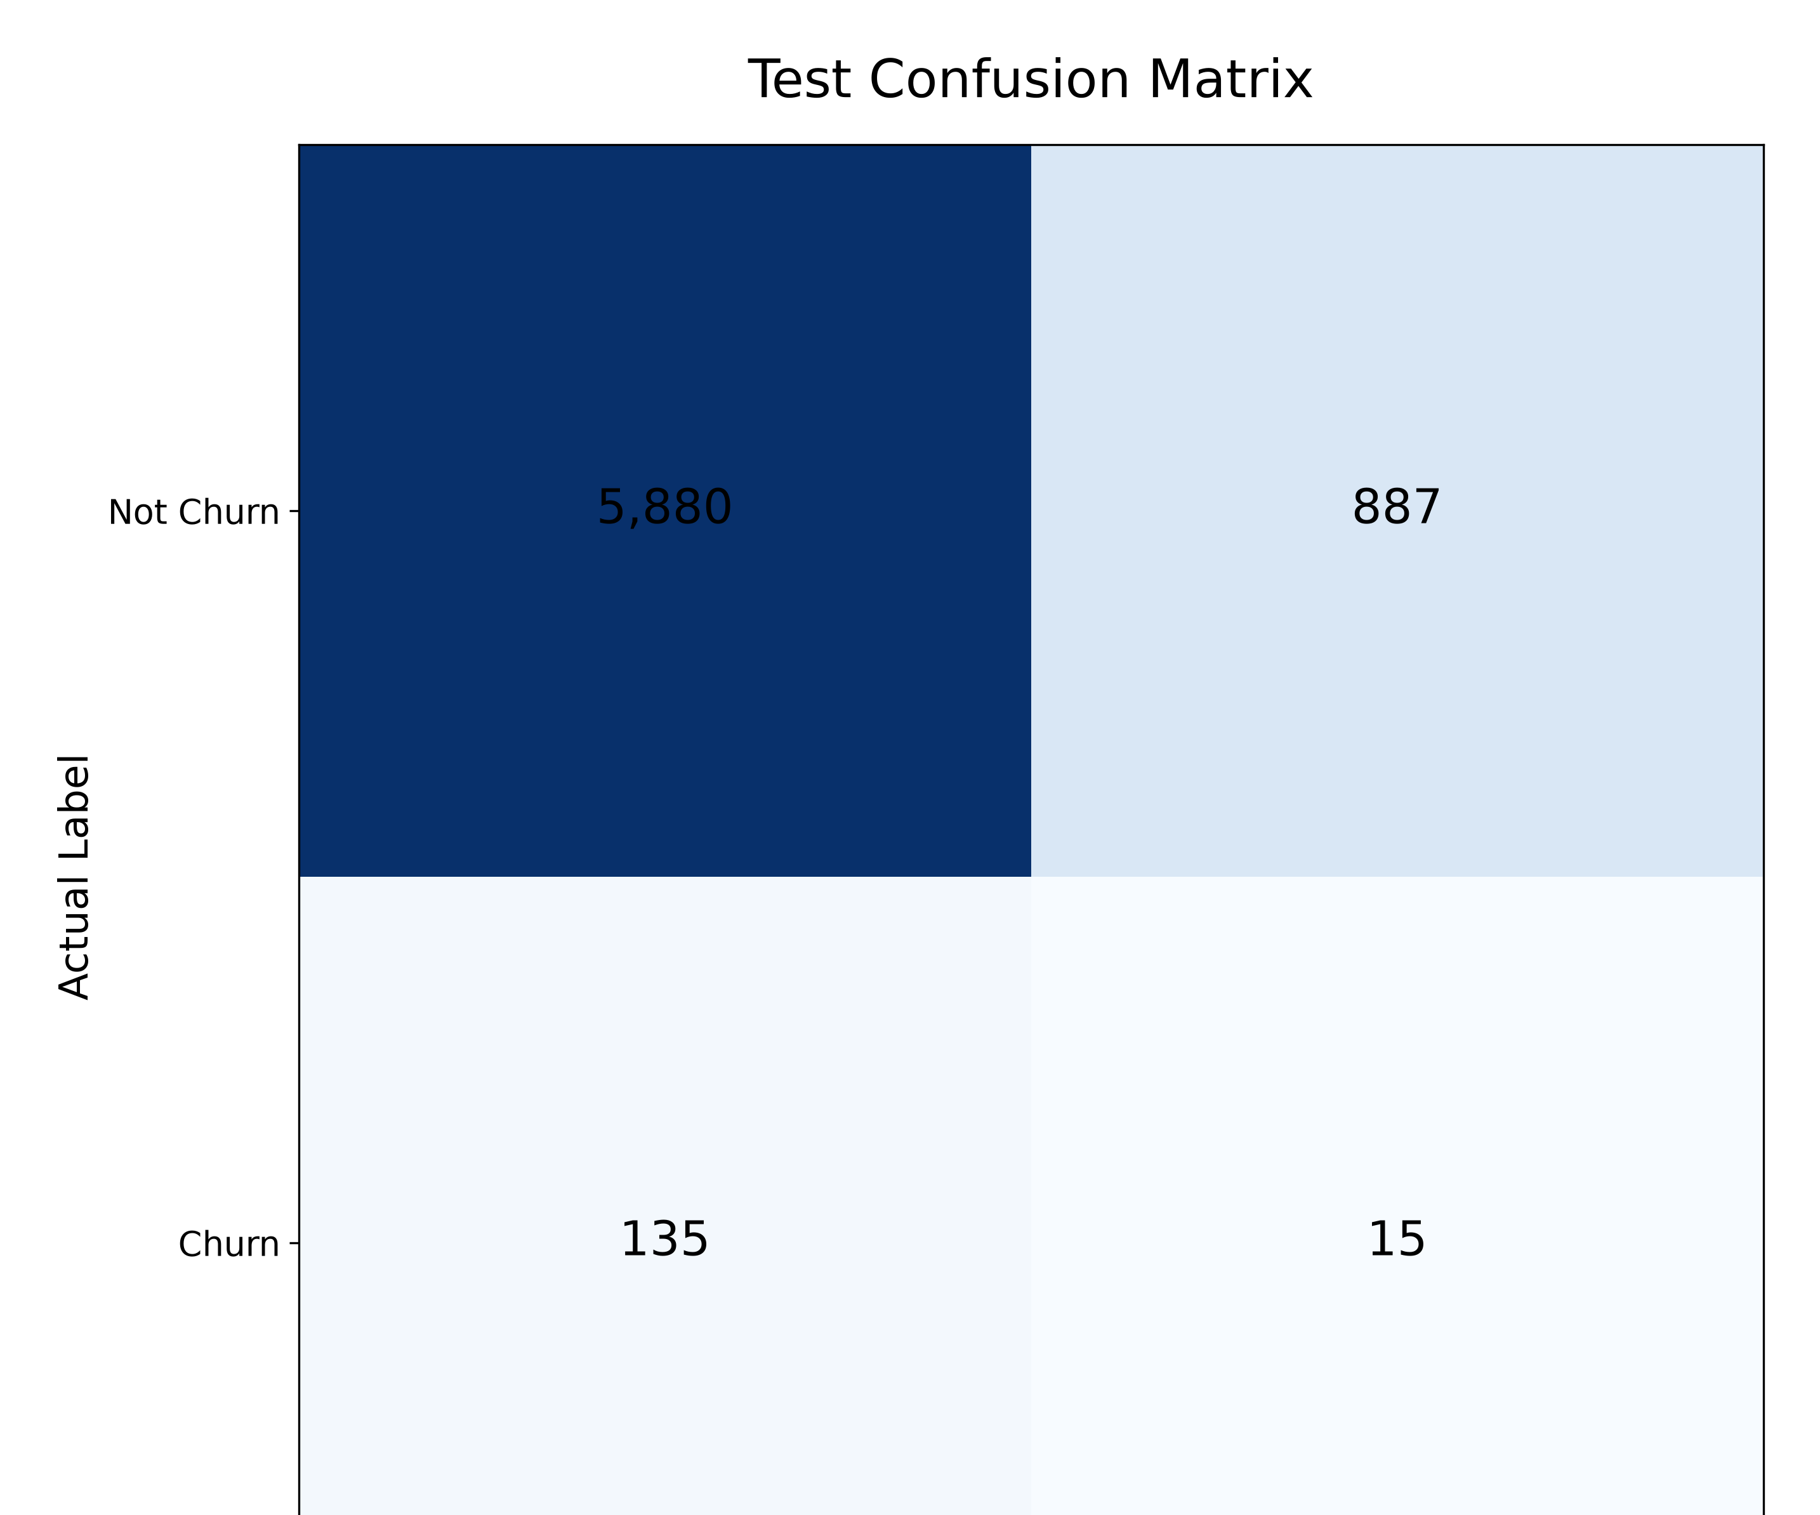
TEST CONFUSION MATRIX

Slide 13
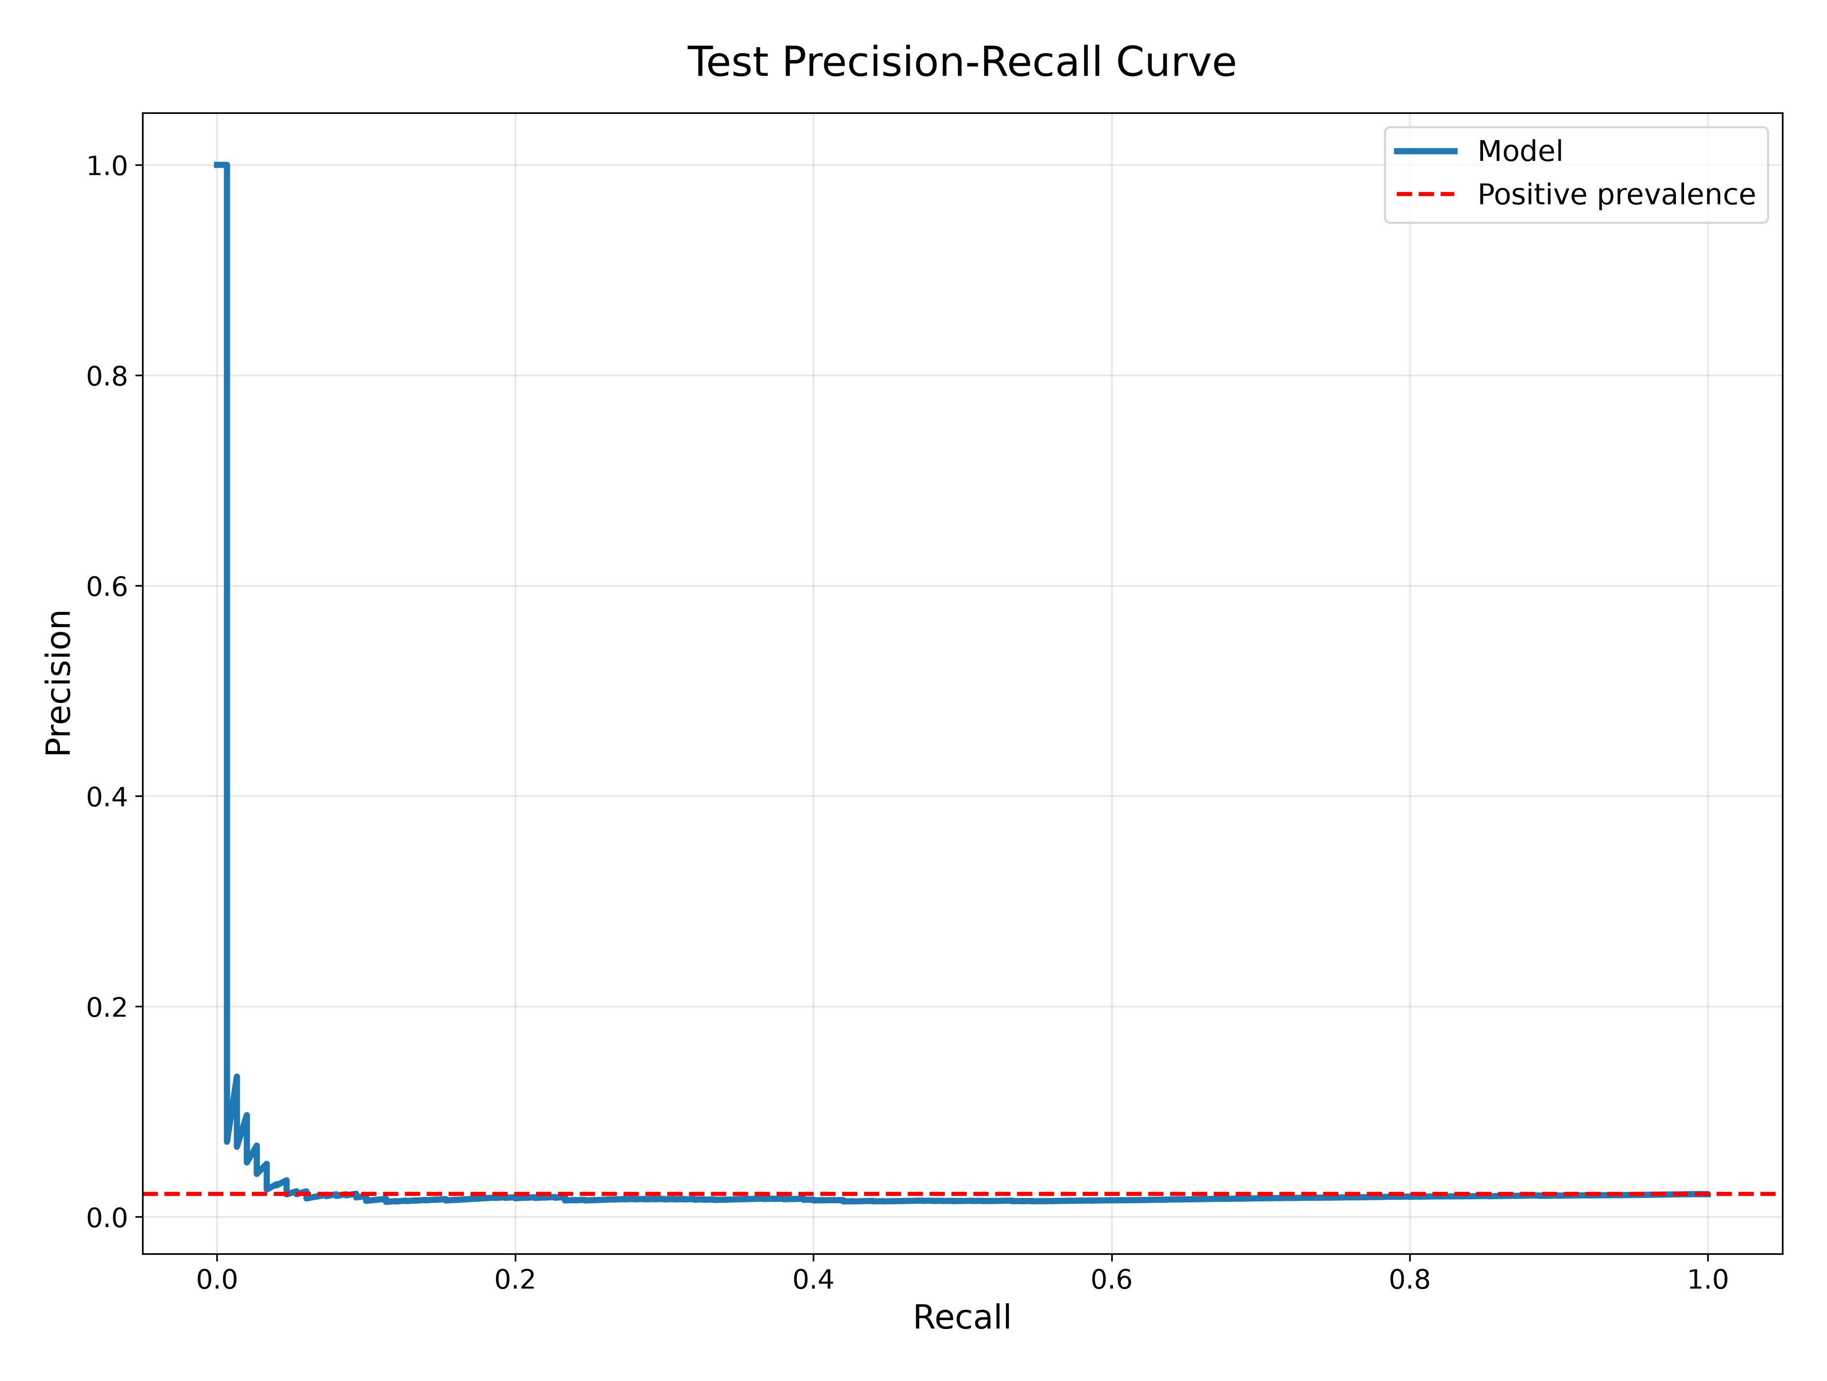
The model achieved an average precision of approximately 0.0244, compared with a test prevalence of approximately 0.0217. This is only a small improvement over the prevalence benchmark.
The ROC-AUC of 0.3925 is below 0.5, indicating poor ranking performance on this test period. Precision is also low at the selected threshold, while recall is 12%.

Slide 14
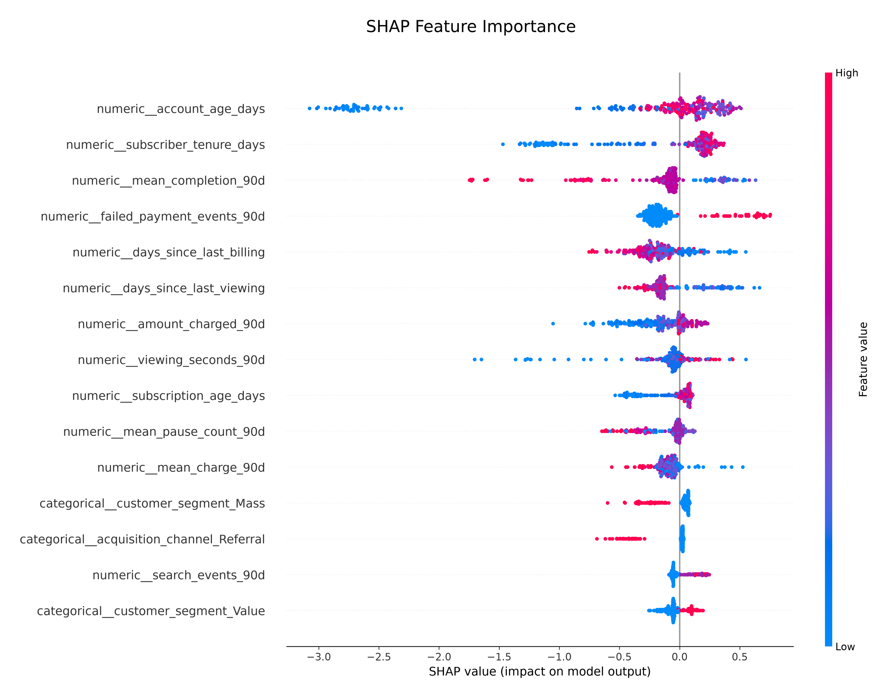
Understanding the Model's Predictions

Slide 15
SHAP
SHAP helps us understand how a fitted model arrives at predictions and also provides a global view of feature attribution.
However, explanations do not establish causation. Furthermore, because test performance is weak, the explanations should not be treated as reliable evidence of the real-world drivers of churn

Slide 16
What Should Happen Next?
Audit the experiment: verify target construction, feature timing, class encoding and predicted probabilities.
Investigate generalisation: examine why test ranking performance is poor relative to the validation results.
Review the features: assess missingness, temporal drift and whether the available history contains useful predictive information.
Confirm business requirements: agree the prediction horizon, intervention capacity and consequences of false positives and false negatives.
Re-evaluate before deployment: test improvements on later, unseen observations and monitor performance over time.

Slide 17
SHORT ACTION ROADMAP
Audit
Check the data, labels and experiment.
Improve
Investigate features and model behaviour.
Re-test
Establish reliable performance before operational use.

Slide 18
The Value of the Project Is in the Evidence
Defined a churn-prediction problem and its data requirements.
Developed a reproducible data preparation and modelling workflow.
Evaluated performance using chronological validation and test periods.
Identified limitations that prevent operational use.
Established clear priorities for further investigation.
The project demonstrates a modelling workflow, but the current results do not establish that churn can be predicted reliably enough for operational use.

