Slide 1

COFFEE SALES ANALYSIS
6-MONTH PERFORMANCE REVIEW · JANUARY – JUNE
Presented by Thakhani Tshibalangada

Slide 2

OBJECTIVES
This analysis examines six months of coffee sales data to uncover performance trends, revenue drivers, and customer behaviour across all store locations.
SALES PERFORMANCE
1
Analyse overall revenue trends and growth across the January–June period.
REVENUE DRIVERS
2
Identify the products, stores, and time periods that contribute most to total revenue.
CUSTOMER BEHAVIOUR
3
Understand purchasing patterns by time of day, day of week, and product preference.
RECOMMENDATIONS
4
Provide data-driven insights to guide strategic decisions and future growth.

Slide 3
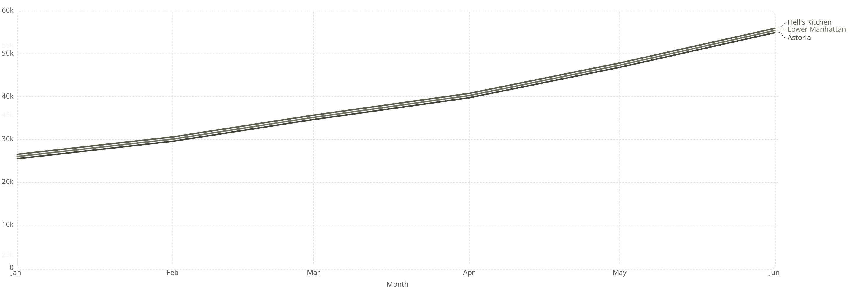
MONTHLY REVENUE TREND BY STORE
Revenue grew consistently across all three locations from January through June, reflecting strong and sustained sales momentum.
R26,000 → R55,000+
100%+ GROWTH
CONSISTENT ACROSS STORES
Revenue per store more than doubled from January to June.
An overall increase of more than 100% signals strong upward sales performance.
All three locations followed a similar upward trajectory throughout the period.

Slide 4
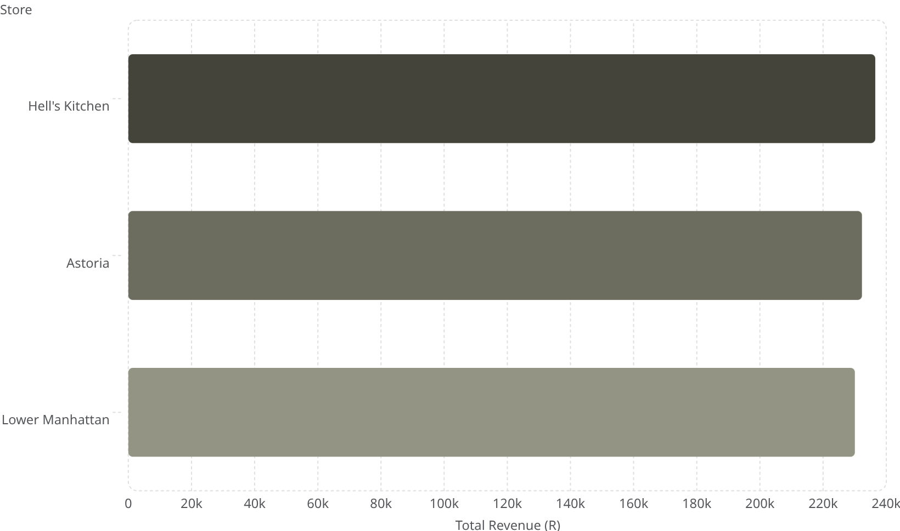

TOTAL REVENUE BY STORE
All three stores performed at a remarkably similar level over the six-month period, with Hell's Kitchen leading by a narrow margin.
KEY TAKEAWAYS
237k
Hell's Kitchen recorded the highest total revenue at approximately R236,511, followed closely by Astoria and Lower Manhattan.
The relatively small gap between stores indicates balanced performance across all locations, suggesting effective and consistent operations.
232k
230k
This balanced distribution reduces concentration risk and supports a stable multi-store business model.

Slide 5

REVENUE CONTRIBUTION BY STORE
BALANCED STORE DISTRIBUTION
Each store contributes roughly 33–34% of total revenue, with no single location dominating the portfolio.
Astoria·33%
This near-equal split reflects stable multi-store performance and effective risk diversification across the business.
·33%
·
Hell's Kitchen·34%
·34%
·
Lower Manhattan·33%
·33%
·
ASTORIA — 33%
HELL'S KITCHEN — 34%
LOWER MANHATTAN — 33%

Slide 6

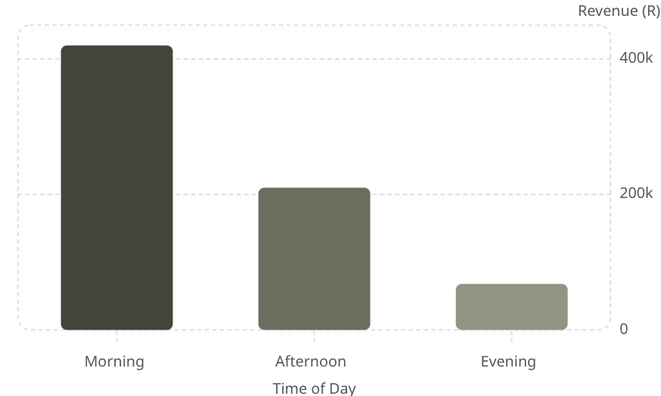

REVENUE BY TIME OF DAY
MORNING DOMINATES SALES
The morning period generates the highest revenue by a significant margin compared to afternoon and evening combined.
This reflects peak customer activity during early hours, most likely driven by commuter and breakfast demand.
Opportunity: Strengthening afternoon promotions could help capture underutilised revenue potential later in the day.

Slide 7
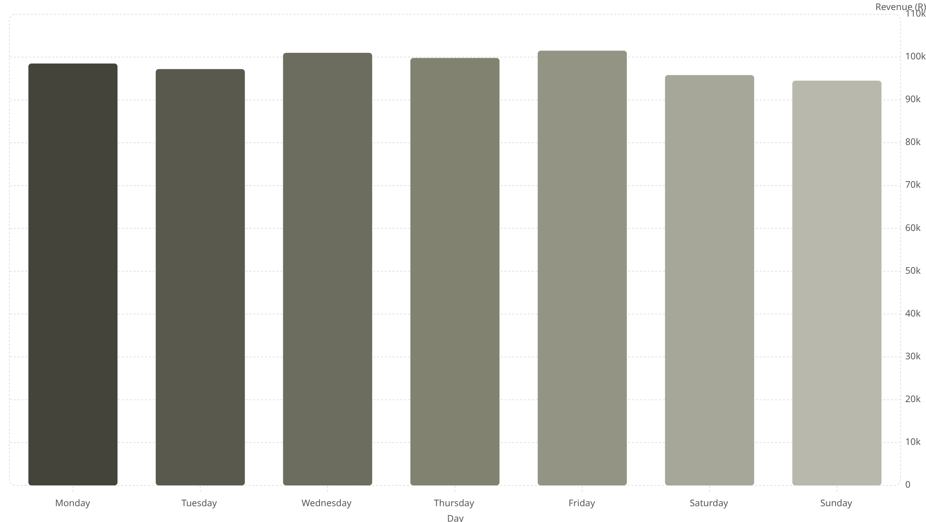

REVENUE BY DAY OF WEEK
Purchasing patterns shift across the week, reflecting the influence of work routines and leisure schedules on customer behaviour.
98.5k
101k
99.8k
102k
97.2k
95.8k
94.5k
Weekday revenue trends higher than weekends, suggesting the core customer base is driven by work-week routines and commuter traffic.

Slide 8
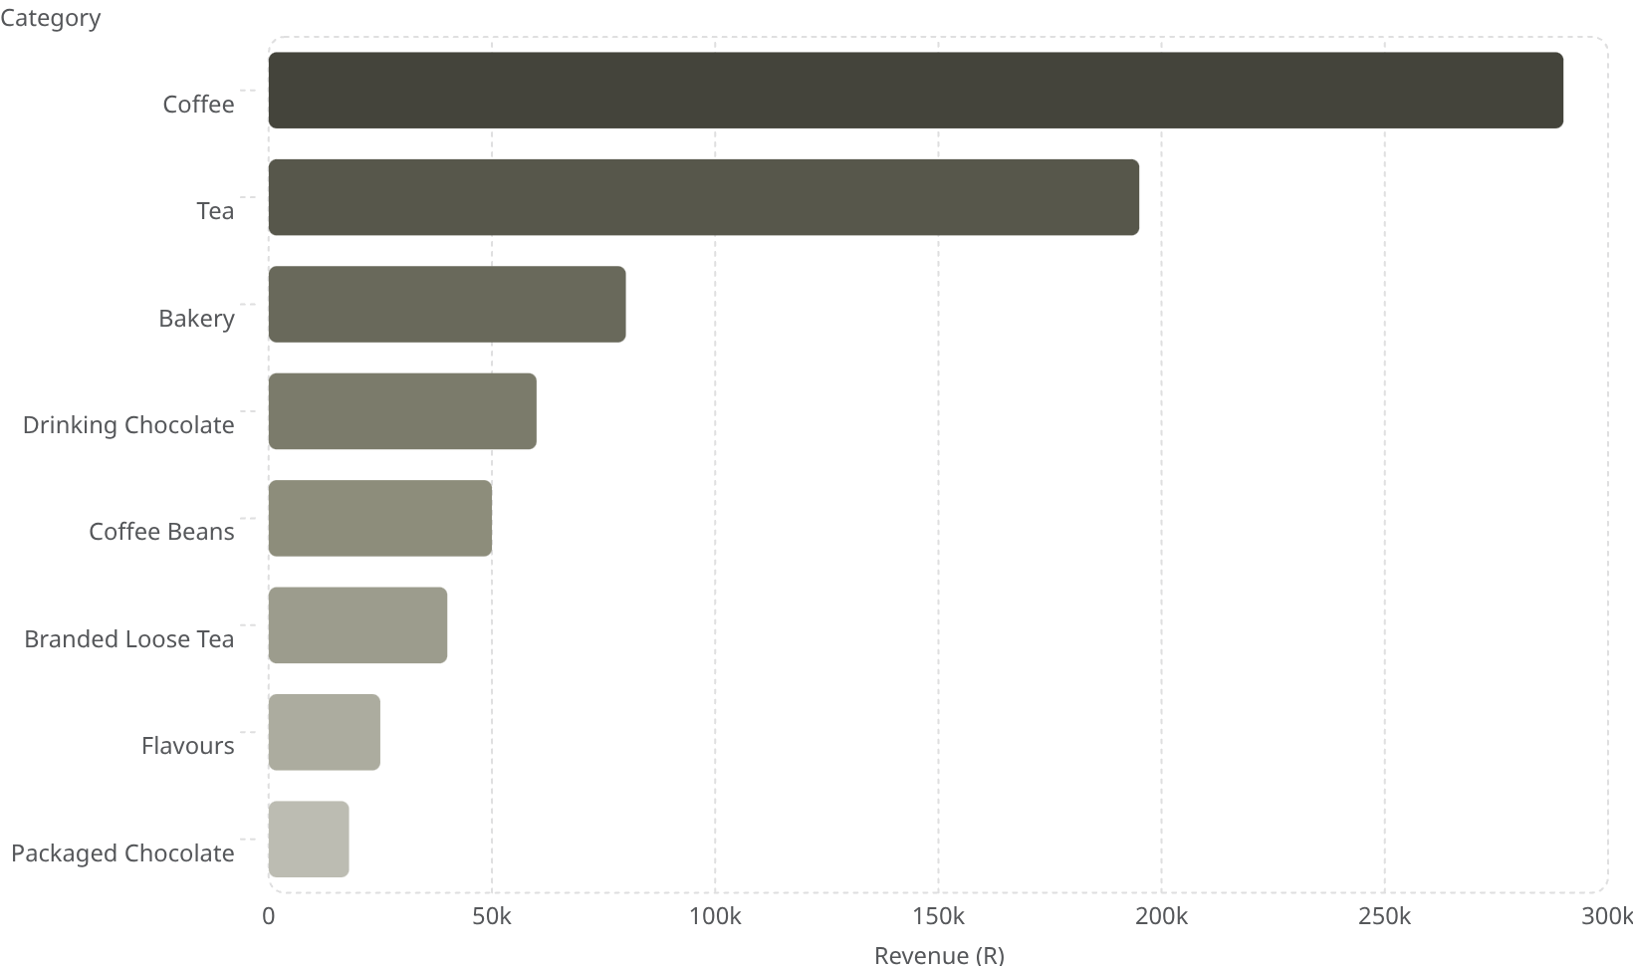
REVENUE BY PRODUCT CATEGORY
CORE BEVERAGES LEAD REVENUE
Coffee and Tea are the dominant revenue-generating categories, far outpacing all other product types.
This confirms that core beverage products are the primary drivers of overall sales performance, while ancillary categories (bakery, chocolate) play a supporting role.
Doubling down on coffee and tea product variety and quality could yield the highest return on investment.

Slide 9


TOP-SELLING PRODUCTS
A handful of products drive the majority of revenue — customer demand is clearly concentrated around a few high-performing items.
SUSTAINABLY GROWN ORGANIC LG
Highest revenue — premium beans resonate strongly with health-conscious customers.
DARK CHOCOLATE LG
Second-best performer — a popular indulgence pairing well with coffee.
LATTE RG & CAPPUCCINO LG
Core espresso drinks dominate everyday orders across all stores.
MORNING SUNRISE CHAI LG
A standout tea product, reflecting growing demand beyond traditional coffee.
Recommendation: Prioritise stock, staff training, and promotions around these top SKUs to protect and grow their revenue contribution.

