Slide 1
Algorithms of Inverse Reinforcement Learning
AID-554 Reinforcement Learning : Course Project
Meet Thakkar (20122011), Krudant (20122021)
Instructor : Prof. Manu Gupta

Slide 2
Motivation
Motivation in Inverse Reinforcement Learning (IRL):
Understanding Real-world Behavior : IRL provides a means to understand the motivations and intentions behind observed behavior in real-world scenarios, essential for fields like robotics and human-computer interaction.
Learning from Demonstrations : IRL allows machines to learn from human demonstrations or expert behavior, facilitating the transfer of skills and knowledge from humans to machines, particularly in settings where explicit reward signals are difficult to define.
Robust Decision Making : By uncovering implicit reward functions guiding observed behavior, IRL enables more robust and adaptive decision-making in complex and uncertain environments, crucial for applications like autonomous systems and finance.

Slide 3
The IRL problem setting (Finite Sate Space)
Informally :
Given : 1) measurements of an agent’s behavior over time, in a variety of circumstances
2) if needed , measurements of the sensory inputs to that agent
3) if available, a model of the environment.
Determine : the reward function being optimized

Slide 4
The IRL problem setting (Finite Sate Space)
Formally :
MDPs
Defined as (S, A, P_{sa} , γ, R), where S is states, A is actions, P_{sa}(•) are transition probabilities, γ is discount factor, and R is the reinforcement function.
Policy and Value Functions
Policy π: S → A, value function V*(s), and Q-function Q*(s, a) defined for optimal behaviours.
Optimal Functions
V*(s) is the supremum of value functions, and Q*(s, a) is the supremum of Q-functions.
Representation
In discrete, finite spaces, functions are represented as vectors indexed by states (e.g., rewards as an N-dimensional vector R).

Slide 5
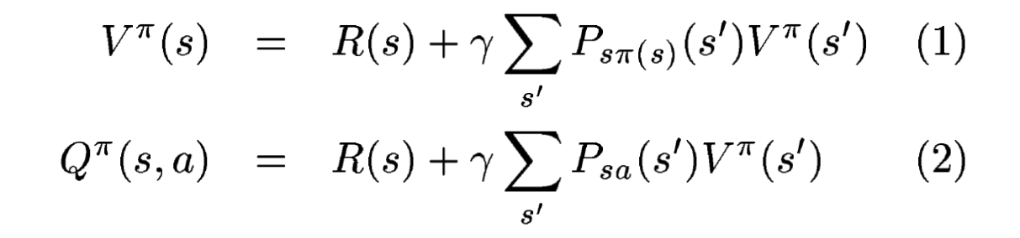
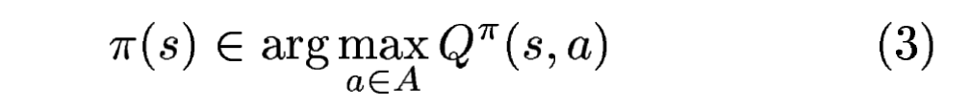
Finite State Space
Theorem 1 (Bellman Equations):
Defines the Bellman equations for value function V*(s) and Q-function Q*(s, a) given an MDP
M = (S, A, P_{sa}, γ, R) and a policy π: S → A.
Equations:
Theorem 2 (Bellman Optimality):
States that policy π is optimal if and only if, for all states s, the action maximizing the Q-value is
taken
Equation:

Slide 6
Finite State Space
Theorem 3: (Characterisation of solution space)
Given a finite state space S, a set of actions A={a₁,...,a_{k}}, transition probability matrices P_{a}​, and a discount factor γ∈[0,1), the policy π defined by π(s)=a₁ is optimal if and only if, for all a = a₂,...,a_{k} the reward R satisfies:
(P_{a} − P_{a1}) (I − γP_{a}) ⁻¹ R ≥ 0 …..(4)
Proof : ON BOARD
Problems :
1. R = 0 always a solution
2. Many R possible

Slide 7
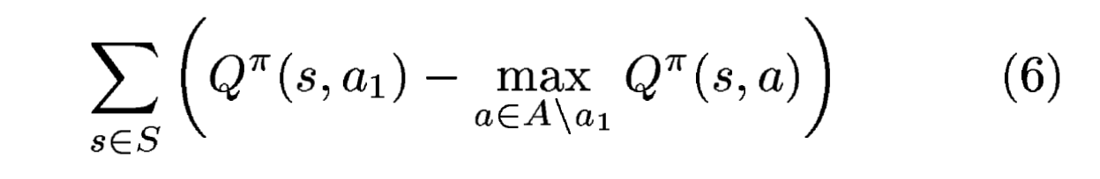
Finite State Space
Choice of Reward Function:
Linear programming can find a feasible point of the constraints in Equation (4).
Proposals are chosen for their incorporation into linear programming while remaining natural.
One approach is to make the policy optimal and favour solutions where any single-step deviation from the policy is costly.
Objective Function:
Maximize the sum of differences between the quality of the optimal action and the next-best action.
Optionally, add a weight decay-like penalty term to balance between small rewards and maximizing the objective function.
This encourages simpler reward functions, where non-zero rewards are sparse.

Slide 8
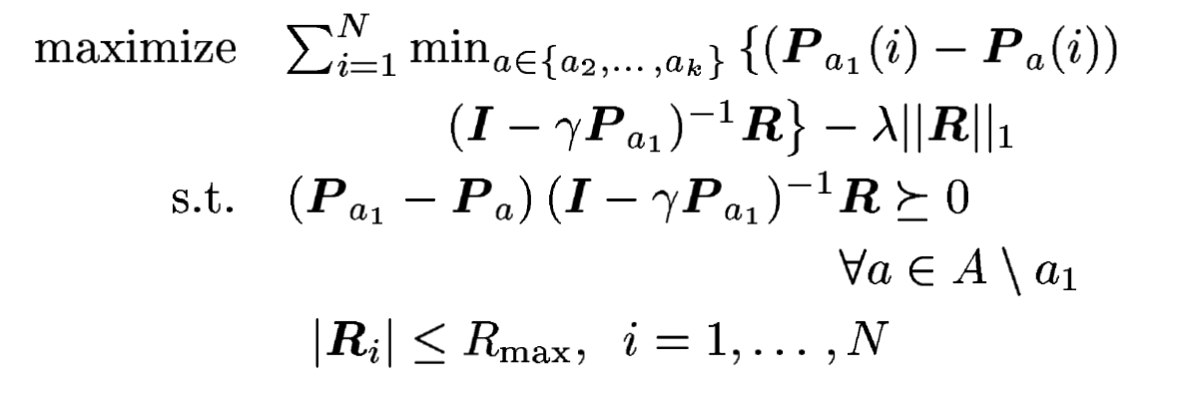
Finite State Space
Optimization Problem:
The optimization problem is formulated as maximizing the difference between the quality of optimal and next-best actions, subject to constraints.
Constraints ensure the policy remains optimal and rewards are bounded.
The problem can be efficiently solved using linear programming techniques.
…..(7)

Slide 9
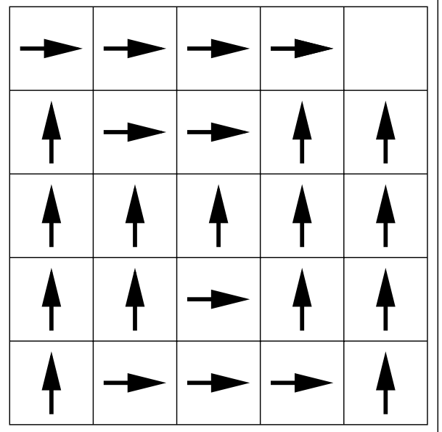
Experiment (5X5 Grid)
A 5x5 grid world is used where the agent starts from the lower-left grid square and aims to reach the upper-right grid square, receiving a reward of 1 upon arrival.
Noisy Actions:
Actions correspond to moving in four compass directions but have a 30% chance of resulting in moving in a random direction instead.
Optimal Policy:
An optimal policy is determined, guiding the agent to navigate through the grid world efficiently.
Inverse Reinforcement Learning (IRL):
The goal is to recover the reward structure given the observed policy and problem dynamics.

Slide 10
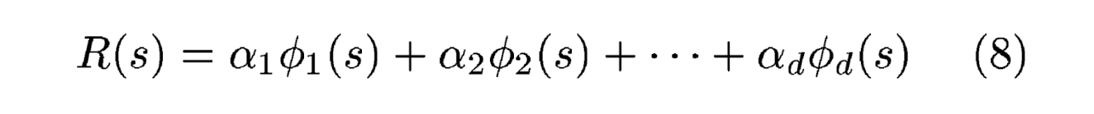

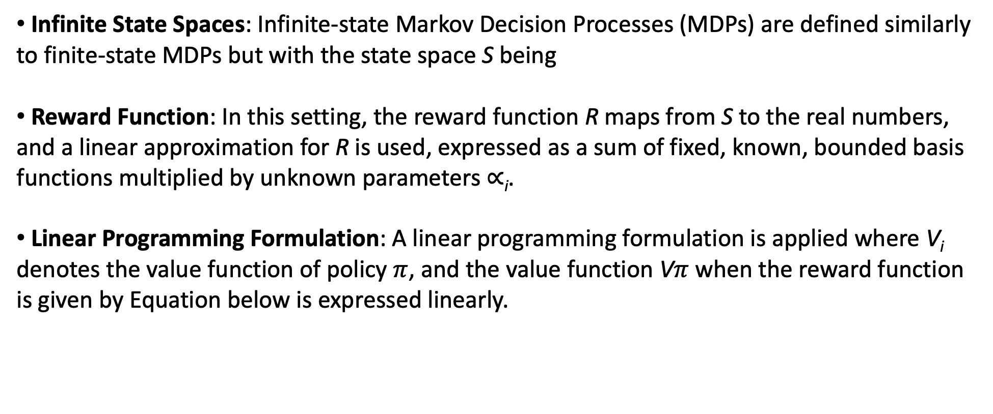
Infinite State Space
Infinite State Spaces: Infinite-state Markov Decision Processes (MDPs) are defined similarly to finite-state MDPs but with the state space S being
Reward Function: In this setting, the reward function R maps from S to the real numbers, and a linear approximation for R is used, expressed as a sum of fixed, known, bounded basis functions multiplied by unknown parameters $∝$_{i}​.
Linear Programming Formulation: A linear programming formulation is applied where V_{i}​ denotes the value function of policy $π$, and the value function V$π$ when the reward function is given by Equation below is expressed linearly.
$$ℝ^{n}$$

Slide 11
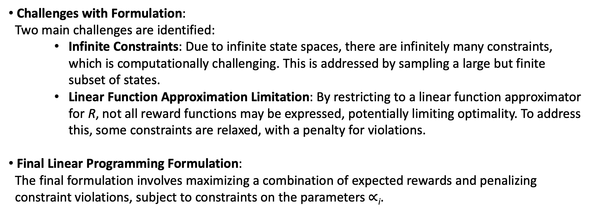
Infinite State Space
Challenges with Formulation:
Two main challenges are identified:
Infinite Constraints: Due to infinite state spaces, there are infinitely many constraints, which is computationally challenging. This is addressed by sampling a large but finite subset of states.
Linear Function Approximation Limitation: By restricting to a linear function approximator for R, not all reward functions may be expressed, potentially limiting optimality. To address this, some constraints are relaxed, with a penalty for violations.
Final Linear Programming Formulation:
The final formulation involves maximizing a combination of expected rewards and penalizing
constraint violations, subject to constraints on the parameters $∝$_{i}​.

Slide 12
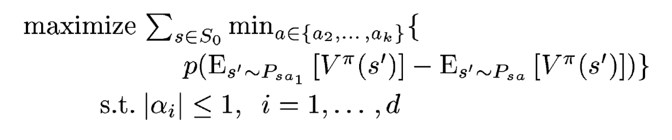
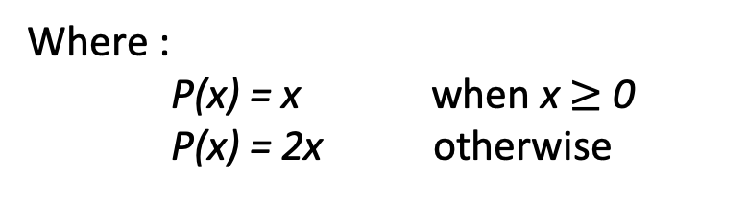
Infinite State Space
Where :
P(x) = x when x $≥$ 0
P(x) = 2x otherwise

Slide 13
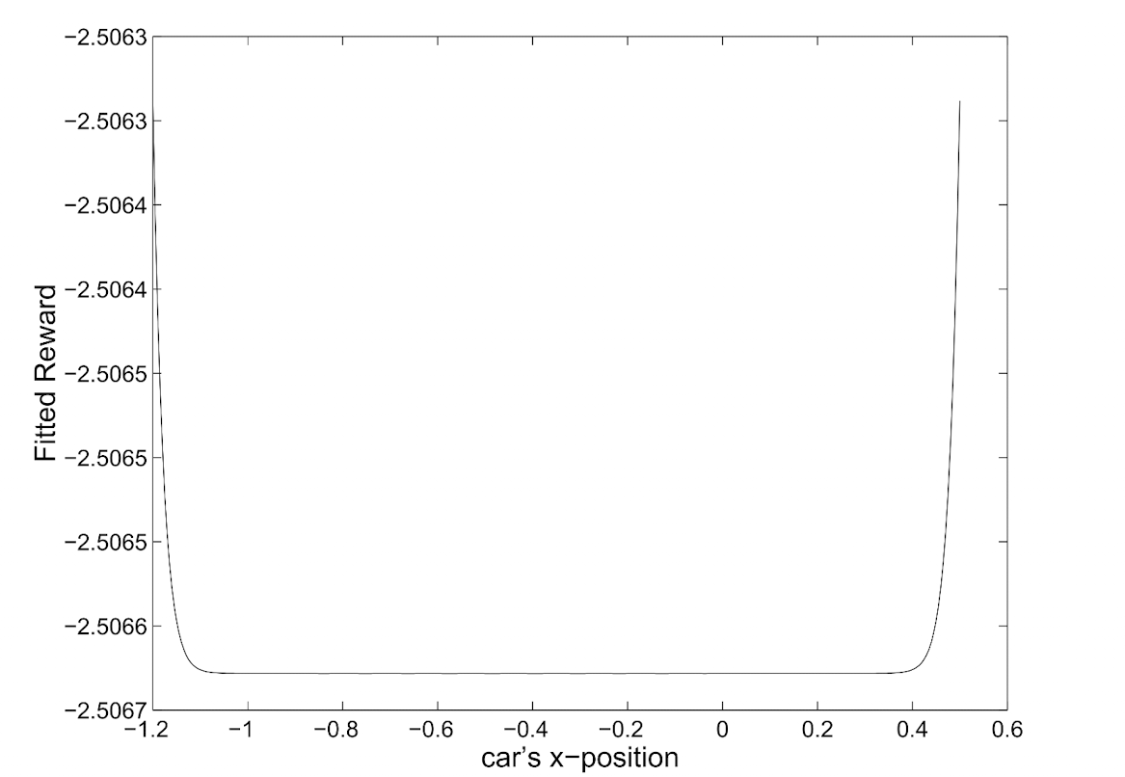
Mountain Car Problem

Slide 14
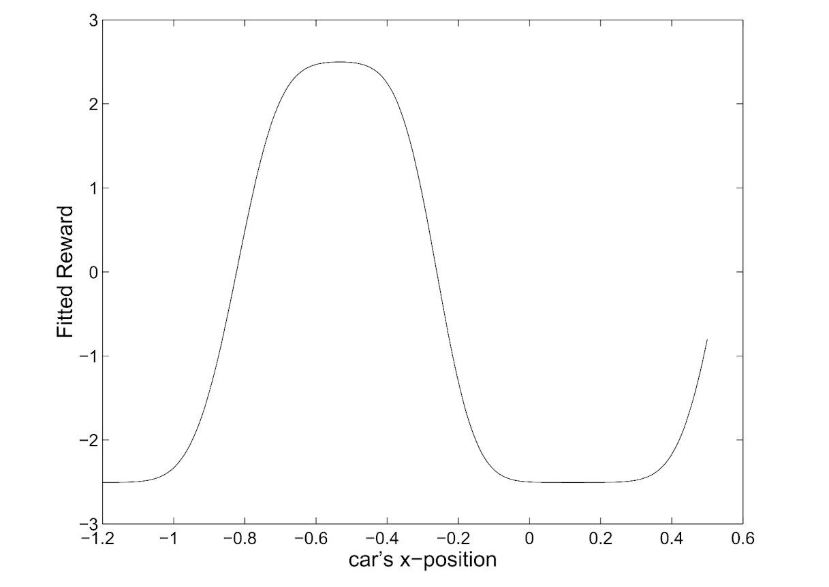
IRL Mountain Car Problem

Slide 15
IRL Mountain Car Problem

Slide 16
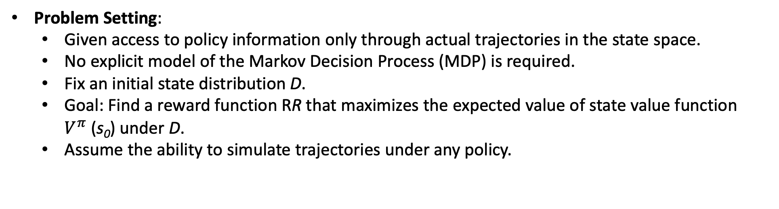
IRL from Sampled Trajectories
Problem Setting:
Given access to policy information only through actual trajectories in the state space.
No explicit model of the Markov Decision Process (MDP) is required.
Fix an initial state distribution D.
Goal: Find a reward function RR that maximizes the expected value of state value function $V^{π}$(s₀​) under D.
Assume the ability to simulate trajectories under any policy.

Slide 17
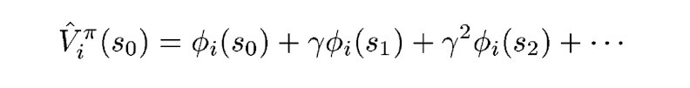
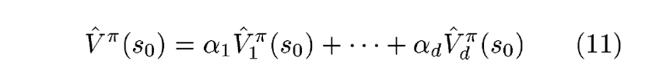

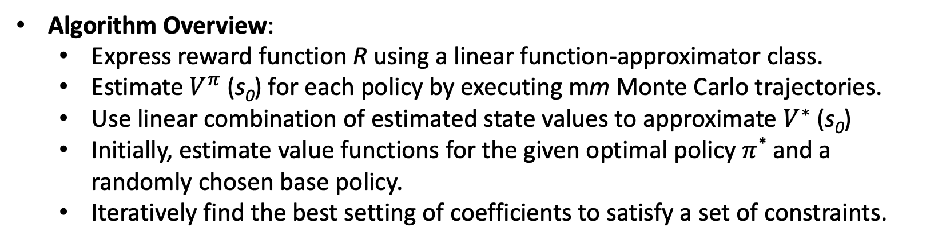
IRL from Sampled Trajectories
Algorithm Overview:
Express reward function R using a linear function-approximator class.
Estimate $V^{π}$(s₀​) for each policy by executing mm Monte Carlo trajectories.
Use linear combination of estimated state values to approximate $V^{∗}$(s₀​)
Initially, estimate value functions for the given optimal policy $π$* and a randomly chosen base policy.
Iteratively find the best setting of coefficients to satisfy a set of constraints.

Slide 18
Demonstration
Link

Slide 19
topic

