Slide 1
Employee Leave Management System
Smart Digital Leave Approval & Tracking Platform
A modern, web-based HR solution built to digitise leave applications, automate approval workflows, and centralise employee leave monitoring — designed for efficiency, transparency, and scalability.
Mini project CRT

Slide 2
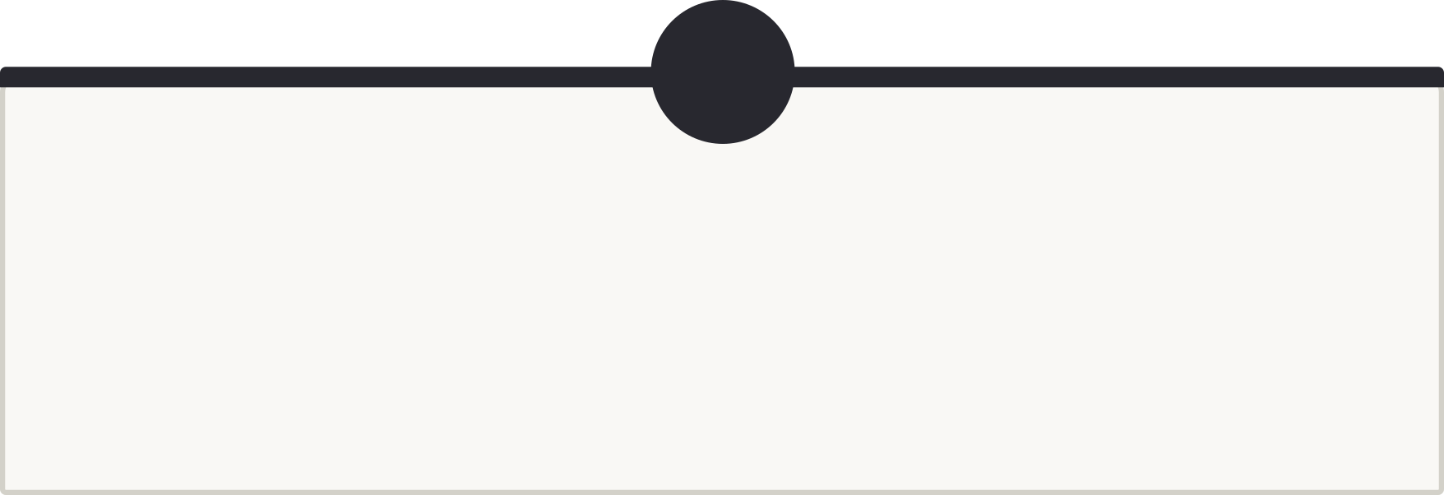
PROBLEM STATEMENT
The Challenge with Manual Leave Management
Organisations still relying on paper-based and manual leave processes face significant bottlenecks that impact both HR productivity and employee experience.
1
2
Paper-Based Applications
Approval Delays
Physical leave forms are error-prone, easily misplaced, and difficult to store or retrieve when needed.
Manual routing between employees, managers, and HR creates unnecessary lag in decision-making.
3
4
No Centralised Tracking
Lack of Visibility
Leave records are scattered across departments, making monitoring and reconciliation a persistent challenge.
Administrators have no real-time view of who is on leave, leading to staffing gaps and disrupted workflows.

Slide 3


PROPOSED SOLUTION
A Unified Digital Leave Management Platform
Digital-First Approach
Digital Leave Application
Automated Approval Workflow
Our web-based system replaces manual, paper-driven processes with a seamless digital workflow — from application to approval — accessible anytime, anywhere.
Employees submit leave requests online with supporting details and justifications.
Requests route instantly to admins for review, approval, or rejection — no paperwork involved.
Real-Time Status Tracking
Centralised Dashboard
A single pane of glass for administrators to oversee all employee leave activities and records.
Employees and admins track leave status live through an intuitive dashboard interface.

Slide 4
TECHNOLOGY STACK
Built on a Robust Modern Stack
Our system leverages industry-standard technologies across the full development lifecycle, ensuring performance, maintainability, and scalability.
Frontend
Backend
Database & Tools
HTML5 & CSS3 for semantic structure and styling
Bootstrap for responsive, mobile-first UI components
JavaScript for dynamic client-side interactions
Java — reliable, object-oriented core language
Spring Boot for rapid enterprise-grade API development
Spring Data JPA for streamlined database operations
MySQL — relational database for persistent storage
RESTful APIs for clean client-server communication
Maven for dependency management and builds

Slide 5
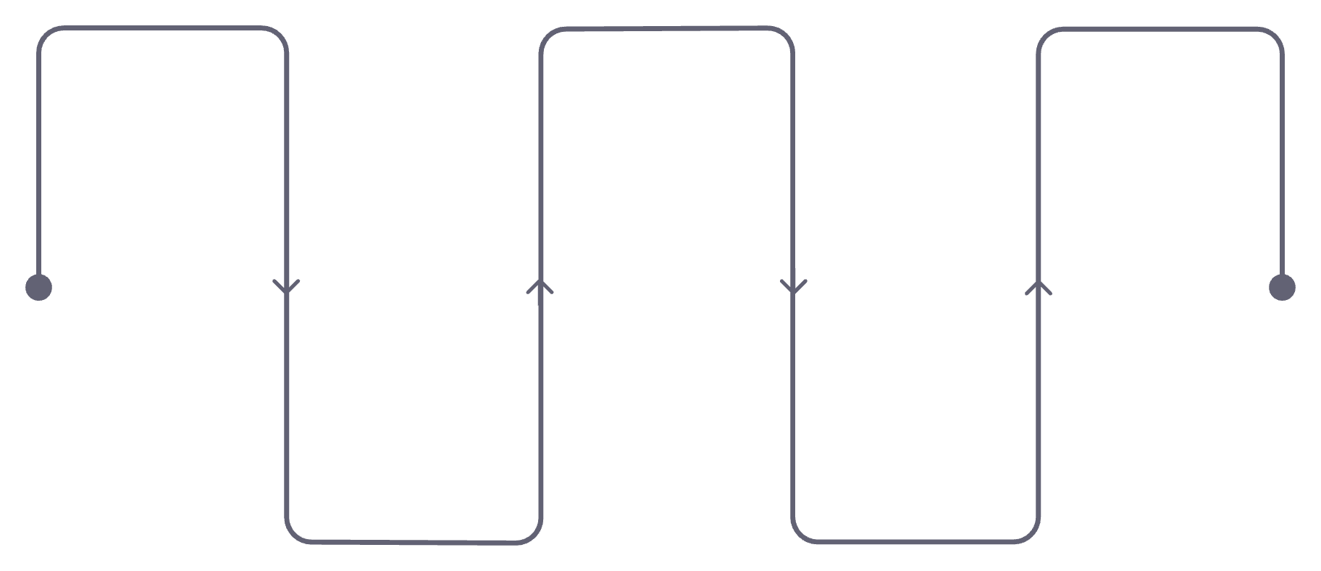
SYSTEM ARCHITECTURE
End-to-End Data Flow Architecture
Architecture Highlights
Client Tier
Employee Login
REST APIs
Business Logic
Expose endpoints for UI
Employees and admins interact via a responsive web dashboard served over HTTP.
Authenticate user credentials
Process rules and validations
API Layer
Web Dashboard
Spring Boot Backend
RESTful endpoints handle all incoming requests with standardised JSON payloads.
UI for employees and admins
Handle requests and routing
Each layer has clearly defined responsibilities, ensuring separation of concerns and maintainability throughout the system.
Persistence Layer
Spring Data JPA repositories map entities to MySQL tables with minimal boilerplate.

Slide 6
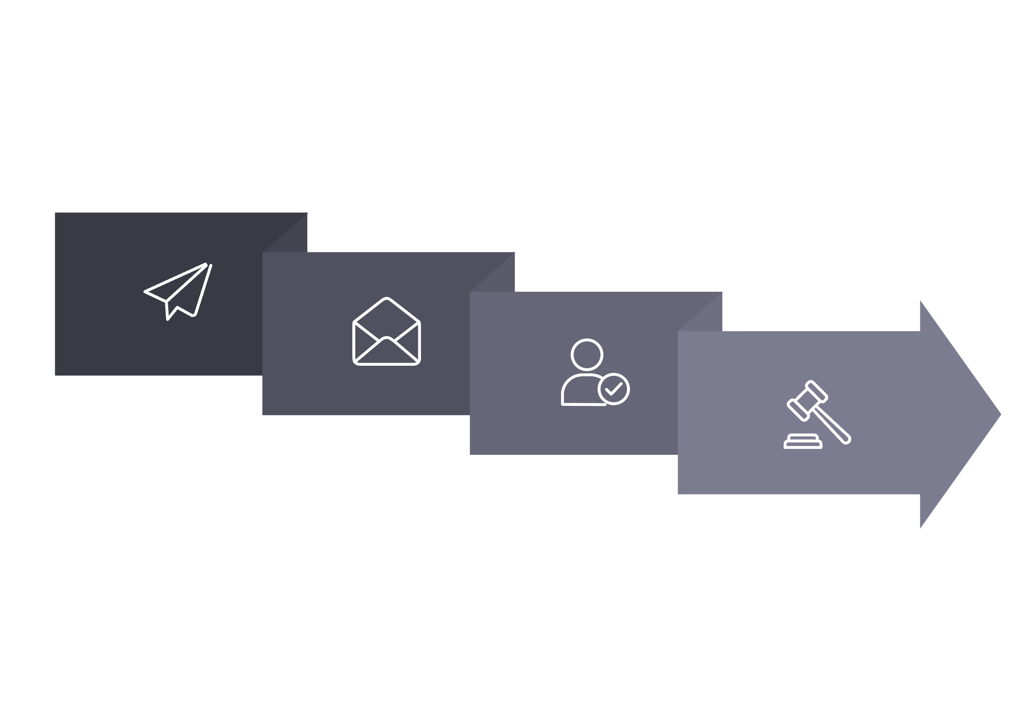
CORE MODULES & WORKFLOW
Heart of the System — Leave Workflow
Send to Admin
Approve / Reject
Apply Leave
Admin Review
The system is organised around five core modules — Employee Management, Leave Application, Leave Approval/Rejection, Leave Tracking, and Reports & Dashboard — each supporting a seamless end-to-end leave lifecycle from request to resolution.

Slide 7
DATABASE & API DESIGN
Relational Schema & REST Endpoints
Database Tables
REST API Endpoints
01
Employee Table
employeeId
POST /employees
employeeName
Register a new employee profile in the system.
02
department
designation & email
GET /employees
Retrieve a list of all registered employees.
Leave Table
03
leaveId, employeeId
POST /leave/apply
leaveType & reason
Submit a new leave request with full details.
startDate & endDate
04
status
GET /leave/requests
Fetch all pending and processed leave requests.
05
PUT /leave/approve & /reject
Admin approves or rejects a specific leave by ID.

Slide 8
DASHBOARD FEATURES
Role-Based Dashboard Capabilities
The system provides tailored interfaces for both employees and administrators, each equipped with the tools they need most.
Employee Portal
Admin Dashboard
Secure login & personalised home screen
One-click leave application form
Approve or reject incoming requests
Manage all employee records & profiles
Leave statistics & advanced search filters
Full leave history with status indicators

Slide 9
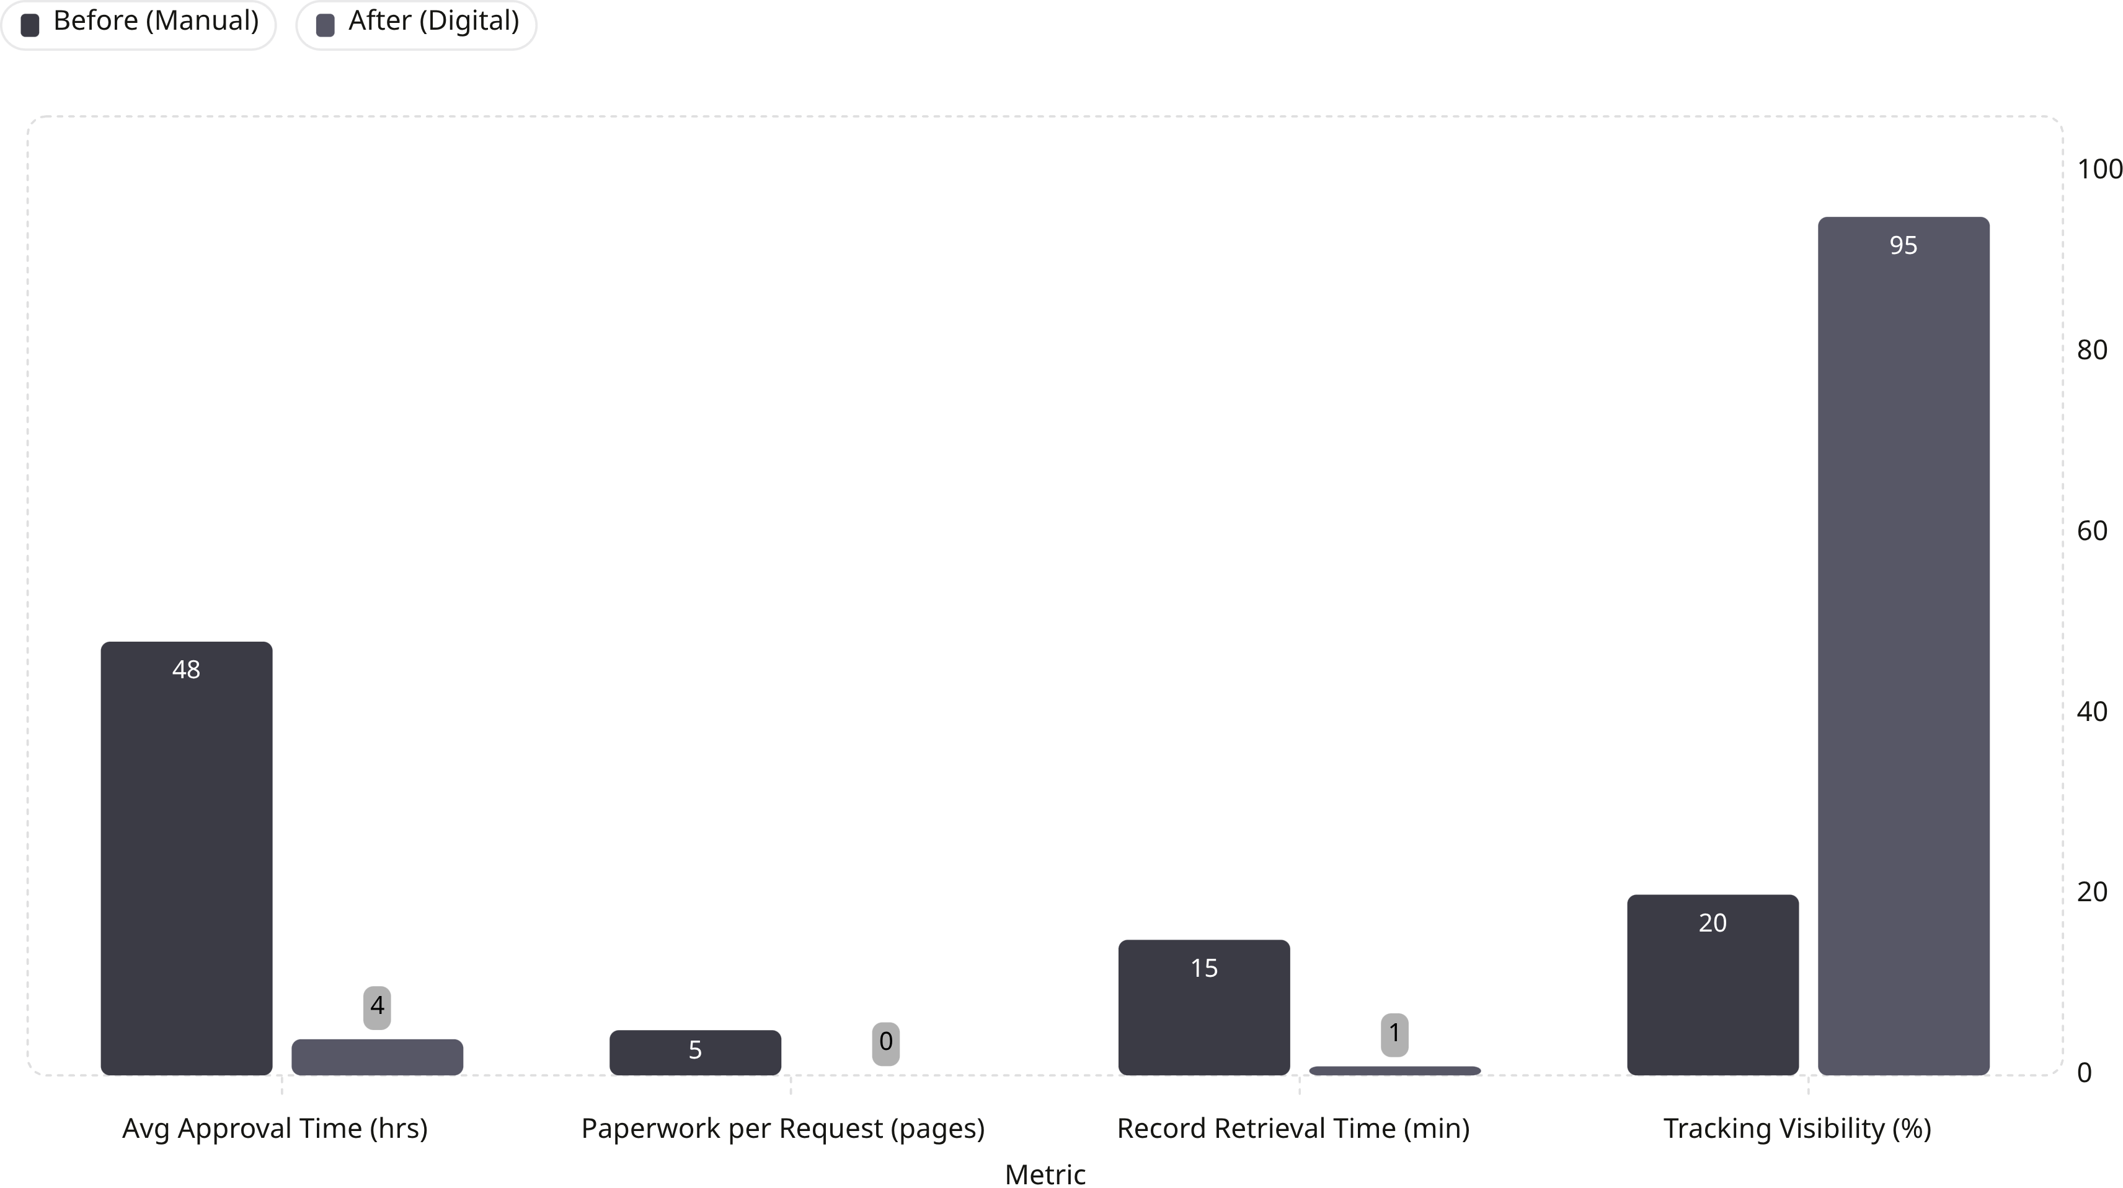
RESULTS & BENEFITS
Measurable Impact on HR Operations
The digital system dramatically reduces approval times, eliminates paperwork, and provides near-total visibility into leave activity — transforming HR efficiency from the ground up.

Slide 10
FUTURE SCOPE & CONCLUSION
Forward-Looking Roadmap & Vision
Our platform is designed for extensibility, with a clear pipeline of enhancements to deliver even greater value and intelligence.
Planned Enhancements
Conclusion
Automated email & SMS notifications
The Employee Leave Management System delivers an efficient, user-friendly, and scalable platform — engineered with a secure architecture and a smart design philosophy that is fully SIH-ready.
Native mobile application for on-the-go access
Leave balance tracking with carry-forward rules
AI-based leave analytics & predictive insights
Cloud deployment for elastic scalability
Multi-branch & multi-region integration
Efficient
Scalable
Secure
Smart

