Slide 1
Assignment-2

Slide 2
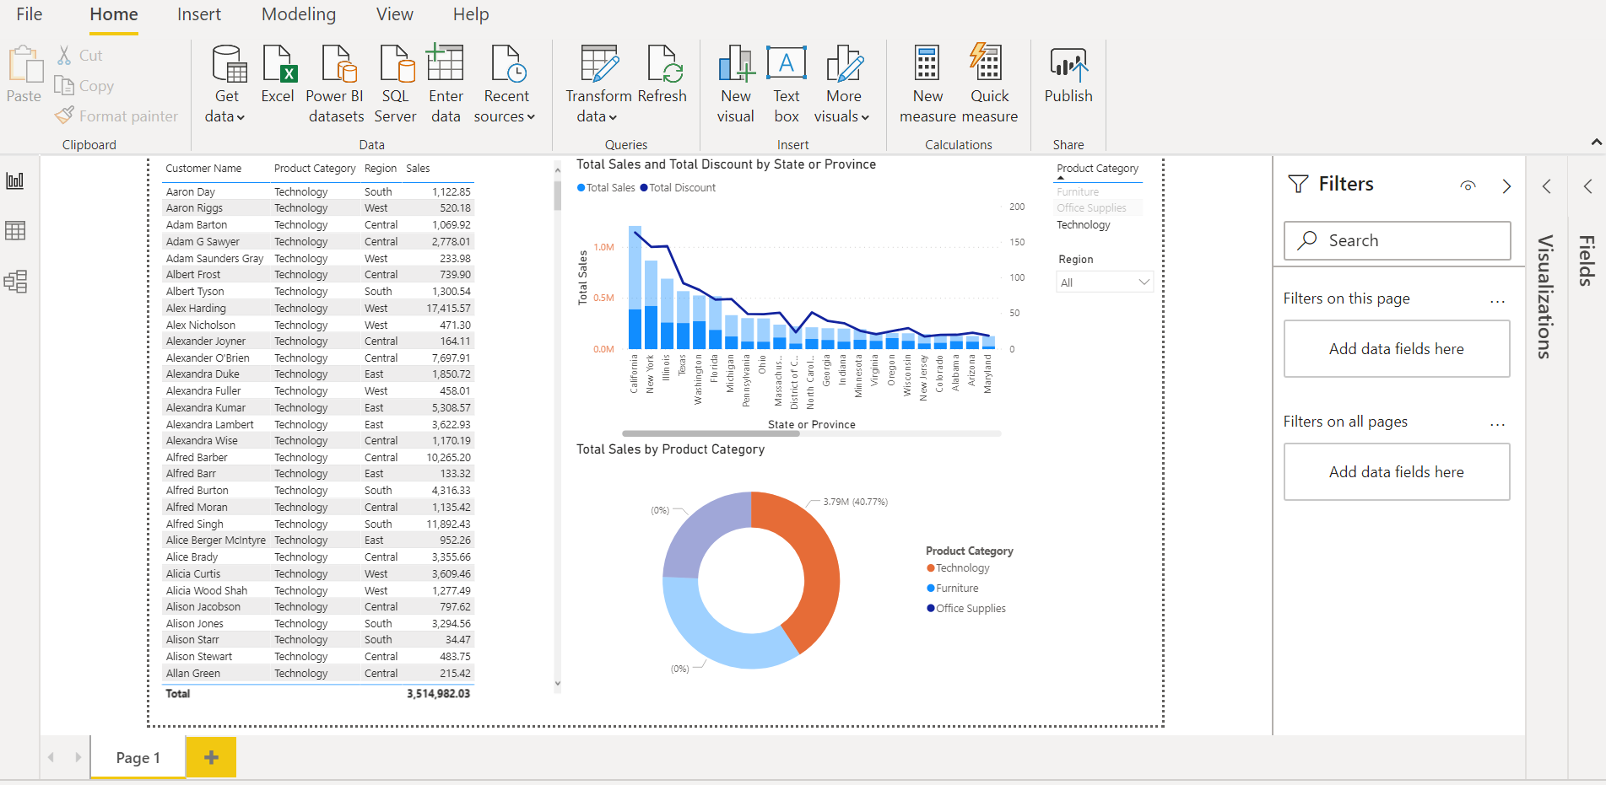
Assignment-2

