Slide 1



Information available in audio.
AI END SEMESTER
TRAFFIC VOLUME PREDICTION
ANUSHKA GAUR --43
AYOUSH BHATNAGAR--62
AKSHAT SANDILYA--25
ABHISHEK KUMAR SINGH --09
AVIGAN SHARMA--02

Slide 2


POINTERS
OBJECTIVE | 3
DATA COLLECTION | 4
FEATURE DESIGNING | 5
DATA PROCESSING | 6
MODEL BUILDING AND EVALUATION | 7
VISUALISATION AND INSIGHTS | 8
CODE | 9
SNAPS | 10
SIGNING OUT

Slide 3
1. Objective
Predict hourly traffic volume using machine learning regression techniques.
Build a model that generalizes well across varying conditions.
Support real-world applications like smart traffic systems and city planning.
Drag and drop your photo or video! Click the sample photo or video and delete. Select yours from the uploads tab, drag, and then drop inside the frame!
Back to Agenda

Slide 4
DATA COLLECTION
Extracted time features: hour, weekday, month, is_weekend, etc.
Created binary indicators for holidays and peak hours.
Briefly elaborate on what you want to discuss data collection
Binned continuous weather variables (e.g., temperature ranges).
Applied one-hot encoding for categorical variables like weather description.
Removed redundant or non-informative features to avoid overfitting.

Slide 5







\Checked for and handled missing or null values.
Scaled numerical features using MinMaxScaler or StandardScaler
DATA PREPROCESSING
Split data into training and testing sets (e.g., 80/20).
Encoded categorical features using one-hot or label encoding.
Ensured data integrity and normalization for model compatibility
Back to Agenda

Slide 6

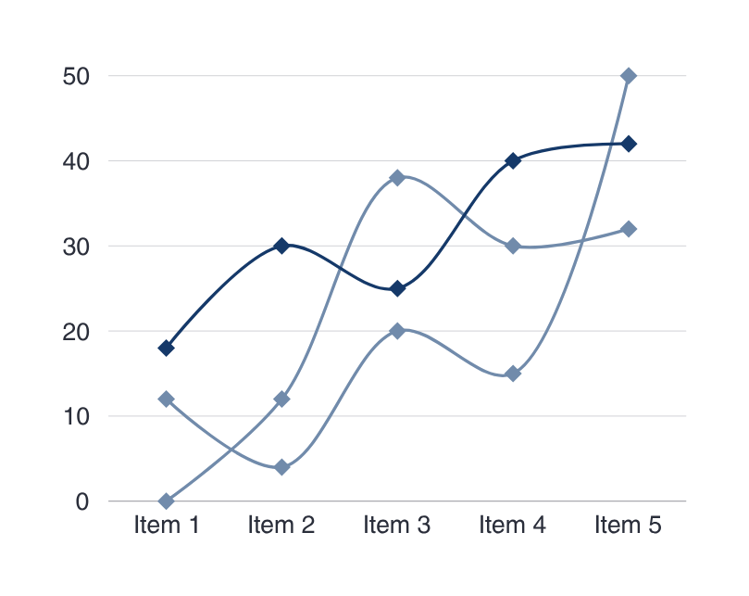
MODEL BUILDING AND EVALIUATION
Back to Agenda
Trained multiple models: Linear Regression, Random Forest, XGBoost.
Used GridSearchCV for hyperparameter tuning and model optimization.
Evaluated models using R² Score, MAE, and RMSE metrics.
Random Forest performed best with a high R² and low RMSE.

Slide 7
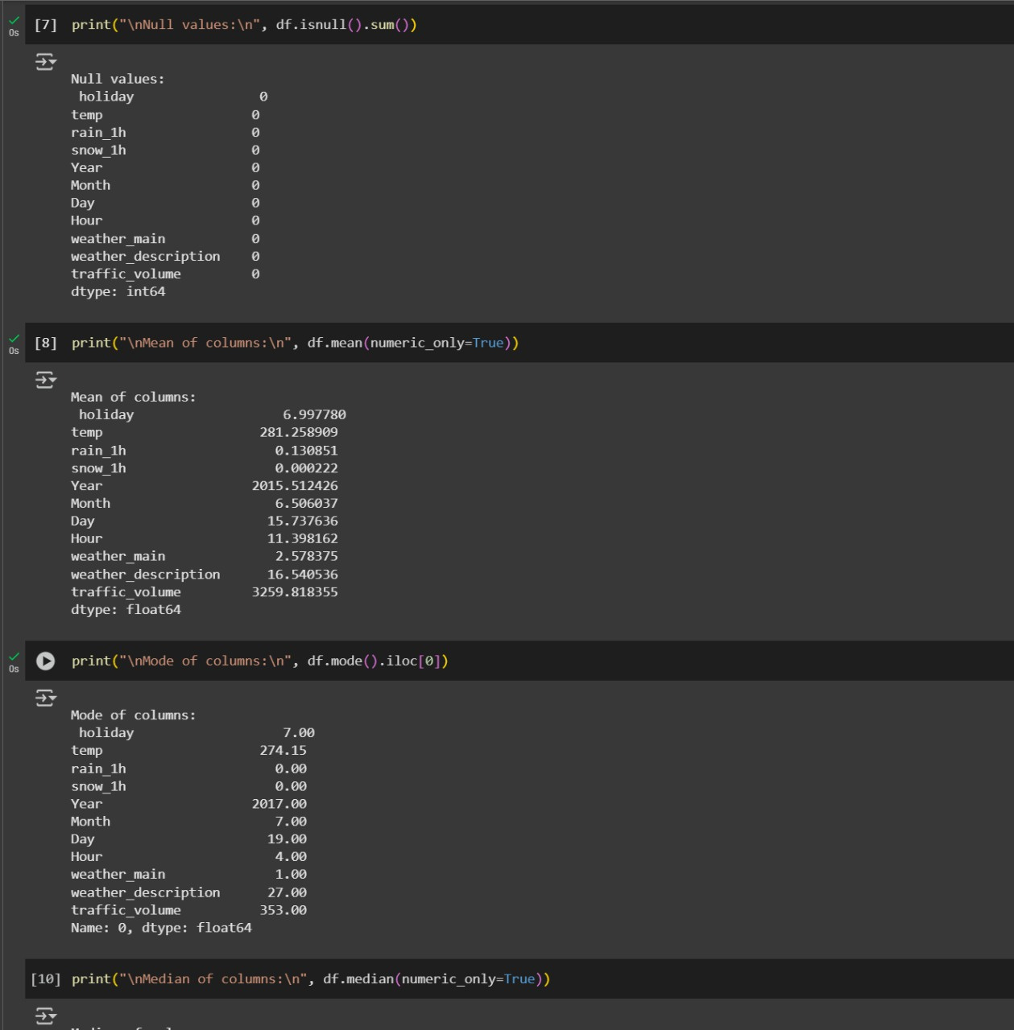

Slide 8
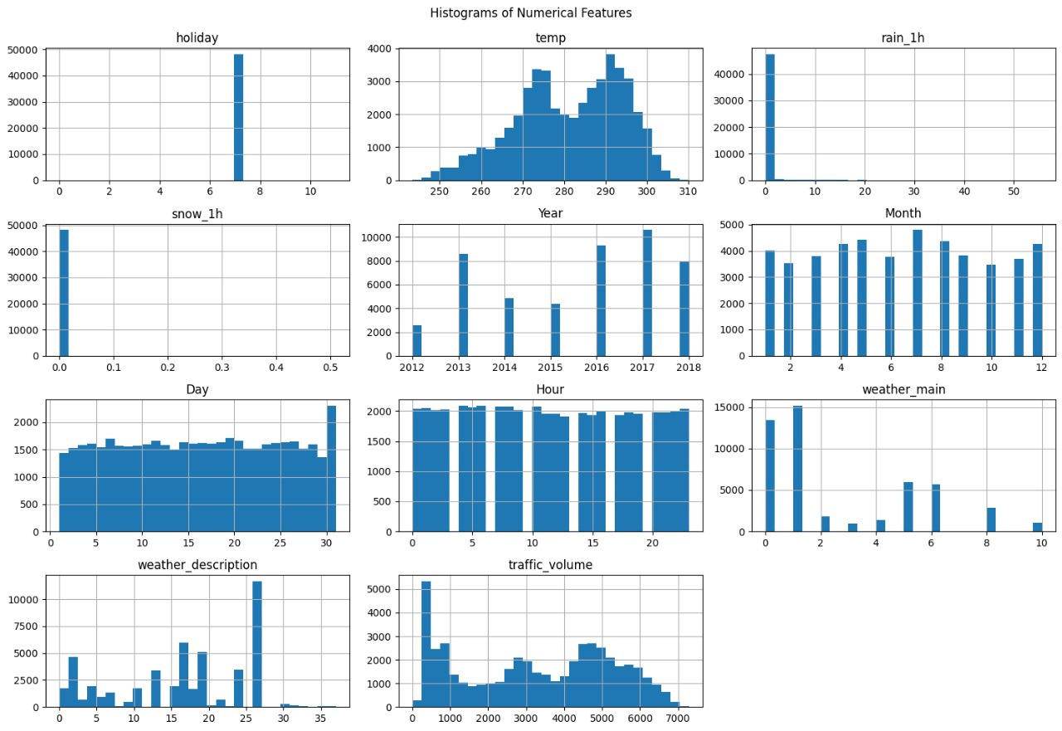
CODE SNAPSHOTS
Back to Agenda

Slide 9
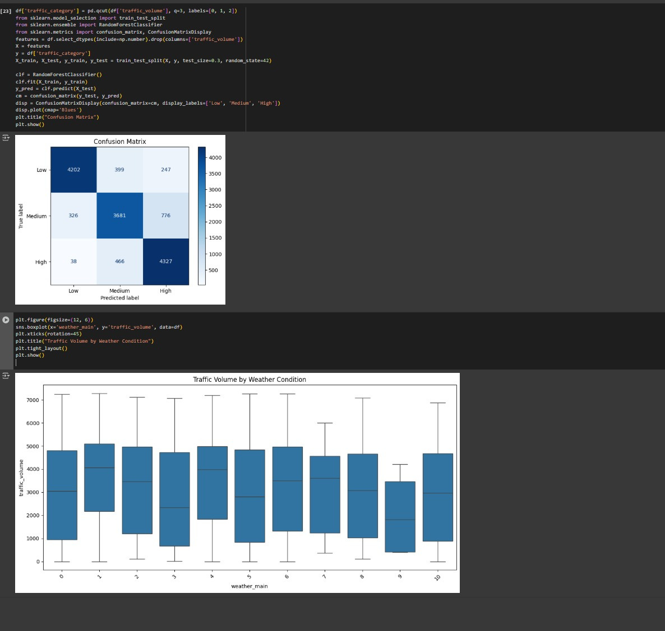
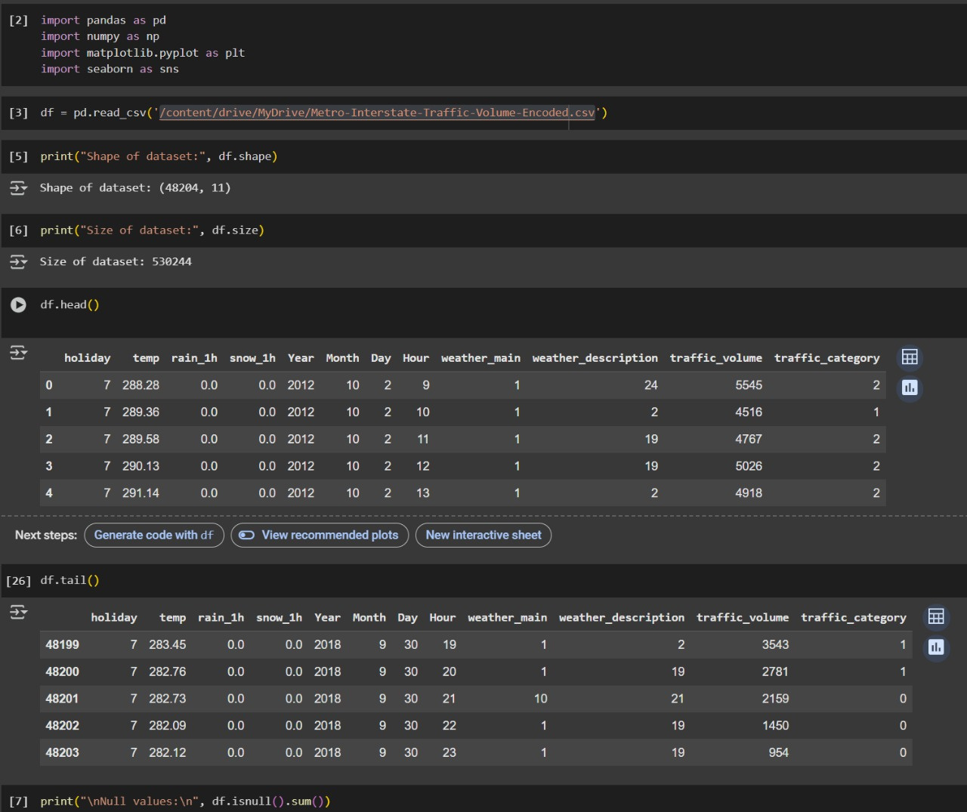

Slide 10
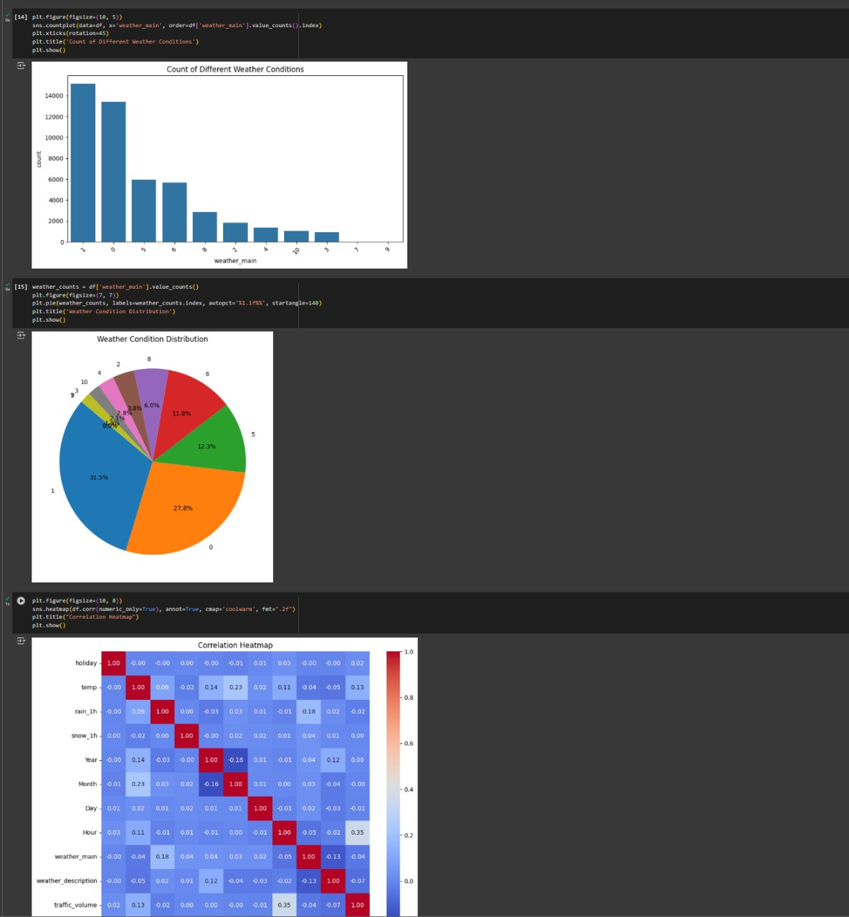

Slide 11
THANK YOU
SIGNING OFF
HOD-REKHA KASHYAP MAM
FACULTY -BIKKI SIR
We extend our heartfelt gratitude to everyone who contributed to the success of our project and supported us throughout this journey. Special thanks to our mentors, faculty members, teammates, and organizers of the expo for providing us with this valuable opportunity. Your guidance, encouragement, and support played a crucial role in making this project a success. We are truly grateful.

