Slide 1
STOCK MANAGEMENT SYSTEM
Presented by
AKASH SHIROOR
AKASH THAKUR

Slide 2
SLIDE OVERVIEW
INTRODUCTION
OBJECTIVES
SYSTEM OVERVIEW
RESULTS/SNAPSHOTS
LIMITATIONS AND FUTURE ENHANCEMENT
CONCLUSION

Slide 3
INTRODUCTION
Stock Management System
Admin Login
View Products
Add new products
Update/ Delete products
User Login
View Products
New User Registration

Slide 4
OBJECTIVES
Easy management of Inventory
Make Stock manageable
Shows the products available

Slide 5
SCOPE
Department Store
Medical Department
Glossary Department
Production Organization

Slide 6
TECHNOLOGIES USED
S/W CONFIGURATION :
Front-End : JSP, Html
Server-side : Servlet
Back-end : MYSQL, Eclipse-IDE
Server : Tomcat v9.0

Slide 7
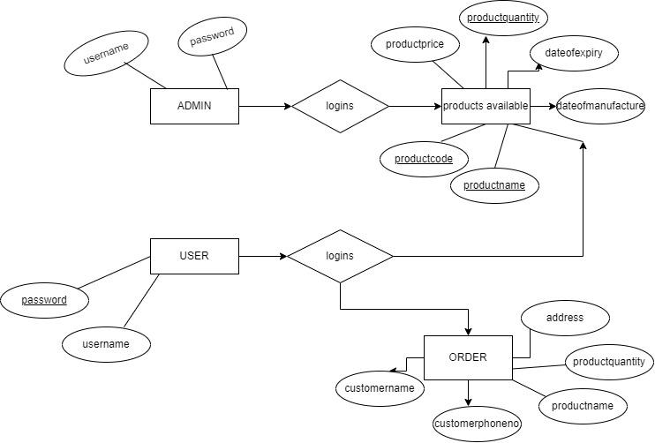
ER-DIAGRAM

Slide 8
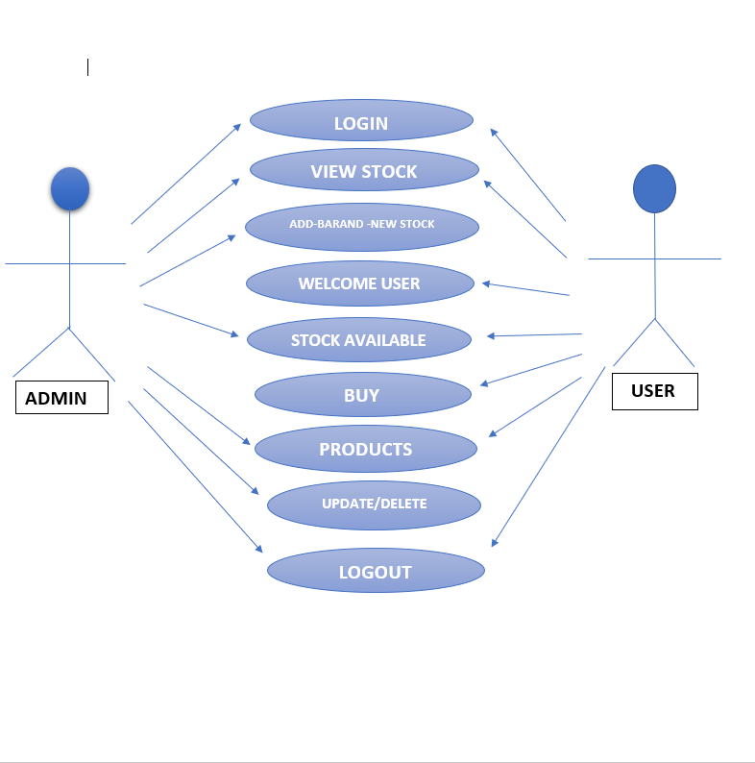
USE-CASE DIAGRAM:

Slide 9
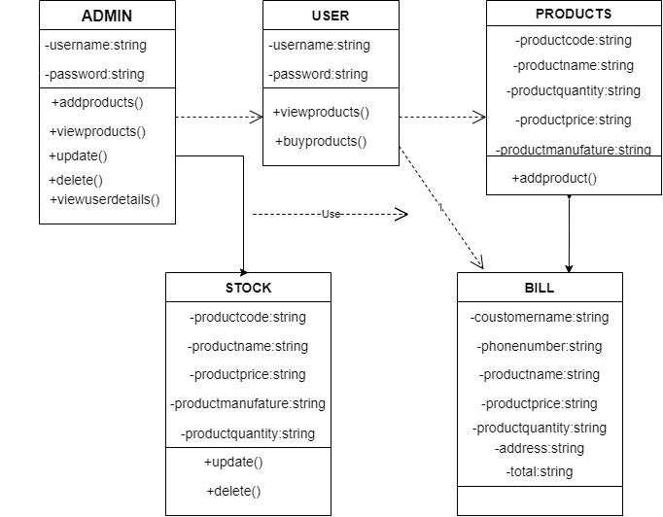
CLASS DIAGRAM:

Slide 10
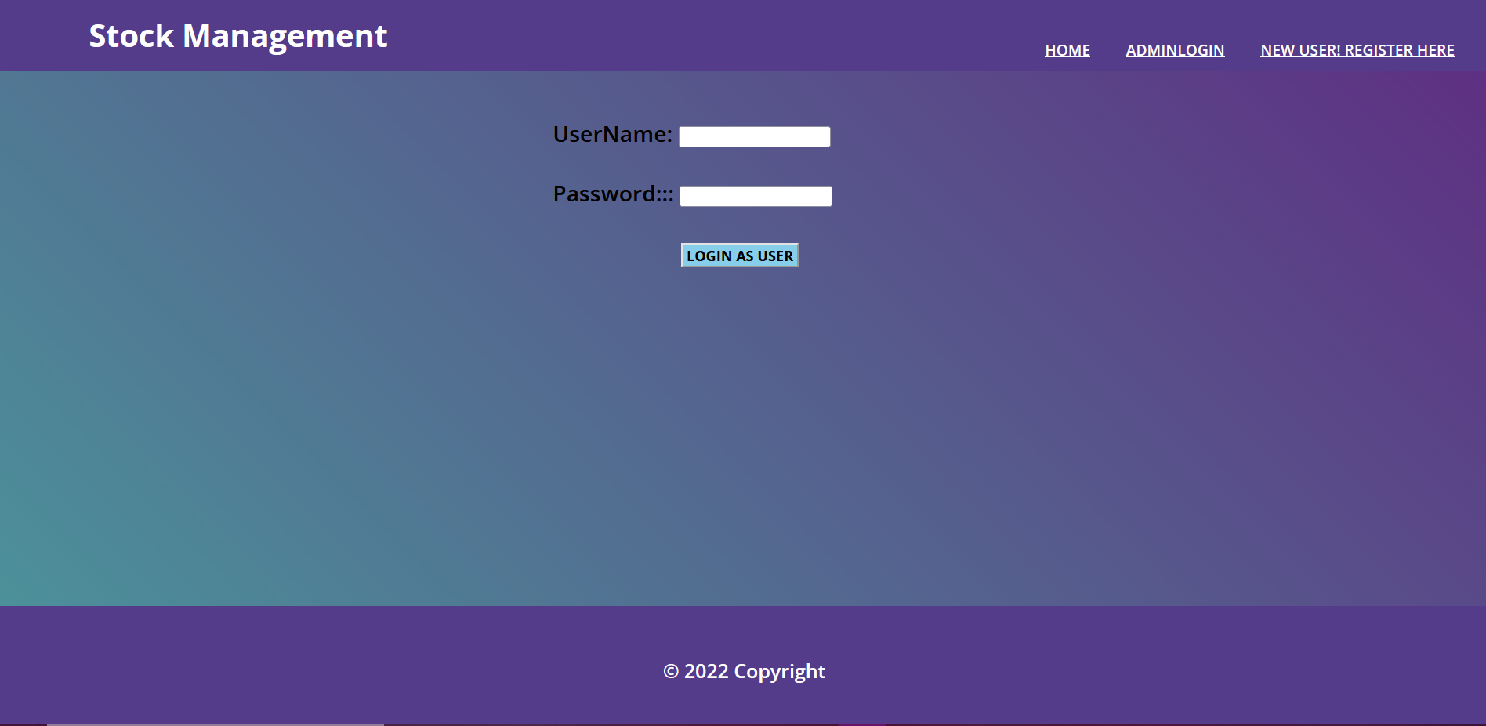
SNAPSHOTS

Slide 11
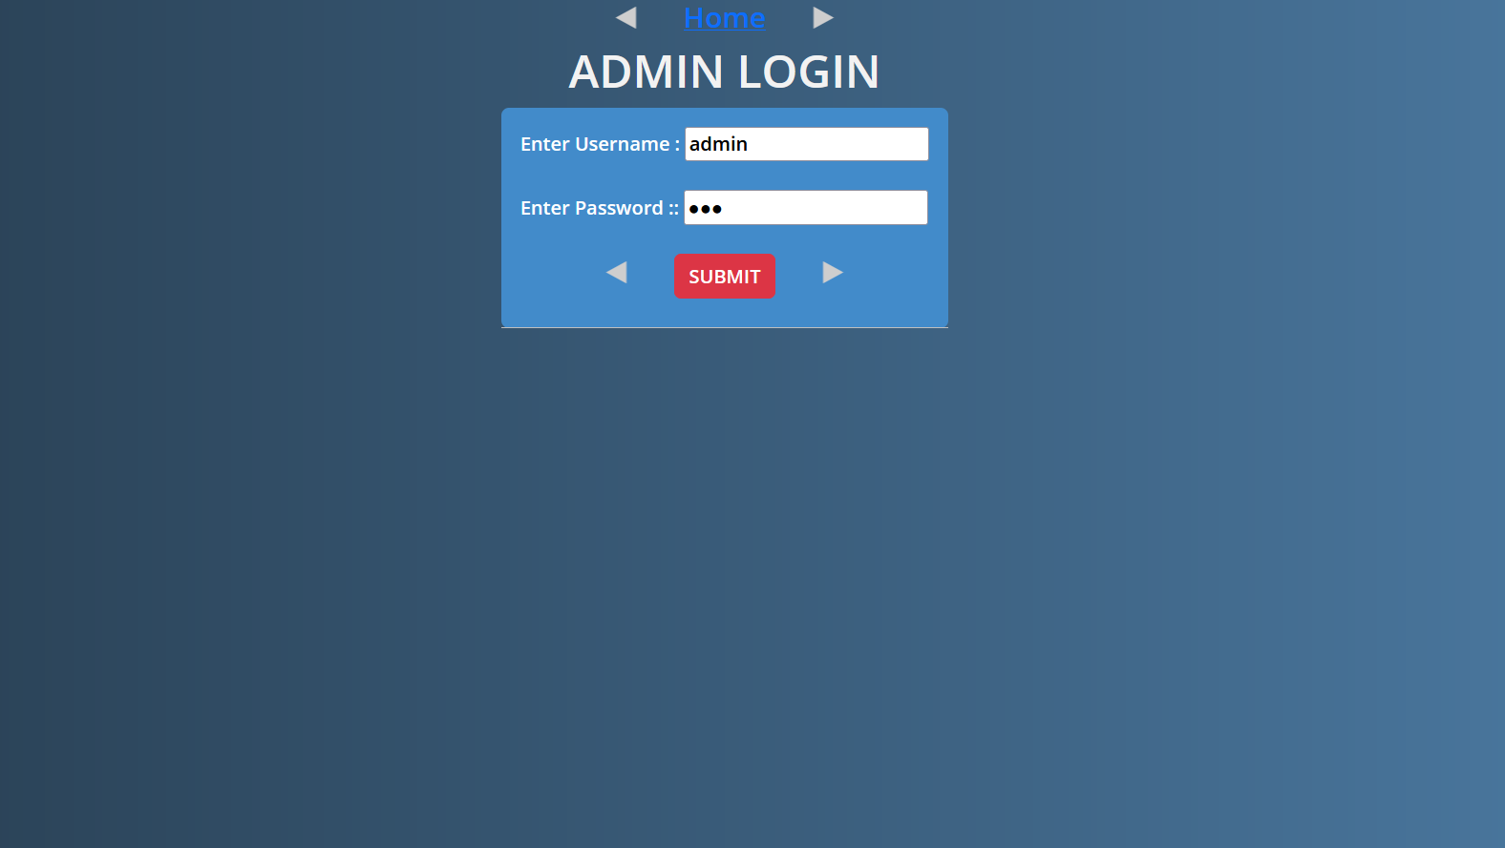
ADMIN LOGIN

Slide 12
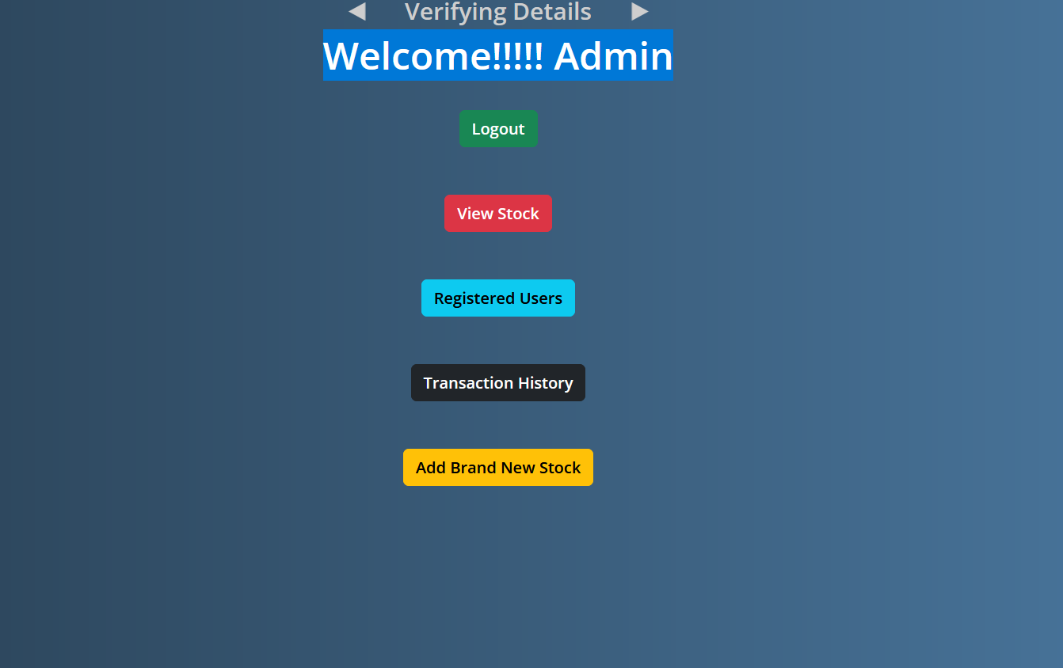
Welcome!!!!! Admin

Slide 13
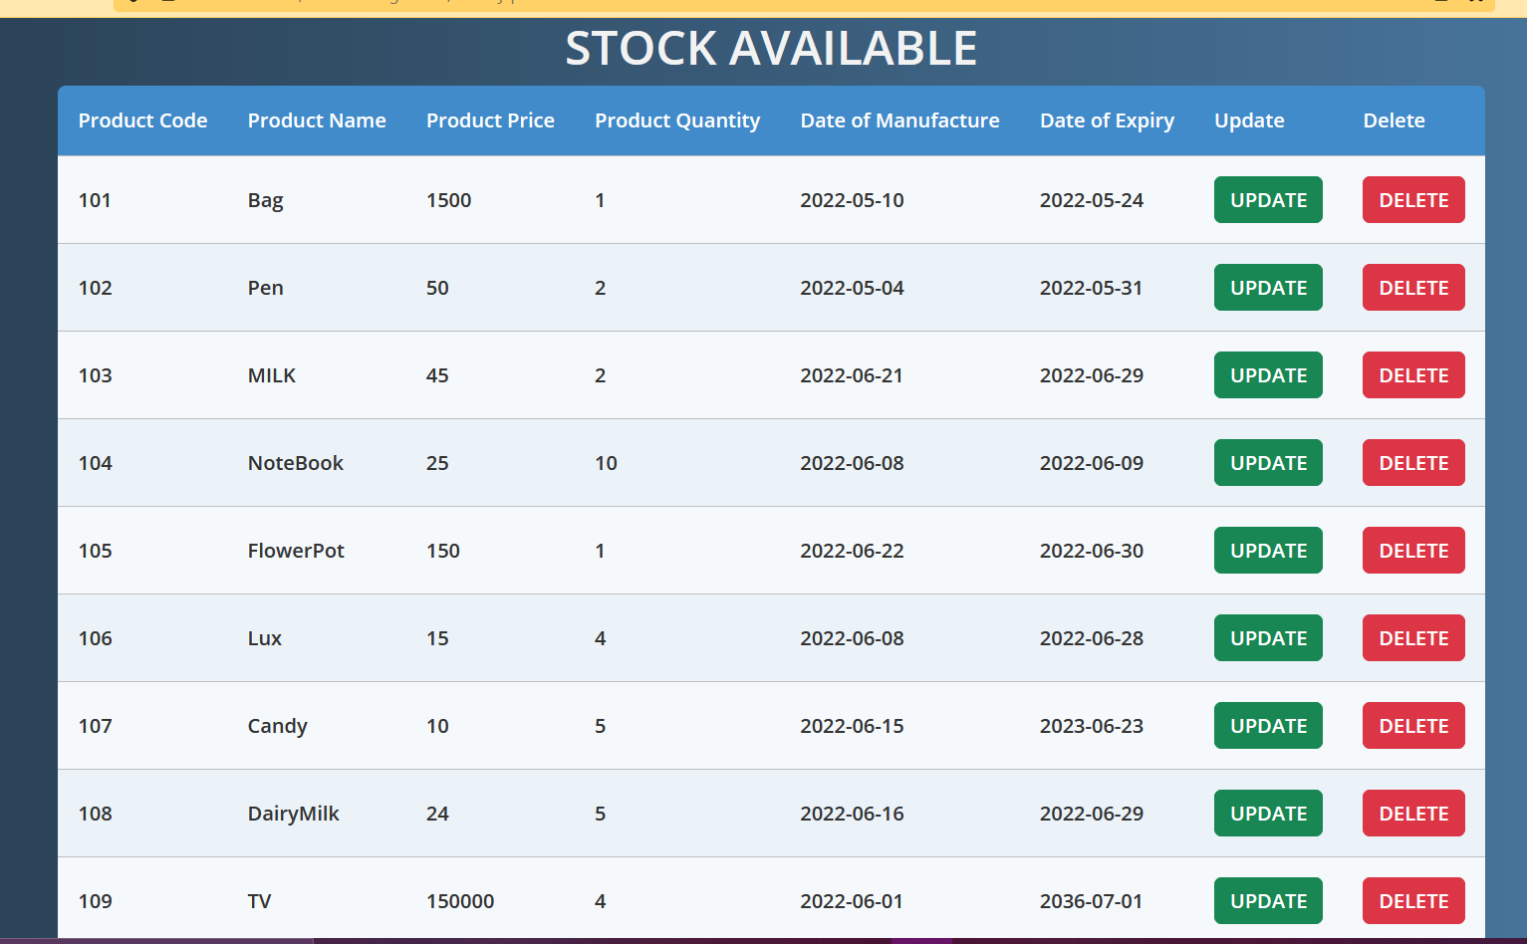
ADD STOCK

Slide 14
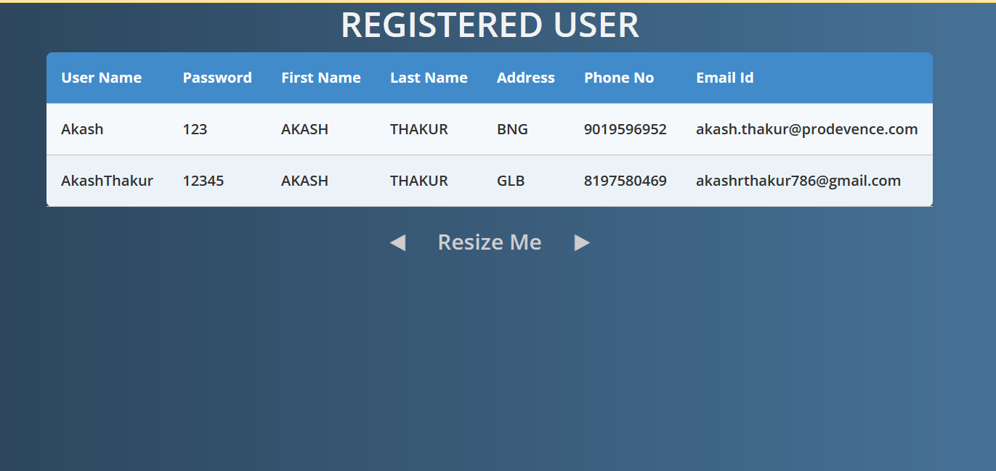
REGISTERED USER:

Slide 15
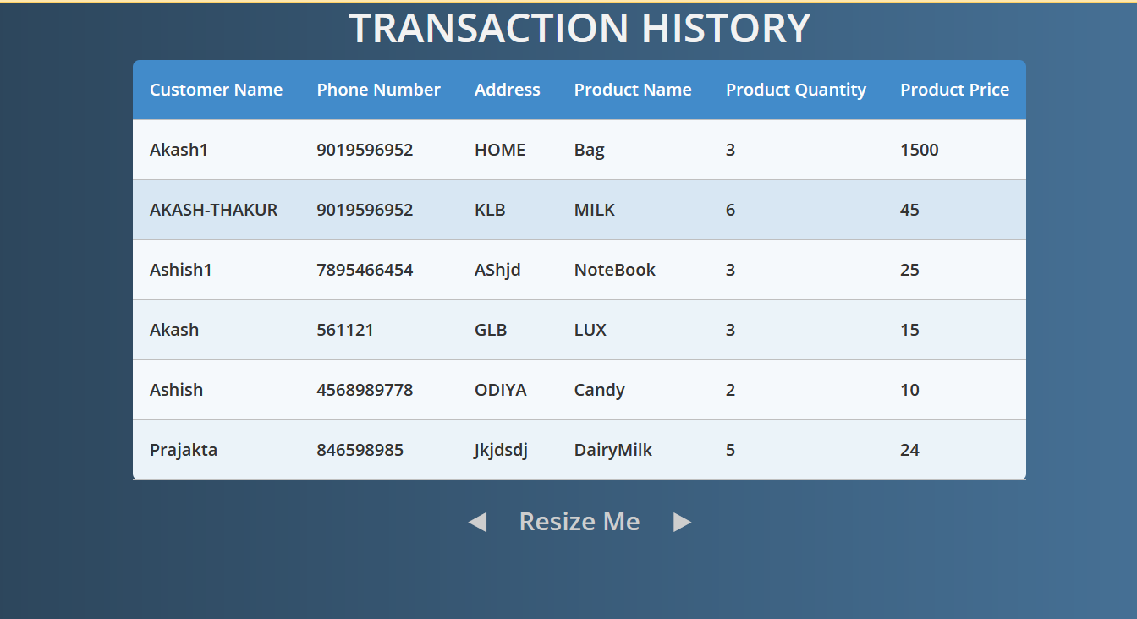
TRANSACTION HISTORY

Slide 16
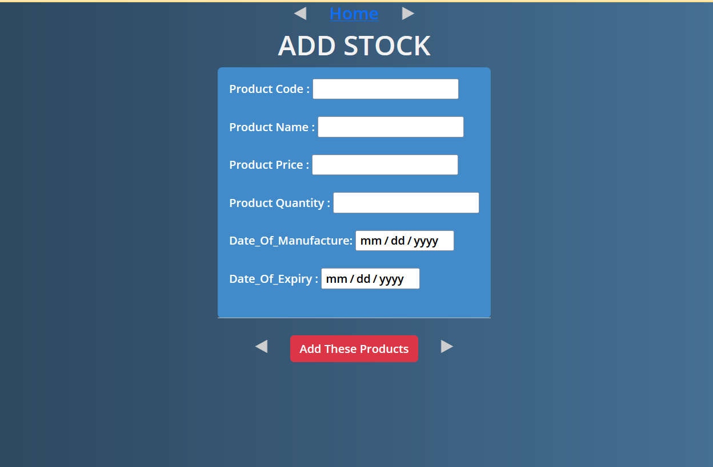
Transaction Details

Slide 17
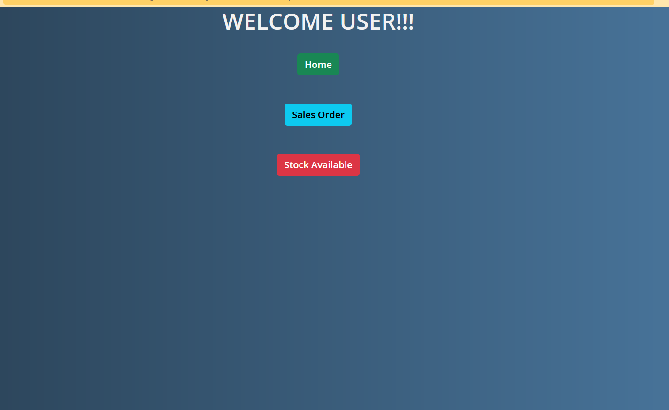
WELCOME USER!!!

Slide 18
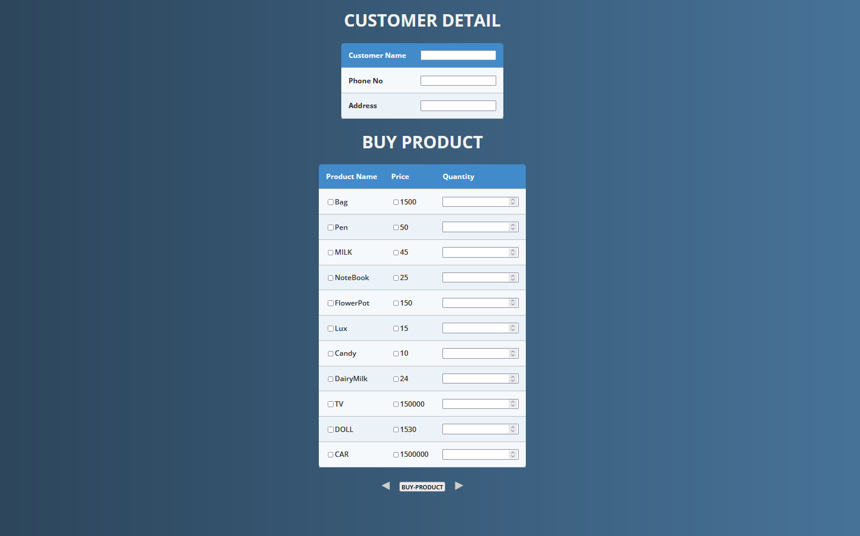
CUSTOMER DETAIL

Slide 19
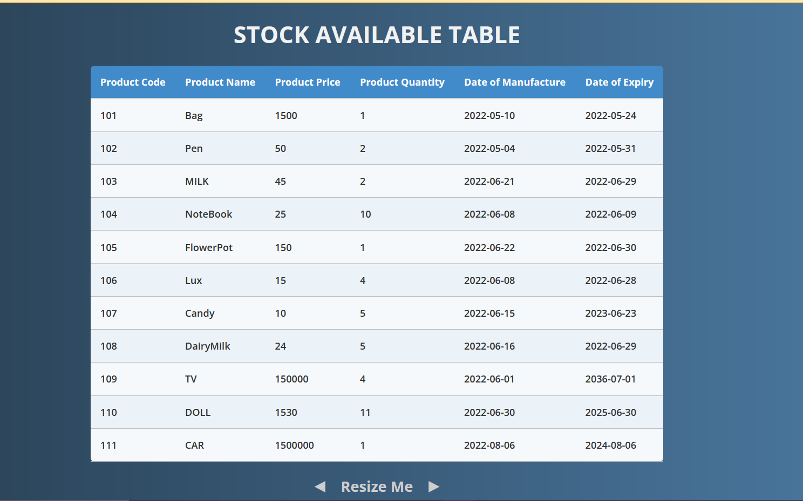
STOCK AVAILABLE TABLE

Slide 20
LIMITATIONS
Generate simple reports.
Single admin panel
Small Production Organization

Slide 21
FUTURE ENHANCEMENT
Lost and breakage.
Customer Orders.
Online payment System.
Use of Oracle as database.
System flexible in any type.

Slide 22
CONCLUSION
Almost accurate output.
Simple desktop application.
System used for inventory management.

Slide 23


