Slide 1
Git and Github

Slide 2
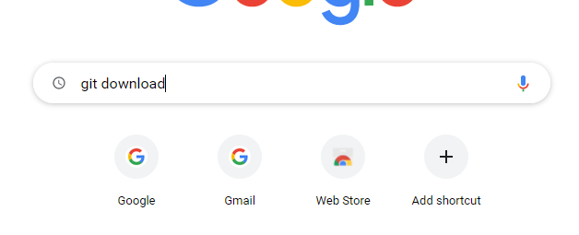
Download Git

Slide 3
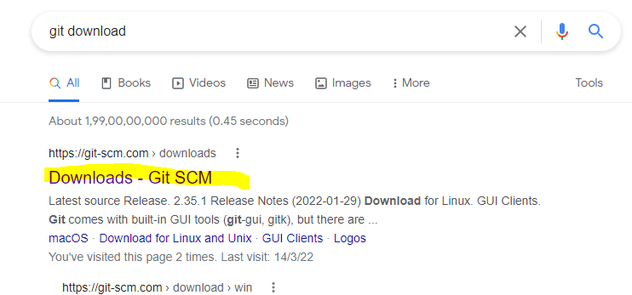

Slide 4
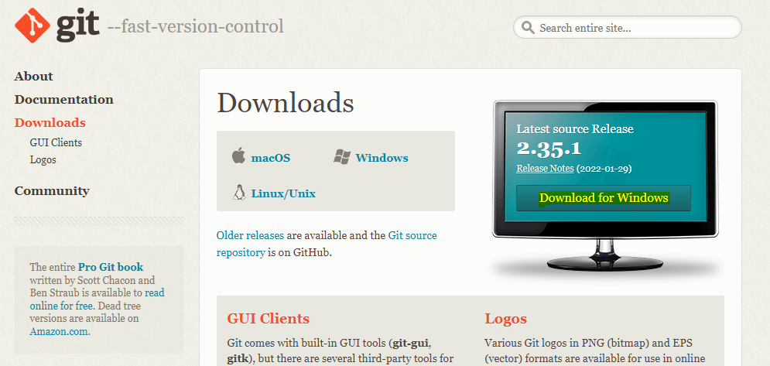

Slide 5
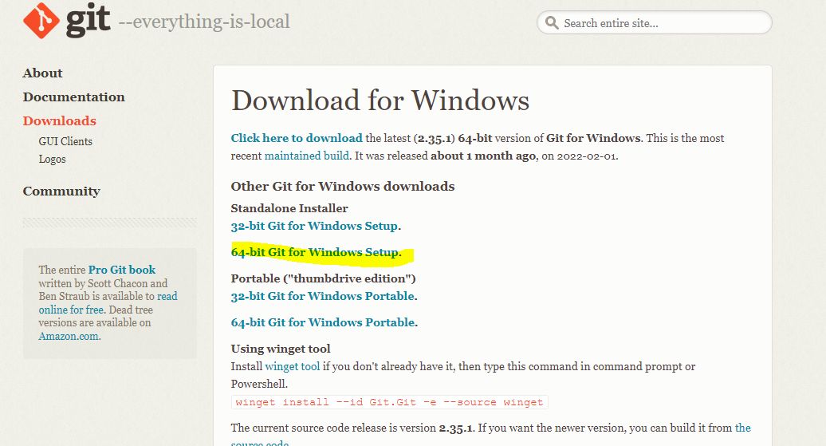


Slide 6
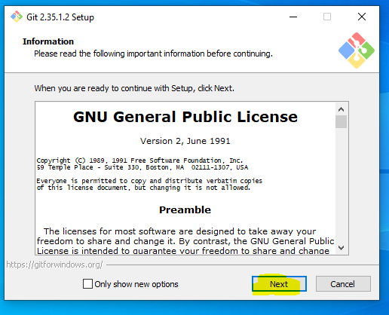

Slide 7
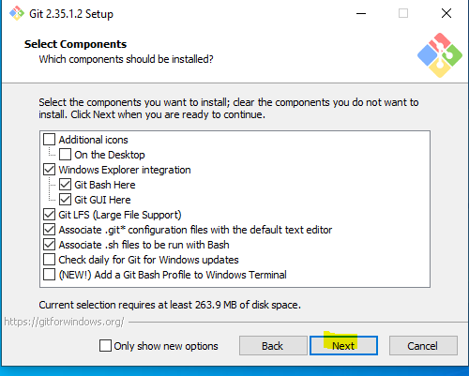

Slide 8
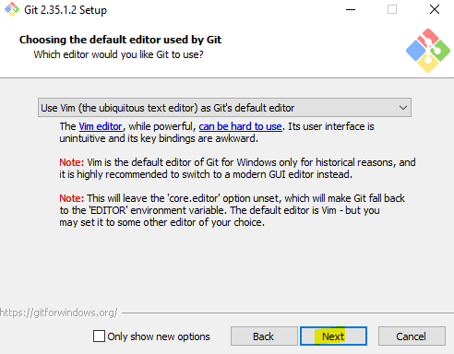

Slide 9
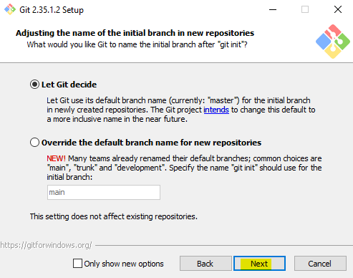

Slide 10
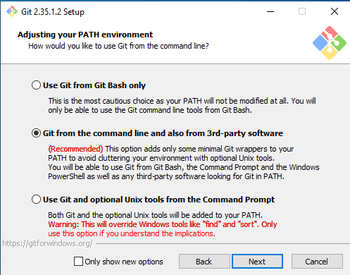

Slide 11
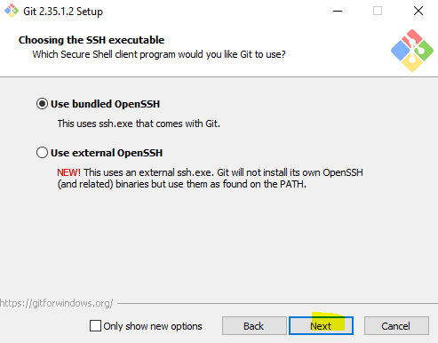

Slide 12
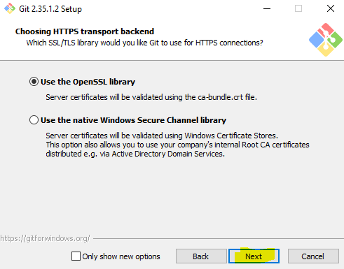

Slide 13
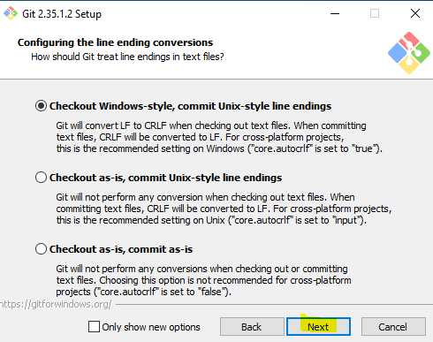

Slide 14
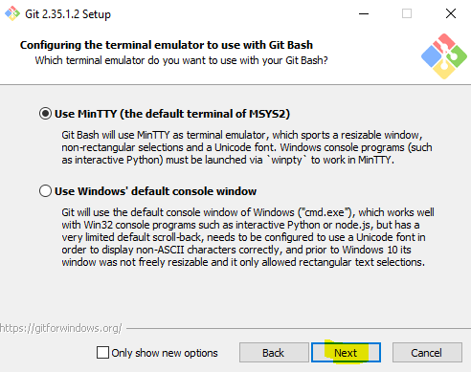

Slide 15
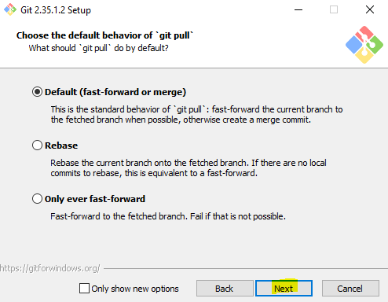

Slide 16
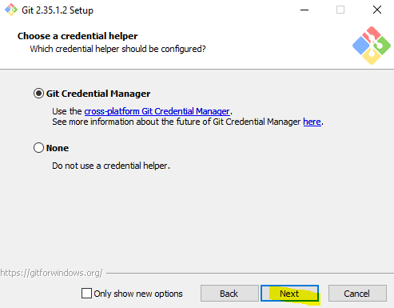

Slide 17
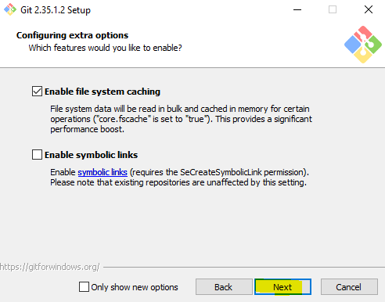

Slide 18
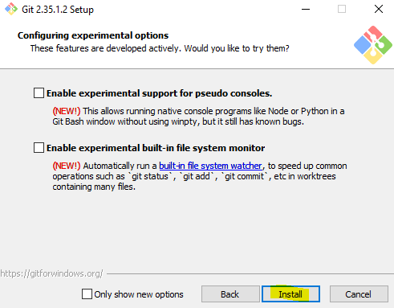

Slide 19
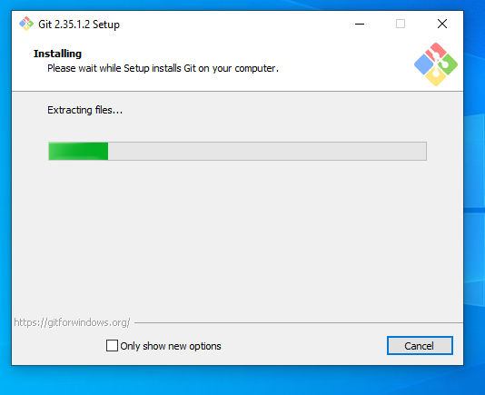

Slide 20
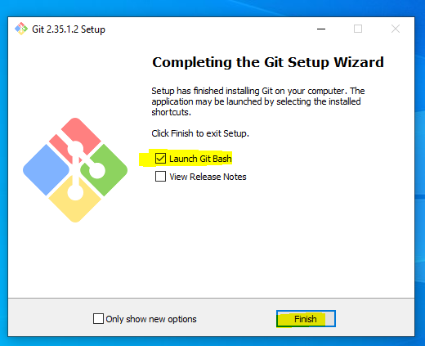

Slide 21
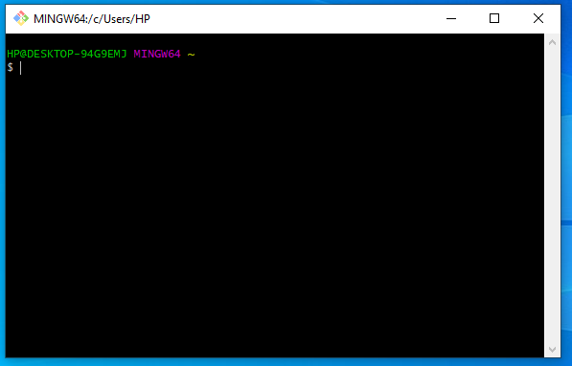

Slide 22
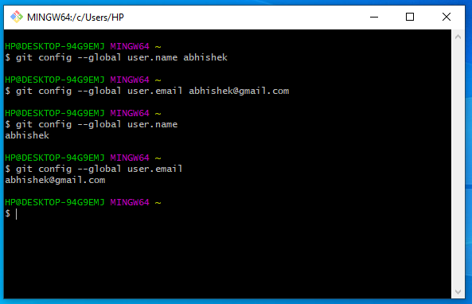
Git config

Slide 23
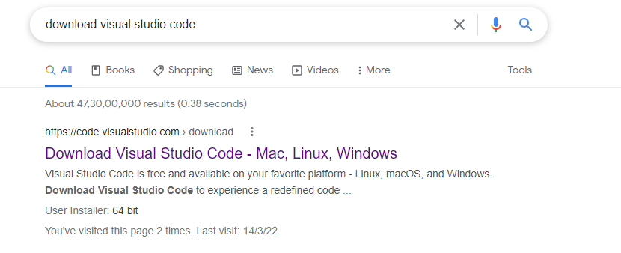
Download Visual studio code

Slide 24
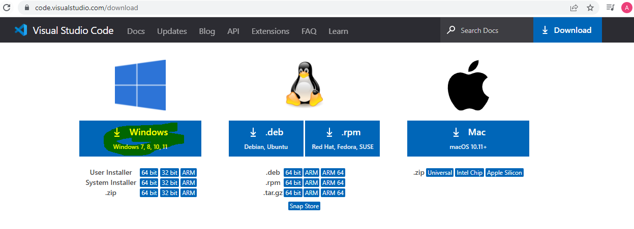


Slide 25
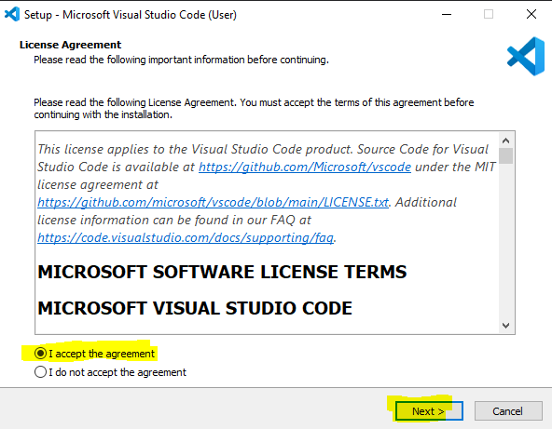

Slide 26
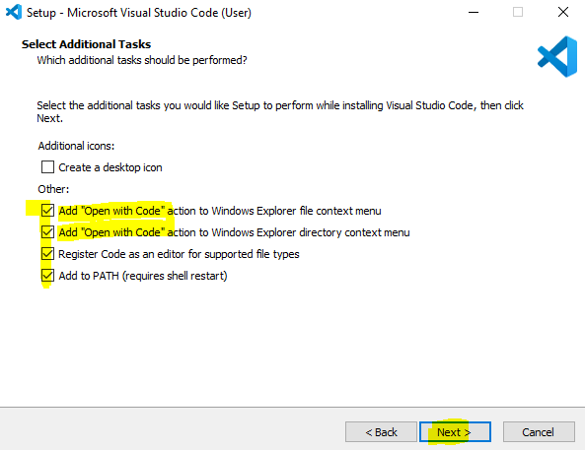

Slide 27
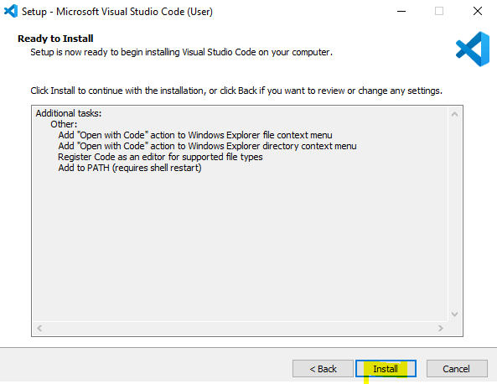

Slide 28
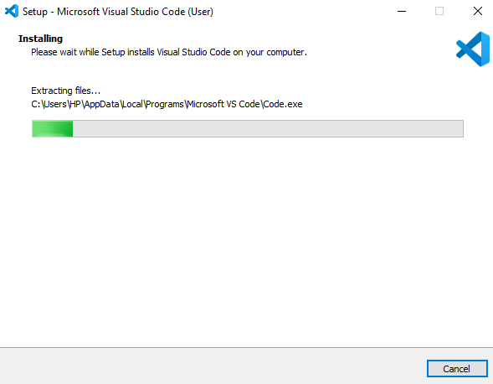

Slide 29
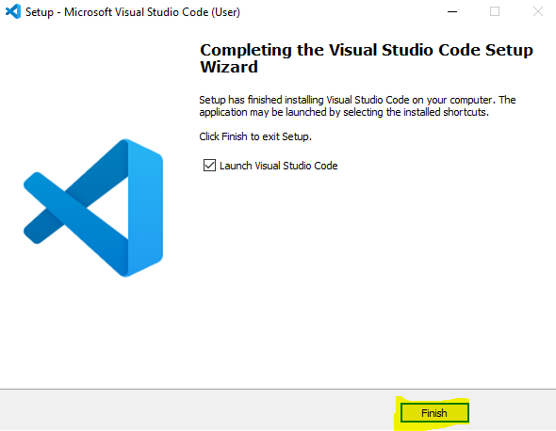

Slide 30
Create a folder on your system with name ‘March Web Fundamentals Assignments’.

Slide 31
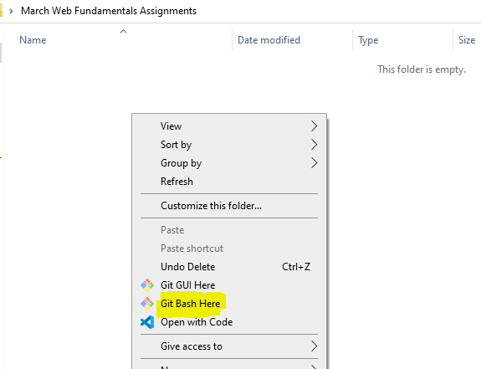
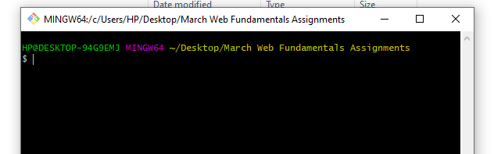

Slide 32
How will you create a git repository?
Have git installed in your system.
Then in order to create a git repository, create a folder for the project and then run git init.
Doing this will create a .git file in the project folder which indicates that the repository has been created.

Slide 33
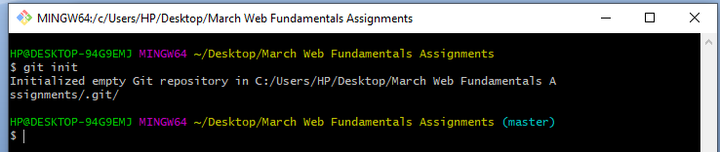
Git init

Slide 34
Go inside the Project folder.
Create Folder ‘March’
Create folders ‘Week1’, ‘Week2’, ‘Week3’, ‘Week4’ and ‘Week5’ inside that March folder.

Slide 35
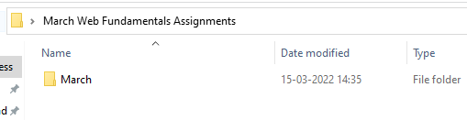
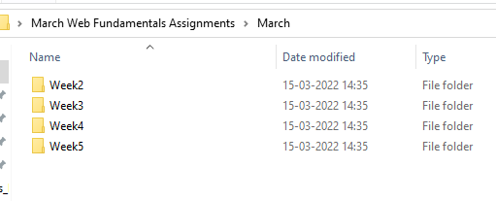
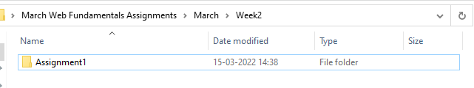

Slide 36
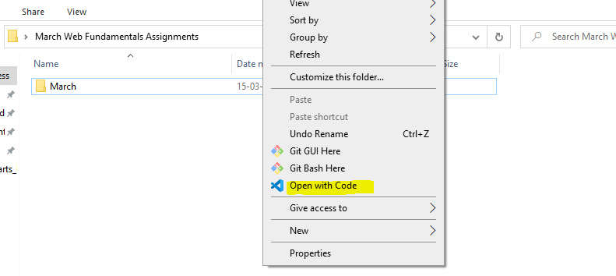

Slide 37
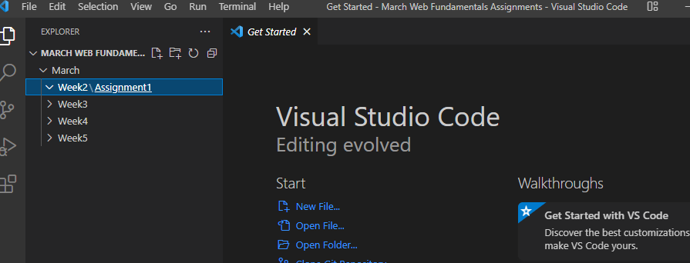

Slide 38

Create a empty index.html file in assignement1

Slide 39
What does git status command do?
git status command is used for
showing the difference between the working directory
also keep track of the tracked and non-tracked changes.

Slide 40
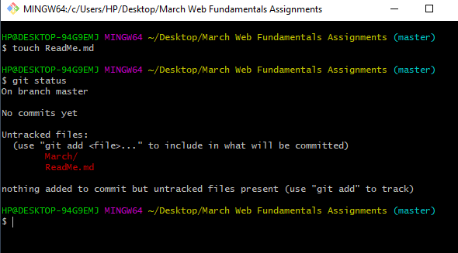

Slide 41
What does ‘git add’ command do?
This command adds files and changes to the index of the existing directory.
add all changes at once using command
git add -A
add files one by one specifically using
git add <file_name>
add contents of a particular folder by using
git add /<folder_name>/

Slide 42
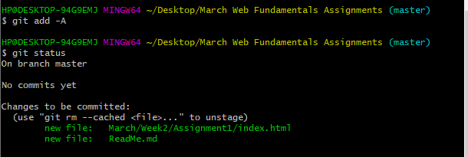

Slide 43
Git commit
Create a new commit containing the current contents and the given log message describing the changes.
Git commit –m ‘log message’

Slide 44
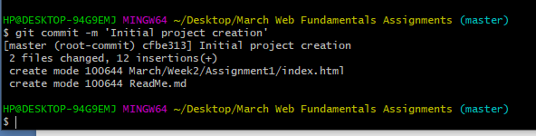

Slide 45
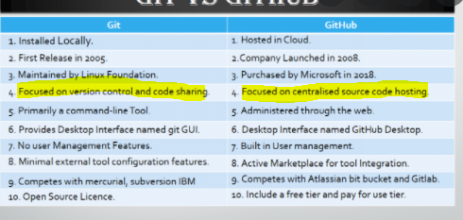
Github vs Git

Slide 46
Create the github account
Create the repository.

Slide 47
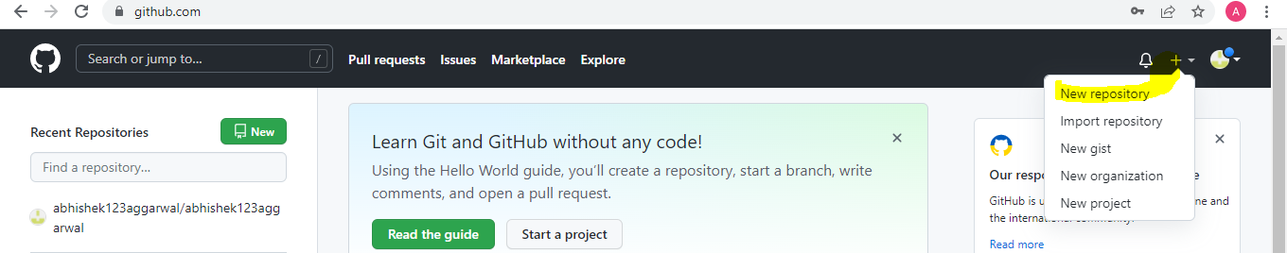
Click on ‘+’ sign to create repository

Slide 48
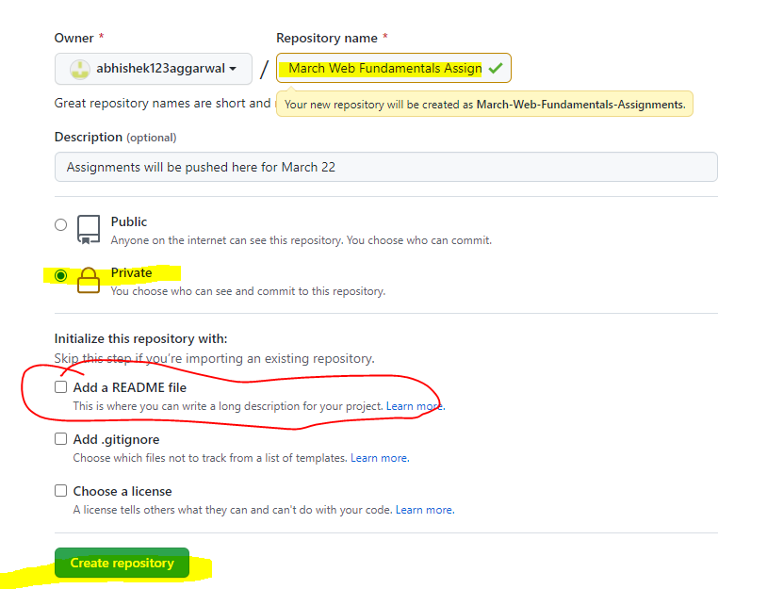

Slide 49
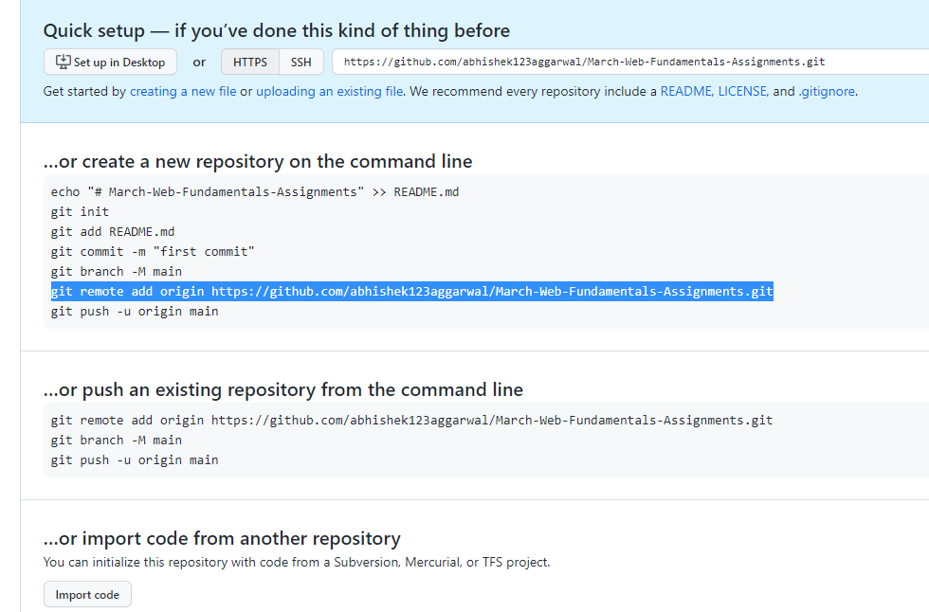

Slide 50
Remote Repository
Local repositories reside on the computers of team members.
Remote repositories are hosted on a server that is accessible for all team members - most likely on the internet or on a local network

Slide 51
We have created a local repository .
Using git init
Now we will push content of local repository to the remote repository.
Now we have to connect our local repository with remote repository.

Slide 52
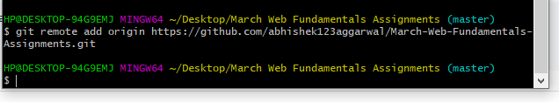

Slide 53
Git remote
To communicate with the outside world, git uses what are called remotes.
These are repositories other than the one on your local disk which you can push your changes into (so that other people can see them) or pull from (so that you can get others changes).

Slide 54
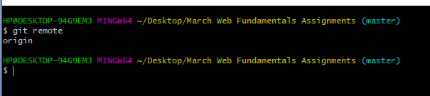


Slide 55

Git push origin master

Slide 56
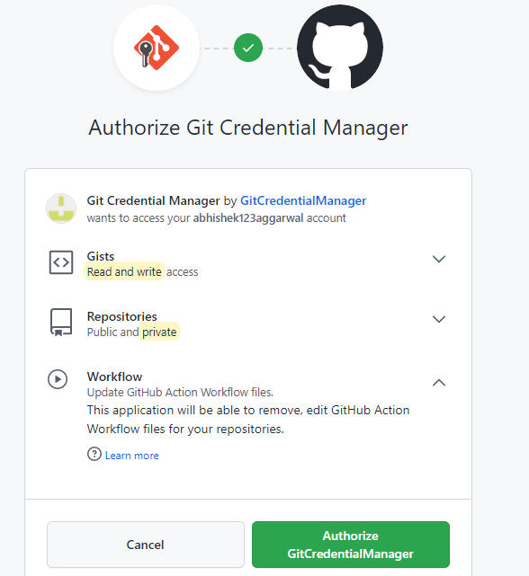

Slide 57
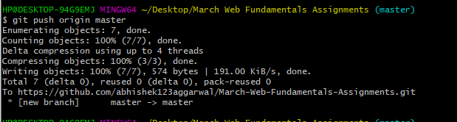

Slide 58
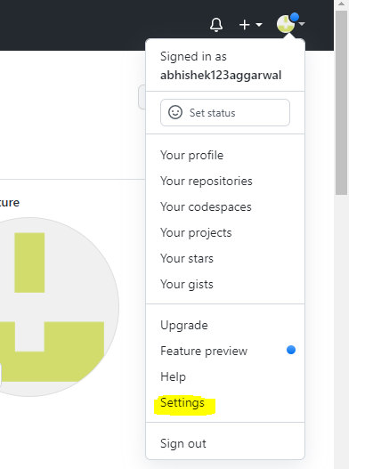
If authorize window is not coming then

Slide 59
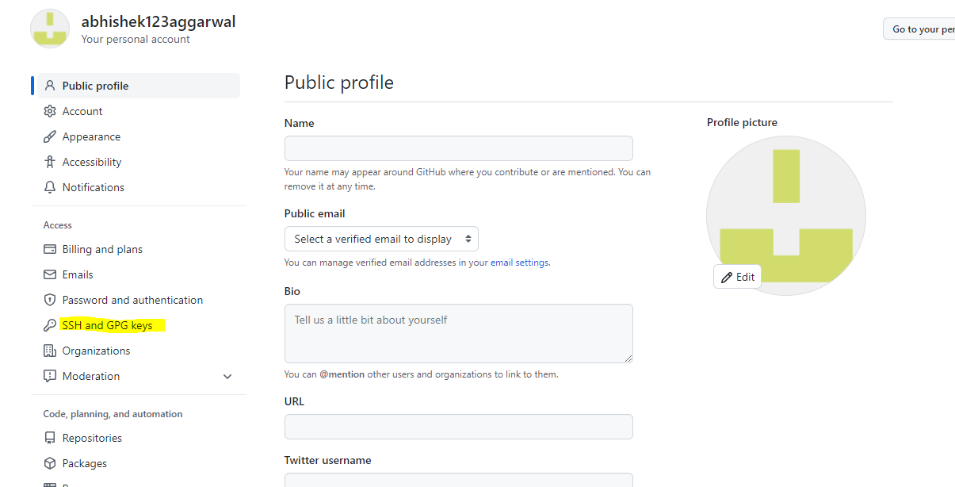

Slide 60
We will give access to the our computer for our github account

Slide 61
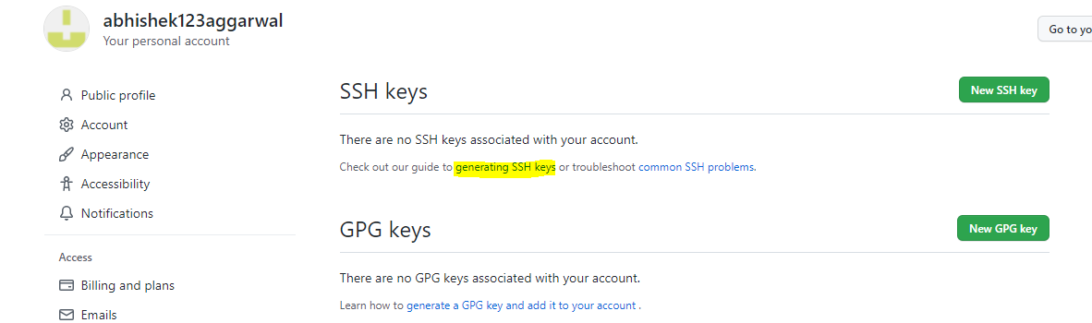

Slide 62


Slide 63


Slide 64


Slide 65


Slide 66

To get the process id

Slide 67

Run ssh add command

Slide 68


Slide 69

Add ssh key to the github account

Slide 70


Slide 71


Slide 72


Slide 73


Slide 74


Slide 75


