Slide 1

HTML
Basics

Slide 2
What is HTML?
HTML stands for Hyper Text Markup Language
HTML is the standard markup language for creating Web pages
HTML describes the structure of a Web page
HTML consists of a series of elements
HTML elements tell the browser how to display the content

Slide 3
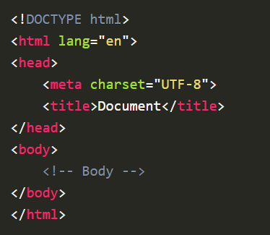
Structure / Boilerplate

Slide 4
Explanation of the HTML Structure
The <!DOCTYPE html> declaration defines that this document is an HTML5 document
The <head> element contains meta information about the HTML page
The <title> element specifies a title for the HTML page (which is shown in the browser's title bar or in the page's tab)
The <body> element defines the document's body, and is a container for all the visible contents, such as headings, paragraphs, images, hyperlinks, tables, lists, etc.
The <h1> element defines a large heading
The <p> element defines a paragraph

Slide 5
What is an HTML Element?
An HTML element is defined by a start tag, some content, and an end tag:
<tagname> Content goes here... </tagname>
The HTML element is everything from the start tag to the end tag:
<h1>Main Heading</h1>
<p>The content of the paragraph</p>

Slide 6
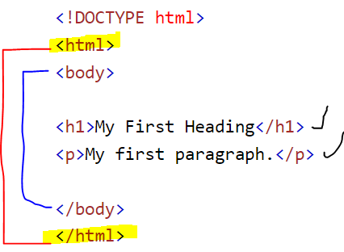
Nested HTML Elements
HTML elements can be nested (this means that elements can contain other elements).
All HTML documents consist of nested HTML elements.
The following example contains four HTML elements (<html>, <body>, <h1> and <p>):

Slide 7
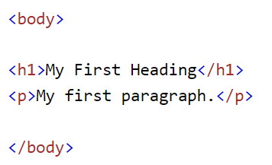
Explanation of Nested HTML
The <html> element is the root element, and it defines the whole HTML document.
It has a start tag <html> and an end tag </html>.
Then, inside the <html> element there is a <body> element:
Never Skip the End Tag

Slide 8
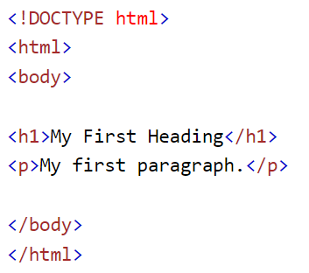
HTML Documents
All HTML documents must start with a document type declaration: <!DOCTYPE html>.
The HTML document itself begins with <html> and ends with </html>.
The visible part of the HTML document is between <body> and </body>.

Slide 9
HTML is Not Case Sensitive
HTML tags are not case sensitive: <P> means the same as <p>.
The HTML standard does not require lowercase tags, but W3C recommends lowercase in HTML, and demands lowercase for stricter document types like XHTML.

Slide 10

<!DOCTYPE> Declaration
The <!DOCTYPE> declaration represents the document type and helps browsers to display web pages correctly.
It must only appear once, at the top of the page (before any HTML tags).
The <!DOCTYPE> declaration is not case sensitive.
The <!DOCTYPE> declaration for HTML5 is:

Slide 11
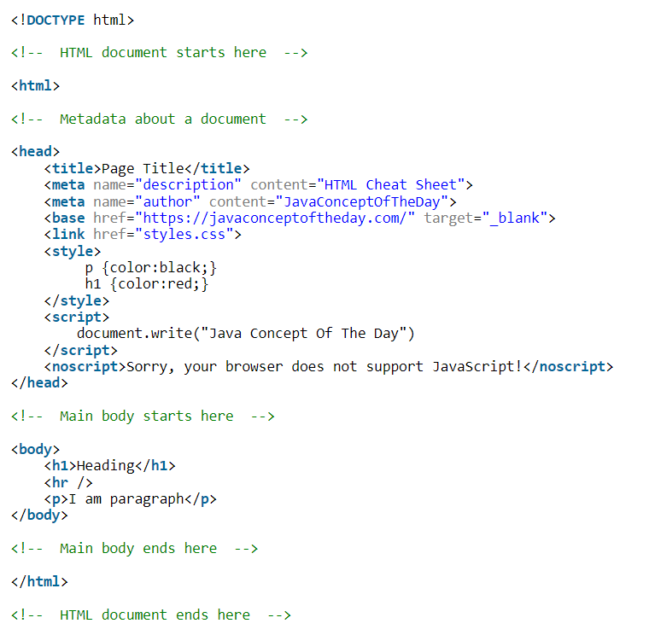

Slide 12
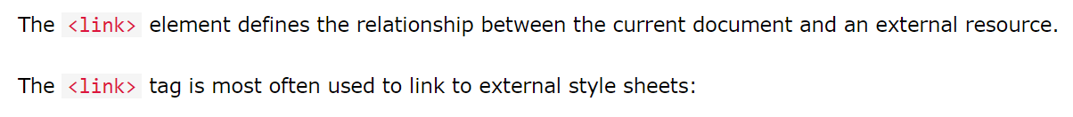
The HTML <link> Element

Slide 13
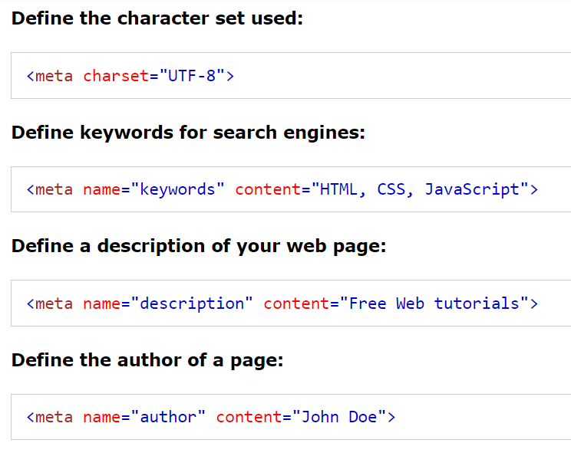
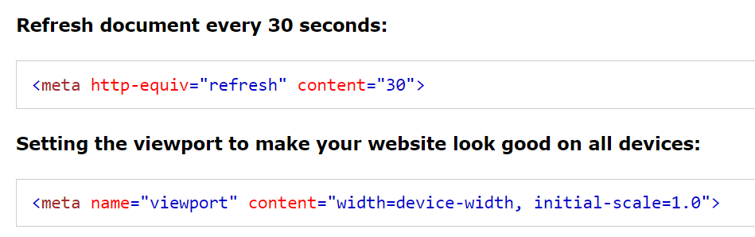
The HTML <meta> Element

Slide 14
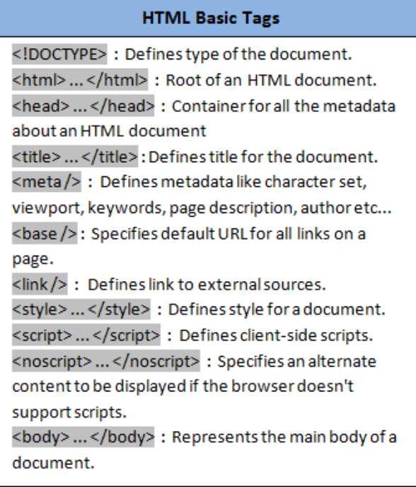
HTML Cheat Sheet 1

Slide 15
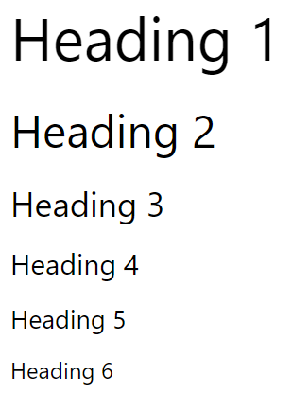
Heading
HTML headings are titles or subtitles that you want to display on a webpage.
HTML headings are defined with the <h1> to <h6> tags.
<h1> defines the most important heading.
<h6> defines the least important heading.

Slide 16
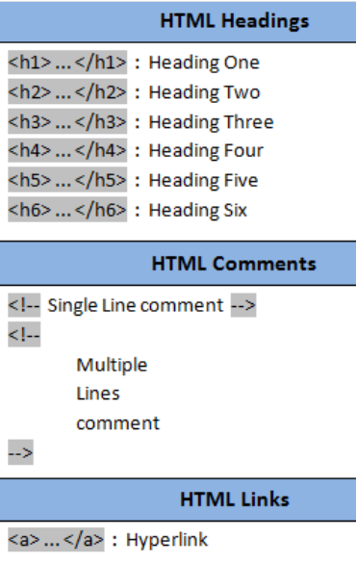
HTML Cheat Sheet 2

Slide 17
HTML Links - Hyperlinks
HTML links are hyperlinks.
One can click on a link and jump to another document.
When user move the mouse over a link, the mouse arrow will turn into a little hand.

Slide 18
HTML Links - Syntax
HTML Links - Hyperlinks
HTML links are hyperlinks.
You can click on a link and jump to another document.
When you move the mouse over a link, the mouse arrow will turn into a little hand.

Slide 19
HTML Link - Attributes
Attribute | Purpose | Example | Required?
href | Specify the link's target URL | a href="domain.com" | Yes
name | Link to an anchor mark within the page | a name="backtotop" | No
target | Specify how the taget document should be opened, e.g. in a new tab | target="_blank" | No
title | Provide text that will be displayed when the user hovers over a link | title="hello! I am a link" | No
rel | Specifies the relationship between the source and the target document | rel="next" | No

Slide 20
HTML Links - The target Attribute
By default, the linked page will be displayed in the current browser window. To change this, you must specify another target for the link.
The target attribute specifies where to open the linked document.
The target attribute can have one of the following values:
_self - Default. Opens the document in the same window/tab as it was clicked
_blank - Opens the document in a new window or tab
_parent - Opens the document in the parent frame
_top - Opens the document in the full body of the window

Slide 21
<ul>
<li><a href="https://example.com">Website</a></li>
<li><a href="mailto:m.bluth@example.com">Email</a></li>
<li><a href="tel:+123456789">Phone</a></li>
</ul>
-------------------------------------------------------------------------------------------------------------
use an image as a link, just put the <img> tag inside the <a> tag
<a href="default.asp"> <img src="smiley.gif" alt="HTML Intro“ style="width:42px; height:42px;"> </a>

Slide 22
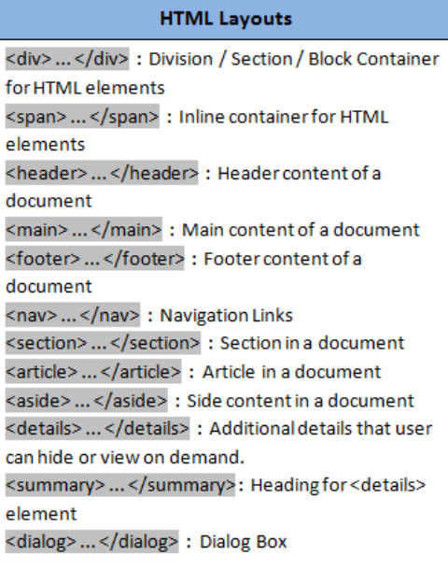
HTML Cheat Sheet 3

Slide 23
<body>
<header>
<nav>
<ul>
<li>Menu_Item_1</li>
<li>Menu_item_2</li>
</ul>
</nav>
</header>
<aside>
<p>Sidebar</p>
</aside>
<main>
<article>
<h1>Main Content</h1>
<p>Paragarpgh-1</p>
</article>
</main>
<footer>
<p>Copywright @ 2021</p>
</footer>
</body>

Slide 24
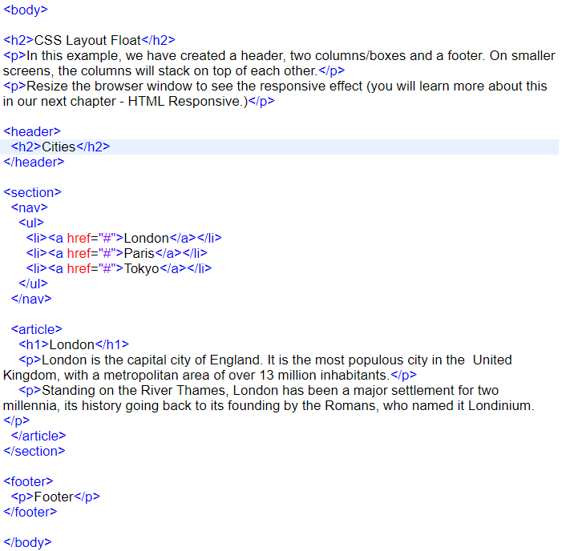
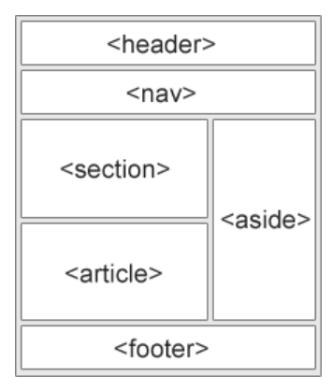

Slide 25
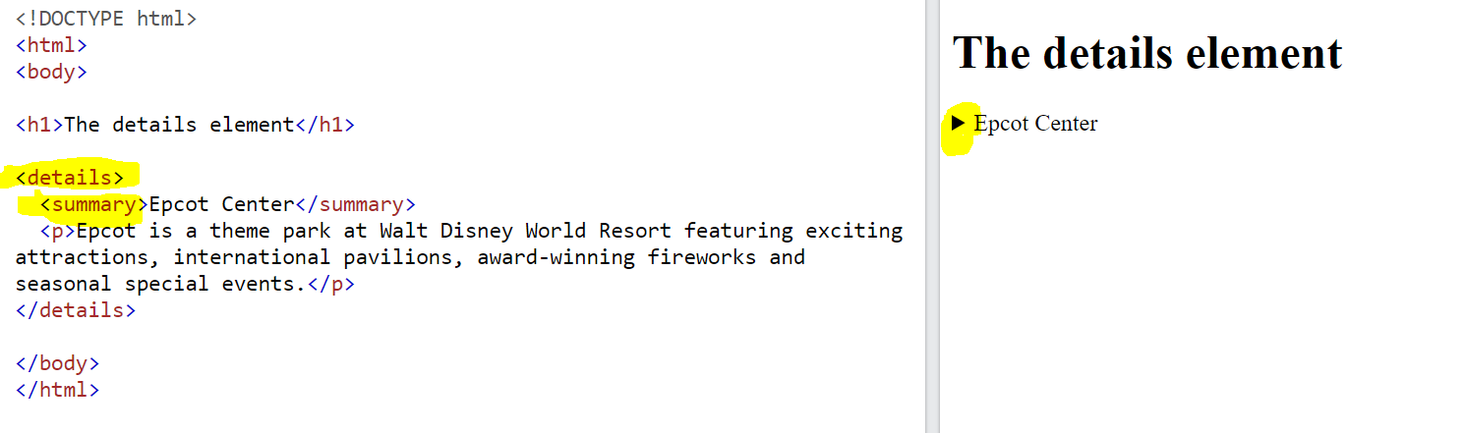
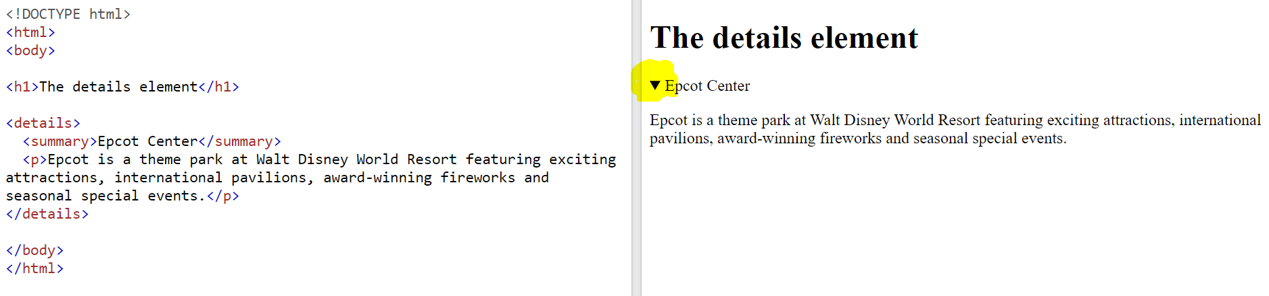

Slide 26
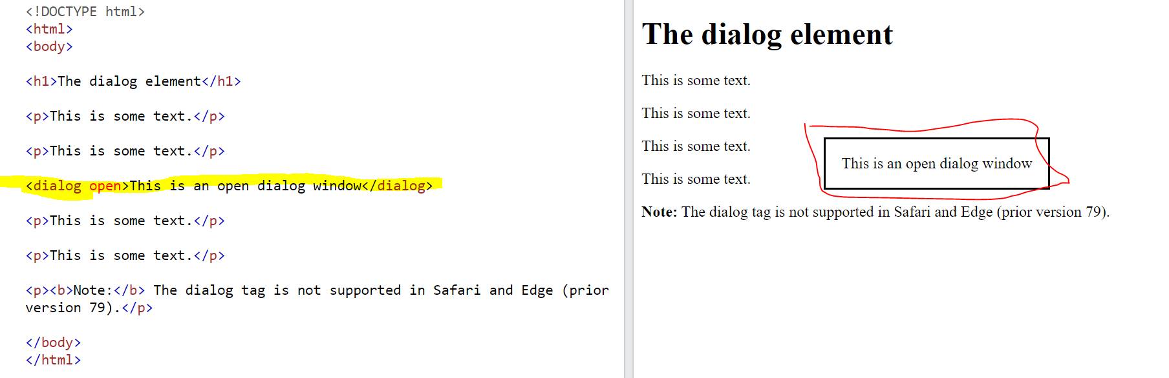

Slide 27
HTML <div> Tag
The <div> tag defines a division or a section in an HTML document.
The <div> tag is used as a container for HTML elements - which is then styled with CSS or manipulated with JavaScript.
The <div> tag is easily styled by using the class or id attribute.
Any sort of content can be put inside the <div> tag!.
Note: By default, browsers always place a line break before and after the <div> element.

Slide 28
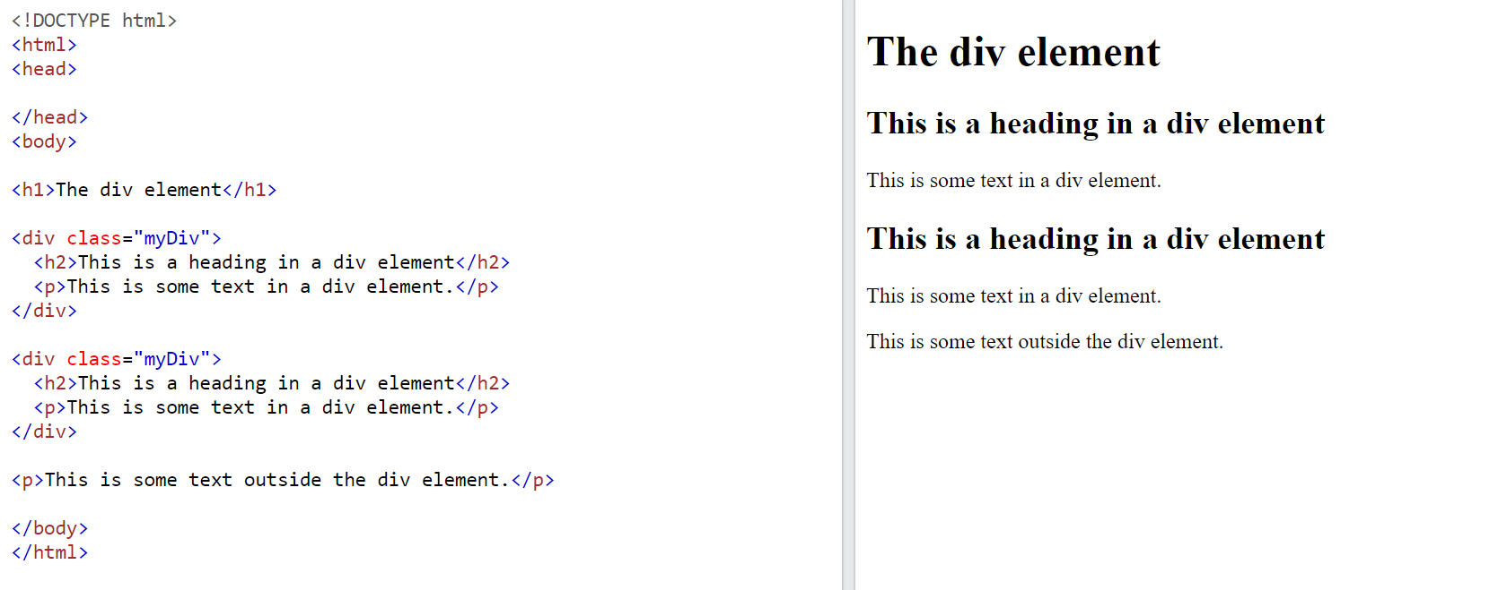
.
.

Slide 29
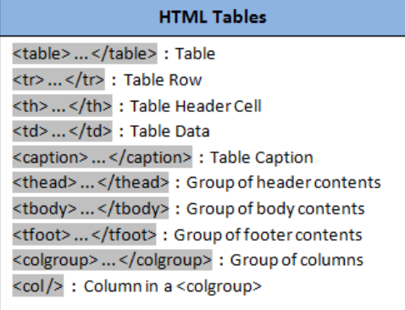
HTML Cheat Sheet 4

Slide 30
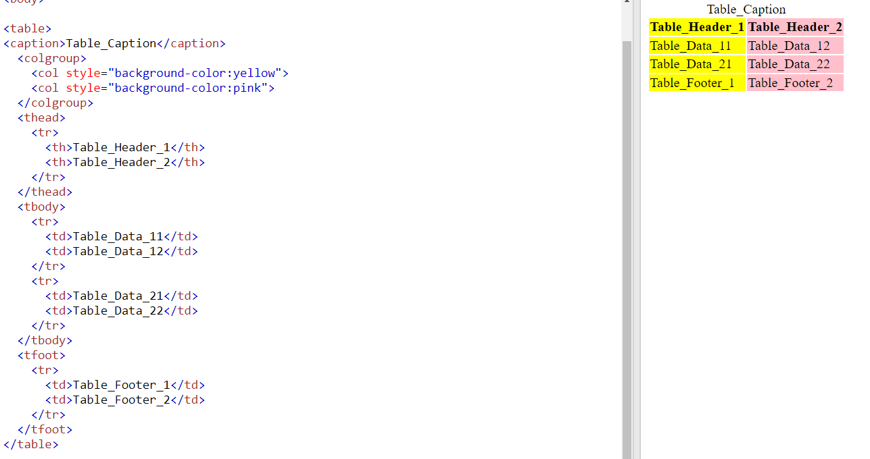

Slide 31
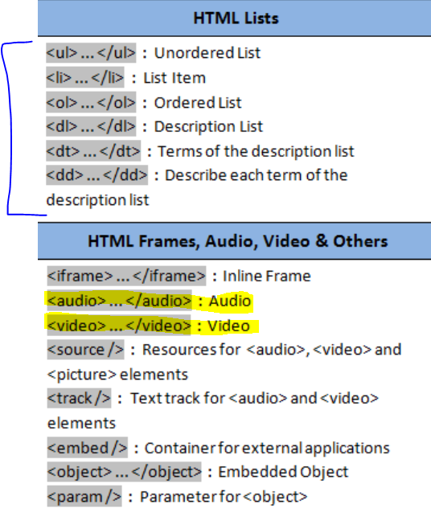
HTML Cheat Sheet 5

Slide 32
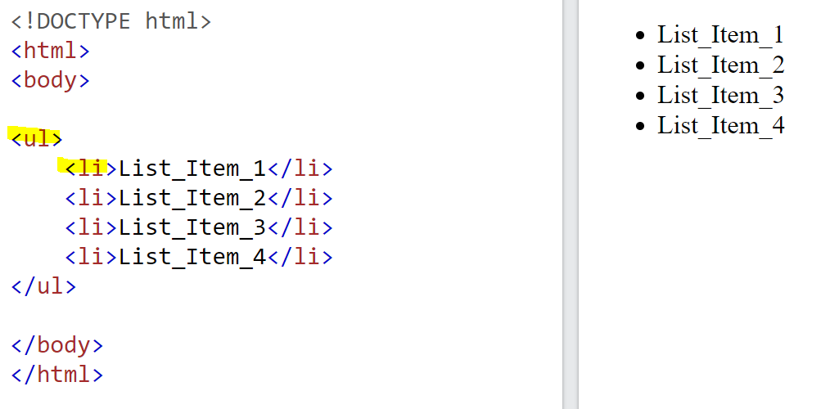

Slide 33
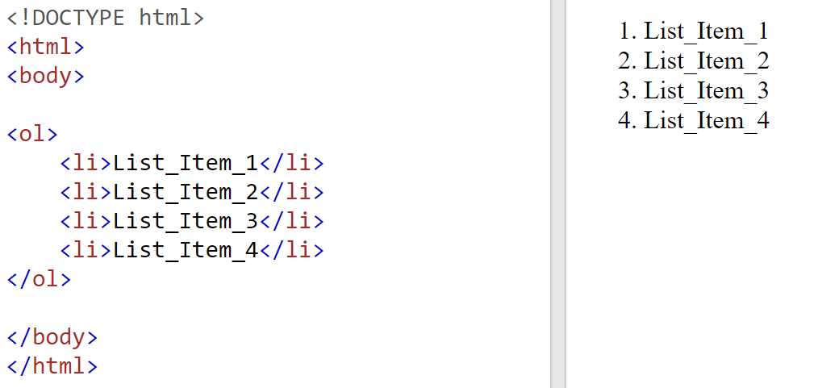

Slide 34
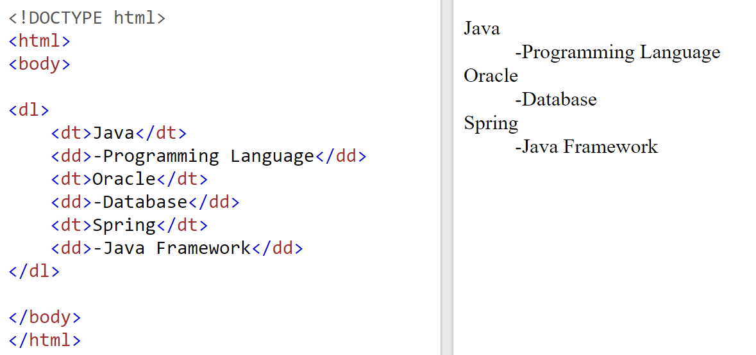

Slide 35
Audio Tag
The <audio> tag is used to embed sound content in a document, such as music or other audio streams.
The <audio> tag contains one or more <source> tags with different audio sources. The browser will choose the first source it supports.
The text between the <audio> and </audio> tags will only be displayed in browsers that do not support the <audio> element.
There are three supported audio formats in HTML: MP3, WAV, and OGG.

Slide 36
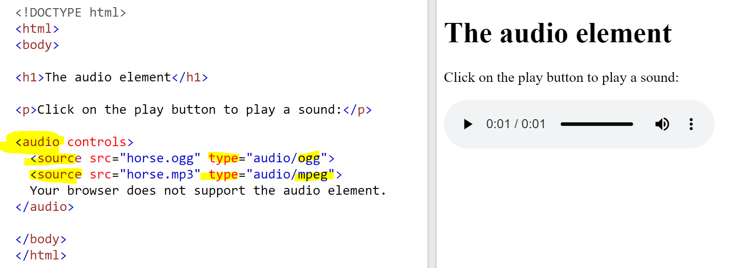

Slide 37
Video Tag
.
The <video> tag is used to embed video content in a document, such as a movie clip or other video streams
The <video> tag contains one or more <source> tags with different audio sources. The browser will choose the first source it supports.
The text between the <video> and </video> tags will only be displayed in browsers that do not support the <video> element.
There are three supported audio formats in HTML: MP3, WAV, and OGG.

Slide 38
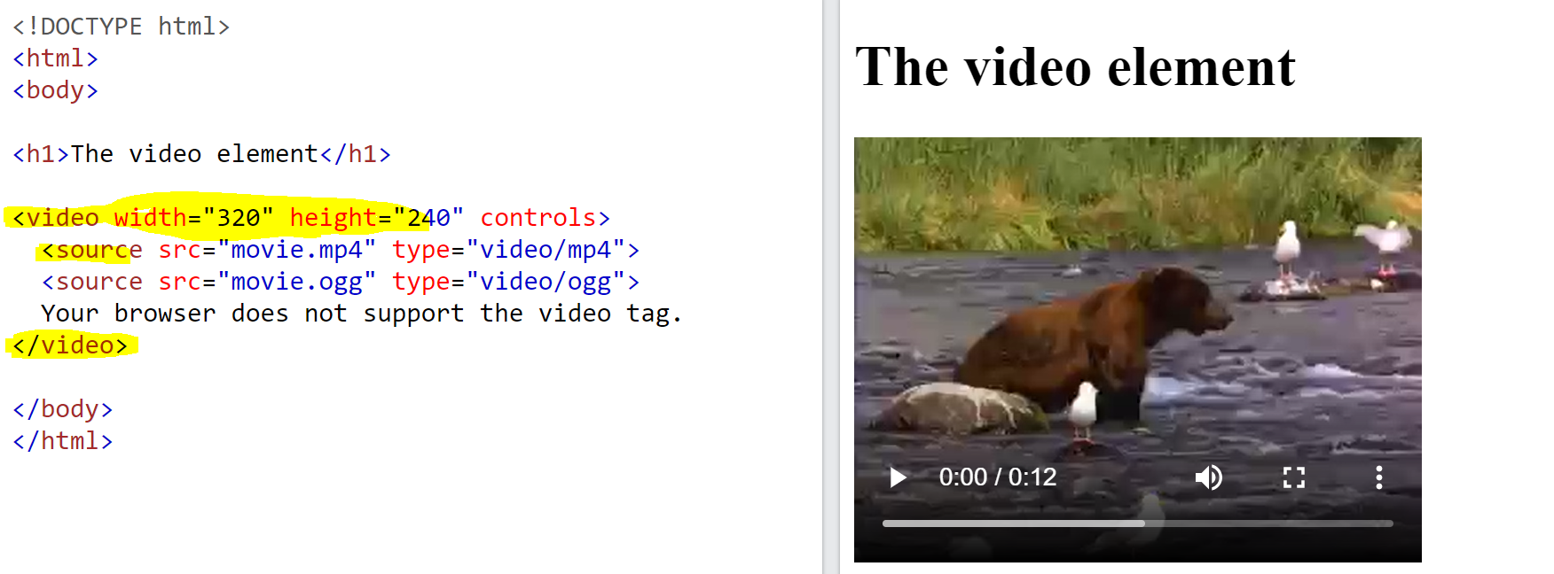

Slide 39
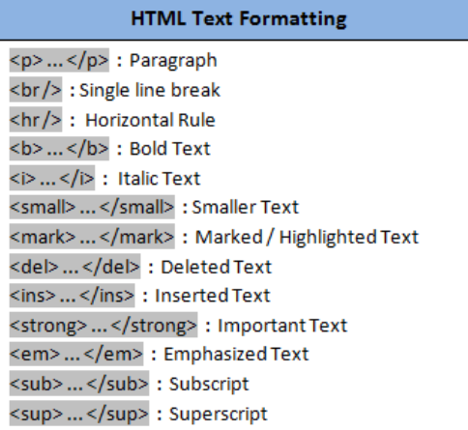
HTML Cheat Sheet 6

Slide 40
