Slide 1

JavaScript
By : Abhishek Aggarwal

Slide 2
What is JavaScript ?
Chapter 1

Slide 3
Our Agenda
What is JavaScript ?
What can JavaScript do ?
What makes JavaScript unique?
JavaScript frameworks and Libraries.

Slide 4
What is JavaScript?
JavaScript is an interpreted, client-side, event-based, object-oriented scripting language.
Invented in 1995 at Netscape Corporation (LiveScript)
JavaScript programs are run by an interpreter built into the user’s web browser.
JavaScript is a case-sensitive Language.

Slide 5
Complier vs Interpreter
Interpreter | Complier
Interpreter translates one statement at a time into machine code. | Compiler scans the entire program and translates whole of it into machine code.
One statement at a time. | Entire program at a time.
Interpreter is needed every time. | Once complied it is not needed.
Partial execution if error. | No execution if an error occurs.
Usually easy for programmers | Usually not as easy as Interpreted ones.
Interpreted language is slower than complied language. | Compiled language is faster.

Slide 6
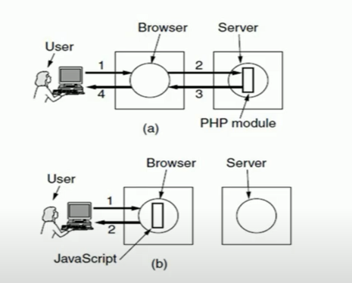
Server-Side and Client-Side

Slide 7
Client- side
Client scripting can be defined as a code that is present in a client’s HTML page.
It is usually attached to the browser in a language that is compatible with the browser.
The language used for client scripting is JavaScript.
It is compatible and has the ability to run on any browsers
The browser then downloads that code temporarily and processes it without the server.
If additional information is required, a request is raised and sent to the server.

Slide 8
What can JavaScript do?
JavaScript can dynamically modify HTML page. (without refreshing page)
JavaScript can validate user input.
JavaScript can be used to create cookies.
JavaScript is a full- features programming language.
JavaScript user interaction does not require any communication with the server.

Slide 9
What makes JavaScript unique?
Support by all major browsers and enabled by default.
Complex things are done simply.
Full integration with HTML / CSS.

Slide 10
JavaScript frameworks and libraries
Angular
React
jQuery
Vue.js
Ext.js
Ember.js
Node.js
Polymer
Aurelia
Backbone.js

Slide 11
How to include JavaScript into HTML ?
Chapter 2

Slide 12
Our Agenda
How to use Internal JavaScript ?
How to use External JavaScript?

Slide 13
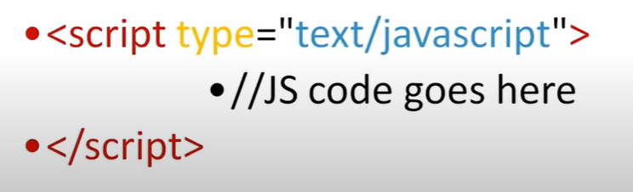
How to use internal JavaScript
JavaScript can be inserted into documents by using the Script tag.
The script tag provides a block to write the JavaScript programs.

Slide 14

How to use external JavaScript?
To use the pre-defined programs of any JavaScript library.

Slide 15
Alert, Prompt, Confirm, console.log() ?
Chapter 3 : Important Functions

Slide 16
Our Agenda
Alert()
Confirm()
Console.log()
Document.write()
Prompt()

Slide 17

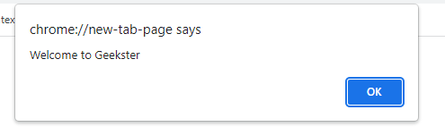
What is alert() and how to use?
It is used to alert the user that something has happened.

Slide 18

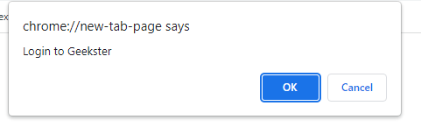
What is confirm() and how to use?
Opens up a confirm / cancel dialog and returns true/false depending on user’s click.

Slide 19

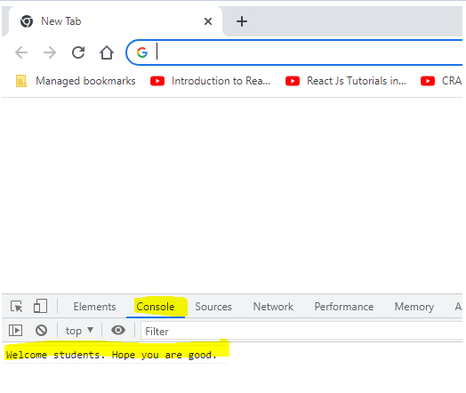
What is console.log() and how to use?
Writes information to the browser console, good for debugging purposes.

Slide 20

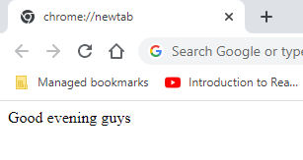
What is document.write() and how to use?
Document -> html page
Document.write() : write directly to the HTML document

Slide 21

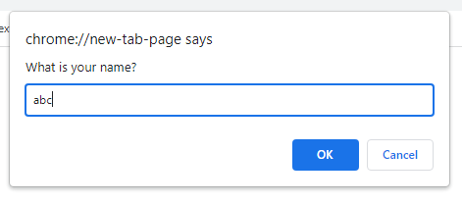
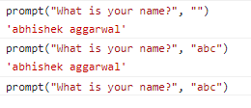
What is prompt() and how to use?
Prompt(message, default) : creates an dialogue for user input.

Slide 22
Variables in JavaScript
Chapter 4

Slide 23
Our Agenda
What is a variable?
How to declare and initialize variable in js.
Scope and Lifetime of variable

Slide 24
What is a Variable?
Variables are containers which hold reusable data.
It is a basic unit of storage in a program.
The stored in a variable can be changed during program execution.

Slide 25
Variable Initialization
Starts from
a-z
A-Z
_
Never starts with number.
Should not include hypen (-)

Slide 26
Case -sensitive
Demo
DeMo
demo

Slide 27
Variable Declaration
Use ‘var’
var name

Slide 28
Scope and life time of a variable
Scope
Variables declared within a function are local to that function.
Variables declared outside of any function are global variables.
Life of a variable
Local Variable's life time is within the bock of its declaration.
Global variable’s life time is throughout the program

Slide 29
Put and Get data from the HTML element
Chapter 5 : JavaScript DOM functions

Slide 30
DOM Explanation
DOM : Document object method
Document > HTML
IF you want to modify any element , any text , any style, you can use DOM functions.
Object : document.get---- will give you complete element or complete object. So that you can modify the things accordingly.

Slide 31
Our Agenda
document.getElementById()
document.getElementsByClassName()
innerHTML()

